Slide 1
COCA: Generative Root Cause Analysis for Distributed Systems with Code Knowledge
Accepted by the 47th IEEE/ACM International Conference on Software Engineering (ICSE'25)

Slide 2
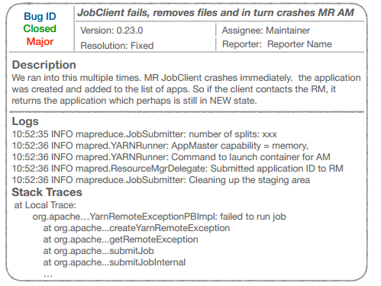
Background
In modern software systems, the reliability of complex distributed systems is crucial for ensuring stable system operation and a positive user experience.
However, even with careful design and thorough testing, distributed systems inevitably encounter various problems during actual operation.
When users encounter system failures, they typically submit issue reports through issue tracking systems such as JIRA.
These issue reports generally include:
a problem description
runtime logs
and possibly a stack trace.
1
2
Distributed systems have the following characteristics:
Large system scale and numerous components;
High decoupling between modules, but complex runtime interactions;
Faults often span multiple components or even multiple machines.

Slide 3
Background
To address these issues, the research community has proposed numerous automated root cause analysis (RCA) methods.
One mainstream approach
relies on comprehensive runtime monitoring data, such as logs, metrics, and call chain tracing information.
These methods typically pinpoint the root cause by comparing data from faulty and normal states.
However
this approach has significant limitations in practice: In real-world scenarios, complete monitoring data is often unavailable.
﻿
Another related area of ​​work is fault localization
However
These methods typically rely on a reproducible bug runtime environment and execution coverage information.
﻿
It primarily focuses on locating the specific code location that caused the failure at the code level.

Slide 4
Background
The development of large language models is rapid.
Perform root cause analysis directly on the issue report.
1
This is especially true when runtime monitoring data is limited or even missing.
Problem
2
this approach still faces a fundamental problem: user-submitted issue reports are often incomplete or even vague.
Users typically only describe the fault symptoms and attach fragments of logs,but rarely accurately describe the system's actual execution logic before the failure.
significantly limits the accuracy of LLM's root cause analysis

Slide 5
COCA
Root Cause Identification
LLM reasoning on code + text
Reconstruct execution paths
Retrieve relevant source code
Issue Report

Slide 6
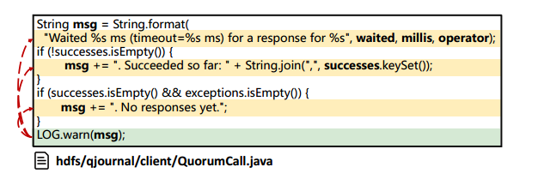
Challenges of Integrating Code Knowledge into RCA
Challenge 1: Sourcing Log Messages
Runtime logs often differ from logging statements in code
Missing metadata (e.g., line numbers) in real-world systems
Dynamic variables and multiple branches make matching difficult
Challenge 2: Reconstructing Execution Paths
Complex dependencies in distributed systems
Static calls, RPC calls, and dynamic bindings
Hard to determine what code was executed before failure
Challenge 3: Profiling Failure-Related Code
Large volume of executed and dependent code
Missing dependencies reduce comprehensibility
Too much code exceeds LLM context limits and increases cost

Slide 7
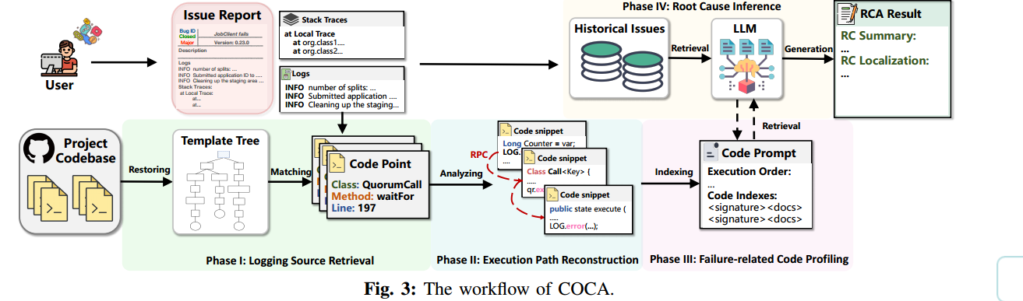
COCA Flowchart

Slide 8
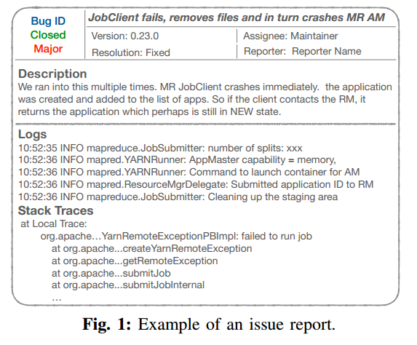
Issue Reports in Distributed Systems

Slide 9
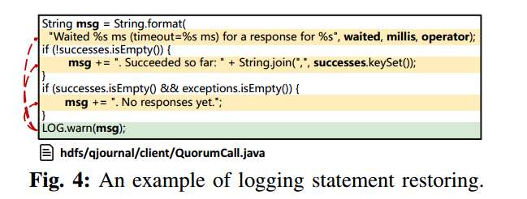
I : Logging Source Retrieval
Objective: Accurately locate the code position corresponding to log messages in issue reports.
Method: Two-step approach
1. Restoring Logging Statements
Process constructed variables (such as `msg`) in the logs
Analyze data dependencies and control flow, tracing back the variable generation path
Restore the log to its original template (constant string + original variables)
Each log entry may generate multiple templates, covering different control branches.

Slide 10
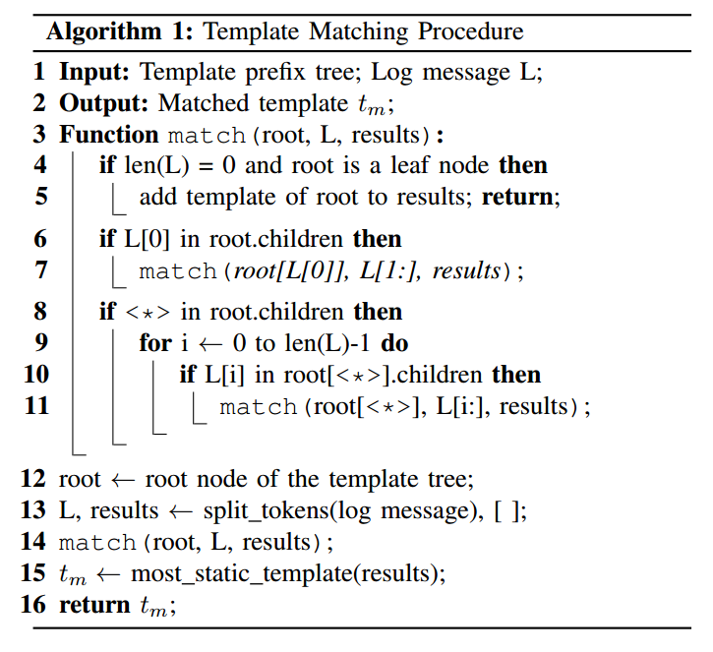
I : Logging Source Retrieval
Objective: Accurately locate the code position corresponding to log messages in issue reports.
Method: Two-step approach
T1 是 "Job created, executing " + <*>
T2 是 "Job created, executing " + <*> + " on node " + <*>。
2. Log Template Matching
Matches issue report logs with the restored templates.
A log may match multiple templates.
Uses a non-pruned recursive matching algorithm (traverses all templates, maintaining a global perspective).
Prioritizes templates with the most static elements to improve matching accuracy.

Slide 11
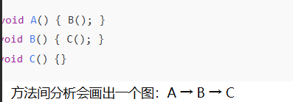
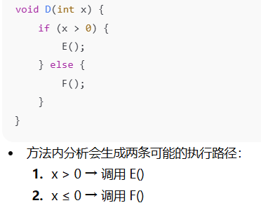
II: Execution Path Reconstruction
Analyze the code lines near the log statements directly.
Constructing a Cross-Method Control Flow Graph (ICFG)
1
Inter-method analysis: Identify the system's call graph, including direct and indirect function call relationships.
Intra-method analysis: Analyze the control flow within each method to determine potential execution paths.

Slide 12
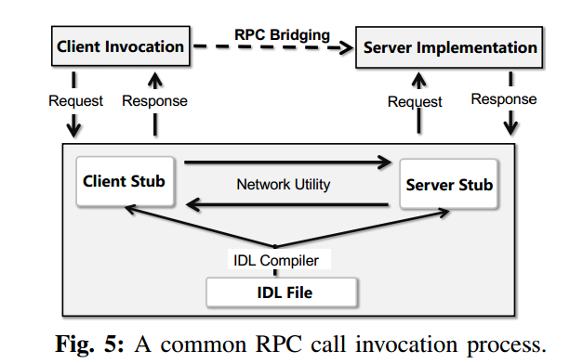
II : Execution Path Reconstruction
RPC bridging method
COCA locates the RPC call point from the client to the server by parsing the RPC IDL file.
COCA further identifies the actual implementation functions on the server side.
ResourceTrack ->ResourceTrackService
Fuzzy matching based on substrings
Check the declaration information of the class
3.Client-to-server call stack bridge
2
e.g : class XXX extends ResourceTrackBase

Slide 13
III : Failure-Related Code Profiling
Two-stage indexing and retrieval methods
Method-level index building
Key Method: Signature Reasoning
COCA creates index entries on a method-by-method basis, recording method signatures and their associated document information, and automatically generates standardized specifications using large language models.
Large language models, based on a holistic understanding of the problem and code, output a list of key method signatures that may involve faults or aid in understanding.
1
2
3
4
Execution path context integration
Target code snippet extraction
The system will uniformly input problem reports, execution path analysis results before failures, and the constructed method-level index into the backbone large language model.
COCA precisely retrieves the corresponding complete method implementation from the original codebase based on the method signature recommended by the model.

Slide 14
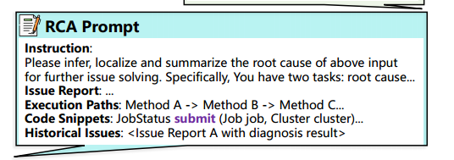
IV : Root Cause Inference
Root cause analysis and localization are achieved through contextual learning and structured prompts.
In-context Learning
The BM25 similarity algorithm selects five of the most relevant reports from historical issue reports as examples and uses a keyword weighting mechanism to improve the accuracy of component-level and fault type matching, overcoming the instability of vector embedding methods in the description of highly heterogeneous problems.
Diagnosis Result Inference
Based on the current issue report, the execution path prior to the failure, and key code snippets, the model uses structured clues to reason and outputs two core results: first, a concise and clear root cause summary; and second, the location of the potential root cause within the relevant code or component.

Slide 15

EXPERIMENT SETUP
1
RQ1: How effective is COCA in RCA compared with
existing methods?
2
RQ2: What are the impacts of different phases in COCA?
3
RQ3: How generalizable is COCA with different backbone models?
question

Slide 16
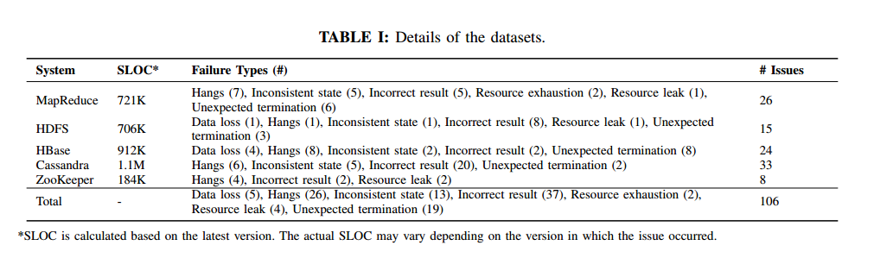
Dataset

Slide 17
Evaluation Metrics
Root Cause Summarization:
Classic text similarity metrics such as BLEU, METEOR, and ROUGE
The generated root cause summaries and the true summaries are vectorized using OpenAI's embedding model, and their semantic similarity is calculated.
The manual evaluation metric—Usefulness—is used to measure the practicality of summaries in actual fault diagnosis.
Root Cause Localization
The Exact Match metric ：used to determine whether the set of root cause components predicted by the model is completely consistent with the set of true root cause components.
The Top-k metric ： used to evaluate whether a model can cover the true root causes among candidate results.

Slide 18
Comparative Methods
We selected RCACopilot and ReAct as the primary baseline methods.
This is because these two methods are most similar to COCA in their RCA workflow and can simultaneously support both root cause summarization and root cause localization.
Furthermore, they both rely on historical issue reports as a knowledge source to improve diagnostic performance, making the comparison more targeted.
Basic Model Comparison
This involves providing a large language model with only five fixed examples to illustrate the task without using any additional analytical information. This comparison visually reflects the performance ceiling when relying solely on the model's own capabilities.

Slide 19
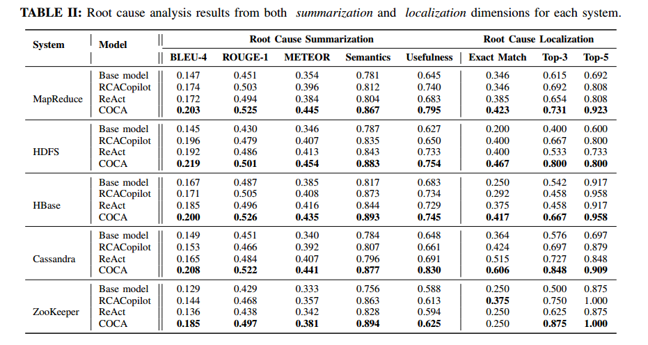
RQ1: Effectiveness of COCA

Slide 20
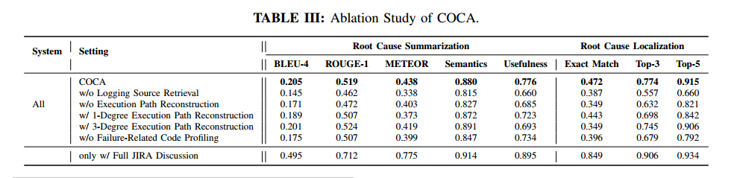
RQ2: Impact of different phases in COCA

Slide 21
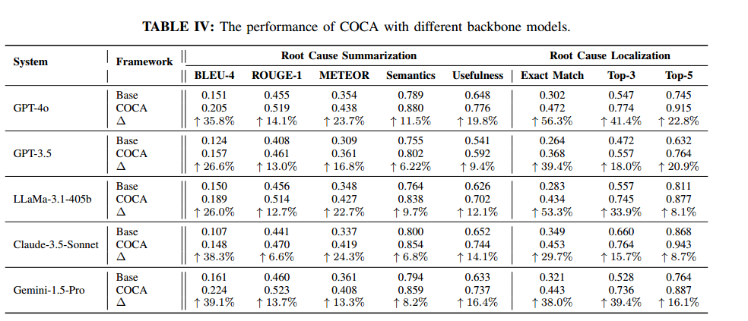
RQ3: Generalizability of COCA

Slide 22
Thank You
Enhancing root cause analysis through code knowledge integration in distributed systems
2025/12/20

