Slide 1

FoundRoot: Towards Foundation Model for Root Cause Analysis via Structured Deep Thinking
ICSE ’26
刘军辉
2026/3/29

Slide 2

Background
The Complexity Challenges of Cloud-Native Systems
Service Component Scale: Hundreds or thousands of microservices
Monitoring Data Scale: Massive time-series metrics and call chains
Core Pain Point: How to quickly locate the root cause when a failure occurs.

Slide 3

Background
The number of metrics is extremely large (hundreds or even thousands).
Complex causal relationships exist among the metrics.
Fault propagation paths span multiple services.
Zero-Shot RCA – Identifies faults directly from current monitoring data without requiring historical tags.

Slide 4




Existing methods and limitations
Method 1: Statistical/Rule-Based Approach
Anomaly detection
Cause-effect graph analysis
Rule matching
Method 2: LLM + Agent Method
Leveraging its semantic understanding capabilities
combined with tools (time-series analysis)

Slide 5
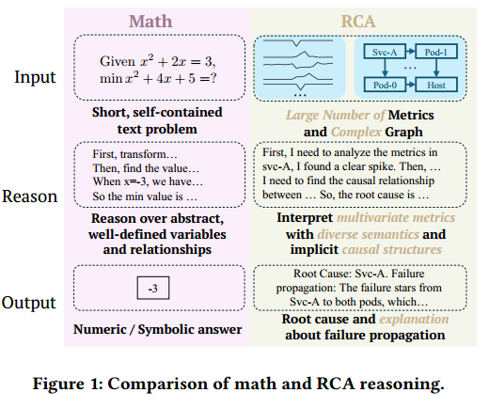
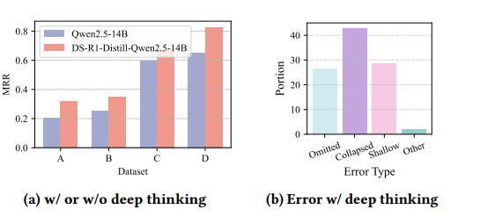
Deep Thinking

Slide 6
Structured Deep Thinking

Slide 7
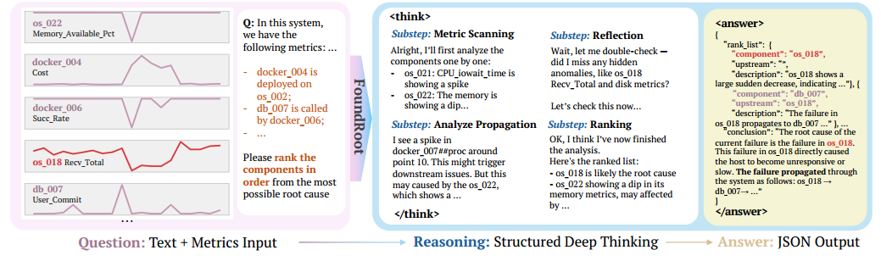
Structured Deep Thinking
inspired by the standard RCA workflow of detection,analysis, causal attribution, and ranking
Key Design
These sub-steps are not controlled by multiple rounds of prompts,
but rather are completed continuously by the model itself within a single generation.
Core idea
Step-by-step reasoning
Goal-oriented substeps
Structured thinking

Slide 9
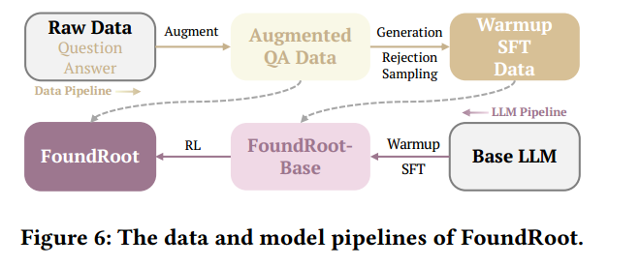
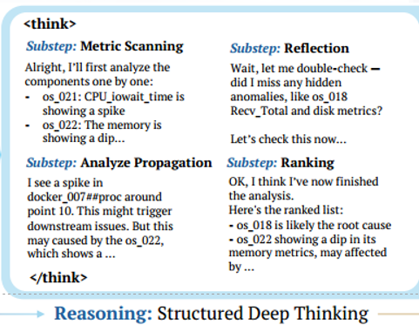
Data and Model Training Pipelines

Slide 10
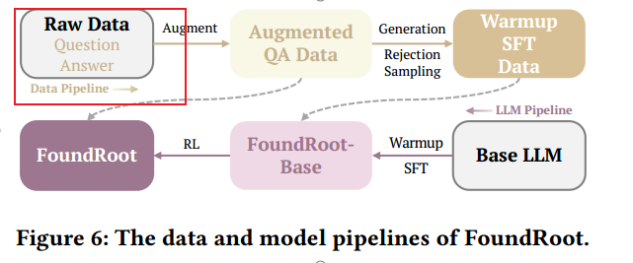
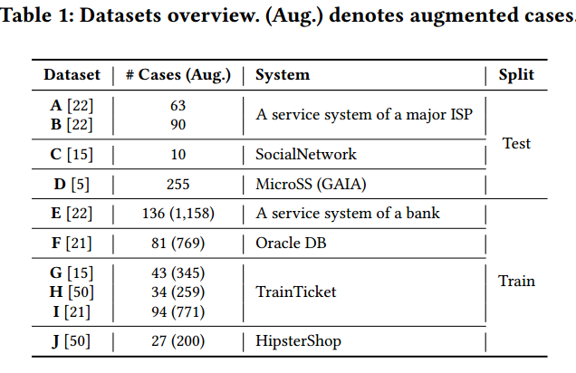
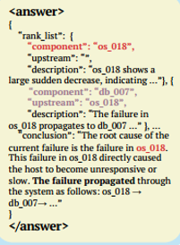
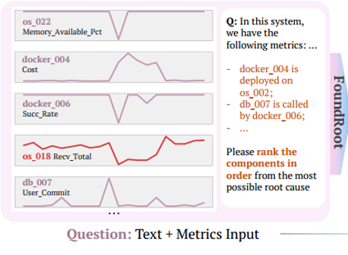
Curation of Datasets Dataset Construction

Slide 11
Curation of Datasets Dataset Construction
Perform extensive preprocessing and cleaning across all datasets
Raw Data → Cleaning → Metric Filtering → Time Window Extraction → Text Conversion → Q&A Format
Data Quality Enhancement:
Remove invalid fault cases
k-sigma anomaly detection
Convert time series to text

Slide 12
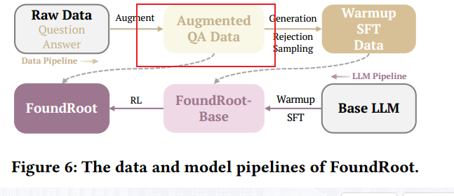


Curation of Datasets Data Augmentation
Temporal sampling.
Metric sampling

Slide 13
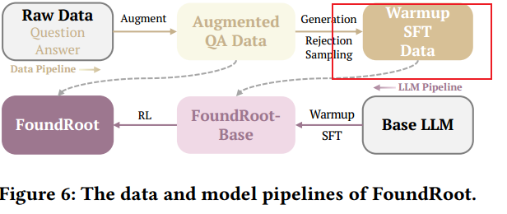
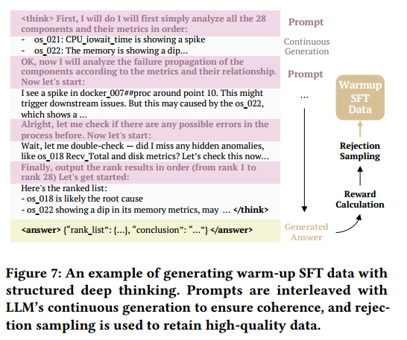
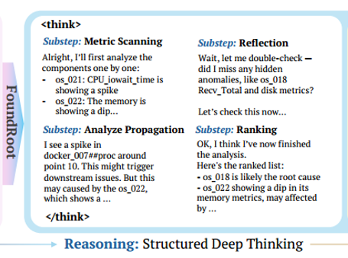
Curation of Datasets Warm-Up SFT Dataset

Slide 14
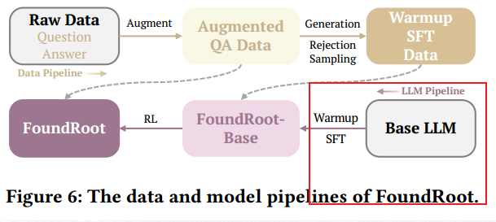
Model and Training Details Warm-Up SFT
Two-stage training:
Warm-up SFT
DAPO (RL optimization)
Output Format:
1. Reasoning：
<think>
Step-by-step reasoning
</think>
2. Answer：
<answer>
{
rank_list: [...],
conclusion: ...
}
</answer>
Input Representation
Time-series → Text
k-sigma anomaly detection

Slide 15
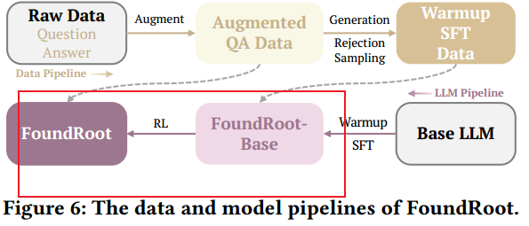
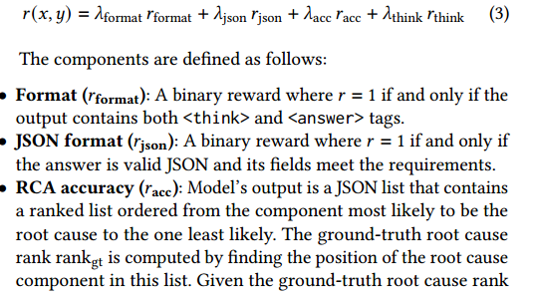
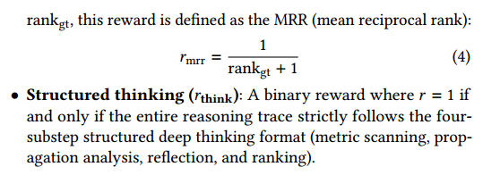
Model and Training Details RL with DAPO
Reward Design
DAPO Framework
Input → Multiple Reasoning Paths
→ Reward Evaluation
→ Learn Best Paths

Slide 16
Evaluation

Slide 17

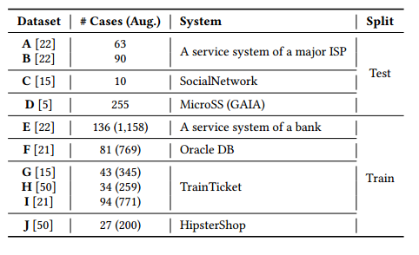
Evaluation
Baselines:
Classical Methods:
MicroScope
MonitorRank
MicroCause
CIRCA
RCD
BARO
ART
Evaluation Metrics:
Top-1 Accuracy
Top-3 Accuracy
MRR
Evaluation Datasets:
LLM-based Methods:
LLMs
RCA-Agent

Slide 18
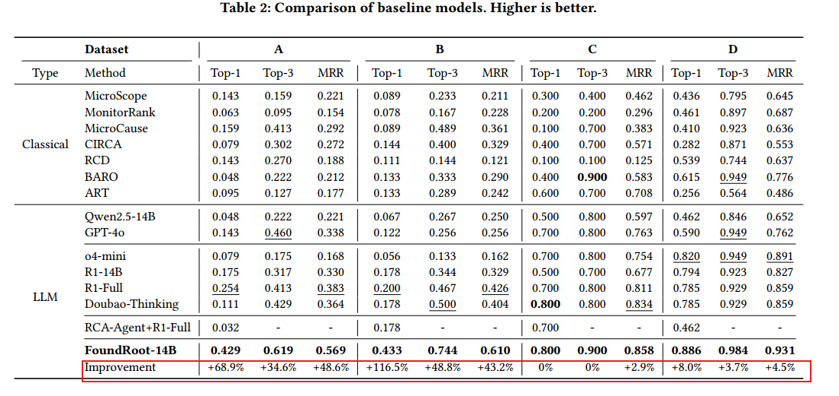
RQ1: Does FoundRoot outperform classical and LLM-based RCA methods?

Slide 19
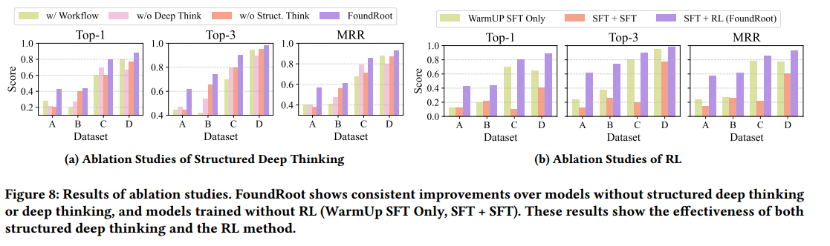
RQ2: How effective is structured deep thinking for RCA?

Slide 20
RQ3: Does RL really improve reasoning performance?

Slide 21
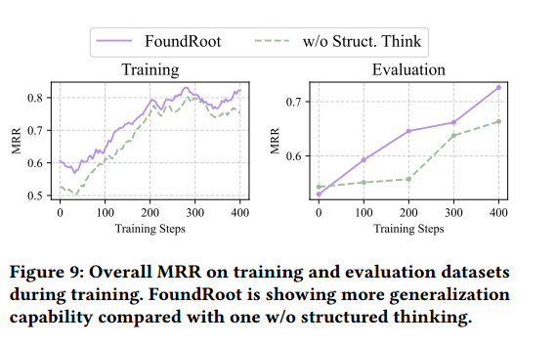
RQ4: Does structured deep thinking provide more generalization to unseen systems?

Slide 22
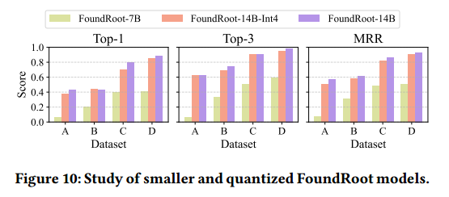
RQ5: How do smaller and quantized variants perform?

Slide 23
谢谢观看

