Slide 1
Skill-Pro: Learning Reusable Skills from Experience via Non-Parametric PPO for LLM Agents
Qirui Mi, Zhijian Ma, Mengyue Yang, Haoxuan Li, Yisen Wang, Haifeng Zhang, Jun Wang
ICML 2026

Slide 2
Challenges
On-the-fly reasoning: Even when facing repeated scenarios, the agent will re-derive the plan, leading to redundant calculations.
Episodic memory : Mainstream external memory methods (like RAG) store episodic memory. This leads to: The context window being heavily used. The agent still needing to spend effort 'understanding' the retrieved cases and re-deriving solutions.
Updating the parameters is costly: Fine-tuning LLMs with reinforcement learning works, but it's expensive, prone to catastrophic forgetting, and can hurt the model's general abilities.

Slide 3
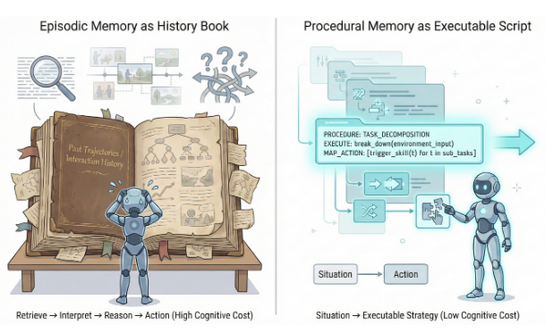
Objective
The goal of Skill-Pro is to let LLM agents can autonomously learn reusable procedural Skills from interaction experience for future decision-making.（Procedural memory）

Slide 4
Contributions
Skill-Pro is a framework that can learn reusable programmatic skills on its own without needing to update model parameters.
Procedural Skill Formalization: We introduce the Skill-MDP, transitioning LLM agents from episodic narratives to reusable procedural Skills.
Non-Parametric PPO: Uses semantic gradients to generate candidate skills and validates them through a PPO Gate.
Superior reuse rates and performance gain across diverse scenarios with extreme memory compression

Slide 5
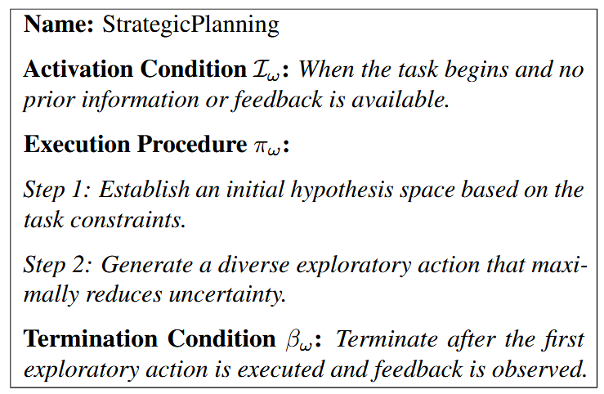

Skill Structure
We define a Skill ω ∈ Ω as a reusable, natural-language procedural unit that specifies when to activate, how to act while active, and when to return control.
(1) Activation Condition Iω
(2) Execution Procedure πω
(3) Termination Condition βω

Slide 6
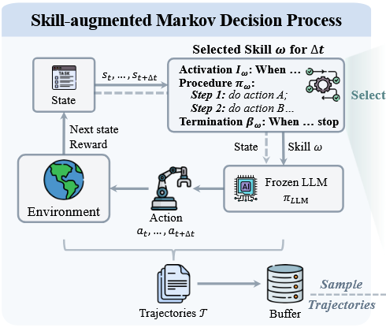
Skill-MDP
We formulate the LLM agent’s decision-making process as a Skill-augmented Markov Decision Process (Skill-MDP).
Traditional MDP: environment->state->action->environment……
Skill MDP: environment->state->skill->action->environment……

Slide 7
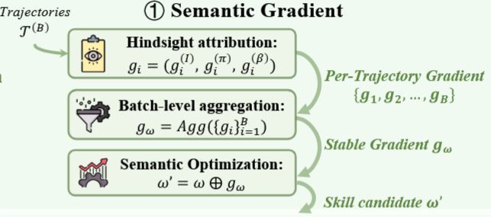
Non-Parametric PPO
1. Semantic Gradients
Per-trajectory semantic gradients: For each trajectory τi, we attribute the outcome to its activation condition, execution procedure, or termination condition.
Batch-level aggregation: To obtain a stable learning signal, we aggregate semantic gradients across the batch.
Semantic Skill Update: We update Skill ω using the batch-averaged semantic gradient to obtain a candidate Skill ω′

Slide 8
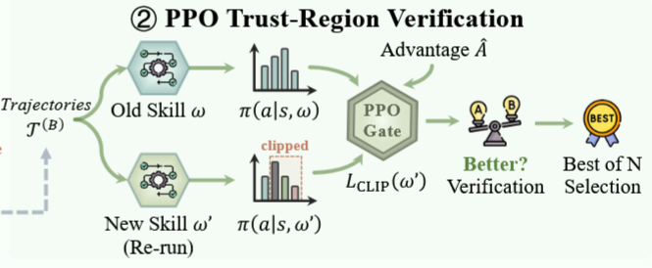
Non-Parametric PPO
2. PPO-Style Trust-Region Verification
Problem: Semantic-gradient updates may extrapolate beyond the observed interaction data and introduce hallucinated or behaviorally unstable Skills.
Solution: Like PPO, a candidate skill is only allowed into the skill pool if it can significantly increase the probability of high-reward actions without deviating too much from the old skill behaviors.

Slide 9
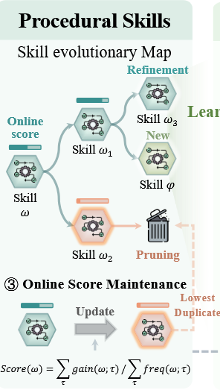

Score-Based Skill Pool Maintenance
Online score update: For each Skill ω, we maintain a cumulative gain Gb(ω) and an invocation count Nb(ω). After processing a batch T (b), we update the online score:
Online Score-Based Pruning: we remove (i) Skills with non-positive online score, i.e., Score(ω) ≤ 0. (ii) duplicate or semantically redundant Skills.

Slide 10
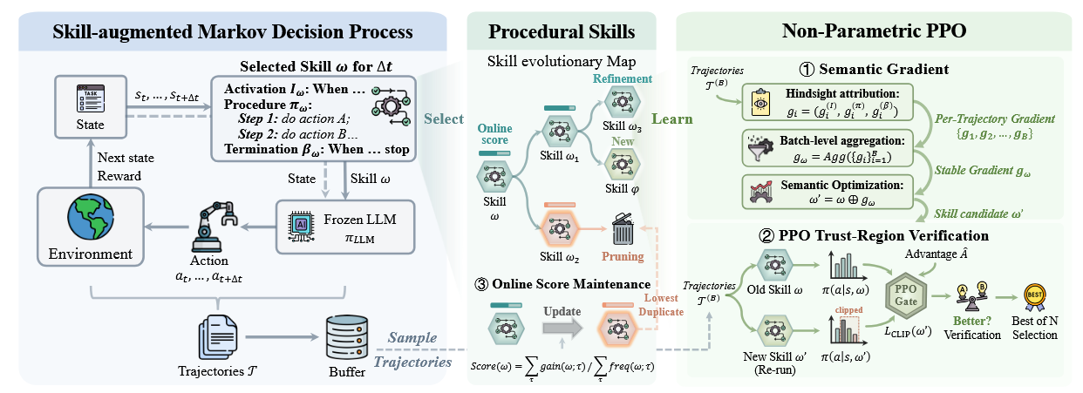
Overview
Overview of the Skill-Pro framework:

Slide 11
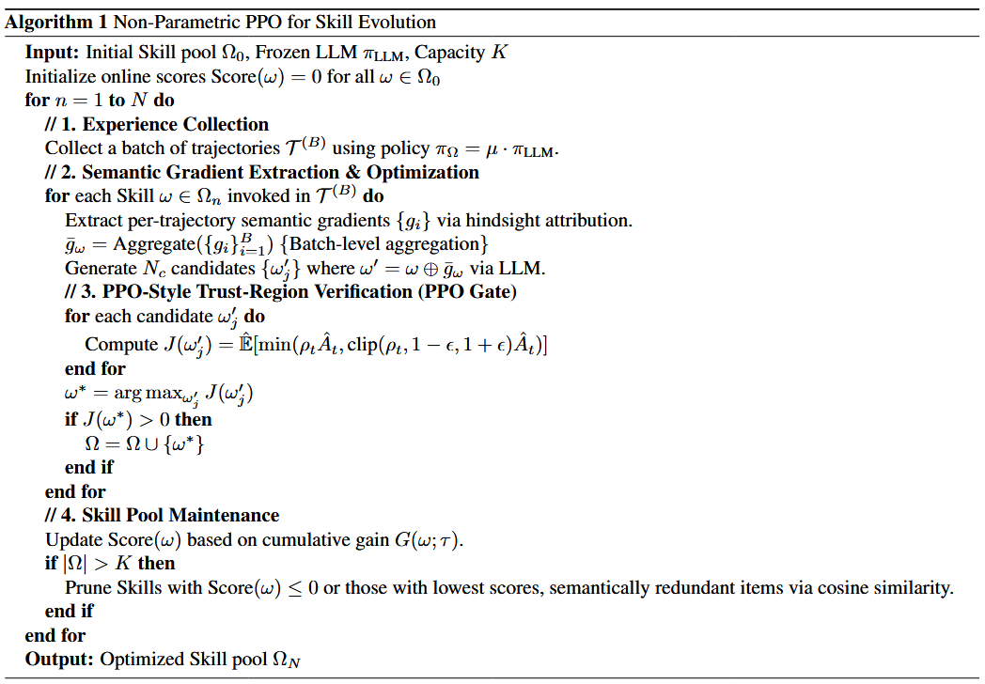
Pipeline
algorithm

Slide 12
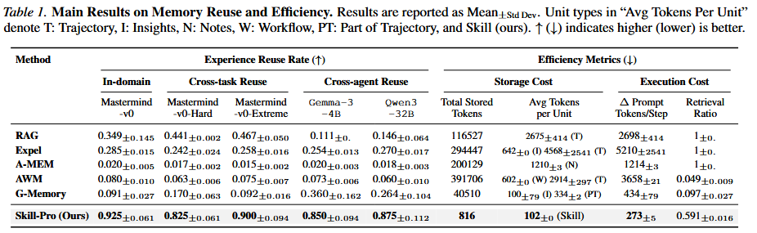
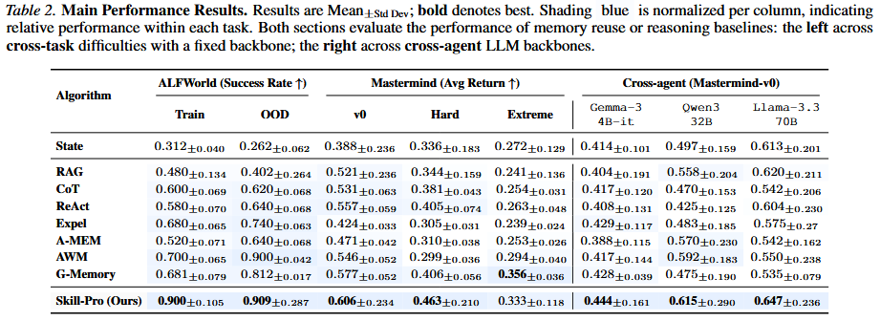
Question 1
Is the learned procedural memory efficiently reusable?

Slide 13
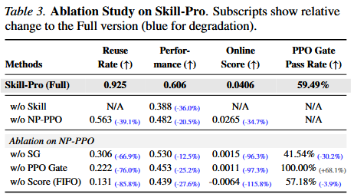
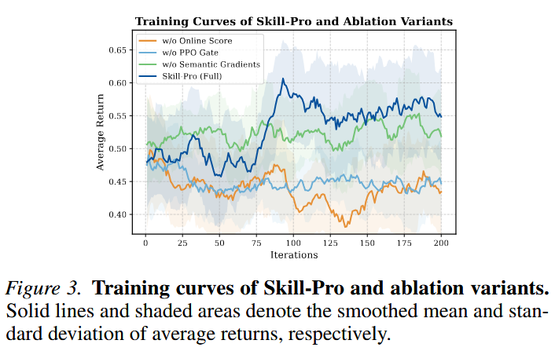
Question 2
How do different components contribute to learning reusable skills?

Slide 14
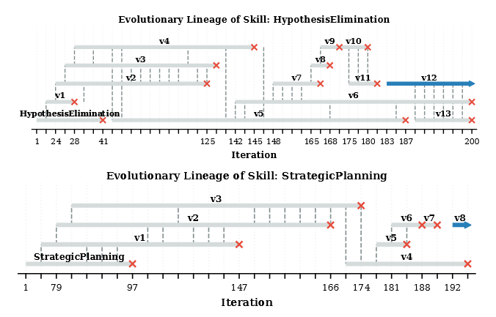
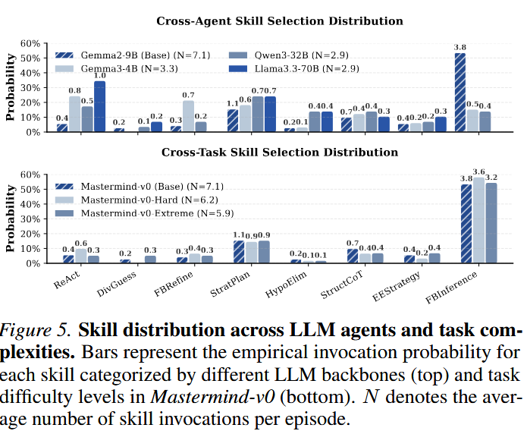
Question 3
How does procedural memory evolve and get reused in practice?

Slide 15
Thank you for listening!

