Slide 1
TORAI: Multi-source Root Cause Analysis for Blind Spots in Microservice Service Call Graph
LUAN PHAM, HUONG HA, XIUZHEN ZHANG, HONGYU ZHANG
FSE 2026

Slide 2
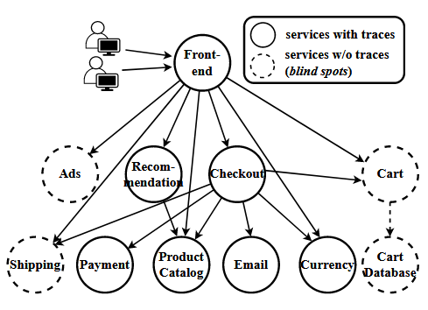
Introduction
Key limitations of existing multi-source RCA methods
approaches that assume the system has full trace coverage, allowing them to construct a full service call graph from traces.
supervised approaches requiring a large volume of labeled data.
intrusive approaches requiring heavy instrumentation of the microservices’ source code.

Slide 3
Framework
TORAI employs unsupervised techniques intuitively.
First, it measures the anomaly severity from multi-source telemetry data.
Second, it clusters services with similar severity symptoms.
Next, it applies causal analysis to identify coarse-grained root causes.
Finally, it uses hypothesis testing to derive fine-grained root causes indicators.
TORAI offers several advantages over existing multi-source RCA methods.
First, it does not rely on the service call graph.
Second, it uses unsupervised techniques such as clustering, and causal analysis, removing the need for labeled data and enabling direct application to microservice systems without requiring training.
Third, it effectively leverages multi-source telemetry data, allowing for the root cause diagnosis in services not present in the call graph.

Slide 4
Contributions
We identify three key limitations of existing multi-source RCA methods, including the assumption of full trace coverage, the reliance on labeled data, and the requirement for intrusive instrumentation.
We introduce TORAI, a novel RCA method that addresses the mentioned limitations effectively. TORAI pinpoints fine-grained root causes by diagnosing available multi-source telemetry without requiring a constructed call graph or labeled data.
We conduct extensive experiments to evaluate TORAI and the experimental results demonstrate that TORAI outperforms existing methods in both effectiveness and efficiency. Additionally, we evaluate TORAI with real-world failures and the results confirm its potential.

Slide 5
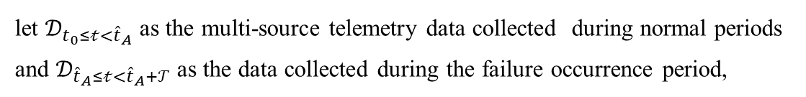
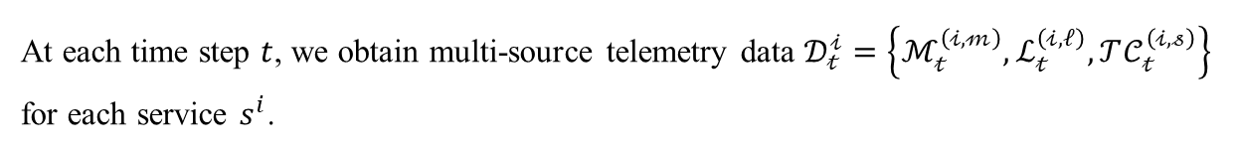
Problem Formulation
Consider a microservice system $𝒮$ comprising $𝒩$ services $\{s^{i}\}_{i=1}^{N}$.
At each time step $t$, we obtain multi-source telemetry data $𝒟_{𝓉}^{𝒾}=\left\{ℳ_{𝓉}^{\left(𝒾,𝓂\right)},ℒ_{𝓉}^{\left(𝒾,𝓁\right)},𝒯𝒞_{𝓉}^{\left(𝒾,𝓈\right)}\right\}$
for each service $s^{i}$.
Given the anomaly detection time ${\hat{t}}_{A},$
let $𝒟_{t_{0}≤𝓉<{\hat{t}}_{A}}$ as the multi-source telemetry data collected during normal periods and $𝒟_{{\hat{t}}_{A}≤𝓉<{\hat{t}}_{A}+𝒯}$as the data collected during the failure occurrence period,
The expected RCA output is a ranked list of root cause services and their corresponding root cause indicators.

Slide 6
Related Work
The Blind Spots of Existing Multi-Source RCA. In the presence of blind spots, existing multi-source RCA methods may not perform RCA effectively.
Supervised RCA Approaches In A Dynamic World. First, Microservice systems are highly dynamic. Second, new faults are introduced over time. Third, microservice systems are typically large in scalemaking it costly and impractical to manually label data to cover all services and fault types.
Tight Integration between Multi-source Data. Many methods struggle in the presence of blind spots, as many metrics and logs may not correspond to any location on the graph, leading to the failure to use these valuable data for failure diagnosis.

Slide 7
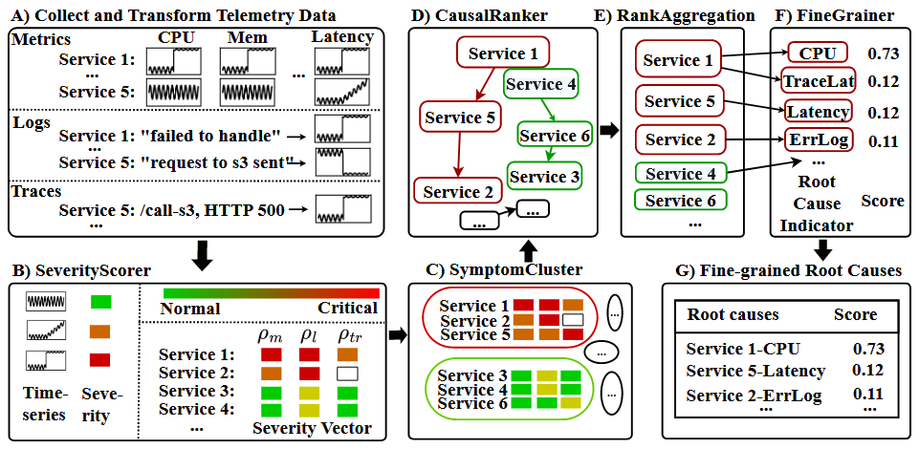
Overview

Slide 8
Transform Multi-source Telemetry Data
Metrics. TORAI collects four metrics types: Traffic, Saturation, Latency, and Errors during both normal and abnormal periods.
Logs. TORAI parses logs into log templates using Drain. TORAI bins the occurrence of log templates based on their timestamps to obtain time series.
Traces. We extract available information from traces, but do not construct the call graph. TORAI transforms latency and status code in traces into time series. Each time series presents the frequency of latency and status code for each trace operation.

Slide 9
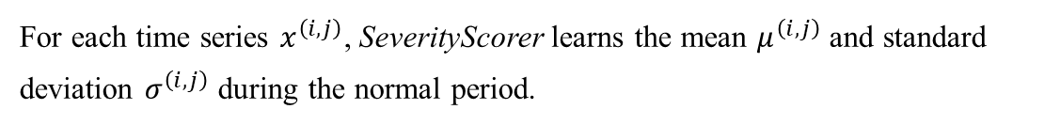
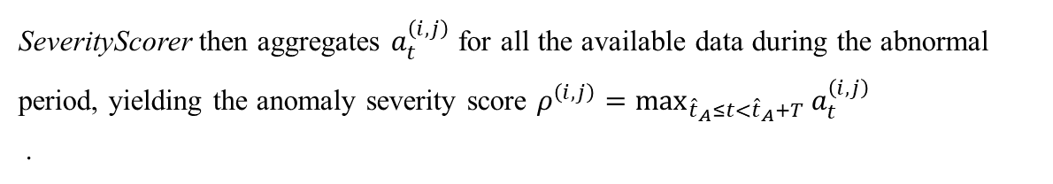
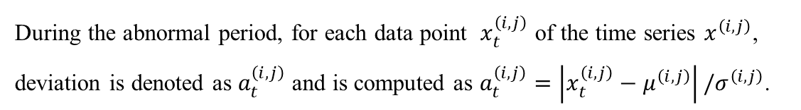
SeverityScorer
SeverityScorer measures anomaly severity scores for each time series and generates a severity vector for each service. These severity vectors effectively assist SymptomCluster in grouping services based on their severity symptoms. This also reduces overhead for CausalRanker.
For each time series $x^{\left(i,j\right)}$, SeverityScorer learns the mean $μ^{\left(i,j\right)}$ and standard deviation $σ^{\left(i,j\right)}$ during the normal period.
During the abnormal period, for each data point $x_{t}^{\left(i,j\right)}$ of the time series $x^{\left(i, j\right)}$, deviation is denoted as $a_{t}^{\left(i,j\right)}$ and is computed as $a_{t}^{\left(i,j\right)}=\left|x_{t}^{\left(i,j\right)}−μ^{\left(i,j\right)}\right|/σ^{\left(i,j\right)}$.
SeverityScorer then aggregates $a_{t}^{\left(i,j\right)}$ for all the available data during the abnormal period, yielding the anomaly severity score $ρ^{\left(i,j\right)}=\max_{{\hat{t}}_{A}≤t<{\hat{t}}_{A}+T}{a_{t}^{\left(i,j\right)}}$
.

Slide 10
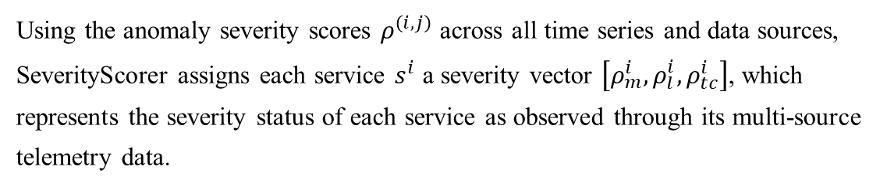
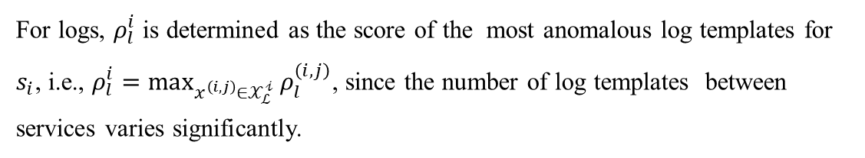
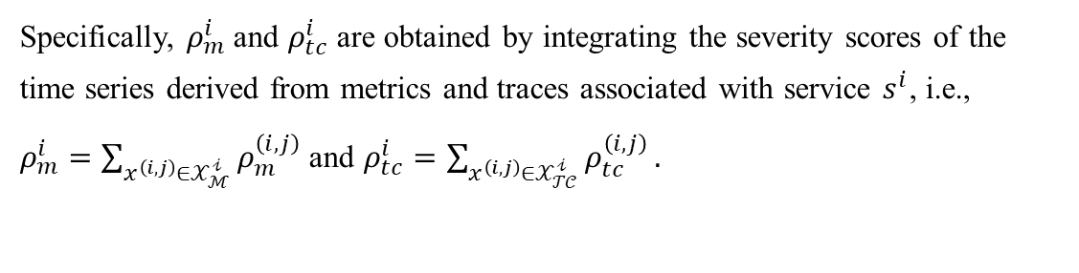
SeverityScorer
Using the anomaly severity scores $ρ^{\left(i,j\right)}$ across all time series and data sources, SeverityScorer assigns each service $s^{i}$ a severity vector $\left[ρ_{m}^{i}, ρ_{l}^{i}, ρ_{tc}^{i}\right]$, which represents the severity status of each service as observed through its multi-source telemetry data.
Specifically, $ρ_{m}^{i}$and $ρ_{tc}^{i}$ are obtained by integrating the severity scores of the time series derived from metrics and traces associated with service $s^{i}$, i.e.,
$ρ_{m}^{i}=\sum_{x^{\left(i,j\right)}∈𝒳_{ℳ}^{𝒾}}{ρ_{m}^{\left(i,j\right)}}$ and $ρ_{tc}^{i}=\sum_{x^{\left(i,j\right)}∈𝒳_{𝒯𝒞}^{𝒾}}{ρ_{tc}^{\left(i,j\right)}}.$
For logs, $ρ_{l}^{i}$ is determined as the score of the most anomalous log templates for $s_{i}$, i.e., $ρ_{l}^{i}=\max_{x^{\left(i,j\right)}∈𝒳_{ℒ}^{𝒾}}{ρ_{l}^{\left(i,j\right)}}$, since the number of log templates between services varies significantly.

Slide 11
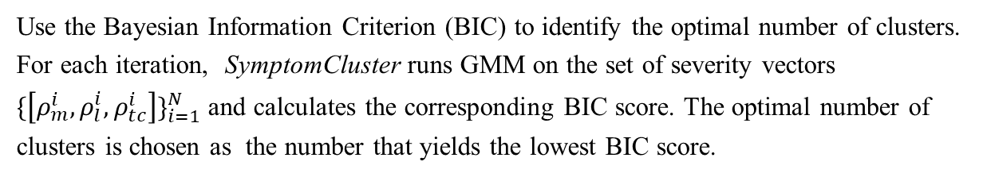
SymptomCluster
SymptomCluster performs clustering to group services with similar severity symptoms. The goal is to effectively separate abnormal services from normal ones, reducing the overhead for CausalRanker when conducting causal analysis.
Use the Bayesian Information Criterion (BIC) to identify the optimal number of clusters.
For each iteration, SymptomCluster runs GMM on the set of severity vectors $\{\left[ρ_{m}^{i},ρ_{l}^{i},ρ_{tc}^{i}\right]\}_{i=1}^{N}$ and calculates the corresponding BIC score. The optimal number of clusters is chosen as the number that yields the lowest BIC score.
For each cluster, SymptomCluster measures the cluster severity score as the mean severity score of all services within that cluster. Finally, SymptomCluster generates a ranked list of clusters, where the highest-ranked clusters are the most likely to contain the root cause.

Slide 12
CausalRanker
CausalRanker is designed to identify the root causes within each severity group obtained from the previous step.
Our CausalRanker ranks services within each cluster via divide-and-conquer causal inference using multi-source time series data.
A causal graph is a directed acyclic graph(DAG) where nodes represent time series and directed edges represent causal relationships.
CausalRanker randomly divides the time series into smaller blocks.
It applies the Ψ-PC to construct causal graphs and identify root causes within each chunk.
The root causes are ranked based on their independence test scores.

Slide 13
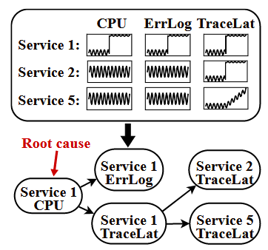
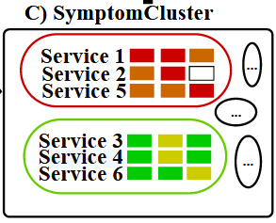
CausalRanker
Lower independence test scores indicate stronger causal influence, suggesting higher likelihood of being the root cause.

Slide 14
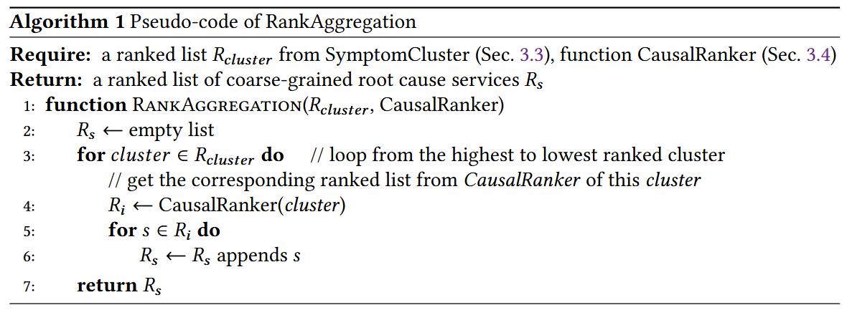
RankAggregation
First prioritize the clusterlevel ranking provided by SymptomCluster. Second, within each cluster, we follow the ranking provided by CausalRanker, meaning that if Service A is ranked higher than Service B within a cluster, then Service A will also be ranked higher than Service B in the final aggregated list.
We apply CausalRanker to all clusters, not just the top severity cluster, and aggregate the results through this Rank Aggregation step.

Slide 15
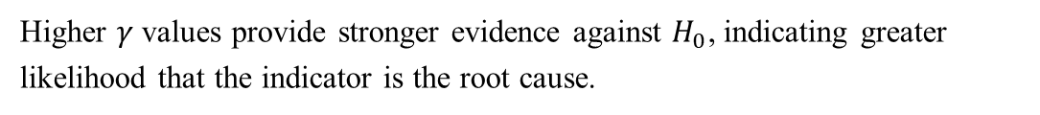
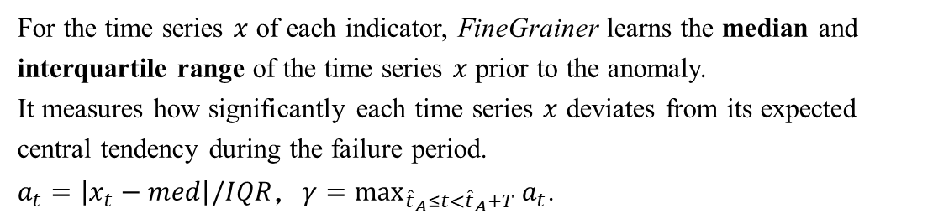
FineGrainer
After identifying the coarse-grained root cause services, we propose FineGrainer to determine fine-grained root cause indicators.
FineGrainer performs hypothesis testing on time series indicators to detect significant distribution changes after the anomaly detection time. Root cause indicators exhibit significant distributional changes after a failure occurs.
For the time series $x$ of each indicator, FineGrainer learns the median and interquartile range of the time series $x$ prior to the anomaly.
It measures how significantly each time series $x$ deviates from its expected central tendency during the failure period.
$a_{t}=\left|x_{t}−med\right|/IQR$，$γ=\max_{{\hat{t}}_{A}≤t<{\hat{t}}_{A}+T}{a_{t}}$.
Higher $γ$ values provide stronger evidence against $H_{0}$, indicating greater likelihood that the indicator is the root cause.

Slide 16
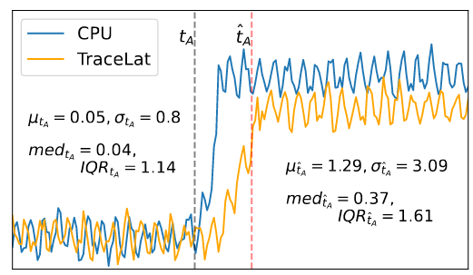
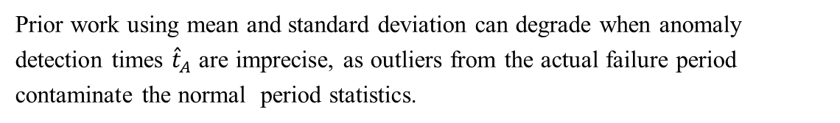
FineGrainer
Prior work using mean and standard deviation can degrade when anomaly detection times ${\hat{t}}_{A}$ are imprecise, as outliers from the actual failure period contaminate the normal period statistics.

Slide 17
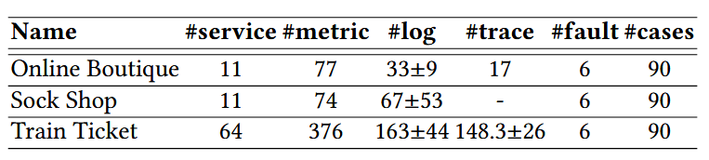
Datasets
We inject six common faults: CPU hog (CPU), memory leak (MEM), disk IO stress (DISK), socket stress (SOCKET), network delay (DELAY), and packet loss (LOSS) into key services of each benchmark system.
For CPU, MEM, DISK, and SOCKET, we use stress-ng to stress the container resource. For DELAY and LOSS, we use tc to manipulate the container traffic.

Slide 18

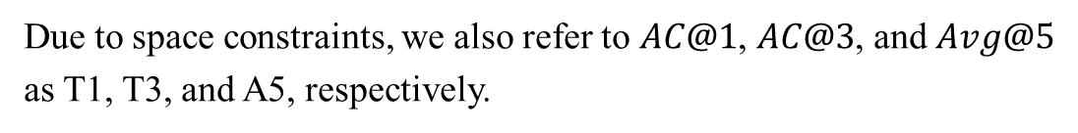
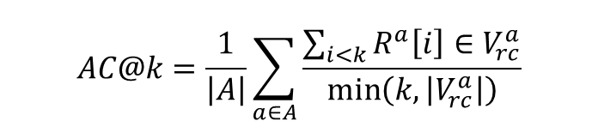
Evaluation Metrics
Given a set of failure cases $A$, $AC@k$ is calculated as follows,
$$AC@k=\frac{1}{\left|A\right|}\sum_{a∈A}{\frac{\sum_{i<k}{R^{a}\left[i\right]}∈V_{rc}^{a}}{\min\left(k,\left|V_{rc}^{a}\right|\right)}}$$
$Avg@k$, which shows the overall RCA performance, is measured as
$$Avg@k=\frac{1}{k}\sum_{j=1}^{k}{A}C@j$$
Due to space constraints, we also refer to $AC@1$, $AC@3$, and $Avg@5$ as T1, T3, and A5, respectively.

Slide 19
Baselines
For the baselines HeMiRCA, CausalRCA, MicroCause, RCD, CIRCA, BARO, MicroRank, and TraceRCA, we use their publicly available implementation and default hyperparameter settings suggested in their respective papers.
For PDiagnose, we follow previous works to implement it since its source code is unavailable.
It is important to note that four of our selected baselines (CausalRCA, MicroCause, RCD, BARO) are metric-based methods that do not require call graphs or trace data. They take time series as input and perform RCA using causal discovery or statistical analysis.

Slide 20
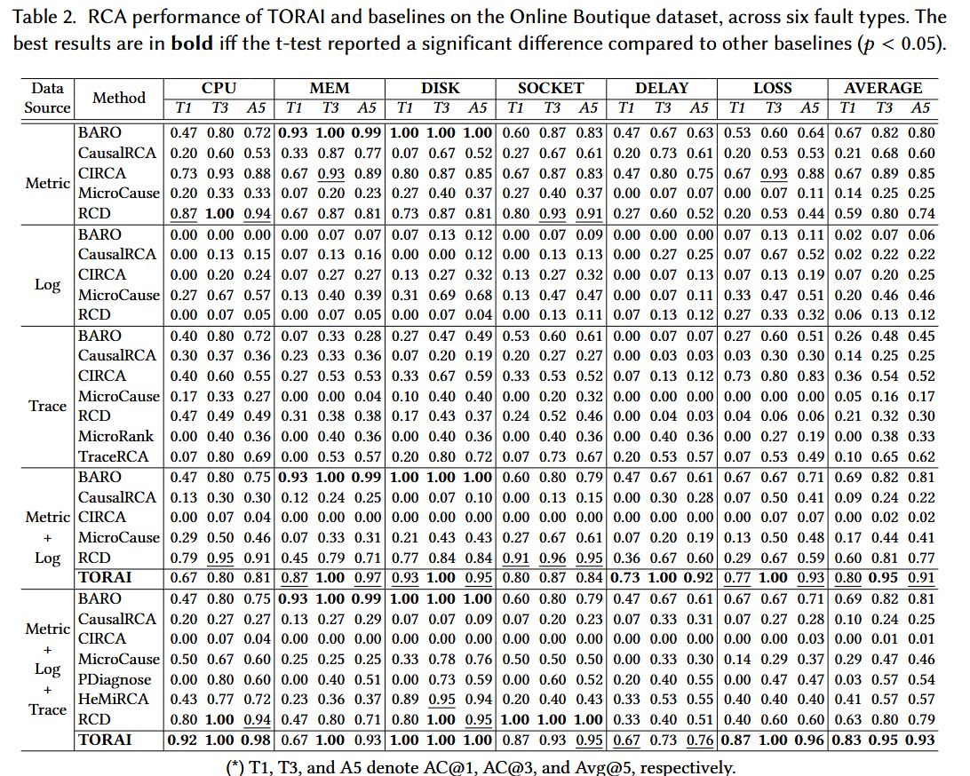
RQ1: How effective is TORAI in coarse-grained RCA?

Slide 21
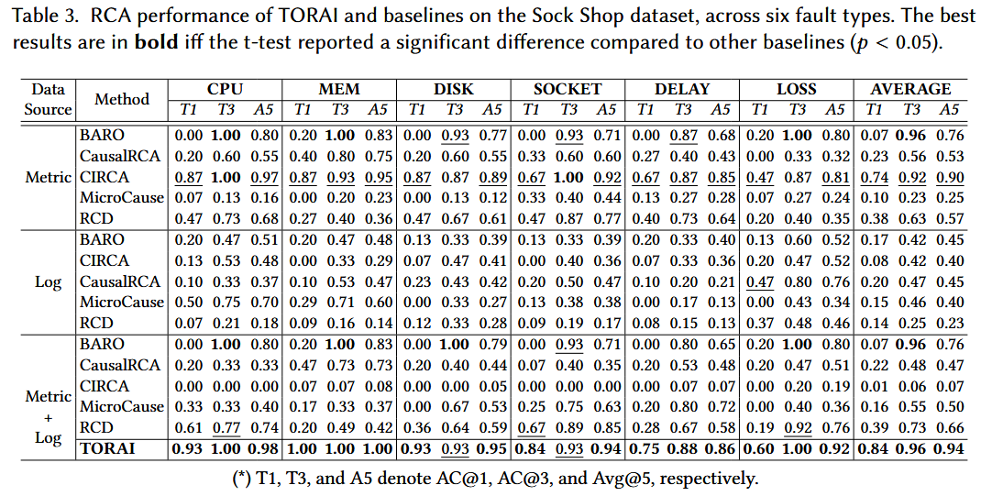
RQ1

Slide 22
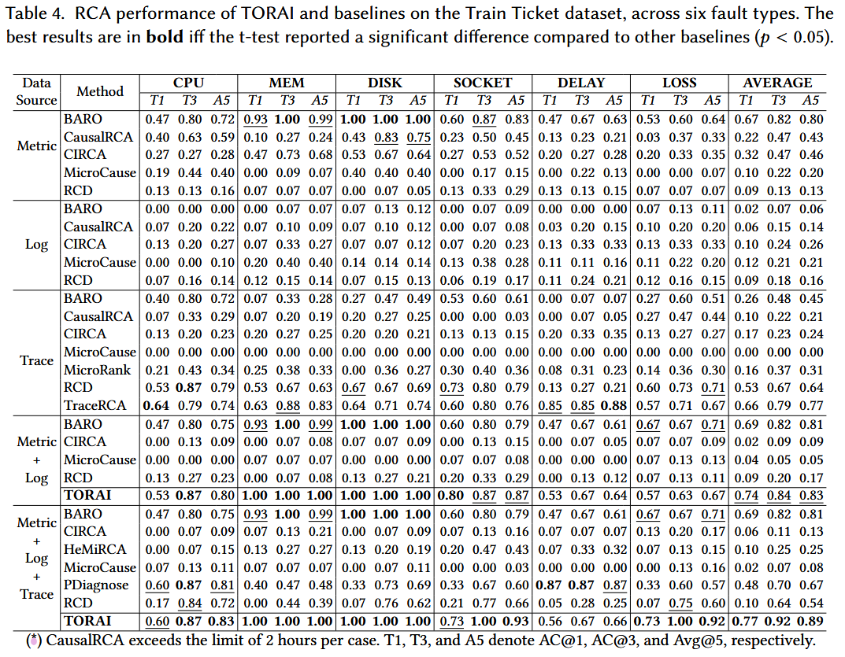
RQ1

Slide 23
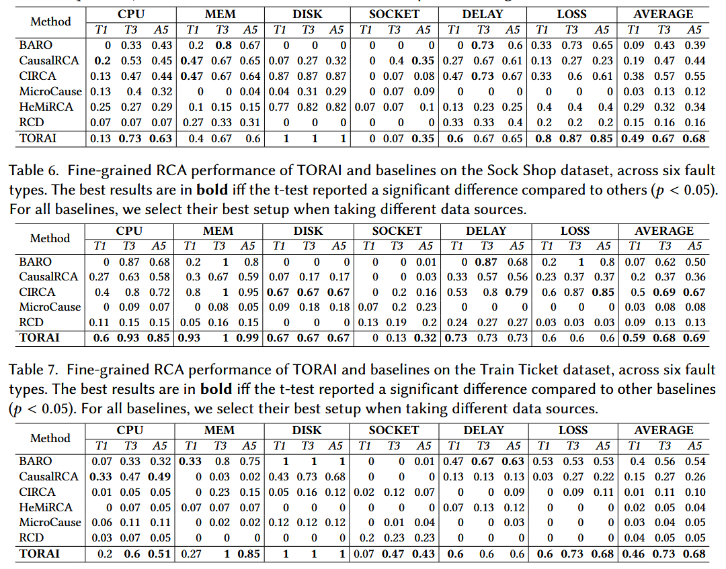
RQ2: How effective is TORAI in fine-grained RCA

Slide 24
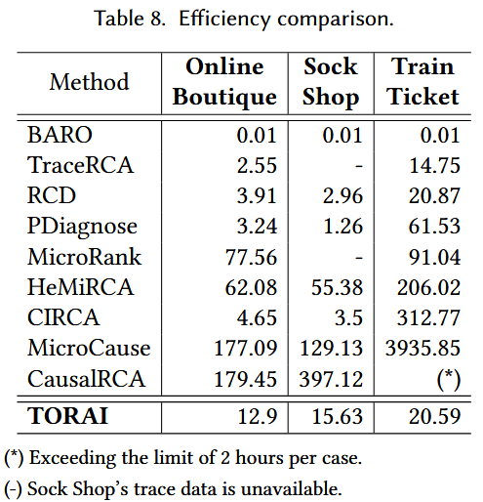
RQ3: How efficient is TORAI in performing RCA?

Slide 25
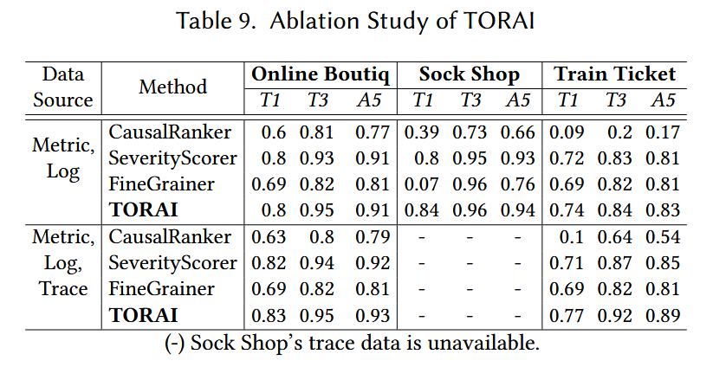
RQ4: How do TORAI’s core components contribute to its overall performance?

Slide 26
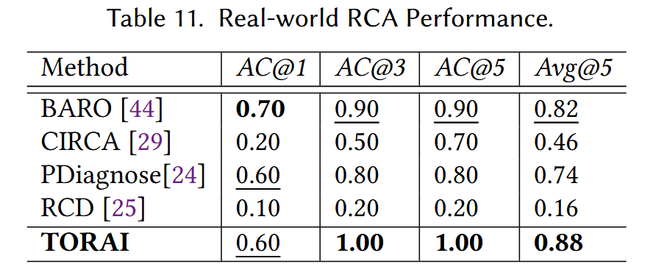
RQ5: How does TORAI perform in real-world scenarios?

Slide 27
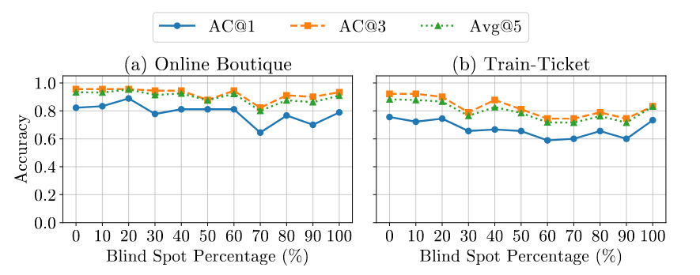
Robust
TORAI remains robust on the Online Boutique system.
TORAI shows graceful degradation on the larger Train Ticket system.
AC@3 is more stable than AC@1 across both systems.

Slide 28
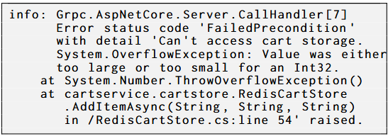
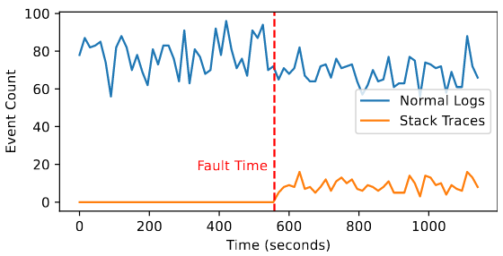
Diagnosing code-level faults
If a code-level fault produces observable symptoms, such as exception logs or erroneous traces, our method can detect the root cause services with these indicators to assist engineers in diagnosing the actual fault more efficiently.

Slide 29

THANK YOU FOR LISTENING

