Slide 1
ICML 2026 · PMLR 306 · arXiv:2605.31176
Retriever Portfolios: A Principled Approach to Adaptive RAG
Miltiadis Stouras · Vincent Cohen-Addad · Silvio Lattanzi · Ola Svensson
EPFL · Google Research
Group Meeting · Paper presentation
Presenter: Zhou Quan
2026.10
1
Notes:
Introduce the paper: ICML 2026, EPFL theory group with Google Research. One sentence up front: this paper turns adaptive RAG into an offline subset-selection problem.

Slide 2
OVERVIEW
Three questions this paper answers
1 Why does a single retriever fail? Queries are heterogeneous, and retrieval configurations specialise in different regions of the query space.
2 How do you choose a set of retrievers rather than one — with a guarantee that the choice is close to optimal?
3 Does it pay off end to end, and what does it cost compared with adapting retrieval per query?
2
m
The answer: move adaptation from every query to a single offline selection step.
Notes:
Frame the talk around these three questions; everything else is detail.

Slide 3
MOTIVATION
RAG still ships one retriever for every query
Pipeline. query → retriever → top-n chunks → LLM. The retriever, its hyper-parameters and n are tuned once on a dev set, then frozen.
Queries are not one distribution. single-hop factoid questions, multi-hop composition, rare entities, domain jargon.
Configurations specialise. lexical precision, diverse evidence, entity-graph expansion — different failure modes.
And the selection objective is wrong. we pick by average score, but deploy by best-per-query.
The same system sees both
• “Which year was X founded?” One lexically similar passage is enough.
• “Are A and B from the same country?” Two passages, plus a composition step.
A retriever tuned for the first is not tuned for the second.
One fixed configuration cannot be right for both.
3
No single retriever is best for all queries — fixing one leaves accuracy on the table.
Notes:
Use the corpus/support statistics to make heterogeneity concrete. The last bullet is the tension the paper exploits: we select by average, but we are judged per query.

Slide 4
PRIOR WORK
Adaptive retrieval exists — but adaptation is expensive
Method | What adapts | Decision space | Cost of adapting
Adaptive-RAG (2024) | query-complexity classifier | 3 hand-built strategies | cheap, but a tiny menu
Self-RAG (2023) | reflection tokens | token-level retrieve / critique | iterative generation
Vendi-RAG (2025) | diversity parameter s | continuous, one dimension | serial retrieve → answer → judge
MoR (2025) | per-query mixture weights | score fusion over a fixed set | no subset selection
This work | which k, and which ℓ to run | subset + routing | offline; parallel inference
4
Two extremes: a tiny hand-built menu, or a per-query search loop. Both pay at inference time.
Notes:
Contrast the two families the paper argues against. Emphasise when the cost is paid: Adaptive-RAG pays a classification error; Vendi-RAG pays a serial search per query.

Slide 5
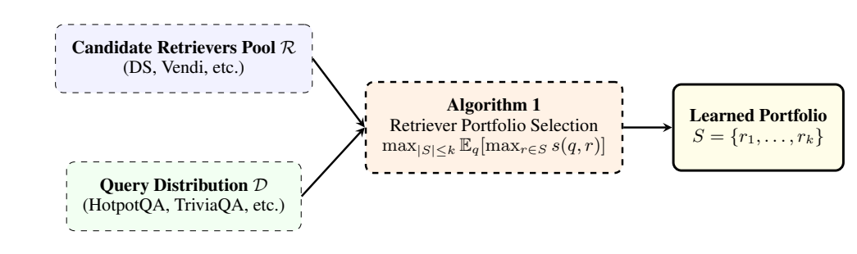
KEY IDEA
Cover the query distribution — do not average over it
Selection is not a ranking
We do not want the best average retriever; we want a set whose best member is good for each query.
A portfolio S is scored by its best member, not its mean: for a random query, how good is the best retriever in S?
Two retrievers that behave alike contribute almost nothing to a maximum — so the objective prices redundancy at zero, automatically.
5
max over members, not mean: F(S) = E_q[ max over r in S of s(q, r) ]
Notes:
This is the conceptual pivot of the talk. Say it twice: the quality of a set is its best-of-k score, and that automatically kills duplicates.

Slide 6
FORMULATION
Portfolio selection as set-function maximisation
Pool R = {r1, …, rm}, budget k
Portfolio S ⊆ R, |S| ≤ k
Score s : Q × R → [0, 1]
Set score score(q, S) = max_{r ∈ S} s(q, r)
Objective F(S) = E_{q~D}[ score(q, S) ]
Goal max_{|S| ≤ k} F(S)
Where it comes from
• Data-driven solution portfolios (Drygala et al., ITCS 2025)
• Catalogue / segmentation problem (Kleinberg et al., 2004)
• Retrievers play the role of candidate algorithms; queries are problem instances.
In the paper, s(q, r) is instantiated as Recall@k against the gold supporting documents of each training query.
Read k as an engineering constraint: the number of retrievers you are willing to maintain and deploy.
6
Still a combinatorial problem — k-subsets of 360 candidates are hopeless without structure.
Notes:
Give the definitions plainly; note that s is abstract here and fixed to Recall@k later.

Slide 7
THEORY (1/2)
Why it is solvable: the objective is submodular
Diminishing returns. Adding a retriever helps a small portfolio at least as much as a large one.
Take A ⊆ B and fix r. Let v_A = max_{r'∈A} s(q,r') and v_B = max_{r'∈B} s(q,r'), so v_B ≥ v_A.
The marginal gain of r is max(0, s(q,r) − v_A) versus max(0, s(q,r) − v_B).
Since v_B ≥ v_A, the first is at least the second — gains shrink as the set grows.
max is monotone and submodular for every q; an expectation over q preserves both.
Why anyone should care
Greedy is not a heuristic here — it has a worst-case approximation ratio.
Submodularity is exactly the property that makes a greedy scan over 360 candidates a principled algorithm rather than a hack.
7
Submodular ⇒ greedy attains (1 − 1/e) of the empirical optimum (Nemhauser et al., 1978).
Notes:
Write the three lines on the board if asked. The key sentence: the max operator looks non-differentiable and unfriendly, but at the level of sets it is exactly submodular.

Slide 8
THEORY (2/2)
Greedy selection, and a bound that survives sampling
sample N queries Q ~ D^N ; V[q] ← 0 for all q ∈ Q
S ← ∅
for i = 1 … k:
r* ← argmax_{r ∈ R\S} Σ_{q∈Q} max(0, s(q,r) − V[q])
S ← S ∪ {r*}
for q ∈ Q: V[q] ← max(V[q], s(q, r*))
return S
Sample size
N = O( (k log|R| + log(1/δ)) / ε² )
Cost O(k|R|N) score evaluations, O(N) memory — independent of how complex the query distribution is.
Theorem 3.1
F(S) ≥ (1 − 1/e) · OPT − ε w.p. 1 − δ
Tight: coverage functions admit no better polynomial-time ratio (Feige, 1998; Wolsey, 1982).
8
1 − 1/e ≈ 0.63 is the worst case; at k = 5 the learned portfolio is close to the per-query oracle.
Notes:
Two guarantees glued together: greedy gives 1 − 1/e on the empirical objective, a union bound gives uniform convergence. Do not dwell on the proof; stress that the constant is tight.

Slide 9
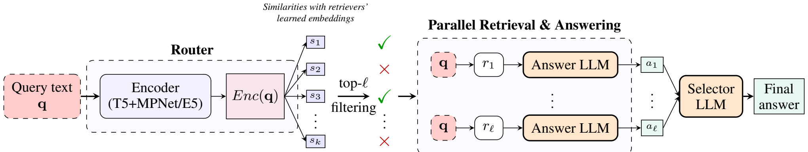
PIPELINE
Offline portfolio, online router, parallel execution
Figure 2 (paper): the router keeps the top-ℓ members; retrieval and answering run in parallel; a selector LLM merges the answers.
Offline: one selection over the whole candidate pool. Online: one routing pass, ℓ retrievals and ℓ generations — all independent.
9
Online cost has a ceiling: one router pass plus ℓ parallel branches.
Notes:
Walk left to right along the figure. Emphasise the parallelism: nothing in the online path depends on the previous step, unlike Vendi-RAG.

Slide 10
CANDIDATES
360 candidate retrievers, three families
Family | Count | What varies | Mechanism
Discounted Similarity | 282 | γ (14 values) × r (10 values) × 2 backbones | down-weights chunks too similar to those already picked
Vendi | 42 | s ∈ {0, 0.05, …, 1} × 2 backbones | relevance–diversity trade-off through the Vendi score
Graph-dense | 36 | 2backbone × 3hops {1,3,5} × 3df × 2#candidates | entity–chunk graph expansion, then dense re-ranking
All candidates share one interface: query in, four chunks out. Two dense backbones (MPNet, E5), FAISS pre-filter of 1,000 candidates, 512-token chunks.
10
Diversity comes from family × embedding backbone × hyper-parameters — not from 360 ideas.
Notes:
The honest reading: 282 of the 360 are one family sampled on a grid. Say this here, and come back to it in the discussion.

Slide 11
LEARNED PORTFOLIO
What the greedy actually selects (Table 2)
Rank | Retriever | Avg. score | Hyper-parameters
1 | GraphDense / E5 | 0.6058 | hops = 1, df = 500
2 | Vendi / E5 | 0.5421 | s = 0.05
3 | GraphDense / E5 | 0.5532 | hops = 3, df = 100
4 | GraphDense / MPNet | 0.4985 | hops = 3, df = 100
5 | Vendi / E5 | 0.5223 | s = 0.20
Ranks 3–5 have a lower solo score than rank 2
Greedy buys marginal gain, not rank — each member covers queries the earlier ones miss.
None of the 282 DS candidates is selected
Diversified-similarity behaviour is subsumed by Vendi; under a maximum it adds nothing.
11
A portfolio is not a leaderboard: members are chosen for what the others miss.
Notes:
This table is the mechanism evidence. Point at ranks 3–5 versus rank 2, then at the absence of DS.

Slide 12
ROUTER
A three-modal router, trained from retrieval recall
Representation. query text (frozen FLAN-T5-Large) ⊕ MPNet embedding ⊕ E5 embedding → 256-d projections → MLP → L2 normalised.
Scoring. one learnable prototype per portfolio member; score = cosine similarity.
Supervision. winners W(q) = members with the best Recall@K on that training query.
Multi-positive contrastive loss
L(q) = − (1/|W|) Σ_{r∈W} log softmax_r( sim(q, r) )
All tied-best retrievers are positives — no arbitrary argmax label.
Training details. drop zero-recall queries and ties larger than 3; balanced batching by winner structure; only non-T5 weights are trained (AdamW, 3e-4, 10 epochs, batch 64).
12
It only has to rank k = 4 candidates — and its top-2 / top-3 are already close to the oracle.
Notes:
Borrowed from RouterDC, applied to retrievers. The interesting bit is the supervision signal: retrieval recall, not answer quality.

Slide 13
SETUP
Four benchmarks, two answer models, one protocol
Dataset | Train | Test | Corpus chunks | Avg. supporting docs
HotpotQA | 88,066 | 9,786 | 5,233,329 | 2.00
MusiQue | 19,938 | 2,417 | 101,962 | 2.37
TriviaQA | 60,413 | 8,837 | 856,435 | 11.86
2WikiMultiHopQA | 167,454 | 12,576 | 384,857 | 2.42
Protocol
Answer models: Gemma-3-27B-It and Llama-3.1-70B-Instruct
Selector: an LLM judge over the ℓ candidate answers
Retrieval metrics: support Recall@k, support F1@k
End to end: Exact Match, tokens, wall-clock time
Single-hop and multi-hop questions; corpora that differ by a factor of 50.
13
Same corpus, chunking, prompts and answer model for every method — the comparison is controlled.
Notes:
Set the stage before the numbers: what is measured, and under which protocol. Point at the spread in supporting documents — it is why heterogeneity matters.

Slide 14
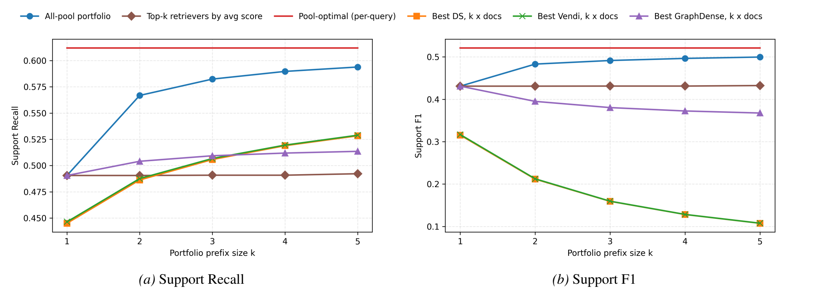
RESULTS · RETRIEVAL COVERAGE
Portfolios close most of the coverage gap
Figure 3 (paper): best-of-k support score as the portfolio grows, averaged over the four QA benchmarks.
14
k = 5: recall 0.491 → 0.594 and F1 0.431 → 0.500, while the average-best baseline stays at 0.492.
Notes:
Read the blue curve against the flat brown one. The red line is the per-query oracle — not deployable, but it shows how much room is left.

Slide 15
RESULTS · CONTROLS
Two controls rule out the obvious explanations
It is not “take the best ones”
It is not “retrieve more”
0.492
→
0.594
0.32 → 0.11
support F1, one retriever with 4 → 20 documents
top-k by average score
learned portfolio (k = 5)
0.431 → 0.500
Support recall at k = 5. The average-score list is filled with near-duplicate configurations.
support F1, learned portfolio, k = 1 → 5
15
Gains come from complementary failure modes, not from a larger context budget.
Notes:
These two controls are what makes the retrieval result credible. If someone is sceptical in the room, this is the slide to return to.

Slide 16
RESULTS · END TO END
Exact Match across four benchmarks (Table 3)
Method | Gemma-3-27B-It |  |  |  | Llama-3.1-70B-Instruct
 | HotpotQA | MusiQue | TriviaQA | 2Wiki | HotpotQA | MusiQue | TriviaQA | 2Wiki
No retrieval | 0.3256 | 0.0608 | 0.6530 | 0.2264 | 0.3483 | 0.0588 | 0.6947 | 0.1920
Nearest neighbour | 0.3945 | 0.1291 | 0.6592 | 0.2408 | 0.4763 | 0.1394 | 0.7022 | 0.2921
Best DS | 0.5128 | 0.1394 | 0.6867 | 0.3544 | 0.4345 | 0.1092 | 0.6318 | 0.2443
Best Vendi | 0.5111 | 0.1427 | 0.6868 | 0.3562 | 0.4331 | 0.1121 | 0.6249 | 0.2445
Best GraphDense | 0.4628 | 0.1134 | 0.6704 | 0.3407 | 0.3978 | 0.0873 | 0.5961 | 0.2387
Vendi-RAG (T = 20) | 0.2853 | 0.1307 | 0.6727 | 0.2560 | 0.4830 | 0.2060 | 0.7040 | 0.2900
Vendi-portfolio (k5, ℓ2) | 0.3927 | 0.1262 | 0.6720 | 0.2341 | 0.4825 | 0.1427 | 0.6956 | 0.3080
All-pool (k4, ℓ2) | 0.5523 | 0.1725 | 0.6937 | 0.4052 | 0.5897 | 0.1820 | 0.7073 | 0.4139
All-pool (k4, ℓ3) | 0.5579 | 0.1949 | 0.6898 | 0.4142 | 0.5827 | 0.2089 | 0.6859 | 0.4187
16
Average EM: 0.464 (Gemma) / 0.474 (Llama) vs. 0.424 best single retriever and 0.336 / 0.421 for per-query tuning.
Notes:
Do not read nine numbers aloud. The message: best single retrievers are dataset-dependent, the portfolio is not; and Vendi-RAG collapses on Gemma/HotpotQA (0.285, below no retrieval).

Slide 17
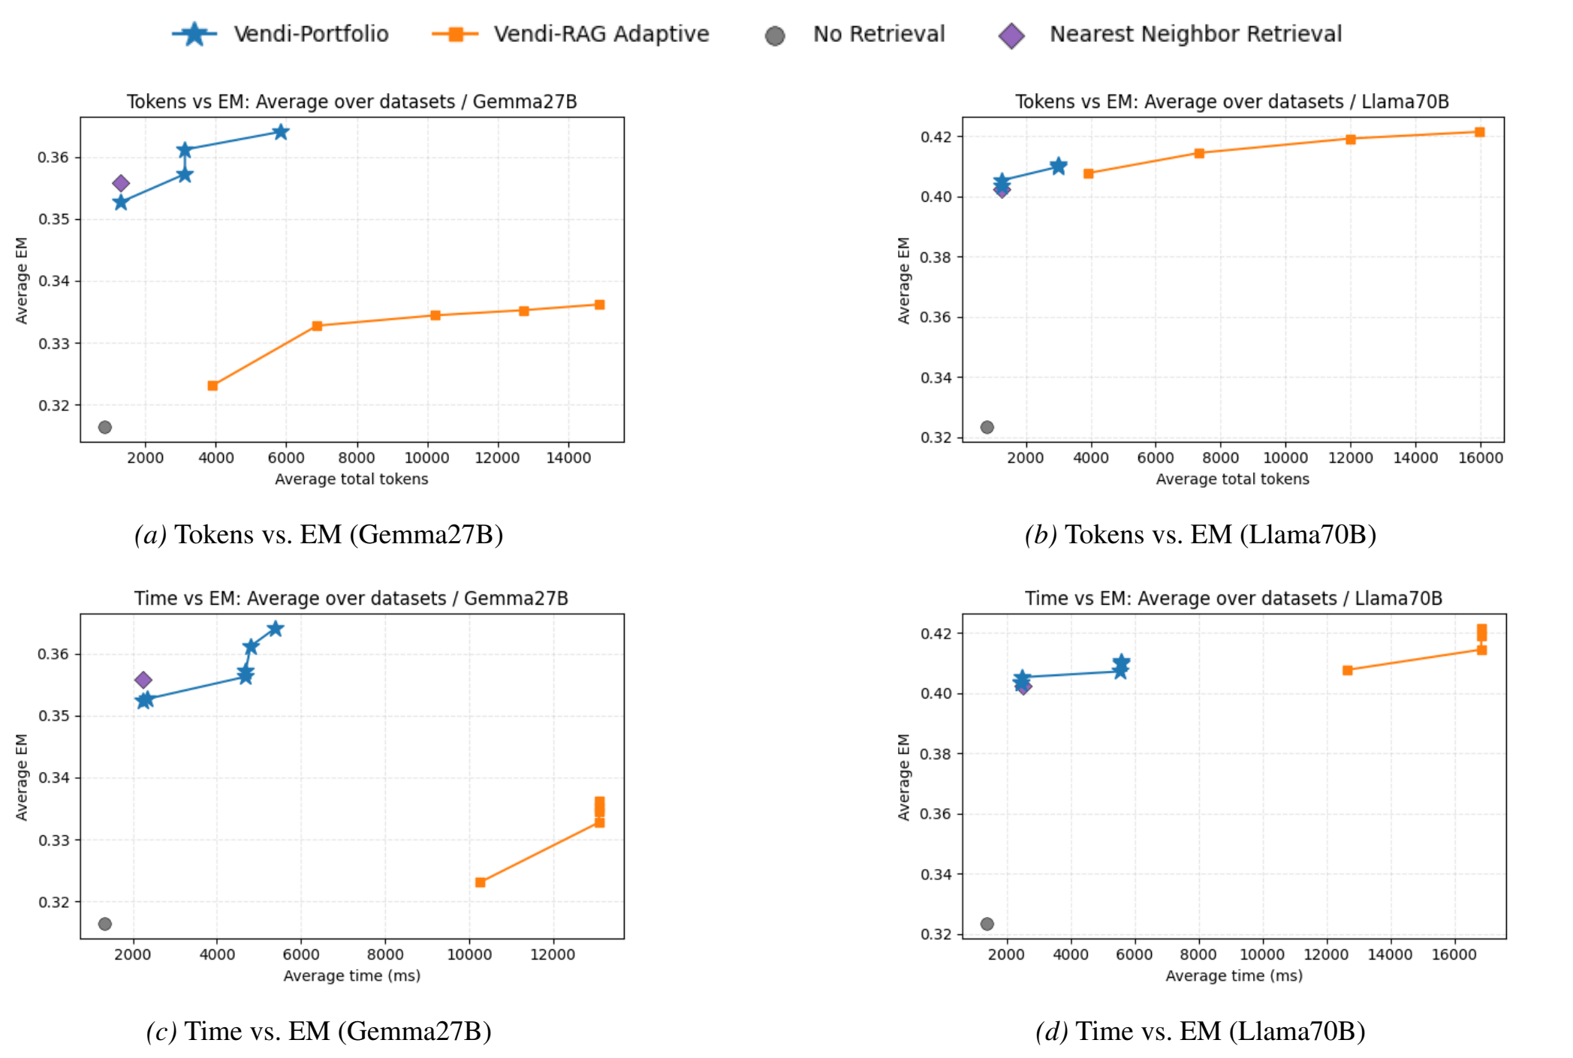
RESULTS · EFFICIENCY
Same search space, but searched offline
Controlled comparison
MPNet + Vendi only — exactly the s-grid Vendi-RAG searches at inference time.
Gemma. The fixed portfolio is better at lower cost.
Llama. Per-query search can match it, but only after a large increase in tokens and latency.
Authors note this is a controlled setting, not a full comparison.
Figure 4 (paper): tokens and wall-clock time against EM.
17
Notes:
Be explicit that this is an apples-to-apples control: the same hyper-parameter grid, chosen offline versus searched online, query by query.

Slide 18
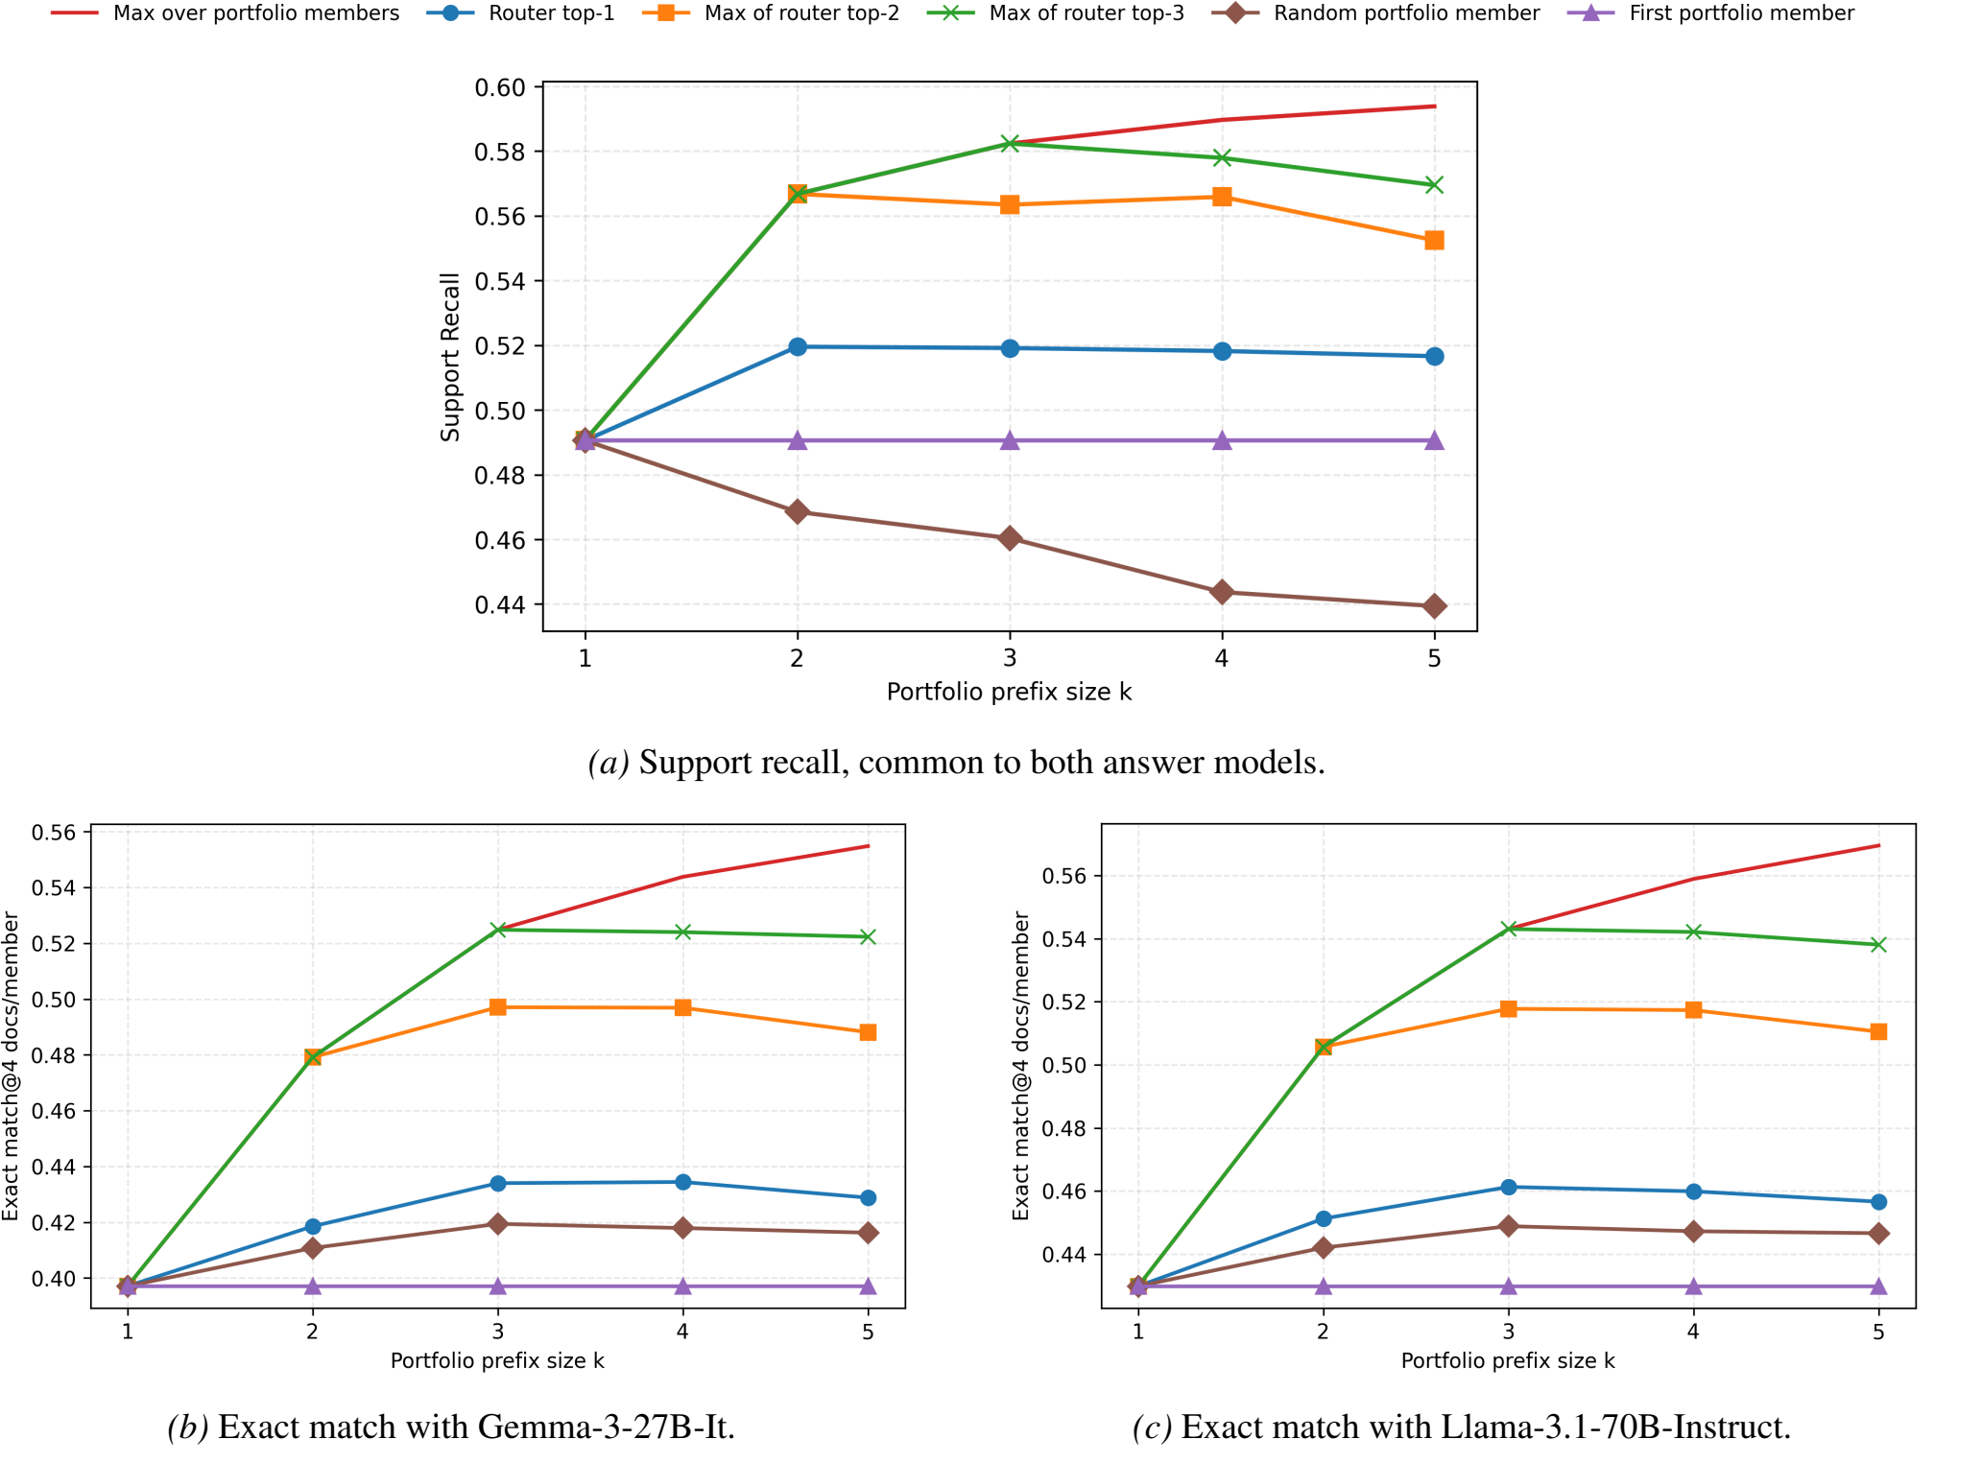
RESULTS · ROUTING
Routing matters — and top-2/3 nearly reach the oracle
Random routing gets worse as k grows
Picking a member at random sometimes picks one that is wrong for the query.
Top-1 beats the best single retriever once k > 1 — the router is not just defaulting to the strongest average member.
Top-2 and top-3 track the oracle, which is why executing ℓ > 1 and letting a selector decide is worth the extra calls.
18
The router's short list is calibrated — the selector is not a patch, it is the design.
Notes:
Also note the missing number: the paper never reports routing accuracy itself, only these end-to-end curves.

Slide 19
DISCUSSION
What holds, and what to watch
The contribution is a re-framing: pay for adaptation once, offline, instead of on every query.
Strength. The objective matches the deployment question — best member, not average.
Strength. A guarantee plus two controls that exclude the cheap explanations.
Strength. Cost becomes bounded and parallel, which is what serving needs.
Caveat. Optimises Recall@k, reports EM — a proxy gap.
Caveat. 282 of 360 candidates are one family; no family ablation.
Caveat. No end-to-end comparison with Adaptive-RAG, Self-RAG or MoR.
Caveat. Offline cost (N × 360 scores), single seed, no error bars.
19
Core insight: adaptive retrieval is a subset-selection problem before it is a search problem.
Notes:
This is where a group meeting earns its keep. Say the caveats yourself, before someone asks.

Slide 20
TAKEAWAYS
Three things worth remembering
1 Reframe. Choose a portfolio offline; route to a few members online.
2 Guarantee. The best-of-k objective is submodular, so greedy is (1 − 1/e) − ε, and the constant is tight.
3 Evidence. Coverage up, EM up, cost down against per-query search — with two controls that rule out “more context”.
20
Reusable idea: amortise the adaptation, keep inference parallel and bounded.
Notes:
Close on the reusable idea, then invite questions.

