Slide 1
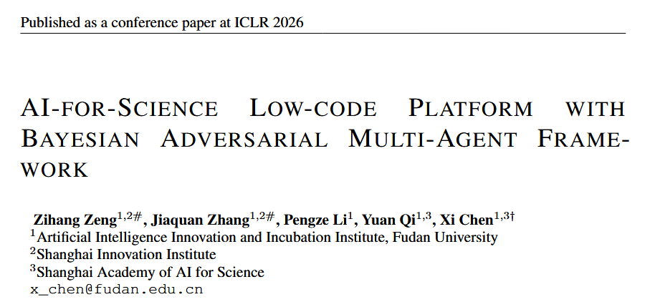

Slide 2
Background
Several challenges hinder LLM’s reliable application in AI4S research:
(1) LLM’s reliability is undermined by the probabilistic nature of LLMs, which can produce hallucinations in both generated code and its corresponding test cases. In a multi-agent architecture, these errors can propagate and compound, leading to flawed final outputs.
(2) potentially unclear prompt descriptions from domain scientists without computer science backgrounds.
(3) evaluating the code of domain-specific tasks is often difficult. (the need to maintain adherence to physical laws and domain-specific constraints.)

Slide 3
Contributions
A Novel AI4S Low-Code Platform(LCP) with Bayesian Adversarial Framework: We introduce a multi-agent framework that employs a Bayesian recursive co-updating strategy to iteratively refine generated code and test cases using a non-LLM-based adversarial score.
Bayesian Optimization for code performance estimation: We proposed a Bayesian Optimization method to estimate the performance of a given code
Domain Knowledge Refinement for scientific tasks

Slide 4
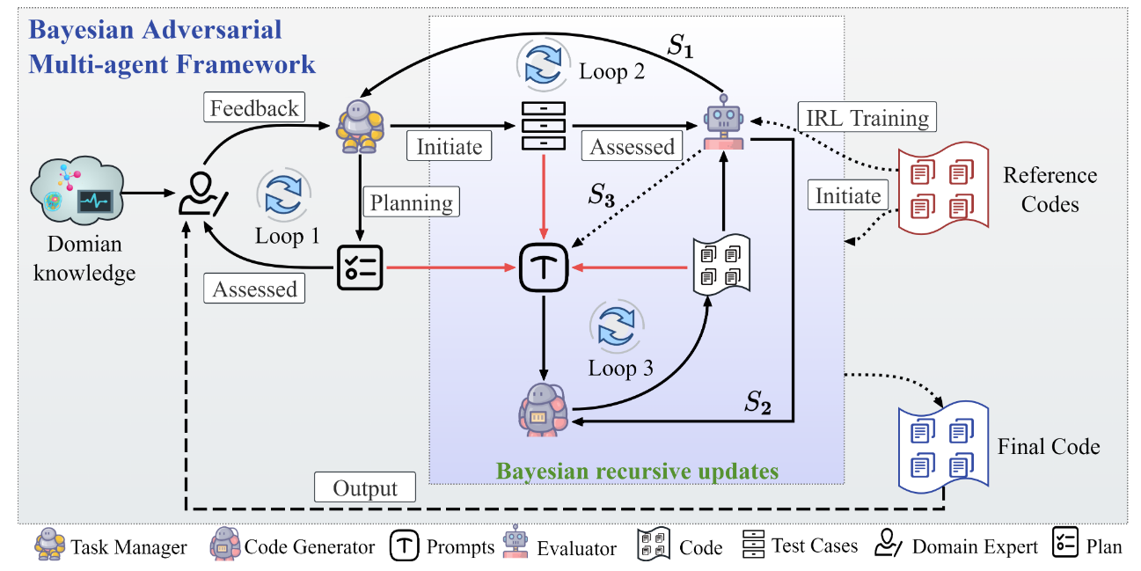
Overview
Task Manager (TM) agent serving as Challenger,
Solution Generator (SG) agent as Solver,
Evaluator agent for comprehensive assessment

Slide 5
TM agent and SG agent
Task Manager (TM) agent:
1. Decomposing the primary task into sub-tasks.
2. Posing Sanity Checks for data structure and range.
3. Reasoning about the logical workflow and dependencies between sub-tasks.
4. Formulating strategic advice for the generation of effective test cases.
Solution Generator (SG) agent:
The code generation agent uses prompt to produce N candidate solutions (codes).

Slide 6
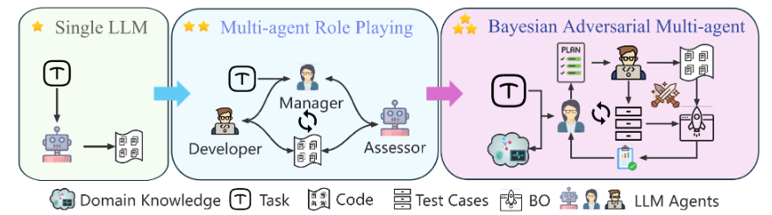
Adversarial interaction
The TM agent’s role evolves to that of a Challenger. It aims to create test suites that are optimally challenging for the SG’s current learned capabilities
The SG agent, as the Solver, implicitly adapts by producing code in response to these evolving challenges.

Slide 7
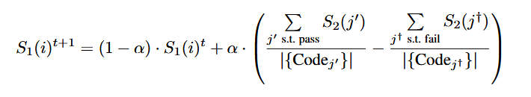


Evaluator agent
The Evaluator agent is responsible for assessing the candidate codes, the effectiveness of the test cases, and the overall quality of the prompts used in each iteration.
Test case score(S1)
Code score(S2)
Prompt Score (S3)

Slide 8
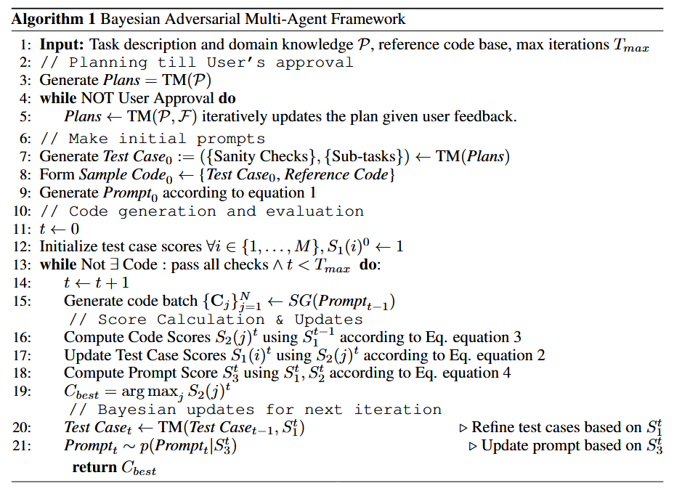
Algorithm

Slide 9

Bayesian optimization
We noticed that executing all the generated codes for testing can be computationally expensive.
1. code embeddings: This embedding model is used to map generated code candidates into a semantic-structural vector space.
2. obtain the pair-wise similarity between all the code embeddings. These pairwise similarities {k(xi, xj)}i,j form the kernel matrix K
3. follow a standard Bayesian Optimization practice and fit a Gaussian Processes (GP) model

Slide 10



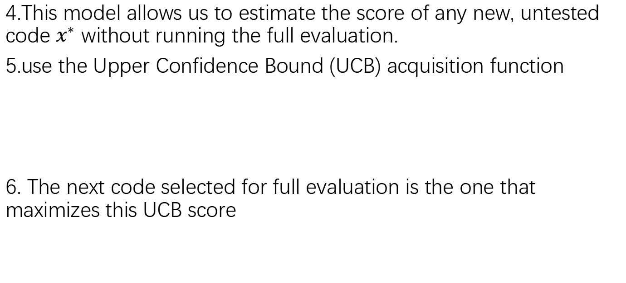
Bayesian optimization
4.This model allows us to estimate the score of any new, untested code $x^{∗}$ without running the full evaluation.
5.use the Upper Confidence Bound (UCB) acquisition function
6. The next code selected for full evaluation is the one that maximizes this UCB score

Slide 11

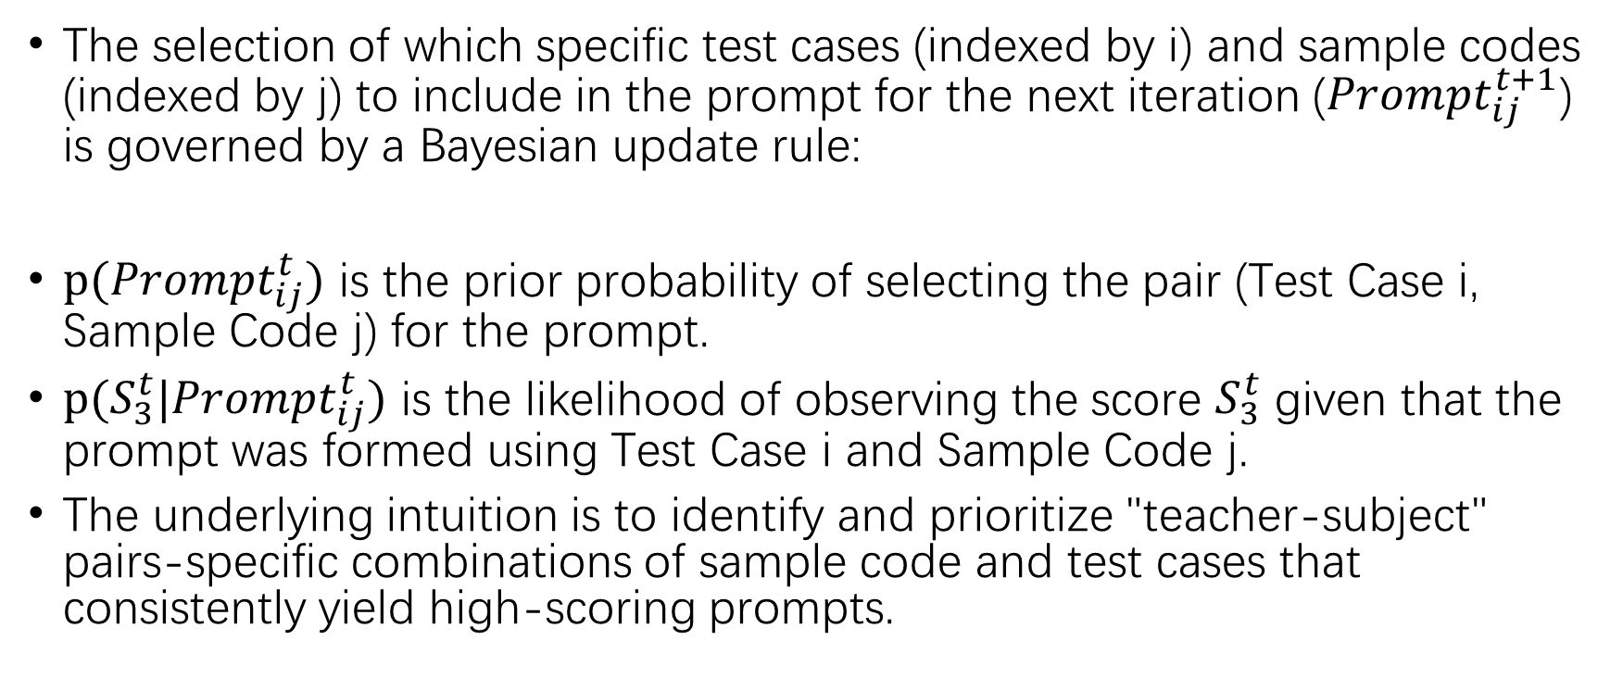
Bayesian prompt updates
The selection of which specific test cases (indexed by i) and sample codes (indexed by j) to include in the prompt for the next iteration (${Prompt}_{ij}^{t+1}$) is governed by a Bayesian update rule:
$p({Prompt}_{ij}^{t})$ is the prior probability of selecting the pair (Test Case i, Sample Code j) for the prompt.
$p(S_{3}^{t}|{Prompt}_{ij}^{t})$ is the likelihood of observing the score $S_{3}^{t}$ given that the prompt was formed using Test Case i and Sample Code j.
The underlying intuition is to identify and prioritize "teacher-subject" pairs-specific combinations of sample code and test cases that consistently yield high-scoring prompts.

Slide 12
Experimental setup
Benchmarks: For general code generation: we use HumanEval,
HumanEval-ET, MBPP, MBPP-ET, APPS.For AI for Science tasks: SciCode,
ScienceAgentBench
Base Models: model-agnostic
Compared Methods: Few-Shot prompting, Chain-of-Thought (CoT), other prominent agent-based systems
Evaluation Metrics: pass@k
Parameter Setting: The number of initial test cases was set to 15. The number of distinct code snippets generated in each round was 20. The number of codes chosen by acquisition function for further evaluation was set to 5.

Slide 13
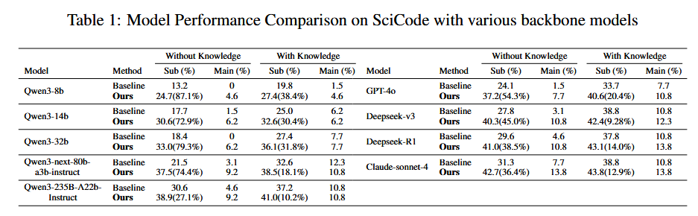
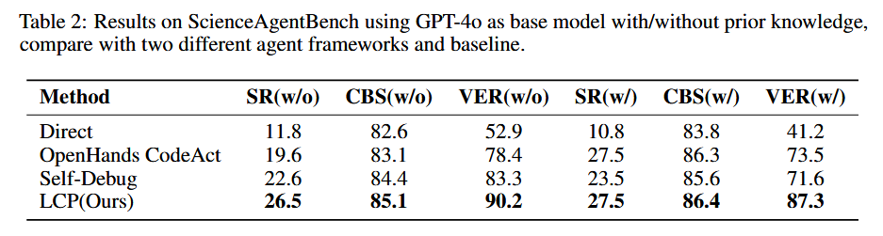
Results
1
Valid Execution Rate (VER), Success Rate (SR), Code-Based Score (CBS)

Slide 14
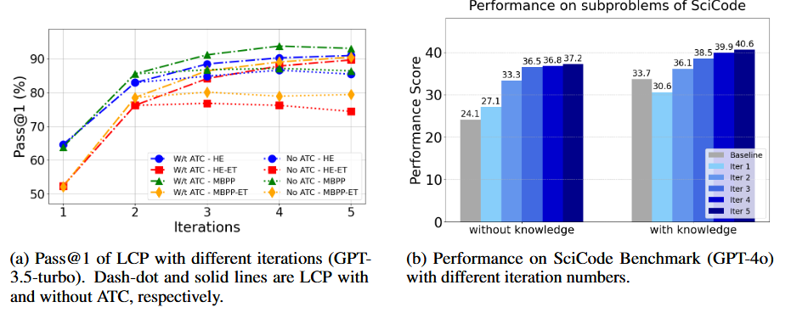
Results
Adversarial Test Cases (ATC)

Slide 15
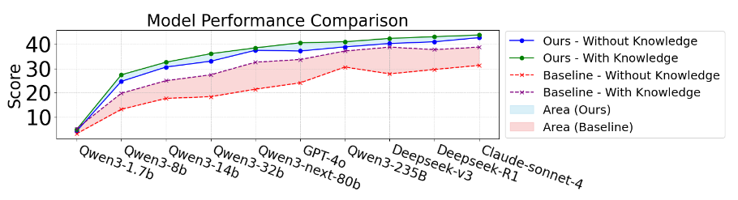
Results

Slide 16
Thank you for listening!

