Slide 1
SE-Agent: Self-Evolution Trajectory Optimization in Multi-Step Reasoning with LLM-Based Agents
Yifu Guo, Jiaye Lin, Huacan Wang, Yuzhen Han, Sen Hu, Ziyi Ni, Licheng Wang, Mingguang Chen
NeurIPS 2025

Slide 2
Background
LLMs have demonstrated remarkable capabilities in various domains. When equipped with external tools and environmental interaction capabilities, these models evolve into autonomous agents that can tackle increasingly complex real-world tasks.
These interaction processes naturally form trajectories. These trajectories contain rich signals about problem-solving strategies. Each trajectory is a full attempt at solving a problem.
Current agents often under-exploit these trajectories. Prevailing methods can effectively balance exploration and exploitation, but they ignore the interdependence among various trajectories and lack the diversity of search spaces.

Slide 3
Challenges
Methods like Monte Carlo Tree Search (MCTS) balance exploration/exploitation but treat each trajectory in isolation. They fail to exploit the relationships among different reasoning paths.
Even with diverse sampling (varying prompts or temperature), agents tend to converge on homogeneous trajectories that differ only superficially. High-probability solution patterns dominate, limiting exploration.
This leads to redundant reasoning and suboptimal outcomes. Many generated trajectories essentially repeat the same strategy, so the agent misses alternative solution approaches.

Slide 4
Contributions
We propose SE-Agent, a novel self-evolution framework for LLM-based agents that enables agents to iteratively optimize their reasoning trajectories by revisiting and enhancing past solution paths.
The approach applies three trajectory-level operations—Revision, Recombination, and Refinement—to expand the search space beyond local optima and leverage insights across different solution paths.
On the SWE-bench Verified benchmark, SE-Agent achieves state-of-the-art results among all open-source agents, representing up to 55% relative improvement.

Slide 5





Preliminaries and Problem Setup
Task-Oriented Reasoning Environment: Formally, we model the reasoning environment as a tuple Ɛ= (T, S, A, P, R).
Reasoning Trajectories: Given a task t ∈ T , a reasoning trajectory τ is defined as an ordered sequence: τ = (s0, a0, s1, a1, . . . , sn).
Objective of Agent: Specifically, given a task t ∈ T , we aim to find a policy π∗ that maximizes the expected reward:

Slide 6
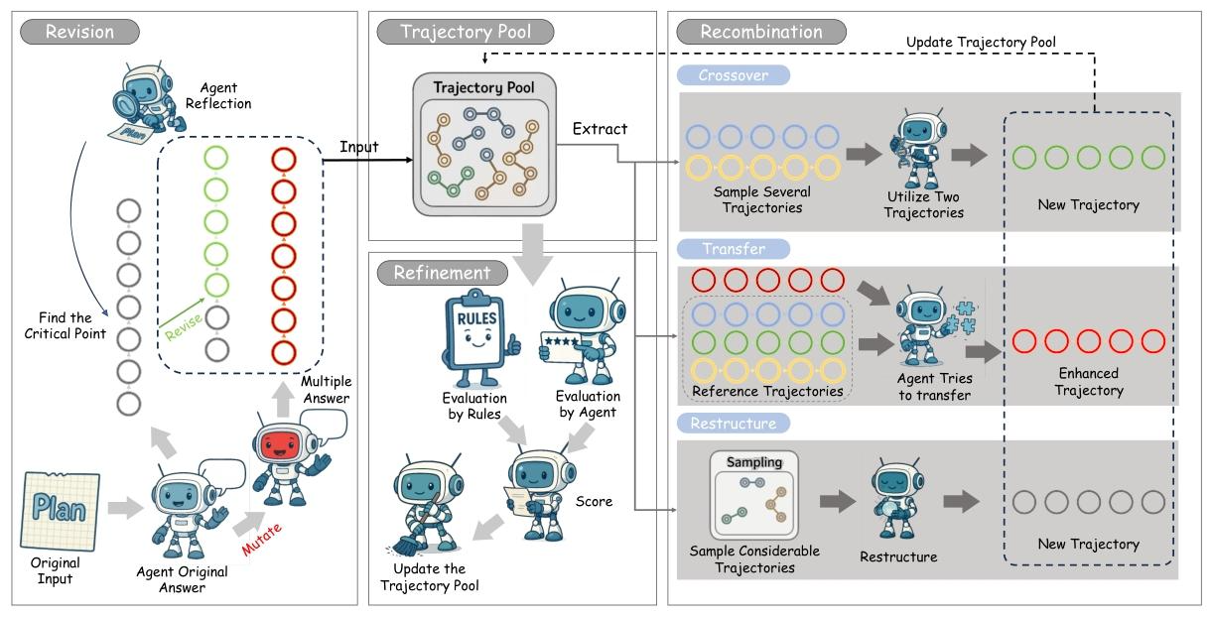
SE-Agent
In this section, we introduce SE-Agent, a novel yet self-evolution paradigm to tackle intricate tasks involving multi-step executions.

Slide 7
Overview of SE-Agent
• Revision: Enhancing individual trajectories through self-reflection and targeted improvement
• Recombination: Creating new trajectories by combining strengths from existing paths
• Refinement: Optimizing trajectories by eliminating redundancies and enhancing efficiency

Slide 8





Revision Operation
Generating Initial Trajectories：To establish a diverse starting point for evolution, we employ two complementary approaches.
Multi-Planning Exploration: We first generate several distinct trajectories for task T by varying planning strategies, prompting techniques, and reasoning approaches.
Mutation-Based Diversification: We further expand the trajectory pool by applying controlled mutations to existing trajectories, producing M additional paths.
Reflection and Revision：

Slide 9

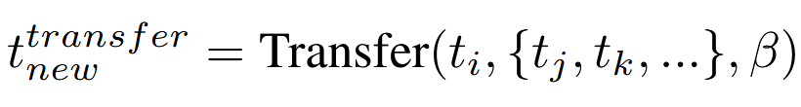

Recombination Operation
We implement three complementary recombination strategies to generate superior trajectories.
Crossover: We identify high-performing trajectory segments across different paths and combine them to create hybrid trajectories that inherit the strengths of multiple parents.
Transfer Learning: Knowledge and strategies from successful trajectories are systematically transferred to enhance less developed paths.
Restructuring: Trajectory restructuring based on collective insights from the trajectory pool.

Slide 10
Refinement Operation
The refinement phase represents the culmination of our self-evolution approach, focusing on trajectory optimization and final selection based on comprehensive evaluation metrics.
Evaluation Function：We design a multidimensional reward function that evaluates trajectory quality.
where AutoEval consists of rule-based structural validation metrics, while ExpertEval incorporates LLM-based evaluation of solution quality.

Slide 11


Refinement Operation
Selection and Convergence
Building upon our comprehensive evaluation function, we implement a strategic selection mechanism that balances trajectory quality and diversity to drive the evolutionary process forward.
This selection process continues iteratively until either a predefined number of evolution cycles is completed or convergence criteria are met

Slide 12
Refinement Operation
Two critical advantages:
(1) exploring substantially larger solution spaces by systematically navigating beyond local optima and
(2) leveraging crosstrajectory inspiration to efficiently enhance performance while minimizing the impact of suboptimal reasoning paths.

Slide 13
Experiments
Experimental Setup
Benchmark: In our experiments, we utilize SWE-bench Verified, a curated subset of the broader SWE-bench, consisting of 500 real-world GitHub issues.
Evaluation Metrics: To evaluate the performance of our proposed SE-Agent, we employ two key metrics, i.e., the resolve rate (Pass@1) and Pass@5.
Baselines: We compare the performance of SE-Agent against two widely recognized baselines: SWE-Agent (CodeAct-based) and SWE-Search (MCTS-based).

Slide 14
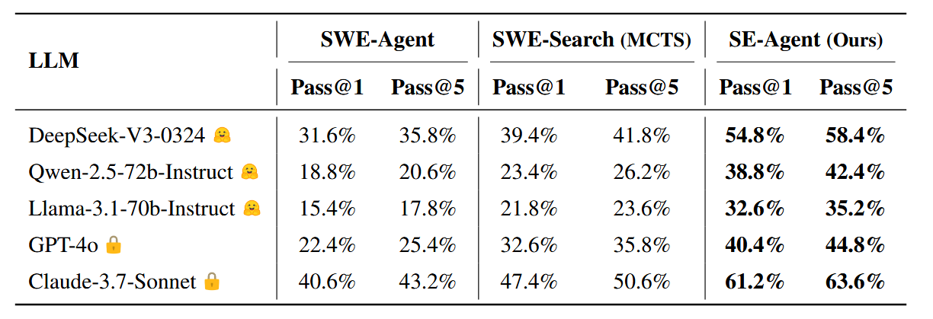
Experiments
Specifically, we evaluate three leading open-source models (DeepSeek-V3-0324, Qwen-2.5-72bInstruct, and Llama-3.1-70b-Instruct) as well as two stateof-the-art closed-source models (GPT-4o and Claude-3.7Sonnet).

Slide 15
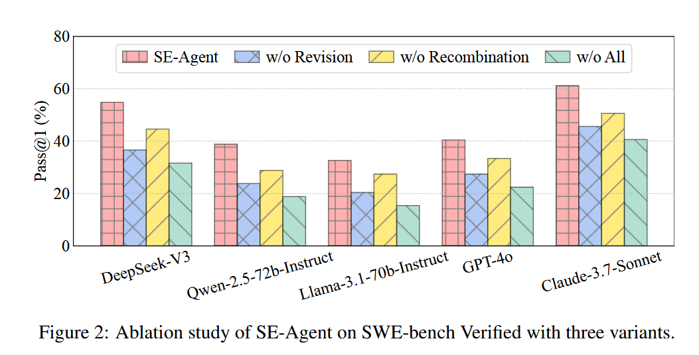
Experiments
Ablation Study
(i) w/o Revision, i.e., the Revision operation is removed, resulting in only multiple homogenized trajectories.
(ii) w/o Recombination, where we do not use the Recombination operation for trajectory interaction.
(iii) w/o All, which does not use any trajectory optimization operation.

Slide 16
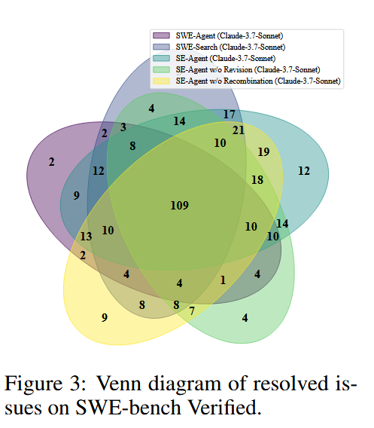
Experiments
We further conduct a detailed analysis of the overlap in successfully resolved issue instances across different frameworks on SWE-bench Verified, using a Venn diagram for visualization.

Slide 17
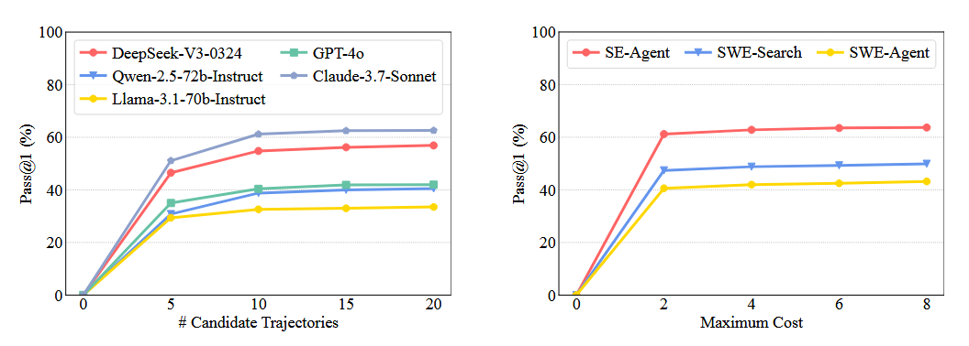
Experiments
We investigate the effect of two key hyperparameters on the performance of SE-Agent: the number of candidate trajectories and the maximum API cost.

Slide 18
Conclusion
In this work, we proposed SE-Agent, a self-evolution framework designed to enhance the multi-step reasoning capabilities of LLM-based agents through iterative trajectory optimization.
Experimental evaluations on SWE-bench Verified demonstrate that SE-Agent consistently outperforms strong baselines across multiple LLMs, demonstrating the effectiveness and robustness of trajectory-level optimization.
Looking forward, we aim to extend the self-evolution paradigm of SE-Agent to a wider spectrum of path-search problems, including iterative search-based reasoning, reinforcement learning policy discovery, and embodied intelligence.

