Slide 1
GFM-RAG: Graph Foundation Model for Retrieval Augmented Generation
Linhao Luo, Zicheng Zhao, Gholamreza Haffari, Chen Gong, Dinh Phung, Shirui Pan Monash University, Nanjing University of Science and Technology,Shanghai Jiao Tong University, Griffith University,
NeurIPS
11 Dec 2025

Slide 2
Outline
Related work & Limitations
Traditional RAG (Retrieval-Augmented Generation)
Representative: Dense Retrieval (e.g., Contriever), Multi-step RAG (e.g., IRCOT)
Method: Retrieves documents based on vector similarity or iterative LLM reasoning.
Limitation:
Lack of Structure: Struggles to capture complex, multi-hop relationships between documents.
High Cost: Multi-step reasoning is computationally expensive.
Graph-Enhanced RAG (GraphRAG)
Representative: LightRAG, HippoRAG, G-retriever
Method: Uses Knowledge Graphs (KGs) or GNNs to model explicit relationships for retrieval.
Limitation:
Noise Sensitivity: Performance suffers from noisy or incomplete graph structures.
Poor Generalizability: GNN models usually require training from scratch on specific datasets.

Slide 3
Outline
Related Work & Limitations
Graph Foundation Models (GFM)
Representative: ULTRA, OpenGraph
Method: Pre-trained large-scale models that generalize across different graphs.
Limitation:
Task Mismatch: Primarily designed for link prediction/classification, not optimized for LLM reasoning.

Slide 4
Outline
Contribution
We introduce a graph foundation model for retrieval augmented generation (GFM-RAG), powered by a novel query-dependent GNN to enable efficient multi-hop retrieval within a single step.
We train a large-scale model with 8M parameters, marking the first graph foundation model (GFM) that can be applied directly to various unseen datasets for retrieval augmented generation.
We evaluate GFM-RAG on three multi-hop QA datasets and seven domain-specific RAG datasets, achieving state-of-the-art performance across all, demonstrating its effectiveness, efficiency, generalizability, and potential as a foundational model for further enhancement.

Slide 5
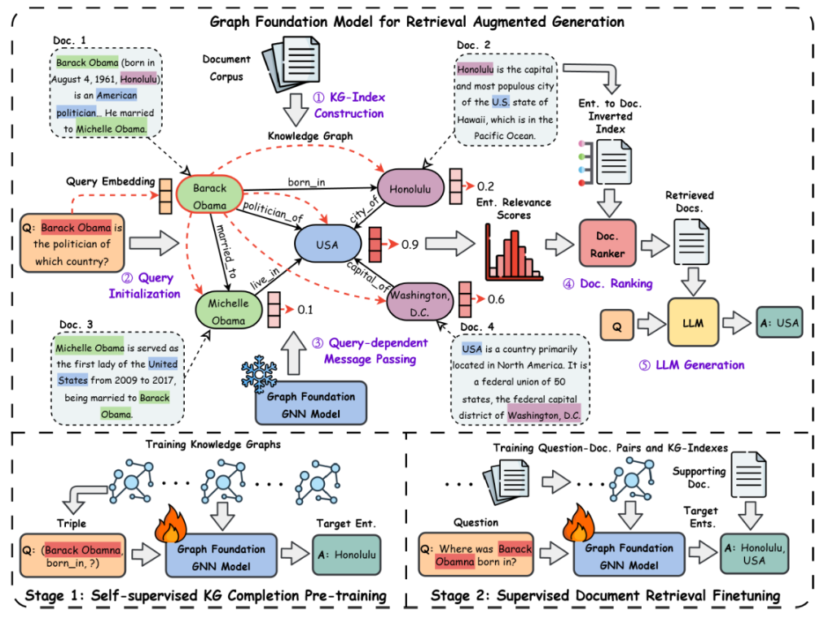
Outline
Proposed Method: GFM-RAG
Overall Framework:
Consists of three stages: KG-Index Construction, GFM Retrieval, and Answer Generation.
Pipeline:
Documents → Knowledge Graph → GFM Reasoning → Ranked Documents → LLM Answer.

Slide 6
Outline
Proposed Method: GFM-RAG
KG-Index Construction:
Extraction: Uses OpenIE (via LLM) to extract entities and relations from documents,build inverted indexes for entities and documents.
Entity Resolution: Merges semantically similar entities (e.g., "USA" and "United States") using dense embeddings to improve connectivity.
Result: Creates a structured index bridging unstructured documents, enabling global context access.

Slide 7
Outline
Proposed Method: GFM-RAG
Query-dependent GNN:
Initialization: The query is embedded and used to initialize specific "anchor nodes" in the graph. Other nodes start as zero.
Message Passing: Information propagates from query nodes to neighbors based on relation semantics (e.g., "born_in" implies location).
Mechanism: Performs Multi-hop Reasoning in a single forward pass, dynamically adjusting attention based on the user's specific question.

Slide 8
Outline
Proposed Method: GFM-RAG
Retrieval & Ranking:
Output: Generates relevance scores for all entities in the graph.
Doc Selection: Maps top-scored entities back to documents via the Inverted Index to select the Top-K supporting documents.

Slide 9
Outline
Proposed Method: GFM-RAG
Self-supervised KG Completion (Pre-training)
Task: Randomly mask entities in triples (e.g., (Obama, born_in, ?)) and ask the model to predict the missing link.
Goal: Learn general graph reasoning patterns and logical structures from large-scale data (14M triples).
Result: Universal graph understanding capability independent of specific domains.

Slide 10
Outline
Proposed Method: GFM-RAG
Supervised Document Retrieval (Fine-tuning)
Task: Optimize the model to identify target entities (mapped from ground-truth documents) as high-relevance nodes given a natural language question.
Goal: Align the graph reasoning capability with natural language understanding.
Result: A robust retriever that generalizes to unseen datasets (Zero-shot).

Slide 11
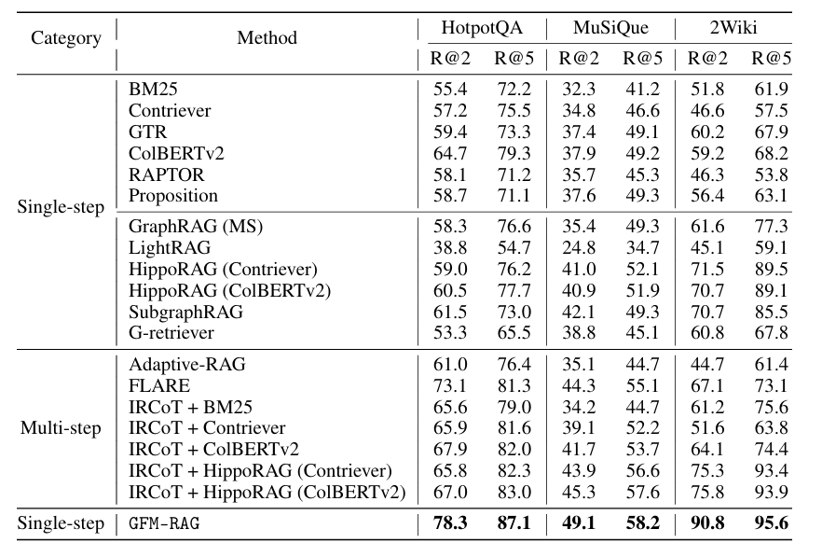
Outline
Retrieval Performance
Table1:Retrieval performance comparison.
State-of-the-Art Performance: GFM-RAG achieves the best performance across all three datasets, outperforming the previous SOTA (IRCoT + HippoRAG) by significant margins (e.g., +16.8% on HotpotQA).
Superiority over Multi-step Methods: Remarkably, the single-step GFM-RAG surpasses computationally expensive multi-step methods like IRCoT, proving its efficient reasoning capability.

Slide 12
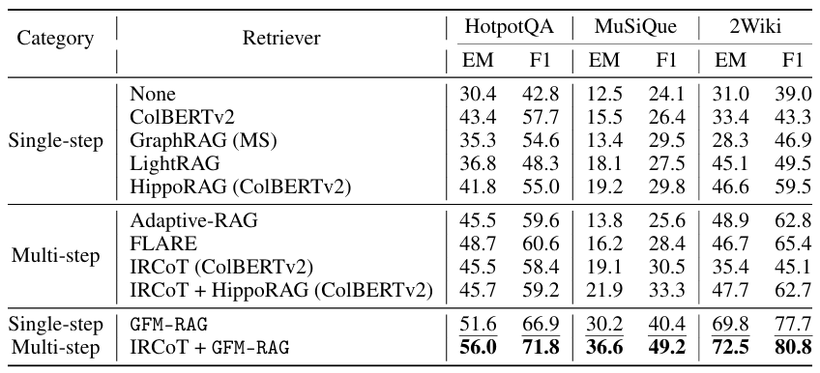
Outline
Question Answering Performance
Table2:Question answering performance comparison.
State-of-the-Art QA Performance: Single-step GFM-RAG outperforms all baselines across three datasets, achieving state-of-the-art results in exact match (EM) and F1 scores.
Excellent Compatibility: Integrating GFM-RAG with the IRCoT framework further boosts performance, demonstrating its effectiveness as a flexible foundation model.

Slide 13
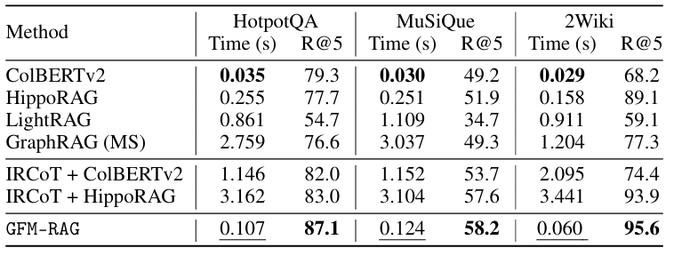
Outline
Efficiency Analysis
Table3:Retrieval efficiency and performance comparison
Reasoning at Speed: GFM-RAG conducts complex multi-hop reasoning within a single step, making it significantly faster (e.g., ~30x faster on HotpotQA) than multi-step methods like IRCoT.
Best Efficiency-Performance Balance: It achieves state-of-the-art retrieval accuracy (highest R@5) with low latency comparable to standard single-step retrievers.

Slide 14
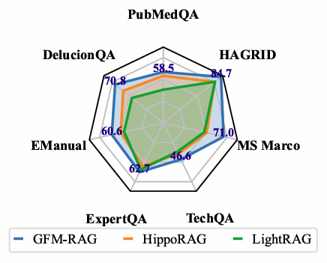
Outline
Model Generalizability
Figure3:Model generalizability comparison.
Strong Zero-shot Generalizability: GFM-RAG achieves state-of-the-art performance across 7 unseen domain datasets (e.g., Medical, Tech) without any fine-tuning, validating its robust transferability.

Slide 15
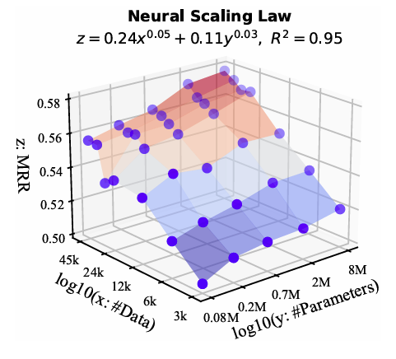
Outline
Model Neural Scaling Law
Figure4:Neural scaling law of GFM-RAG
Predictable Scalability: The model follows neural scaling laws, where performance improves linearly with the power of data size and parameters, indicating significant potential for future scaling.

Slide 16
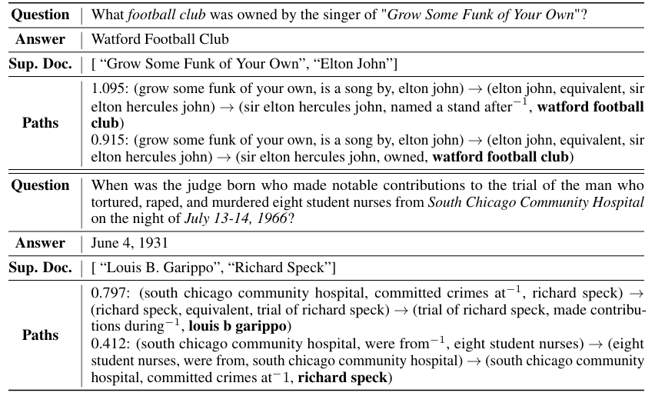
Outline
Path Interpretations
Table 4: Path interpretations of GFM for multi-hop reasoning, where $r^{−1}$ denotes the inverse of original relation.
Explicit Reasoning Paths: It visualizes how GFM-RAG successfully traces multi-hop logical chains (e.g., Song → Singer → Club) to answer complex queries.
Transparent Interpretability: Unlike black-box models, it provides readable reasoning paths with importance scores, explaining why a specific answer was retrieved.

