Slide 1
SYMPHONY: Synergistic Multi-agent Planning with Heterogeneous Language Model Assembly
Wei Zhu Zhiwen Tang∗ Kun Yue
NeurIPS
19 Sept 2025

Slide 2
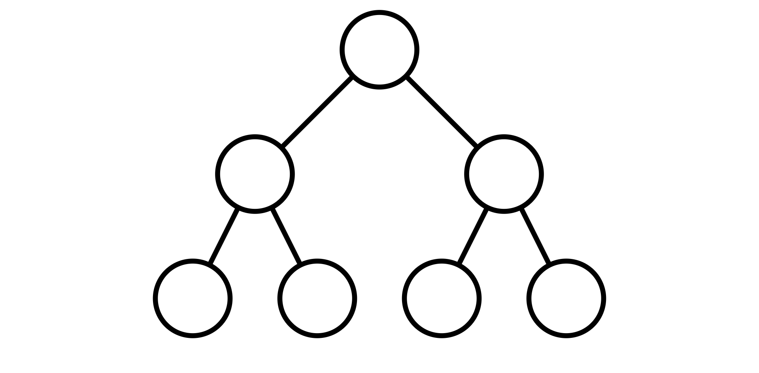
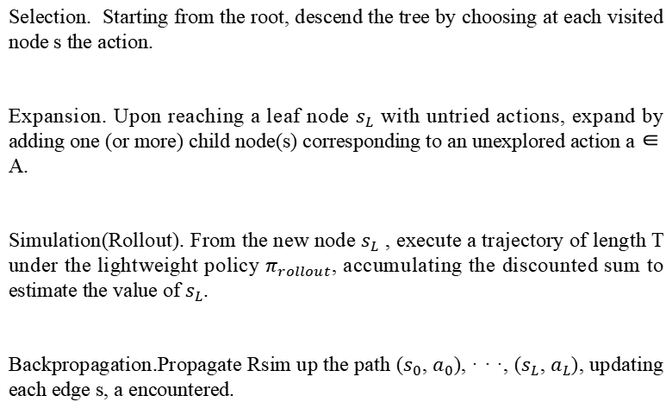
Outline
Monte Carlo Tree Search (MCTS)
Selection. Starting from the root, descend the tree by choosing at each visited node s the action.
Expansion. Upon reaching a leaf node $s_{L}$ with untried actions, expand by adding one (or more) child node(s) corresponding to an unexplored action a ∈ A.
Simulation(Rollout). From the new node $s_{L}$ , execute a trajectory of length T under the lightweight policy $π_{rollout}$, accumulating the discounted sum to estimate the value of $s_{L}$.
Backpropagation.Propagate Rsim up the path ($s_{0}$, $a_{0}$), · · ·, ($s_{L}$, $a_{L}$), updating each edge s, a encountered.

Slide 3
Outline
Research Background
Integration of LLM-based Agents and MCTS: The integration of large language models (LLMs) with planning algorithms, such as Monte Carlo Tree Search (MCTS), has shown promise in enhancing the decision-making processes of autonomous agents for complex tasks.
Limitations of Single-Model Paradigm: Existing methods predominantly adopt a single-model paradigm during MCTS planning, relying on the stochasticity of a single LLM to generate diverse action branches. However, this approach often produces highly similar outputs that reflect the model's dominant reasoning pattern, leading to narrow and redundant search trajectories.

Slide 4
Outline
Current Deficiencies
Susceptibility to Local Optima: When the search tree is populated with highly similar branches, the planner becomes susceptible to local optima, and its ability to discover novel or unexpected solutions is greatly diminished.
Failure in Complex Tasks and High Computational Overhead: In particularly challenging tasks that require compositional reasoning or multi-step tool use, the agent may fail to identify the correct solution path altogether. Even in cases where the solution is eventually found, the process may involve excessive sampling and token consumption, incurring significant computational overhead.

Slide 5
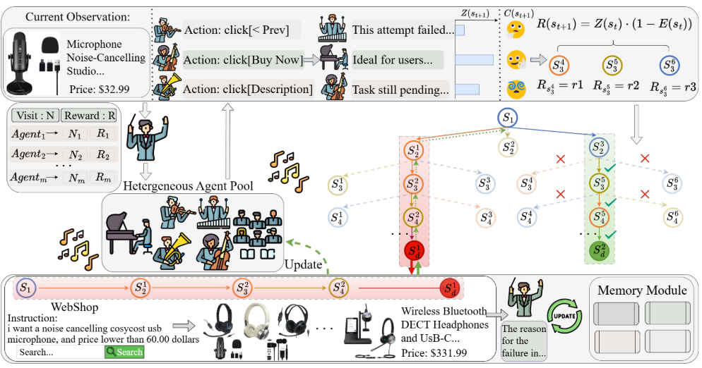
Outline
SYMPHONY System Overview
Pool-wise Memory Sharing：When an exploration path fails, an agent generates a natural language reflection detailing the root cause. This insight is stored in a global memory pool and broadcasted as context (via prompt) to all heterogeneous agents during subsequent planning.

Slide 6
Outline
SYMPHONY System Overview
Heterogeneous Agent Pool:To overcome the homogenous reasoning patterns inherent in single-model paradigms, SYMPHONY maintains a diverse pool of large language models (LLMs) characterized by distinct pre-training backgrounds and reasoning styles. During the tree expansion phase, different models are scheduled to generate candidate actions for the same state.

Slide 7
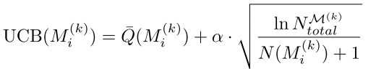
Outline
SYMPHONY System Overview
Agent Scheduling：

Slide 8
Outline
SYMPHONY System Overview

Slide 9
Outline
Experiment Settings
SYMPHONY supports flexible agent composition and is compatible with a range of language models under different computational constraints. We evaluate two deployment configurations: SYMPHONY-S, designed for consumer-grade hardware, and SYMPHONY-L, which leverages large-scale foundation models via cloud-based APIs.
SYMPHONY-S comprises open-source models that can be executed locally, including Qwen2.5-7B-Instruct-1M, Mistral-7B-Instruct-v0.3, and Llama-3.1-8B-Instruct. This configuration supports efficient inference with minimal deployment cost. In contrast, SYMPHONY-L comprises high-performance models: GPT-4, Qwen-Max (2024-09-19), and DeepSeek-V3 (2025-03-24) , which operate through API endpoints within inference-as-a-service infrastructures.

Slide 10
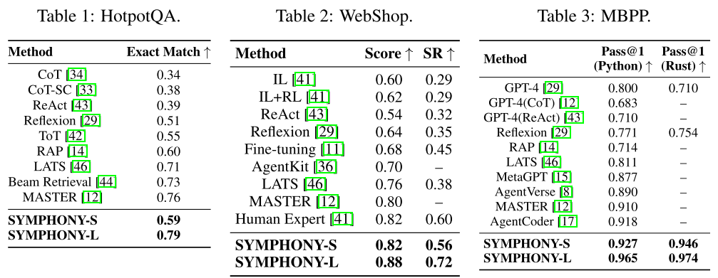
Outline
Experiments
Note: Metrics are normalized to the [0,1] range; A dash (–) marks those not reported in the publication.

Slide 11
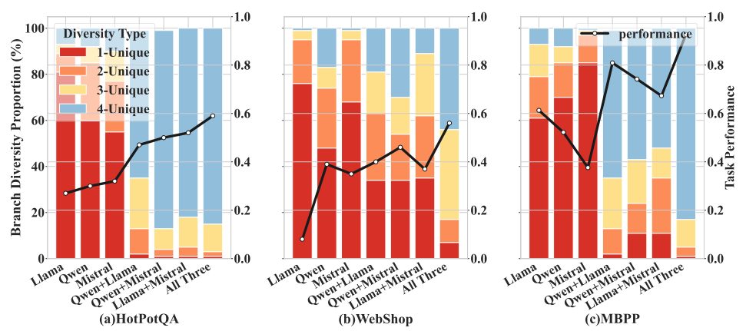
Outline
Diversity Analysis
Figure 2: Branch Diversity vs. Task Performance. Bars and left y-axis shows the branch diversity, while lineplot and right y-axis shows the task performance.

Slide 12
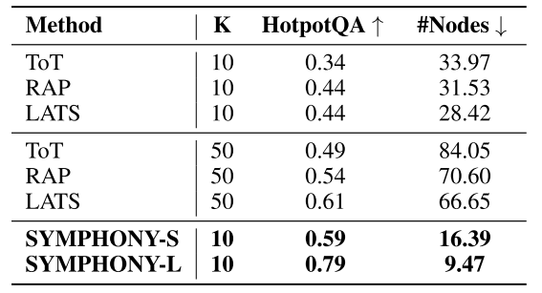
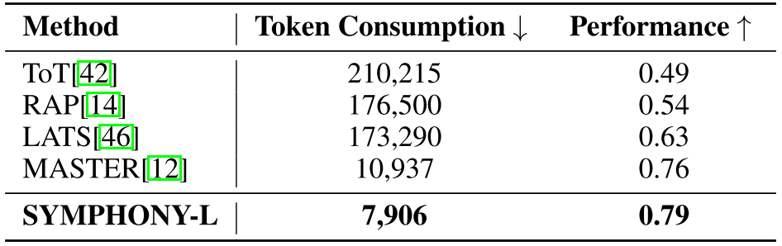
Outline
Efficiency and Cost
Table 4: Comparison of the search tree size on HotpotQA.
Table 6: Comparison of average token consumption per question and task performance on HotpotQA. SYMPHONY achieves the highest task accuracy while incurring the lowest token cost, effectively mitigating the computational overhead of tree-structured reasoning.

