Slide 1

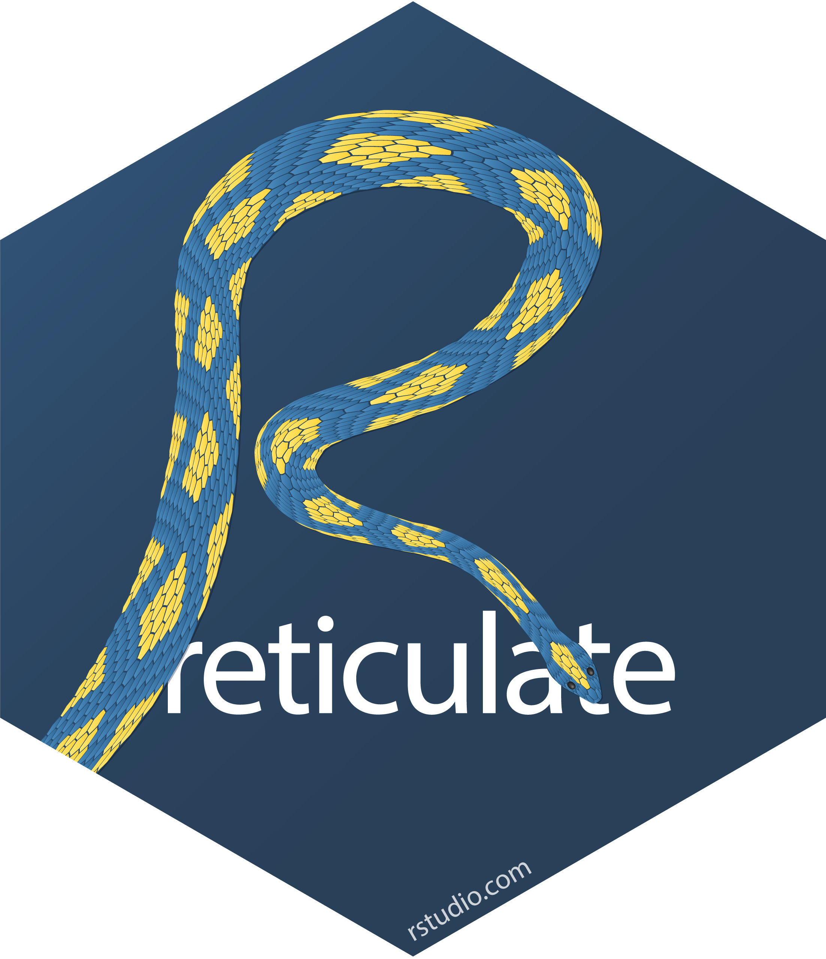
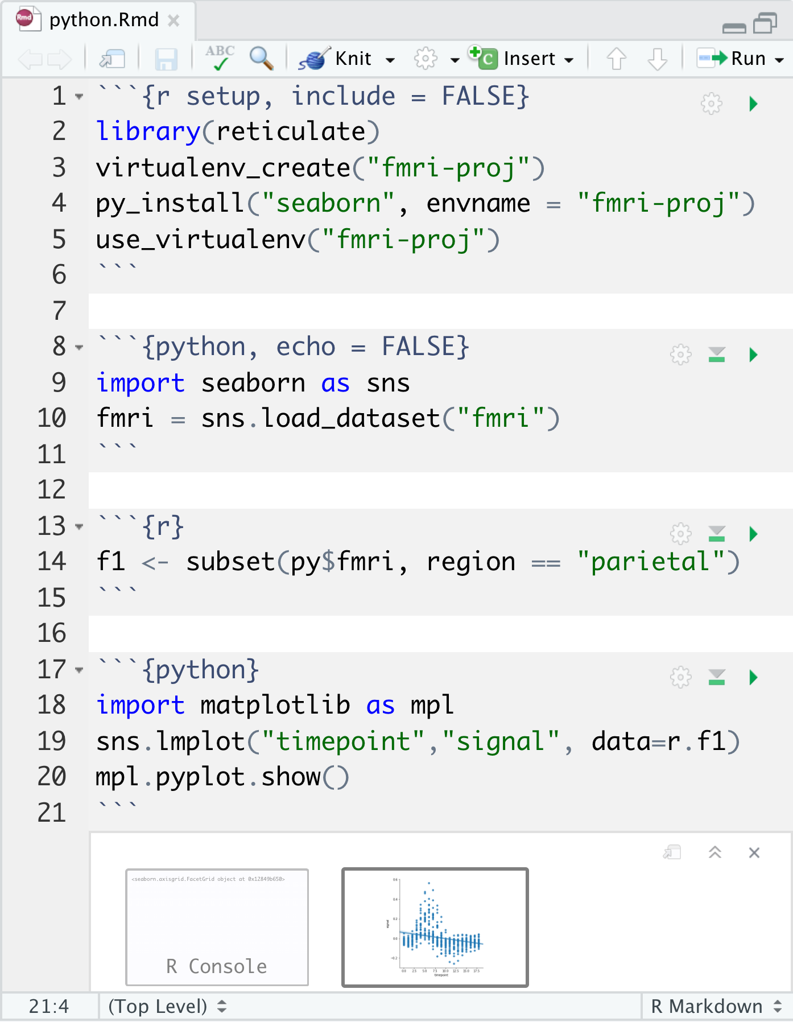
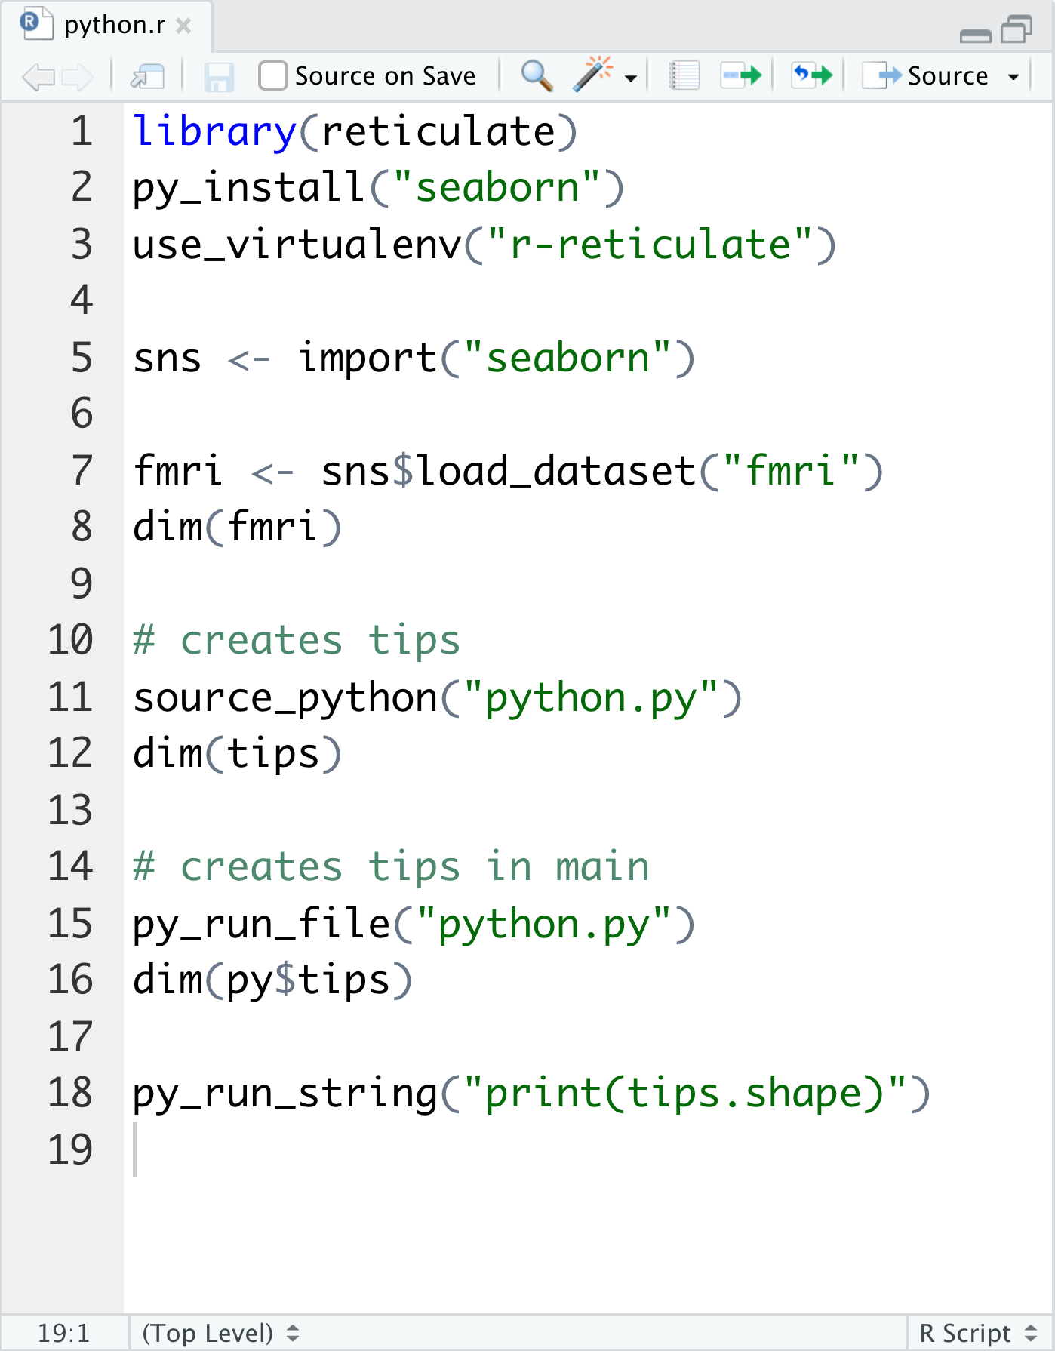

Use Python with R with reticulate : : CHEAT SHEET
The reticulate package lets you use Python and R together seamlessly in R code, in R Markdown documents, and in the RStudio IDE.
Python in R Markdown
Python in R
(Optional) Build Python env to use.
Add knitr::knit_engines$set(python = reticulate::eng_python) to the setup chunk to set up the reticulate Python engine (not required for knitr >= 1.18).
Suggest the Python environment
to use, in your setup chunk.
Begin Python chunks with ```{python}. Chunk options like echo, include, etc. all work as expected.
Use the py object to access objects created in Python chunks from R chunks.
Python chunks all execute within a
single Python session so you have access
to all objects created in previous chunks.
Use the r object to access objects created in R chunks from Python chunks.
Output displays below chunk,
including matplotlib plots.
Call Python from R code in three ways:
IMPORT PYTHON MODULES
Use import() to import any Python module. Access the attributes of a module with $.
import(module, as = NULL, convert = TRUE, delay_load = FALSE) Import a Python module. If convert = TRUE, Python objects are converted to
their equivalent R types. Also import_from_path. import("pandas")
import_main(convert = TRUE)
Import the main module, where Python executes code by default. import_main()
import_builtins(convert = TRUE) Import Python's built-in functions. import_builtins()
SOURCE PYTHON FILES
Use source_python() to source a Python script and make the Python functions and objects it creates available in the calling R environment.
source_python(file, envir = parent.frame(), convert = TRUE) Run a Python script, assigning objects to a specified R environment. source_python("file.py")
Object Conversion
Tip: To index Python objects begin at 0, use integers, e.g. 0L
Helpers
Reticulate provides automatic built-in conversion between Python and R for many Python types.
dict(..., convert = FALSE) Create a Python dictionary object. Also py_dict to make a dictionary that uses Python objects as keys. dict(foo = "bar", index = 42L)
np_array(data, dtype = NULL, order = "C") Create NumPy arrays. np_array(c(1:8), dtype = "float16")
array_reshape(x, dim, order = c("C", "F")) Reshape a Python array. x <- 1:4; array_reshape(x, c(2, 2))
py_func(object) Wrap an R function in a Python function with the same signature. py_func(xor)
py_main_thread_func(object) Create a function that will always be called on the main thread.
iterate(..., convert = FALSE) Apply an R function to each value of a Python iterator or return the values as an R vector, draining the iterator as you go. Also iter_next and as_iterator. iterate(iter, print)
py_iterator(fn, completed = NULL) Create a Python iterator from an R function. seq_gen <- function(x){n <- x; function() {n <<- n + 1; n}};py_iterator(seq_gen(9))
py_capture_output(expr, type = c("stdout", "stderr")) Capture and return Python output. Also py_suppress_warnings. py_capture_output("x")
py_get_attr(x, name, silent = FALSE) Get an attribute of a Python object. Also py_set_attr, py_has_attr, and py_list_attributes. py_get_attr(x)
py_help(object) Open the documentation
page for a Python object. py_help(sns)
py_last_error() Get the last Python
error encountered. Also py_clear_last_error
to clear the last error. py_last_error()
py_save_object(object, filename, pickle = "pickle") Save and load Python objects with pickle. Also py_load_object. py_save_object(x, "x.pickle")
with(data, expr, as = NULL, ...) Evaluate an expression within a Python context manager.
py <- import_builtins(); with(py$open("output.txt", "w") %as% file, { file$write("Hello, there!")})
RUN PYTHON CODE
R | Python
Single-element vector | Scalar
Multi-element vector | List
List of multiple types | Tuple
Named list | Dict
Matrix/Array | NumPy ndarray
Data Frame | Pandas DataFrame
Function | Python function
NULL, TRUE, FALSE | None, True, False
Execute Python code into the main Python module with py_run_file() or py_run_string().
py_run_string(code, local = FALSE, convert = TRUE) Run Python code (passed as a string) in the main
module. py_run_string("x = 10"); py$x
py_run_file(file, local = FALSE, convert = TRUE) Run Python file in the main module. py_run_file("script.py")
py_eval(code, convert = TRUE) Run
a Python expression, return the result.
Also py_call. py_eval("1 + 1")
Access the results, and anything else in Python's main module, with py.
py An R object that contains
the Python main module and
the results stored there. py$x
Or, if you like, you can convert manually with
py_to_r(x) Convert a Python object to an R object. Also r_to_py. py_to_r(x)
tuple(..., convert = FALSE) Create a Python tuple. tuple("a", "b", "c")
RStudio® is a trademark of RStudio, Inc. • CC BY SA RStudio • info@rstudio.com • 844-448-1212 • rstudio.com • Learn more at rstudio.github.io/reticulate/ • reticulate 1.12.0 • Updated: 2019-04

Slide 2
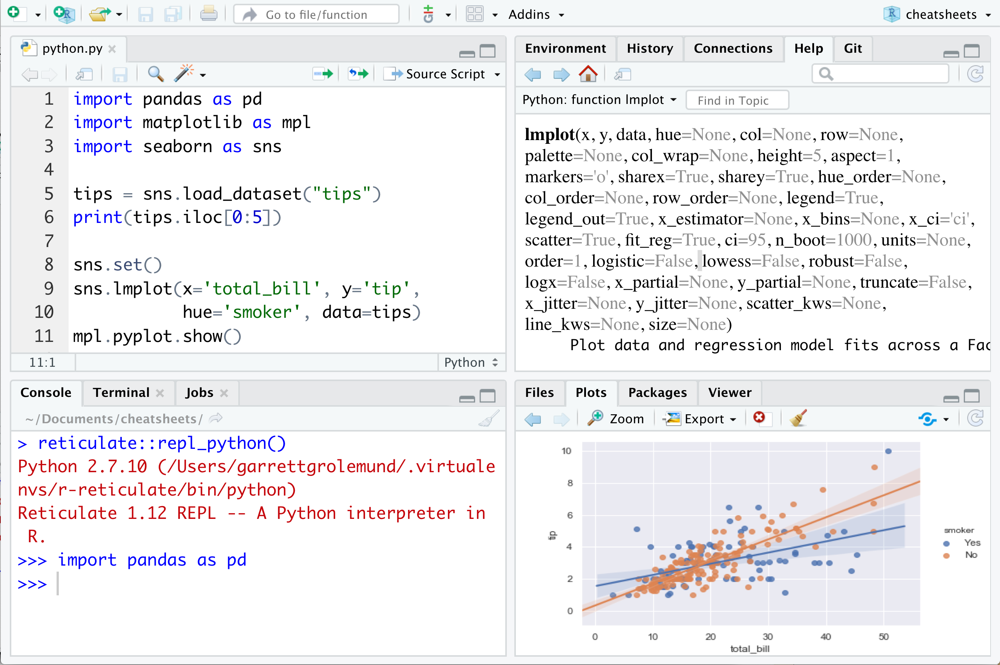

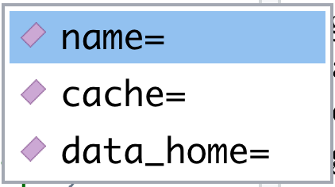
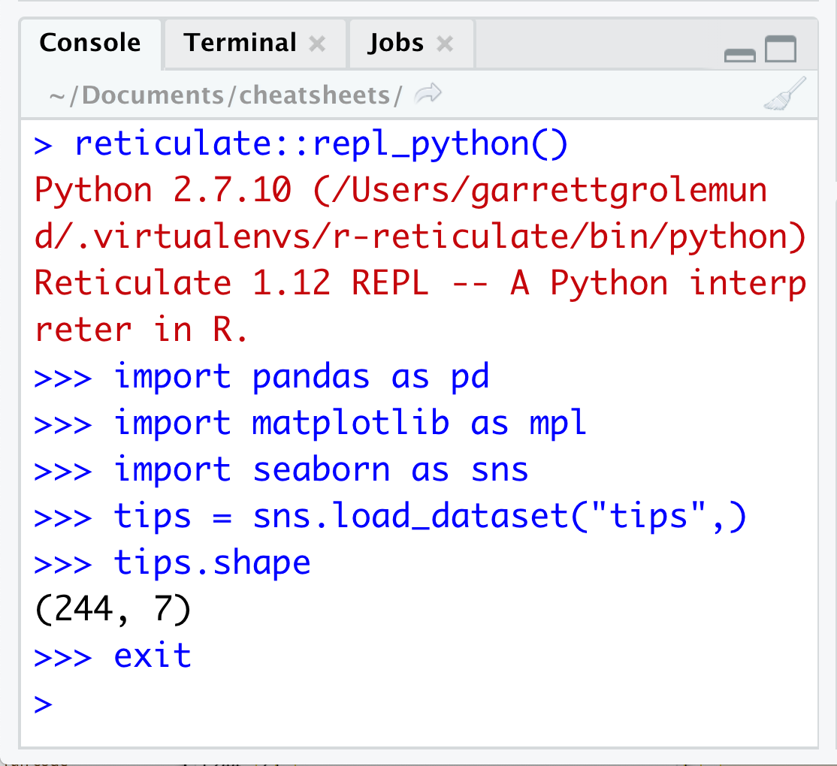
Python in the IDE
Requires reticulate plus RStudio v1.2 or higher.
Configure Python
Syntax highlighting for Python scripts and chunks
Tab completion for Python functions and objects (and Python modules imported in R scripts)
Source Python scripts.
Execute Python code line by line with Cmd + Enter (Ctrl + Enter)
Press F1 over a Python symbol to display the help topic for that symbol.
matplotlib plots display in plots pane.
Reticulate binds to a local instance of Python when you first call import() directly or implicitly from an R session. To control the process, find or build your desired Python instance. Then suggest your instance to reticulate. Restart R to unbind.
Find Python
py_discover_config() Return all detected versions of Python. Use py_config to check which version has been loaded. py_config()
py_available(initialize = FALSE) Check if
Python is available on your system. Also py_module_available, py_numpy_module. py_available()
virtualenv_list() List all available virtualenvs.
Also virtualenv_root(). virtualenv_list()
conda_list(conda = "auto") List all
available conda envs. Also conda_binary() and conda_version(). conda_list()
Create a Python env
Suggest an env to use
virtualenv_create(envname) Create a new virtualenv. virtualenv_create("r-pandas")
conda_create(envname, packages = NULL, conda = "auto") Create a new Conda env. conda_create("r-pandas", packages = "pandas")
To choose an instance of Python to bind to, reticulate scans the instances on your computer in the following order, stopping at the first instance that contains the module called by import().
The instance referenced by the environment
variable RETICULATE_PYTHON (if specified).
Tip: set in .Renviron file.
Sys.setenv(RETICULATE_PYTHON = PATH)
Set default Python binary. Persists across sessions! Undo with Sys.unsetenv. Sys.setenv(RETICULATE_PYTHON =
"/usr/local/bin/python")
The instances referenced by use_ functions
if called before import(). Will fail silently if called after import unless required = TRUE.
use_python(python, required = FALSE)
Suggest a Python binary to use by path.
use_python("/usr/local/bin/python")
use_virtualenv(virtualenv = NULL, required = FALSE) Suggest a Python
virtualenv. use_virtualenv("~/myenv")
use_condaenv(condaenv = NULL,
conda = "auto", required = FALSE)
Suggest a Conda env to use. use_condaenv(condaenv = "r-nlp",
conda = "/opt/anaconda3/bin/conda")
Within virtualenvs and conda envs that carry
the same name as the imported module.
e.g. ~/anaconda/envs/nltk for import("nltk")
At the location of the Python binary discovered on the system PATH (i.e. Sys.which("python"))
At customary locations for Python, e.g./usr/local/bin/python, /opt/local/bin/python...
Install Packages
Install Python packages with R (below) or the shell:
pip install SciPy
conda install SciPy
A Python REPL opens in the console when you run Python code with a keyboard shortcut. Type exit to close.
py_install(packages, envname = "r-reticulate", method = c("auto", "virtualenv", "conda"), conda = "auto", ...) Installs Python packages into a Python env named
"r-reticulate". py_install("pandas")
virtualenv_install(envname, packages, ignore_installed = FALSE) Install a package within a virtualenv. virtualenv_install(
"r-pandas", packages = "pandas")
virtualenv_remove(envname, packages = NULL, confirm = interactive()) Remove individual packages or an entire virtualenv. virtualenv_remove("r-pandas", packages = "pandas")
conda_install(envname, packages, forge = TRUE, pip = FALSE, pip_ignore_installed = TRUE, conda = "auto") Install a package within a Conda env. conda_install(
"r-pandas", packages = "plotly")
conda_remove(envname, packages = NULL, conda = "auto") Remove individual packages or an entire Conda env. conda_remove(
"r-pandas", packages = "plotly")
Python REPL
A REPL (Read, Eval, Print Loop) is a command line where you can run Python code and view the results.
Open in the console with repl_python(), or by running code in a Python script with Cmd + Enter (Ctrl + Enter) .
repl_python(module = NULL, quiet = getOption("reticulate.repl.quiet", default = FALSE)) Launch a Python REPL. Run exit to close. repl_python()
Type commands at >>> prompt
Press Enter to run code
Type exit to close and return to R console
RStudio® is a trademark of RStudio, Inc. • CC BY SA RStudio • info@rstudio.com • 844-448-1212 • rstudio.com • Learn more at rstudio.github.io/reticulate/ • reticulate 1.12.0 • Updated: 2019-04

