Slide 1
Materials and methods
GWAS datasets
AD:7,055,881 SNPs
T2D:2,473,441 SNPs
Data preparation
get common SNPs:2,310,500 SNPs
SNP删减： 利用linkage disequilibrium (LD) measure （R^2>0.2,window=5） 用plink按照参数得到262,661 SNPs，
数据集的修建使用the HapMap 3 CEU reference genotypes

Slide 2
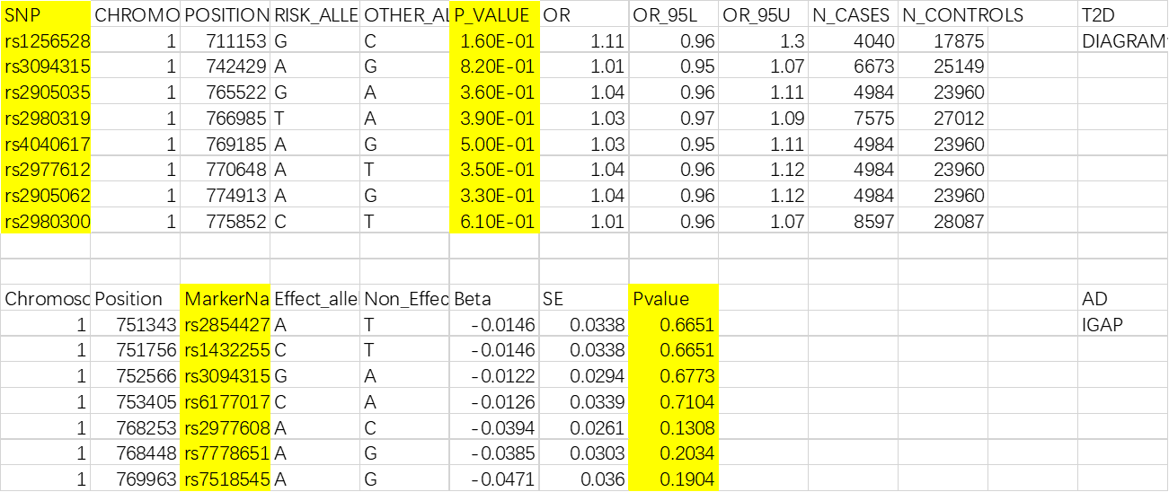
Get common SNPs

