Slide 1
Sequence to Sequence Learning with Neural Networks
Ilya Sutskever,Oriol Vinyals, Quoc V. Le. Sequence to Sequence Learning with Neural Networks
https://tensorflowkorea.gitbooks.io/tensorflow-kr/content/g3doc/tutorials/seq2seq/

Slide 2
Abstract
In this paper, we present a general end-to-end approach to sequence learning that makes minimal assumptions on the sequence structure.
Our method uses a multilayered LSTM to map the input sequence to a vector of a fixed dimensionality, and then another deep LSTM to decode the target sequence from the vector.
Our main result is that on an English to French translation task from the WMT-14 dataset, the translations produced by the LSTM achieve a BLEU score of 34.8 on the entire test set, where the LSTM’s BLEU score was penalized on out-of-vocabulary words.
Notes:
End-to-end approach : input과 output만을 이용한 접근법이라고 이해함.
이 논문에서는 sequence structure에 대한 최소한의 가정을 가지고 sequence learning을 하는 end-to-end 일반적 접근 방법을 ㅈ세히가ㅗ 있다.
제시하는 방법으로는 multilayered lstm을 input sequece에 맵핑하고 다른 lstm을 타겟 시퀀스에 맵하는 형식으로 전개됨.

Slide 3
Introduction
Deep Neural Networks (DNNs) are extremely powerful machine learning models that achieve excellent performance on difficult problems such as speech recognition and visual object recognition.
Despite their power, DNNs can only be applied to problems whose inputs and targets can be sensibly encoded with vectors of fixed dimensionality.
It is a significant limitation, since many important problems are best expressed with sequences whose lengths are not known a-priori
It is therefore clear that a domain-independent method that learns to map sequences to sequences would be useful.
In this paper, we show that a straightforward application of the LSTM architecture can solve general sequence to sequence problems.
Notes:
딥뉴럴넷은 매우 강력하지만 고정된 차원으로 인코딩할수 있는 문제에만 적용이 가능하다.
다양한 문제들이 sequencial 한 문제들이기 때문에 큰 한계점이다.
이 논문에서는 이러느 sequence to sequence problem을 해결할 수 있는 LSTM architecture 에 대해 소개한다.
사람들은 생각을 매초 처음부터 다시 시작하지 않는다. 딥뉴럴 네트워크는 강력하지만 고정된 차원에서 인코딩 가능한 문제에ㅁ나 적용이 가능하기 때문에 sequencial한 문제를 풀기 적합하지 않다.

Slide 4
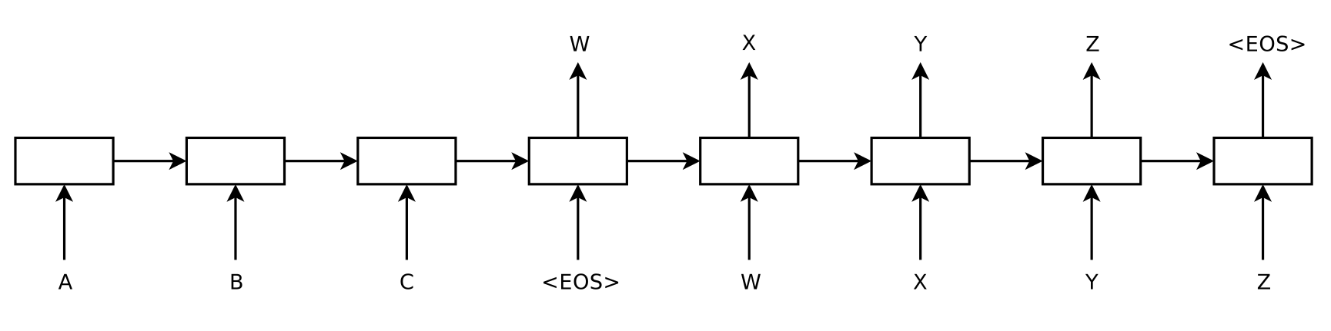
Introduction
The idea is to use one LSTM to read the input sequence, one timestep at a time, to obtain large fixed-dimensional vector representation, and then to use another LSTM to extract the output sequence from that vector.
The second LSTM is essentially a recurrent neural network language model except that it is conditioned on the input sequence.
The LSTM’s ability to successfully learn on data with long range temporal dependencies makes it a natural choice for this application due to the considerable time lag between the inputs and their corresponding outputs
Notes:
메인 아이디어는 한 lstm이 input sequenceㄹ르 한 타임스텝마다 읽어들이고 다른 lstm이 output sequence를 출력시킨다는 거다
두번째 lstm은 rnn이지만 input sequence를 전제로 한다

Slide 5
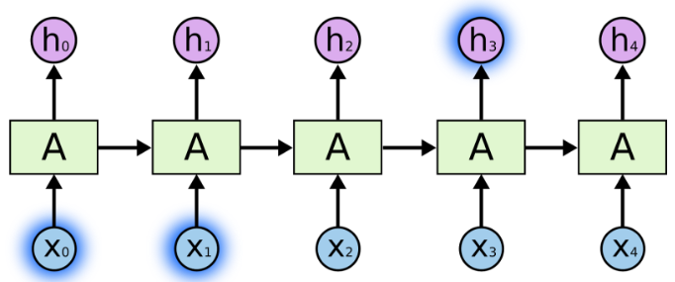
The Problem of Long-Term Dependencies
RNNs의 장점으로는 이전 정보를 현재 작업으로 연결할 수 있다는 점이다. 예를들어 비디오를 예로든다면 이전 프레임이 현재 프레임을 이해하는데 영향을 미친다는 의미이다. 예를들어 'the clouds are in the sky'라는 문장에서 sky를 예측하고 있다면 the clouds are in the 까지만 보더라도 마지막 단어를 쉽게 예측할 수 있다.

Slide 6
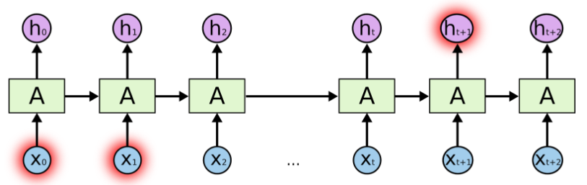
The Problem of Long-Term Dependencies
'I grew up in France. … I can speak French fluently'라는 문장에서 'French'라는 단어를 예측하기 위해서 훨씬 앞쪽에 있는 'France'라는 문맥이 필요합니다. 이 경우 단어와 단어 사이의 거리가 굉장히 멀기 때문에 RNNs은 이 정보들을 연결 할 수 없게 되는데 이 문제를 long-term dependencies problem이라고 한다.
http://www.whydsp.org/280

Slide 7
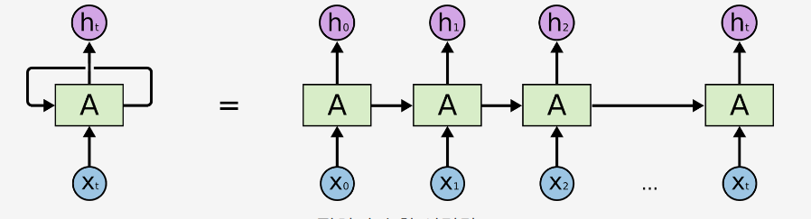

The model
The Recurrent Neural Network (RNN) is a natural generalization of feedforward neural networks to sequences.
Given a sequence of inputs (x 1 , . . . , x T ), a standard RNN computes a sequence of outputs (y 1 , . . . , y T ) by iterating the following equation:
The RNN can easily map sequences to sequences whenever the alignment between the inputs the outputs is known ahead of time.
However, it is not clear how to apply an RNN to problems whose input and the output sequences have different lengths with complicated and non-monotonic relationships.
Notes:
기존 RNN 모델은 사전에 출력을 알 수 있는 입력간의 정렬이 있을 경우 시퀀스와 시퀀스를 쉽게 맵핑할 수 있지만
복잡한 관계로 인해 입력 및 출력 시퀀스 길이가 다른 문제에서는 적용하기 어렵다는 단점이 있습니다.

Slide 8
The model
A simple strategy for general sequence learning is to map the input sequence to a fixed-sized vector using one RNN, and then to map the vector to the target sequence with another RNN.
While it could work in principle since the RNN is provided with all the relevant information, it would be difficult to train the RNNs due to the resulting long term dependencies.
However, the LSTM is known to learn problems with long range temporal dependencies, so an LSTM may succeed in this setting .
The goal of the LSTM is to estimate the conditional probability p(y1,…,yT'|x1,…,xT) where (x1,…,xT) is an input sequence and y1,…,yT' is its corresponding output sequence whose length T' may differ from T.
Notes:
이런 문제점을 단순히 input sequence를 하나의 RNN에 매핑하고 target sequence를 또다른 RNN에 매핑하는 형식으로 해결할 수 있다.
기존의 RNN cell의 경우 long term dependencies 으로 인해 훈련이 어렵지만 LSTM을 이용하면 이 세팅으로 훌륭한 결과를 ㄷ초루해낼 수 있다.

Slide 9

The model
The LSTM computes this conditional probability by first obtaining the fixed-dimensional representation v of the input sequence (x1,…,xT) given by the last hidden state of the LSTM, and then computing the probability of y1,…,yT with a standard LSTM-LM formulation whose initial hidden state is set to the representation v of x1,…,xT:
In this equation, each p(yt|v,y1,…,yt-1) distribution is represented with a softmax over all the words in the vocabulary.
Note that we require that each sentence ends with a special end-of-sentence symbol "<EOS>", which enables the model to define a distribution over sequences of all possible lengths.
*LSTM-LM : LSTM-Language Model
Notes:
LSTM은 초기은닉층을 설정할 x들의 집합인 고정된 차원의 v를 구하고 y들의 조건부 확률을 계산한다.

Slide 10
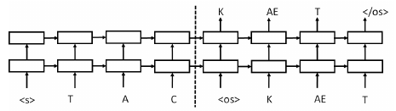
The model
Our actual models differ from the above description in three important ways.
First, we used two different LSTMs: one for the input sequence and another for the output sequence, because doing so increases the number model parameters at negligible computational cost and makes i natural to train the LSTM on multiple language pairs simultaneously.

Slide 11
The model
Second, we found that deep LSTMs significantly outperformed shallow LSTMs, so we chose an LSTM with four layers.
Third, we found I extremely valuable to reverse the order of the words of the input sentence. So for example, instead of mapping the sentence a, b, c to the sentence α, β, γ, the LSTM is asked to map c, b, a to α, β, γ, where α, β, γ is the translation of a, b, c.
This way, a is in close proximity to α, b is fairly close to β, and so on, a fact that makes it easy for SGD to “establish communication” between the input and the output. We found this simple data transformation to greatly boost the performance of the LSTM.

Slide 12
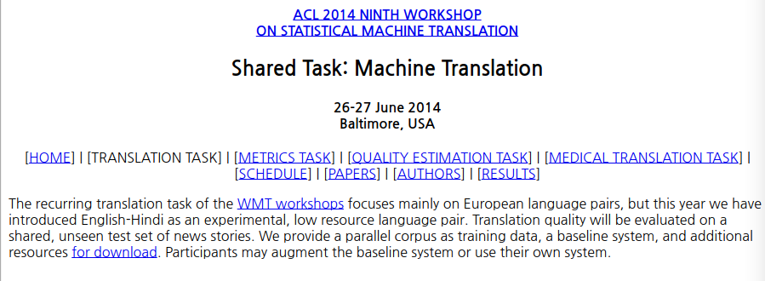
Experiments – Dataset details
As typical neural language models rely on a vector representation for each word, we used a fixed vocabulary for both languages. We used 160,000 of the most frequent words for the source language and 80,000 of the most frequent words for the target language. Every out-of-vocabulary word was replaced with a special “UNK” token.

Slide 13


Experiments – Decoding and Rescoring
The core of our experiments involved training a large deep LSTM on may sentence pairs.
We trained it by maximizing the log probability of a correct translation T given the source sentence S, so the training objective is
Where S is in the training set. Once training is complete, we produce translations by finding the most likely translation according to the LSTM:
We search for the most likely translation using a simple left-to-right beam search decoder which maintains a small number B of partial hypotheses, where a partial hypothesis is a prefix of some translation. At each timestep we extend each partial hypothesis in the beam with every possible word in the vocabulary.
This greatly increases the number of the hypotheses so we discard all but the B most likely hypotheses according to the model's log probability.
As soon as the '<EOS>' symbol is appended to a hypothesis, it is removed from the beam and is added to the set of complete hypotheses

Slide 14

Maximum likelihood Estimation
Maximum Likelihood Estimation (MLE)란 random variable의 parameter를 estimate하는 방법 중 하나로, 오직 주어진 Observation, 혹은 데이터들만을 토대로 parameter estimation하는 방법이다.
알려지지 않은 probability density function f0가 있다고 가정하자. 그리고 X = (x1,…,xn)을 그 확률로 생성되는 observation이라고 한다. 이제 density function이 다음과 같이 θ로 parameterize된 어떤 분포의 family라고 가정해보자. {f(⋅|θ)}{f(⋅|θ)}.
만약 observation x가 주어진다면, θ의 값만 알 수 있다면 바로 f(x|θ)의 값을 계산할 수 있는 것이다. 만약 f가 가우시안이라면 θ는 mean μ와 covariance Σ일 것이다. 이렇게 정의하게 되면 Likelihood는 다음과 같이 정의할 수 있다.
Maximum Likelihood Estimation (MLE)는 θ를 estimate하는 방법 중 하나로, Likelihood를 최대로 만드는 값으로 선택하는 것이다. 만약 우리가 선택하는 값을 θ^라고 적는다면, MLE는 다음과 같은 방식으로 값을 찾는다.

Slide 15
Maximum likelihood Estimation
참고로, 만약 observation이 i.i.d. (independent and identical distributed)하다면,
가 되며, 여기에 log를 씌우면 덧셈 꼴이 된다.
log는 단조증가함수이므로, log를 취했을 때 최대값을 가지는 지점과 원래 최대값을 가지는 지점이 동일하고, 보통 곱셈보다 덧셈이 계산이 더 간편하므로, 많은 경우에 likelihood가 아니라 log likelihood를 사용해 parameter estimation을 계산한다.
MLE는 가장 간단한 parameter estimation method이지만, observation에 따라 그 값이 너무 민감하게 변한다는 단점을 가지고 있다.

Slide 16
Experiments – Reversing the Source Sentences
While the LSTM is capable of solving problems with long term dependencies, we discovered that the LSTM learns much better when the source sentences are reversed.
While we do not have a complete explanation to this phenomenon, we believe that it is caused by the introduction of many short term dependencies to the dataset.
Normally, when we concatenate a source sentence with a target sentence, each word in the source sentence is far from its corresponding word in the target sentence.
As a result, the problem has a large 'minimal time lag'. By reversing the words in the source sentence, the average distance between corresponding words in the source and target language is unchanged. However, the first few words in the source language are now very close to the first few words in the target language, so the problem's minimal time lag is gretly reduced.

Slide 17
Sequence to sequence in tensorflow

