Slide 1


Explainable Recommendation Through Attentive Multi-View Learning
The 33rd AAAI Conference on Artificial Intelligence (AAAI 2019)
Honolulu, Hawaii, USA
Jingyue Gao^{1,2}, Xiting Wang^{2,*}, Yasha Wang¹, Xing Xie²
¹ Peking University, ² Microsoft Research Asia

Slide 2

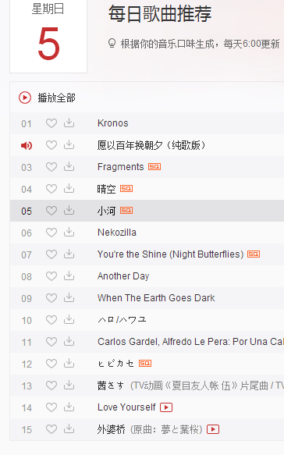
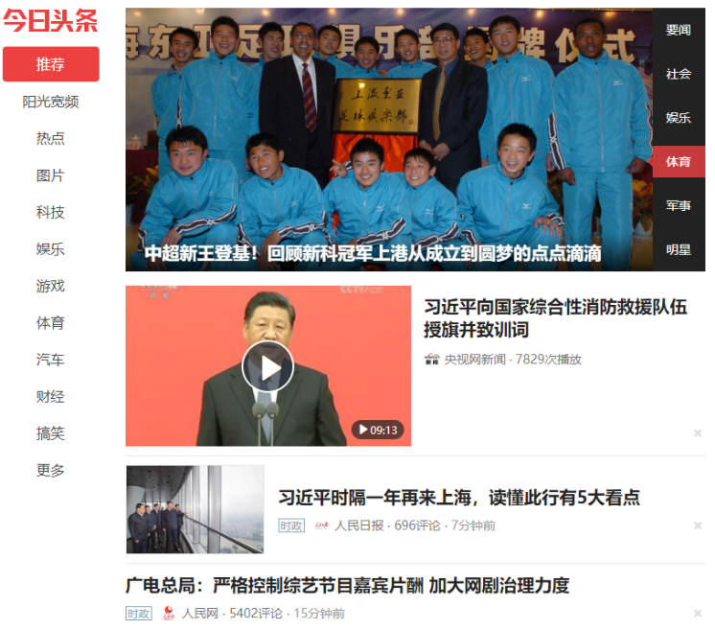
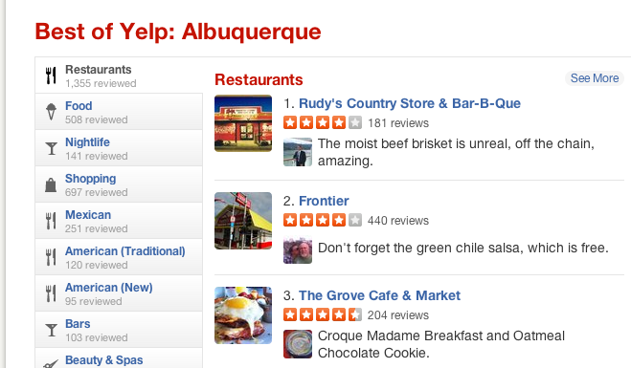
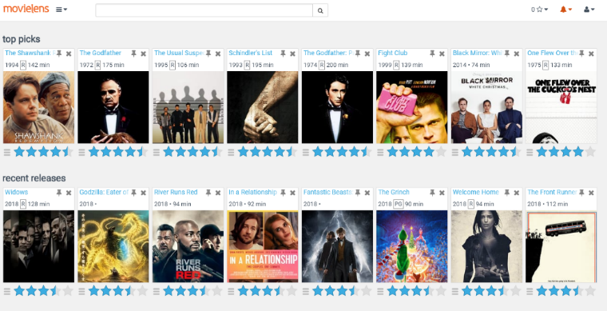
Recommendation Is Almost Everywhere
E-commerce recommendation
Movie recommendation
Music recommendation
News recommendation
Restaurant recommendation
......

Slide 3

Two Desired Properties
Accurate
Predict ratings of users on items accurately
Explainable
Provide explanations about why an item is recommended
Better persuade users to try this item
Increase users’ trust
Help users make better decisions
……

Slide 4
Existing Recommendation Models
Deep but unexplainable
Pros: model complex high-level features with deep learning techniques
Cons: Features they learn are beyond the comprehension of users
Examples
CDL (SIGKDD2015) using SDAE
DeepCoNN (WSDM2017) using CNN
DADM (SIGKDD2017) using CNN and Attention Network

Slide 5
Existing Recommendation Models
Explainable but shallow
Pros: provide explanations from explainable components
Cons: fail to model high-level features of user interest
EFM (SIGIR2014)
Extract explicit product features from reviews
“The steak in the restaurant is delicious but the salad is disappointing”
Factorization model for ratings, user-feature interest and item-feature quality
Feature-level explanations
Other examples:
HFT (RecSys 2013) using topic modelling
NARRE (WWW2018) using one layer of attention network

Slide 6
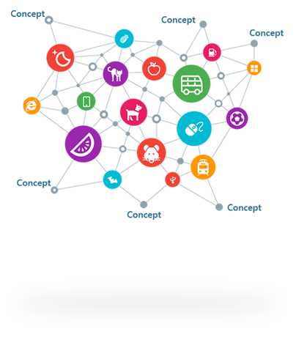
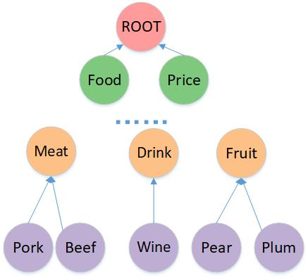

Motivation: An Explainable Deep Model
Build a network based an explainable deep hierarchy to improve accuracy and explainability simultaneously
IsA Relationship
IsA
Microsoft Concept Graph
Feature hierarchy

Slide 7
Challenges
Model multi-level explicit features from noisy and sparse data
Shrimp → Seafood → Meat
Users may be interested in Seafood even if they mainly mention Shrimp and Meat in reviews
Generate explanations from the multi-level structure
Features could be semantically overlapping
Simultaneously putting Shrimp and Seafood in explanations will degrade user experience.

Slide 8
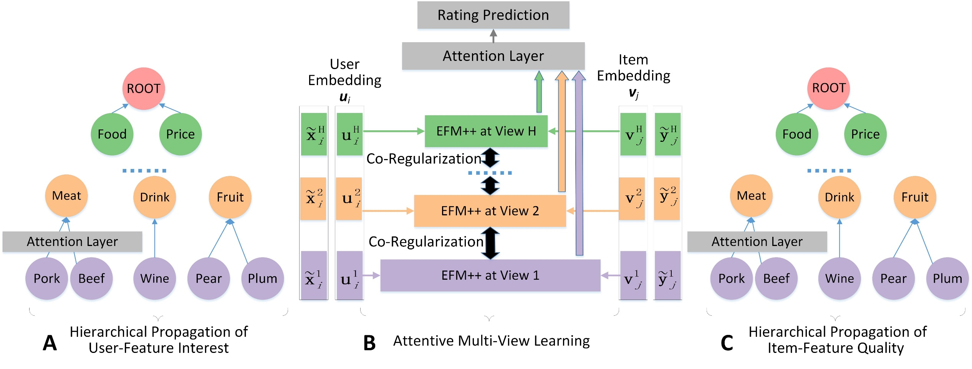
Deep Explicit Attentive Multi-View Learning Model

Slide 9
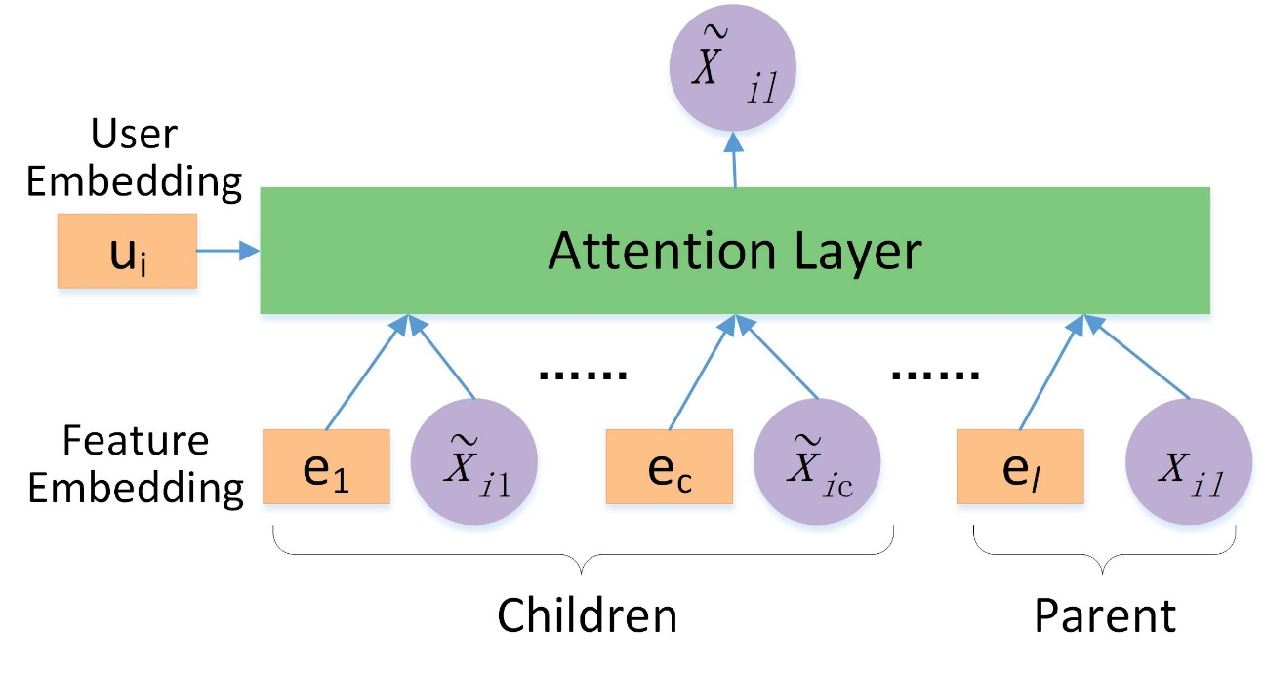
Hierarchical Propagation
Propagate user-feature interest over the hierarchical structure
Feature embedding is trained beforehand using GloVe
to capture both semantic and hierarchical information

Slide 10
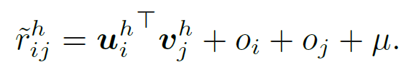
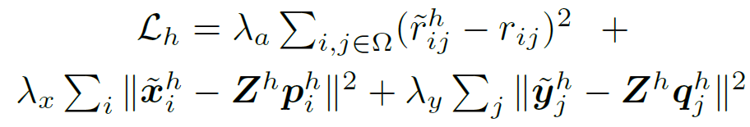
Attentive Multi-view Learning
Features at different hierarchical levels are regarded as different views on user interest and item quality
In each single view, we extend EFM to EFM++ by adding rating biases
Loss in each view

Slide 11
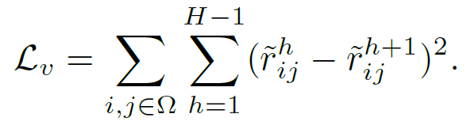
Attentive Multi-View Learning
A common paradigm of Multi-View Learning
Enforce agreement on predictions from multiple views
Co-regularization loss

Slide 12
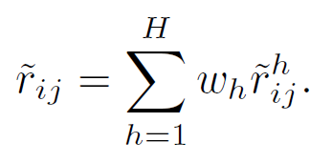
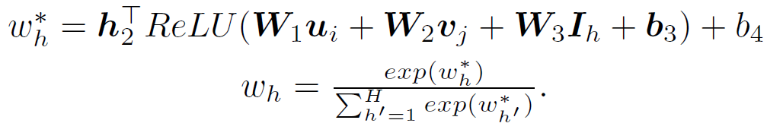
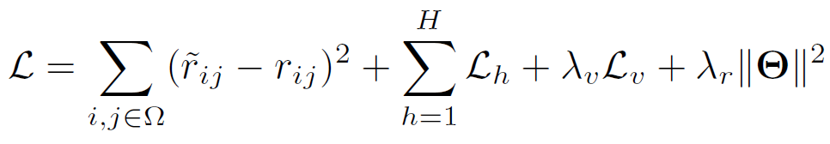
Attentive Multi-View Learning
Predictions from all views are attentively combined for final prediction
Joint learning

Slide 13

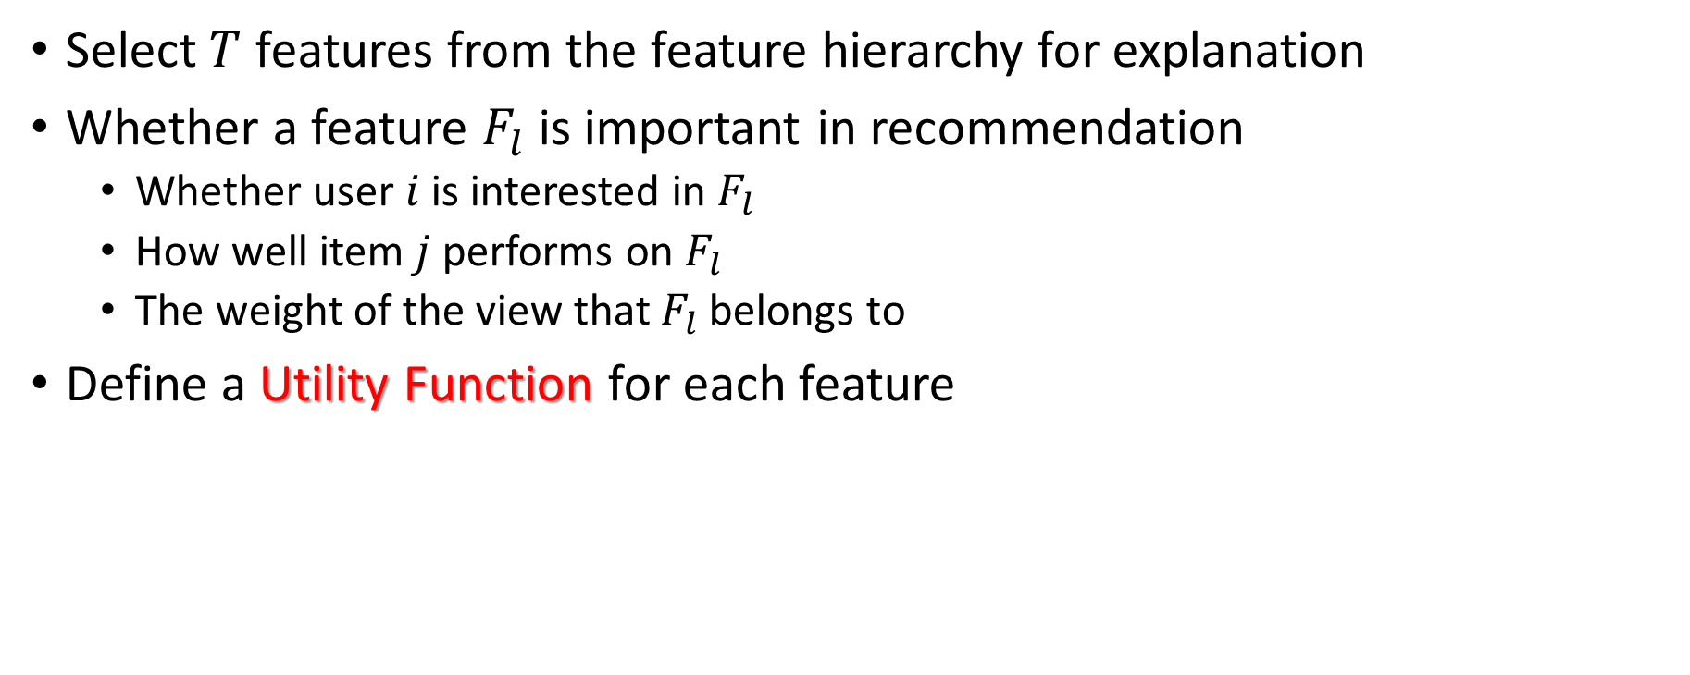
Personalized Explanation Generation
Select $T$ features from the feature hierarchy for explanation
Whether a feature $F_{l}$ is important in recommendation
Whether user $i$ is interested in $F_{l}$
How well item $j$ performs on $F_{l}$
The weight of the view that $F_{l}$ belongs to
Define a Utility Function for each feature

Slide 14
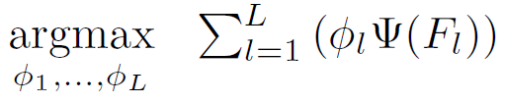
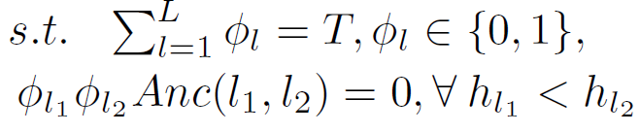
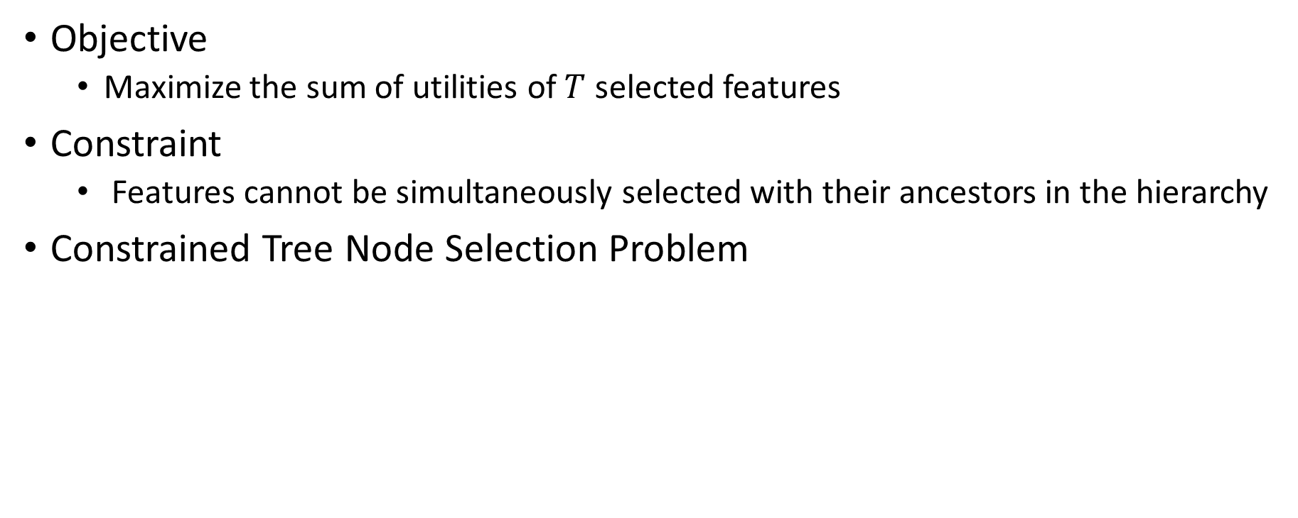
Personalized Explanation Generation
Objective
Maximize the sum of utilities of $T$ selected features
Constraint
Features cannot be simultaneously selected with their ancestors in the hierarchy
Constrained Tree Node Selection Problem

Slide 15
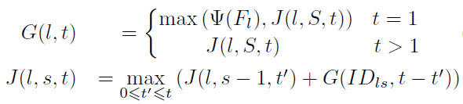
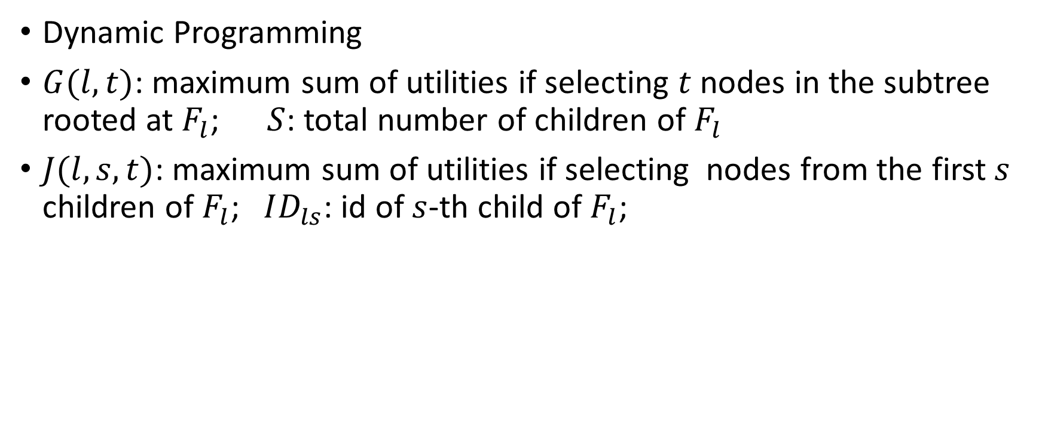
Personalized Explanation Generation
Dynamic Programming
$G(l,t)$: maximum sum of utilities if selecting $t$ nodes in the subtree rooted at $F_{l}$; $S$: total number of children of $F_{l}$
$J(l,s,t)$: maximum sum of utilities if selecting nodes from the first$s$ children of $F_{l}$; $ID_{ls}$: id of $s$-th child of $F_{l}$;

Slide 16
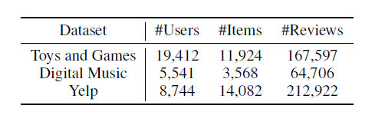
Evaluation
Experiments
Study on model accuracy
Parameter sensitivity analysis
Study on explainability
Datasets

Slide 17
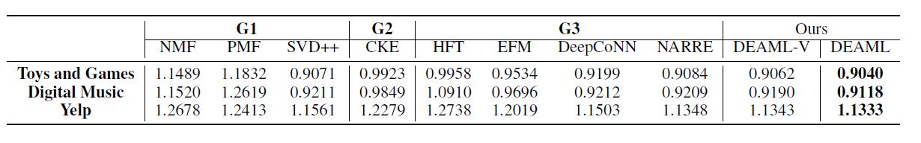
Study on Model Accuracy
G1: only use the observed rating matrix
G2: knowledge-based
G3: leverage textual reviews
EFM: state-of-the-art method for mining feature-level explanations
DeepCoNN, NARRE: deep-learning based
DEAML-V: a variant of our DEAML without attention mechanism

Slide 18
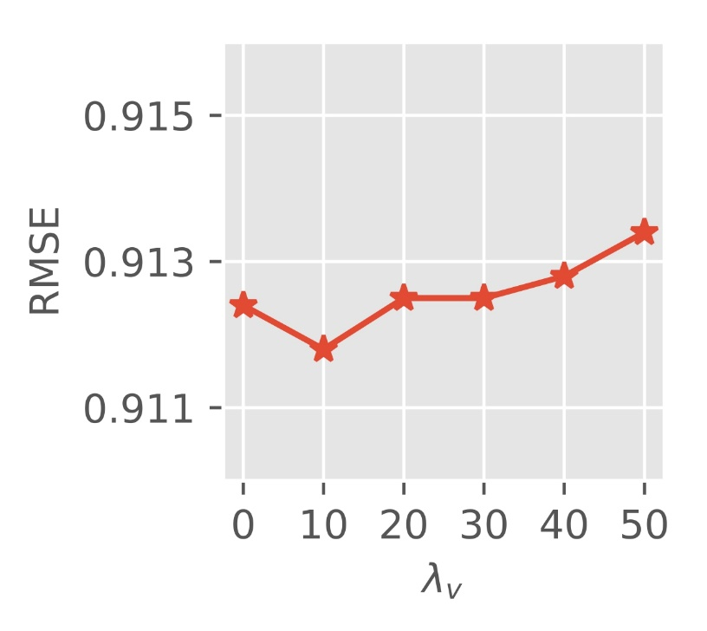
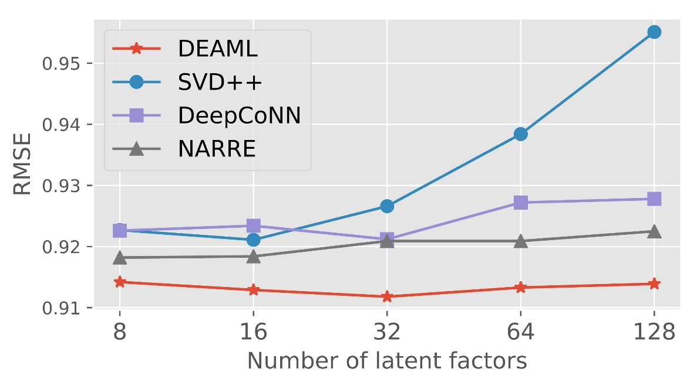
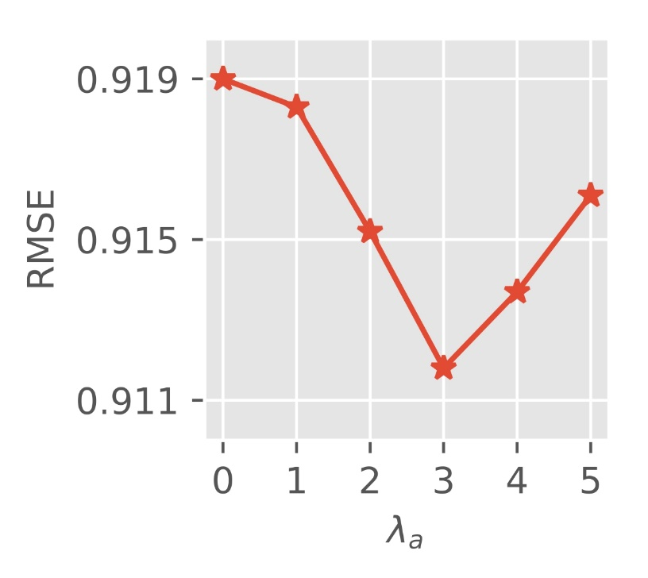

Parameter Sensitivity Analysis
Number of latent factors
Weight $λ_{v}$ of co-regularization
Weight $λ_{a}$ of errors of each review

Slide 19
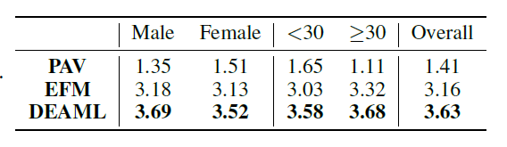
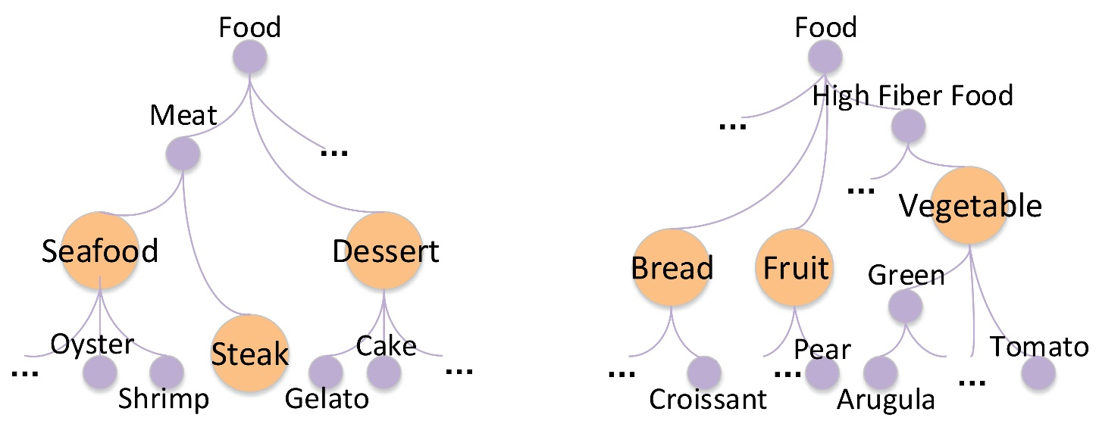
Study on Explainability
Quantitative analysis
Qualitative analysis
Scores (1-5) annotated by users
Visualization of user interest over the feature hierarchy
a 26-year-old female Yelp user
a 30-year-old male Yelp user

Slide 20
Conclusion
An explainable deep model DEAML to simultaneously improve the accuracy and explainability of recommendation
Model multi-level explicit features by attentive multi-view learning
Generate explanations by solving a constrained tree node selection problem
Future Work
Extend the tree structure of features to the graph structure
Extend the DEAML model to sequential recommendation

Slide 21
Q&A
Thanks!

