Slide 1
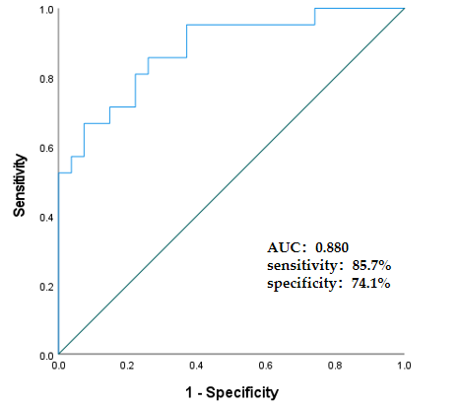
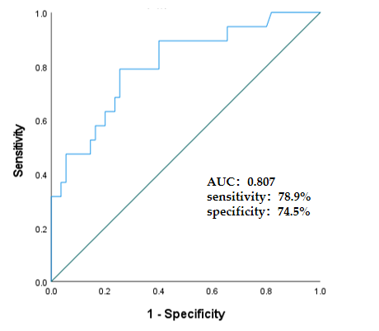
Fig1: (A) (B)

Slide 2
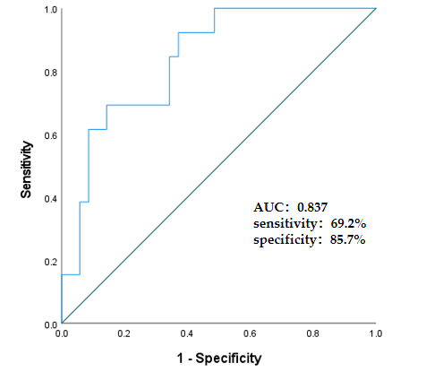
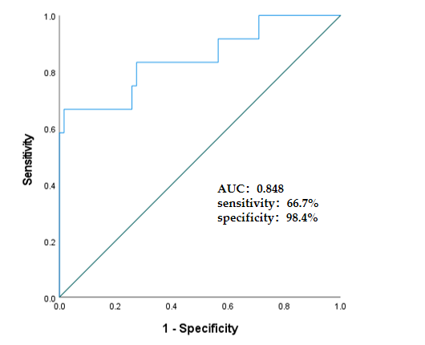
Fig1: (C) (D)

Slide 3
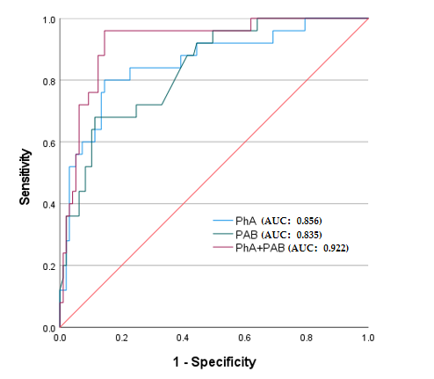
Fig1: (E)
Fig 1. ROC curves for malnutrition and sarcopenia in UC patients. (A) PhA values for malnutrition in females. (B) PhA values for malnutrition in males. (C) PhA values for sarcopenia in females. (D) PhA values for sarcopenia in males. (E) Different predictive indicators value for sarcopenia

Slide 4
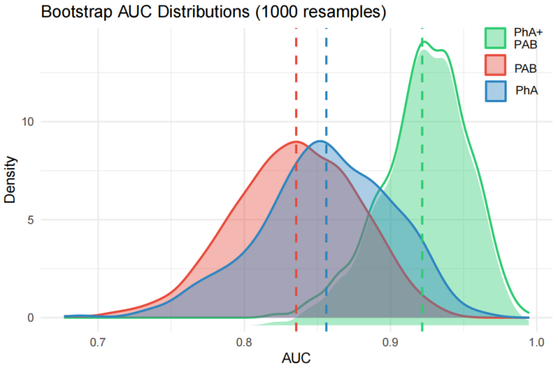
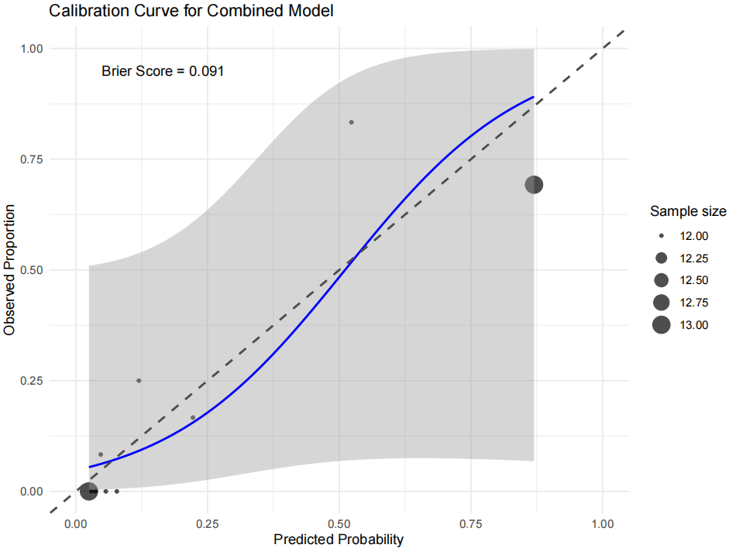
Fig2: (A) (B)
Fig 2. (A) Bootstrap AUC distributions based on 1000 resamples. (B) Calibration Curve for the Combined Model

Slide 5
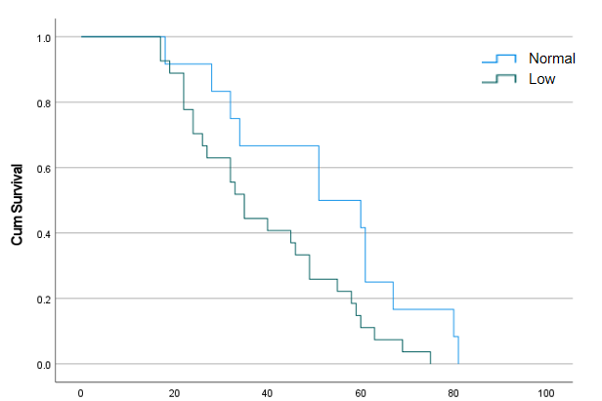
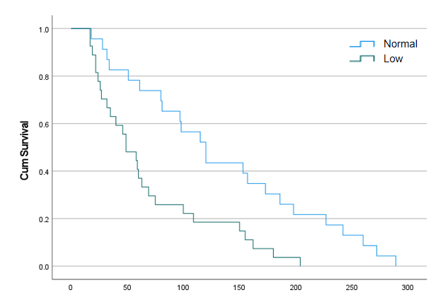
Fig3: (A) (B)
Fig 3. Kaplan-Meier curve for readmission intervals in UC patients. (A) Time between readmission during 12 weeks. (B) Time between readmission during 54 weeks.

