Slide 1
Automatic Gender Recognition from Raw Waveforms using
SincNet
OISHIKI GHOSH – 102006100
JATIN SINGH – 102006169
KARAMJIT SINGH BEDI - 102006179

Slide 2
I N D E X
About SincNet
Why SincNet?
Ravanelli’s Idea
Dataset incorporation

Slide 3
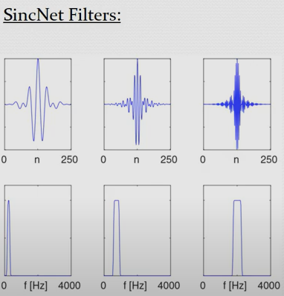
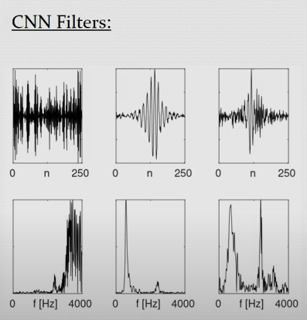
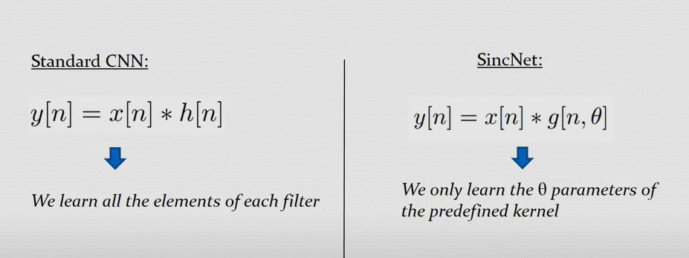
About SincNet
Neural architecture for efficiently processing raw audio data.
Input of theta parameters of predefined kernel.

Slide 4
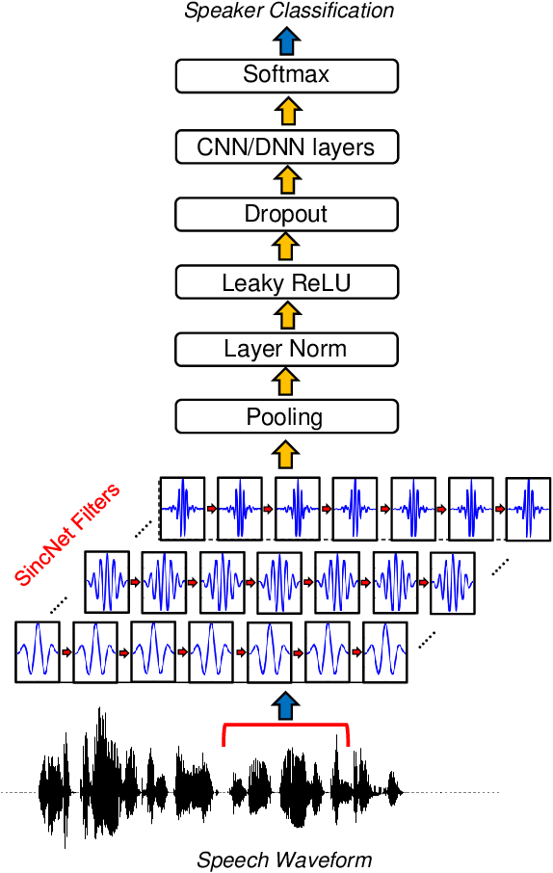
Why SincNet?
In SincNet, we encourage the first convolutional layer of our neural network to find more meaningful filters for the raw input data.
In contrast to standard CNNs, that learn all elements of each filter, only low and high cutoff frequencies are directly learned from data by using this method.
This offers a very compact and efficient way to derive a customized filter bank specifically tuned for our desired speaker recognition model.

Slide 5
Audio sequences are HIGH DIMENSIONAL
A raw waveform sampled at 16 kHz has 16000 features per second
We use hand-crafted features like MFCCs for DIMENSIONALITY REDUCTION
These are not optimal for tasks such as Speaker Recognition
Filters can hinder the extraction of important information such as Pitch and Formants
The CNNs employed for such tasks face PROBLEMS
Sensitive to VANISHING GRADIENT
HIGH DIMENSIONALITY of input
Introduction of NOISE
Output is NOT INTERPRETABLE

Slide 6
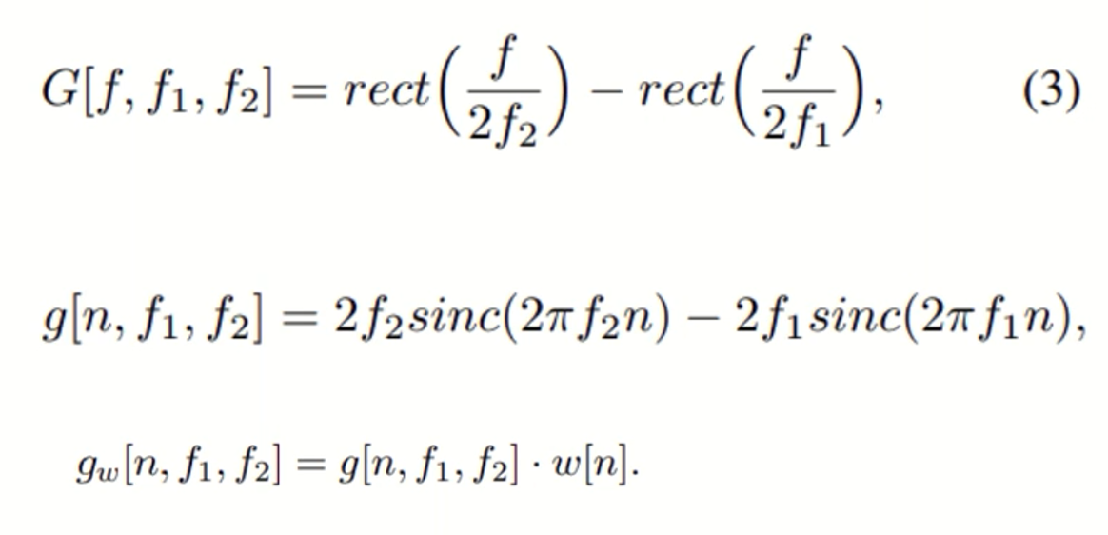
Ravanelli’s idea
Ravanelli et al. proposed an injection of "prior knowledge" into the first Convolutional layer
A kernel that would force the filters learnt by the layer to take a pre-defined shape, which would be more meaningful
The kernel would implement a bank of Band-pass filters
Only the upper and lower cut-off frequencies need to be learnt
Significantly reduces the number of parameters learnt by the layer

Slide 7
EFFICIENT
Kernel is symmetric
Compute convolution for only 50% of the filter
Converges faster (lesser epochs)
COMPACT
CNNs learn L*F parameters
SincNet only learns 2*F parameters
HIGH FREQUENCY-SELECTIVITY
Number of parameters does not depend on L
MORE INTERPRETABLE
Clear peaks for pitch and formants
NOISE
Learns to avoid noisy bandwidth more quickly
Performs better in reverberant conditions

Slide 8
VoxCeleb Gender Corpus

Slide 9
SPECIFICATIONS
3683 audio snippets labelled as “MALE”
2312 audio snippets labelled as “FEMALE”
Each snippet is 5 seconds long
Propose a 75-25 random train-test split
Audio taken from interviews, news reports, movies etc.
This implies real-life environmental noise

Slide 10
REFERENCES
&
CITATIONS
https://github.com/mravanelli/SincNet
https://youtu.be/mXQBObRGUgk
https://arxiv.org/abs/1808.00158
“Speaker Recognition from Raw Waveforms using SincNet” by Mirco Ravanelli, Yoshua Bengio

