Slide 1
PARKEMON

Slide 2


Slide 3
BASIC IDEA
Just like Uber and Ola solved the problem of travelling in overpopulated countries like India by bringing in the idea of ease of booking taxes , similarly India is facing another major problem.
Now just imagine ,if you are in your car and the destination you wanna reach is in a conjusted area where your car cannot go , or you are struck in a traffic jam and you are in your car so you cannot just leave your vehicle like that in the middle of the road, and you don’t have any parking space near you, NOW WHAT!!!????
DON’T WORRY we got a solution for that…..
we present to you the PARKEMON APP.
It simply takes your current location and , what you simply have to do is to book a diver , just like booking a cab in Ola or Uber.
The driver simply come and takes your car nearest registered parking location which you can track in real time.
We will be using simply android studios with the google map api, and then we will take the database of the drivers which are available.

Slide 4
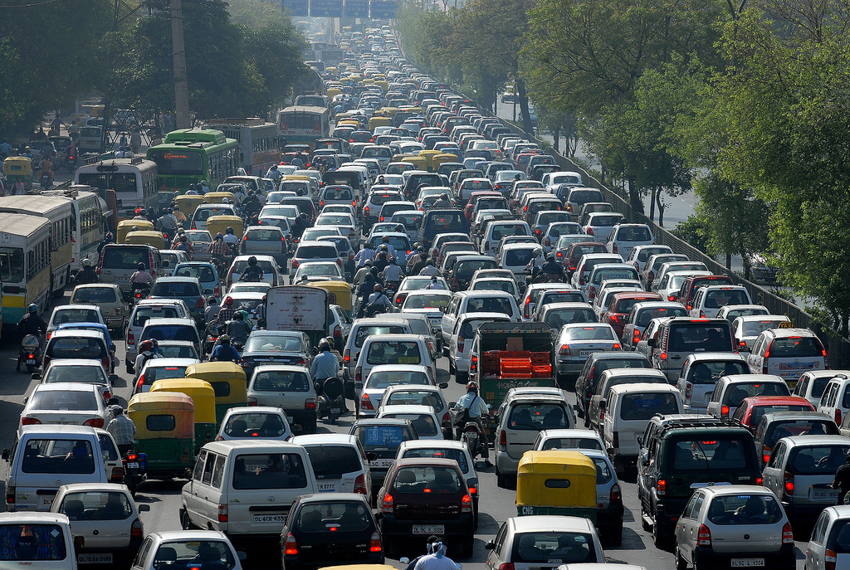
Problems without parkemon
Traffic Jam
Searching for the nearest parking with available space
Time Consuming
Blocks the available space on road

Slide 5
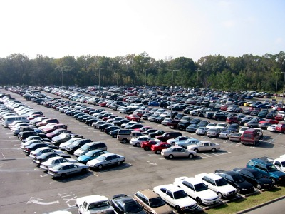
WHY IS IT DIFFERENT!!!!????
It saves your time
Easy to use and understand
Easy to locate nearest parking
Solves the problem of available parking space .

Slide 6
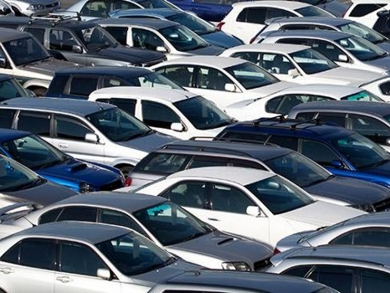

WHY PARKEMON??
This Photo by Unknown Author is licensed under CC BY

Slide 7

I bet you’ll definitely laugh after this so …
Okay now imma gonna tell you why we thought of the name parkemon . You must have heard of doraemon in you childhood so yesss we got its name from there only.
Like doraemon solves all the problem of nobita this app is like doraemon for all of us.
This Photo by Unknown Author is licensed under CC BY-SA-NC

