Slide 2
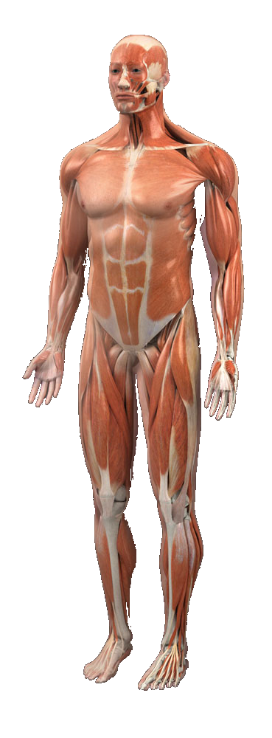
Main UI (1)
General
Head
Chest
Back
Stomach
Arms
Legs

Slide 3
General (2)
Common Cold
Fever
Tiredness
Restlessness

Slide 4
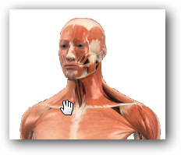
Head (2)
Headache
Sore/Tired Eyes
Stuffy Nose
Runny Nose
Ear ache
Toothache
Neck Pain
Sore Throat
Cough

Slide 5
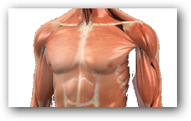
Chest (2)
Chesty Cough
Heart Burn

Slide 6
Back (2)
Upperback Stiffness
Lowerback Pain

Slide 7
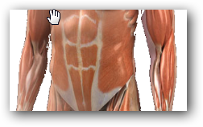
Stomach (2)
Indigestion
Diarrhea
Heartburn
Flatulence
Nausea/Vomitting
Constipation

Slide 8
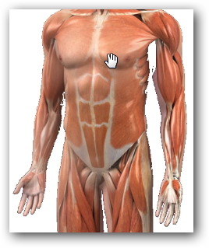
Arms (2)
Shoulder pain
Elbow Pain
Wrist Pain

Slide 9
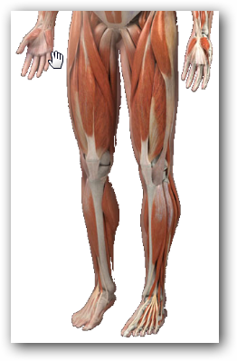
Legs (2)
Hip Pain
Knee Pain
Ankle Pain
Heel Pain

Slide 11
Syndrome lists
Syndrome → Acutepoint
偏頭痛
五十肩

Slide 12
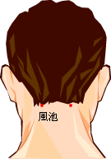
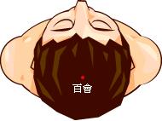
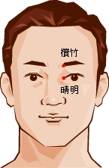
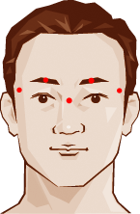
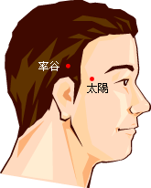
Acutepoint lists—for 偏頭痛

Slide 13
3D

Slide 14
Transparent

Slide 15
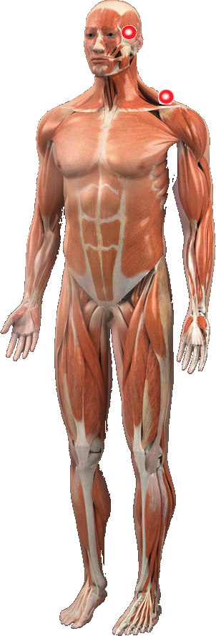
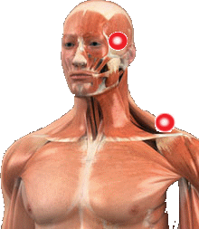
Main UI
Choose syndrome part

