Slide 1
rules
Every project has two weeks to complete.
Send the lab report and experimental results required by the project to our email address with the title "student number-name-project-X" and the lab report will be used as the basis for the rating.
If you have a Grace Day Policy, you can ask for a project to delay a day's acceptance. However, you can only use Grace Day Policy once in a project.
Notes:
1、for example, this project is scheduled for September 25th, then the acceptance should be completed at the latest on October 16th. If the acceptance on October 17th(one day after the deadline), then the score will be multiplied by 0.8. If the acceptance is on October 18th (two days after the deadline), then the score will be multiplied by 0.5. If it is accepted on October 19th and later, this experiment Will get 0 points

Slide 2
outline
1. Download MS Access
2. Download activation tool(KMS activation)
3. Lab project
4. Assignment

Slide 3
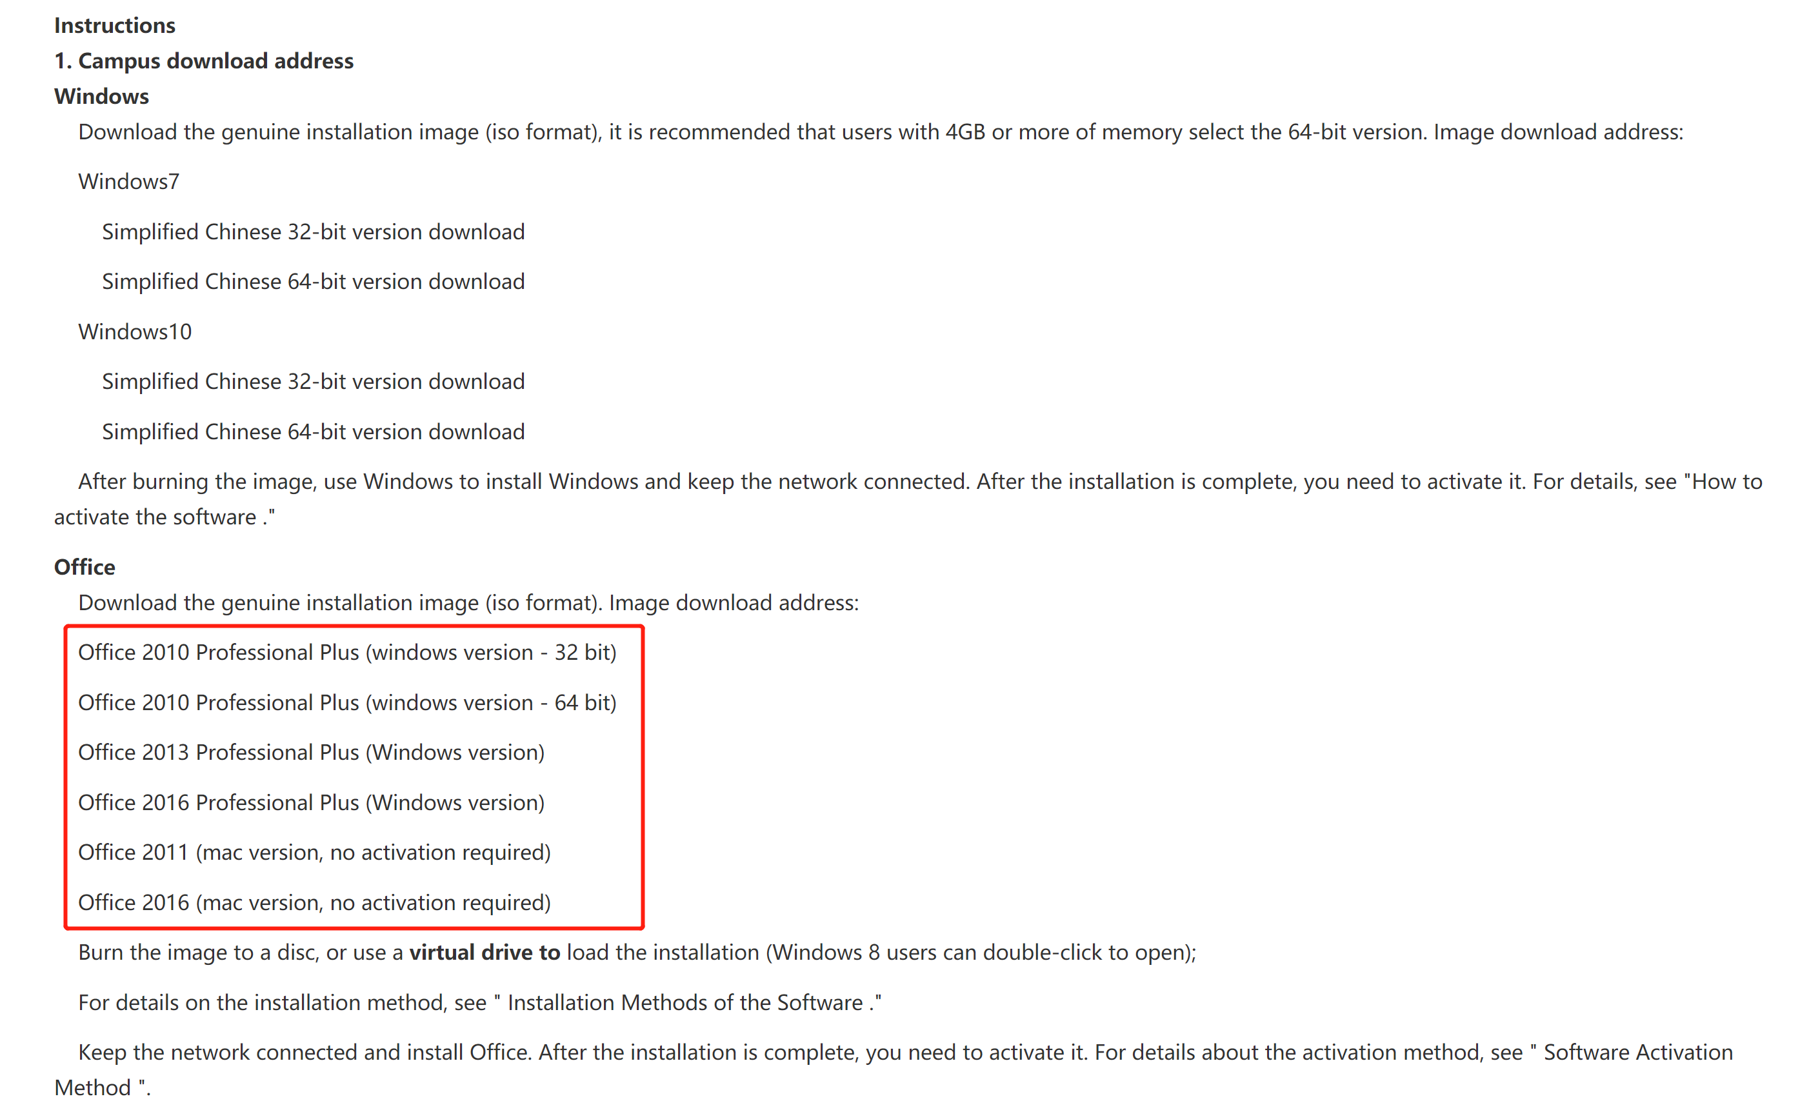
1. Download MS Access
https://nic.seu.edu.cn/2015/0113/c23555a265056/page.htm

Slide 4

2. Download activation tool(KMS activation)
https://nic.seu.edu.cn/_web/cms/folder/http://nic.seu.edu.cn/2015/0113/c12333a115290/page.psp
Download the package and unpack it to the desktop. Right-click the script file “seu.KMS.bat”. Select "run as administrator", as shown below:

Slide 5
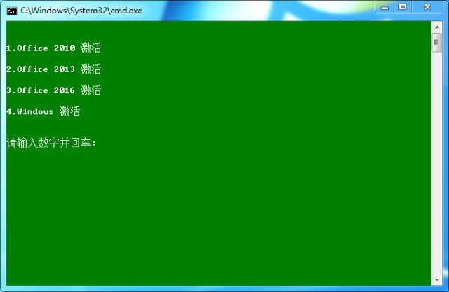
2) According to the menu prompts, enter the version number of the software you want to activate and press enter, as shown below:

Slide 6
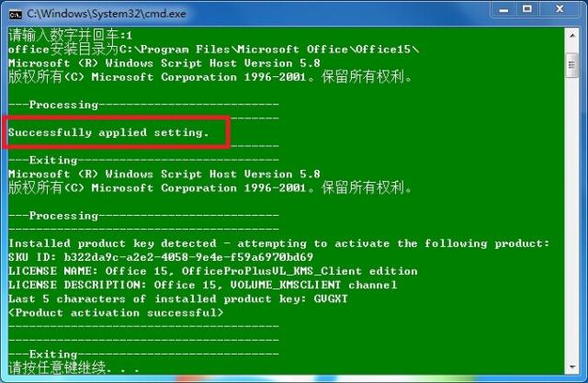
3) After successful activation, the interface displays "Successfully applied setting". Activate by pressing any key as prompted, as shown in the figure below:

Slide 7
3. Create a Database
3.1 Select a Blank Database
3.1.1 From the Access Welcome screen
3.1.2 From the File > New menu
3.2 Name the Database
3.3 Your New Database!

Slide 8
4. Create a Table
4.1 Customize the Blank Table
4.1.1 Select a Data Type for the New Field
4.1.2 Name the Field
4.1.3 Rename the First Field
4.1.4 Save the Table
4.1.5 Your Finished Table

Slide 9
4.2 Create a New Table
4.2.1 Create a New Table
4.2.2 Set up the Fields
Field Name | Data Type
AlbumId | (Leave it as is)
AlbumName | Short Text
ReleaseDate | Date & Time
ArtistId | Number
GenreId | Number

Slide 10
5. Create a Table in Design View
5.1 Create the Table
5.2 Add Fields to the Table
5.3 Change the Genre Field Properties
5.4 Set a Primary Key
5.5 Save the Table

Slide 11
6. Set the Field Properties for an Existing Table
6.1 Open the Albums table in Design View
6.2 Modify the AlbumName Field
6.3 Modify the ArtistId Field

Slide 12
7. Add Data to a Table
7.1 Add Records Directly into Datasheet View
7.2 Add Data using a Form
7.3 Add Data using SQL
7.4 Import Data from an External Source
GenreId* | Genre
(Autonumber) | Rock
(Autonumber) | Pop
(Autonumber) | Jazz
(Autonumber) | Blues
(Autonumber) | Hip Hop

Slide 13
8. Import Data into Access
8.1 Import a CSV File into an Existing Table
8.2 Launch the Import Wizard
8.3 Select the Source File & Destination Table
8.4 Review the Format Options
8.5 Select/Review the Delimiter

Slide 14
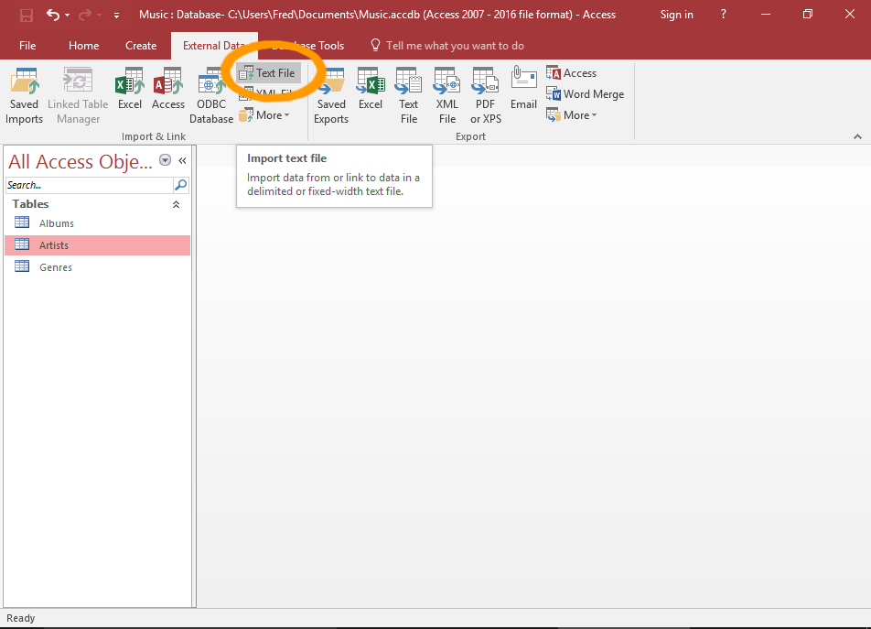

Slide 15
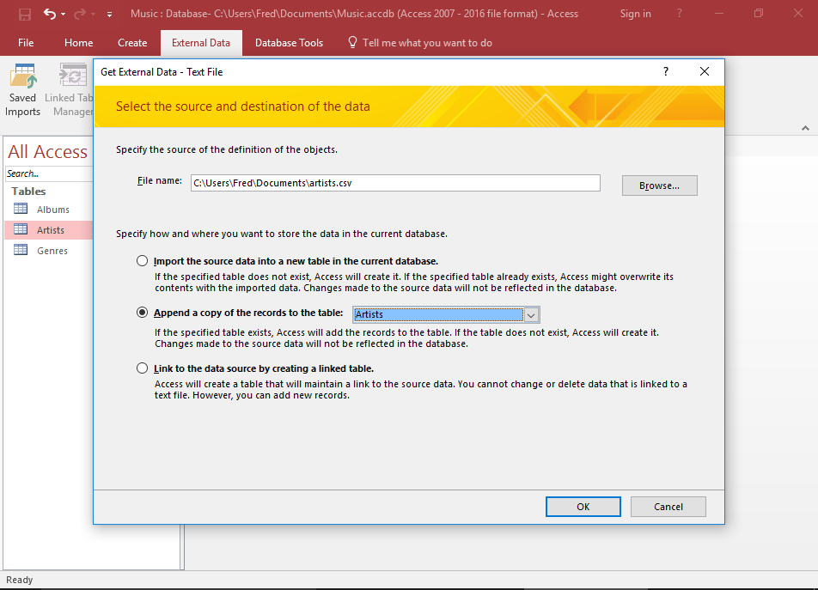

Slide 16
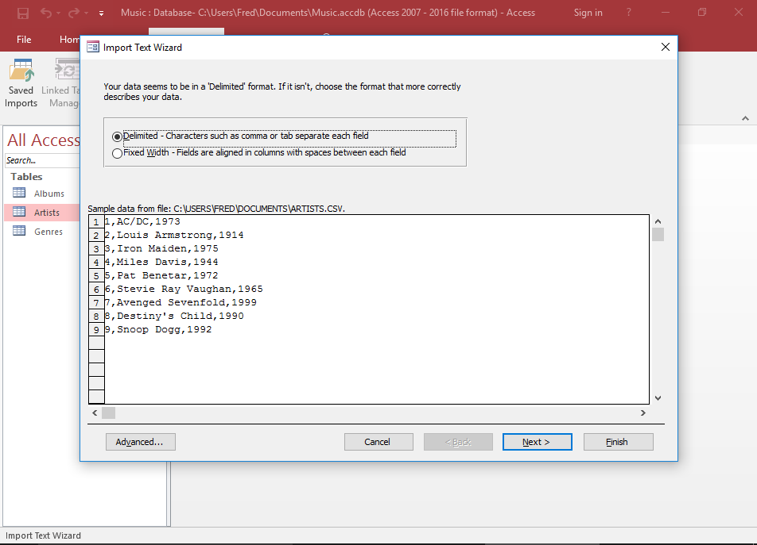

Slide 17
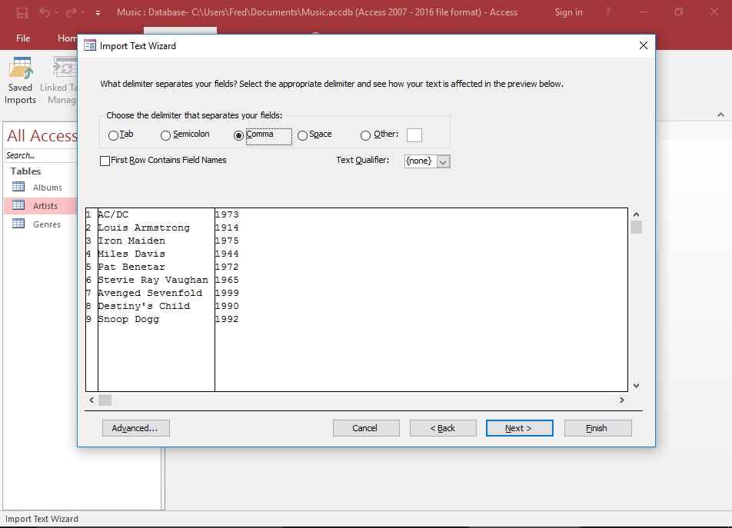

Slide 18
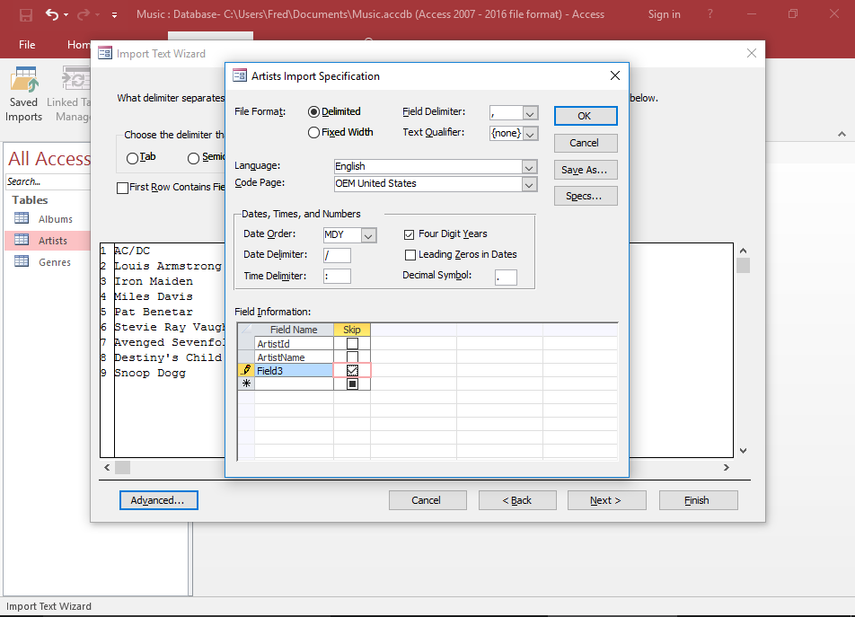

Slide 20
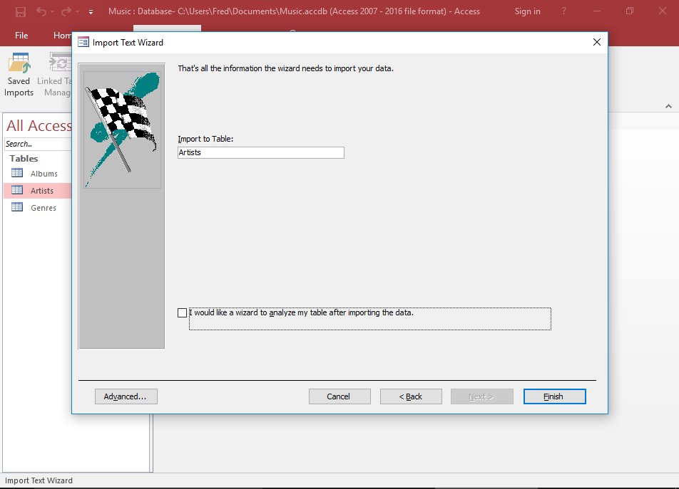

Slide 21
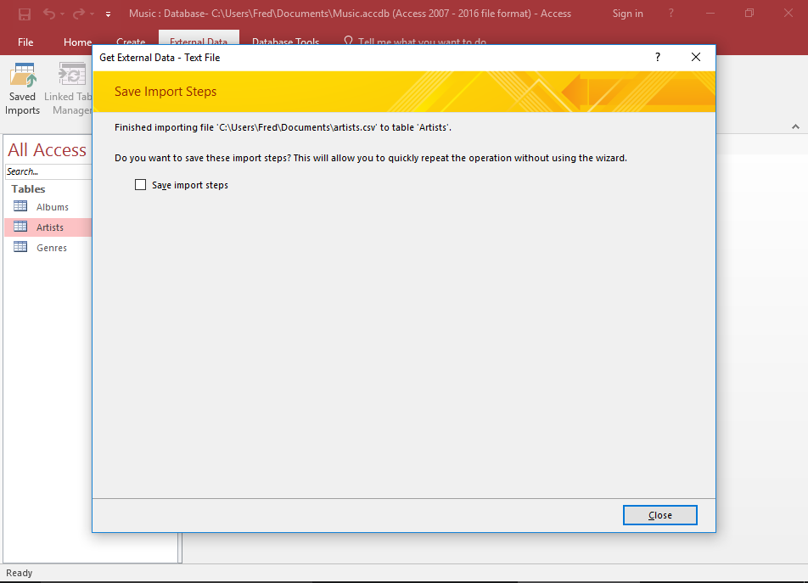

Slide 22
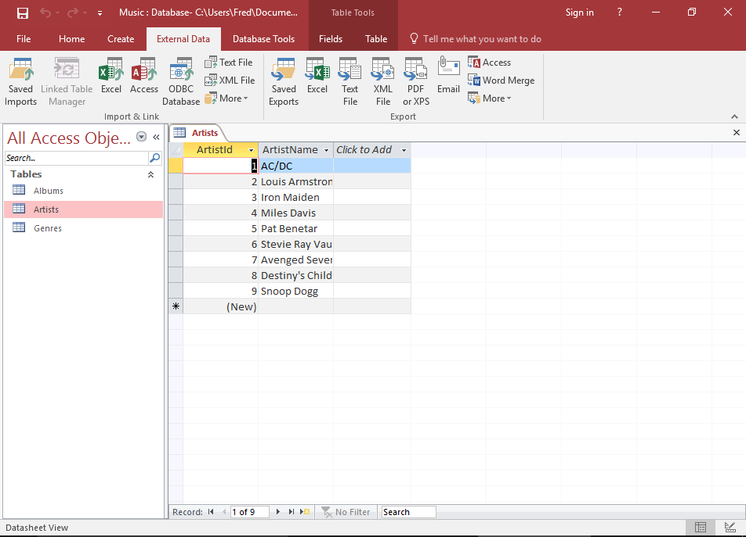

Slide 23
8.6 Skip the Extra Field
8.7 Continue the Wizard
8.8 Run the Import
8.9 Close the Wizard
8.10 Check that the data has been Imported

Slide 24
Assignment1

Slide 25
Content
Familiar with MS Access
Establish a university database
university.mdb
Load data into the database
Make a group of random tuples for student table and let student has more than 5000 tuples

Slide 26
Schema and Sample Data
The schema of the database is provided below (keys are in bold, field types are omitted):
student(sid, sname, sex, age, year, gpa)
dept(dname, numphds)
prof(pname, dname)
course(cno, cname, dname)
major(dname, sid)
section(dname, cno, sectno, pname)
enroll(sid, grade, dname, cno, sectno)
Before you start writing SQL, it is a good idea to take a look at the database and familiarize yourself with its contents.

Slide 27
Data Files
Download the following data files from https://github.com/zygardxerneas/database
course.txt
dept.txt
enroll.txt
major.txt
prof.txt
section.txt
student.txt

Slide 28
Submission
File name format:
StudentNumber_A1.zip
including:
report_A1.doc/ report_A1.docx
university_A1.mdb/university_A1.accdb
Deadline: Beijing time, October 16th, 00:00:00

