Slide 1
Lab 2
Notes:
Hello everyone im sunkai and this is guobaoshen, today we will introduce lab 2 to help you familiar to sql query

Slide 2
outline
1. Download lab2.accdb
2. Using SQL in Access
3. Lab project
4. Assignment2
Notes:
Our class has 4 part . We will tell you how to Download lab2.accdb first. And we will introduce how to use sql in access step by step. Then we will give you 4 examples to practise. Finally part4 is assignment2, and please finish it under class and hand in it in 2 weeks.

Slide 3
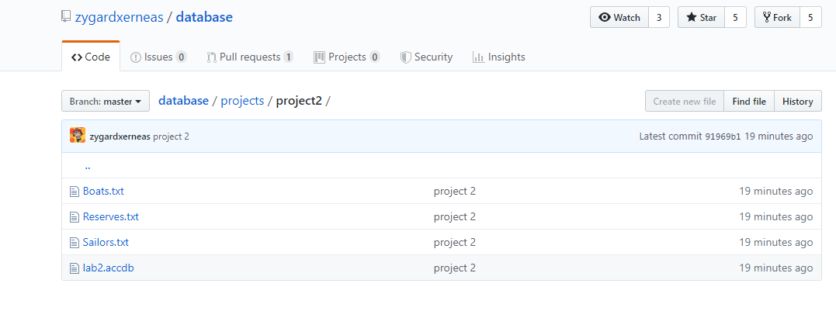
1. Download lab2.accdb
https://github.com/zygardxerneas/database
Notes:
放github截图及网址，分两部分，数据库 和txt ，指出 并说明 兼容性问题

Slide 4
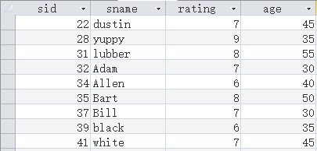
1. Download lab2.accdb
Table - Sailor
Notes:
Now we can find that there are 3 table in the access file. The first one is table sailor,and it has four fields which are sid sname rating and age.
放数据库中三个表的截图

Slide 5
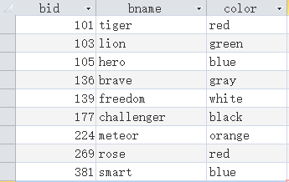
1. Download lab2.accdb
Table - Boats
Notes:
The second one is table boats,and it has three fields which are bid bname and color
放数据库中三个表的截图

Slide 6
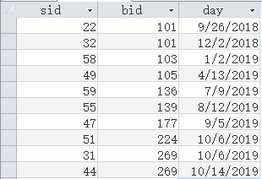
1. Download lab2.accdb
Table - Reserves
Notes:
The last one is table reserves,and it has three fields which are sid bid and day
放数据库中三个表的截图

Slide 7
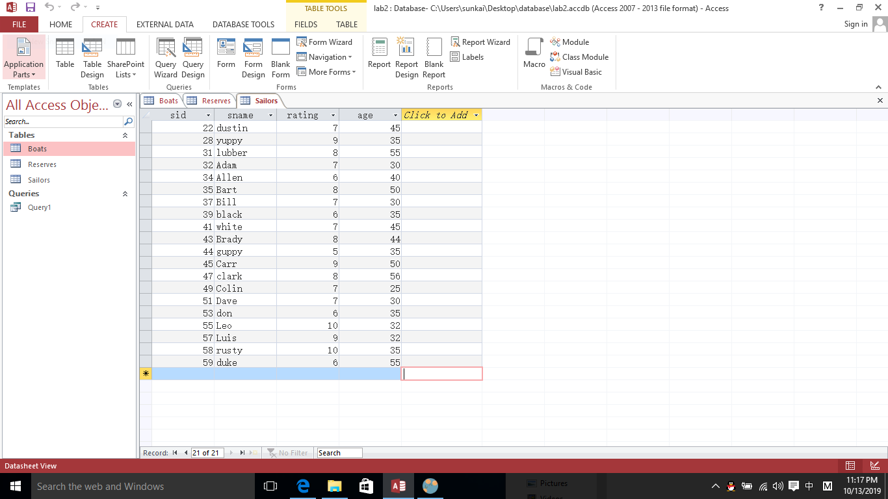
2. Using SQL in Access
Click Create
Click Query Design
Notes:
To use SQL in access
You need to create a query in access then input your SQL Query
Firstly ,click the CREATE button (从左往右第三个按钮）
Then click(choose) Query Design button( in Queries)

Slide 8
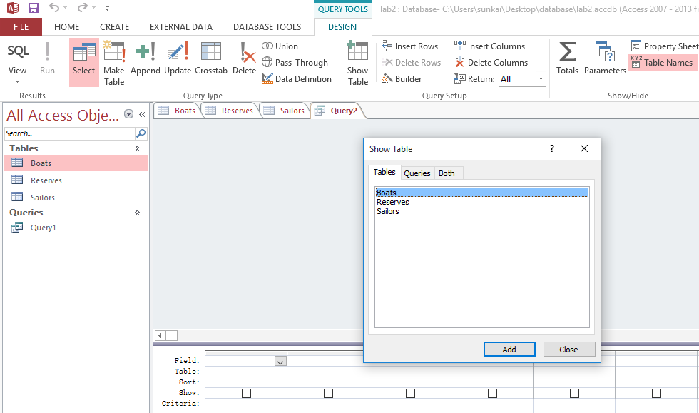
2. Using SQL in Access
Close the Show Table

Slide 9
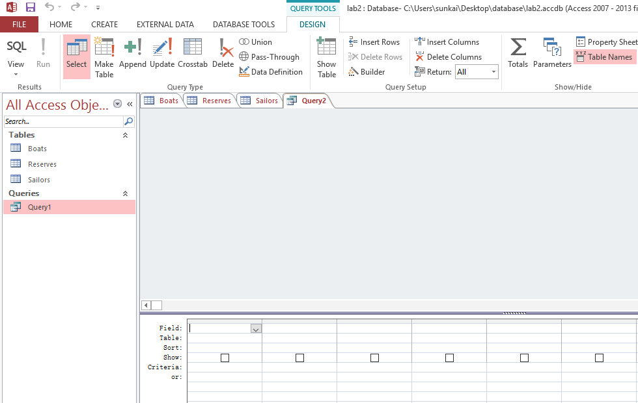
2) Click SQL View
Notes:
Click SQL View, then can typing SQL query(DESIGN下面）

Slide 10
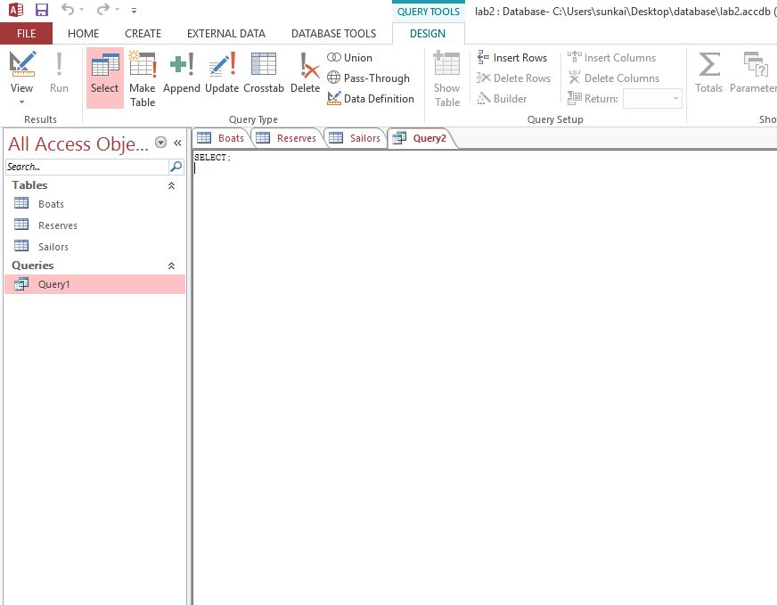
3)Now we change to SQL View, then we can input SQL in access

Slide 11
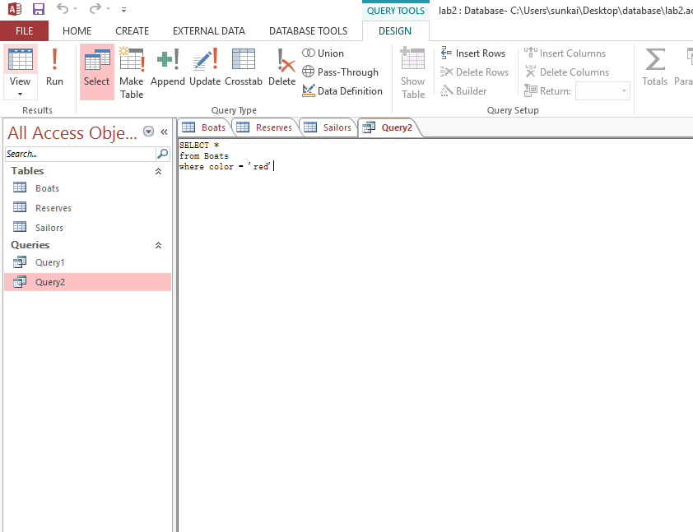
SELECT * from Boats where color = ’red’;
Print records in Boats Table that Boat’s color is ‘red’
Notes:
The SQL interpreter in ACCESS can recognize both Uppercase and lowercase of keywords ,but the table name must be typed accurately
注意大小写问题
After inputing sql query, click RUN button(在design下面) ,and you will get the results

Slide 12
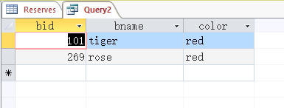
Results of Query
Notes:
This is the results of sql query

Slide 13
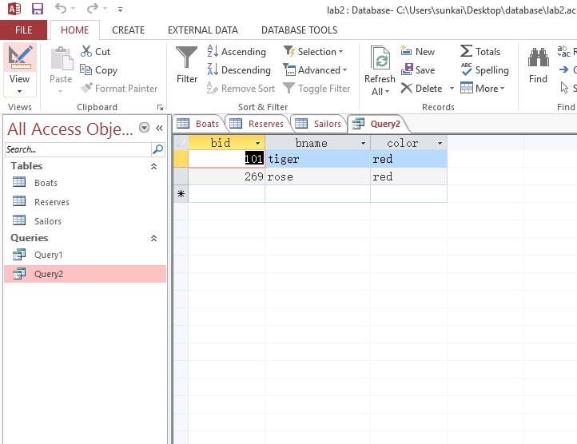
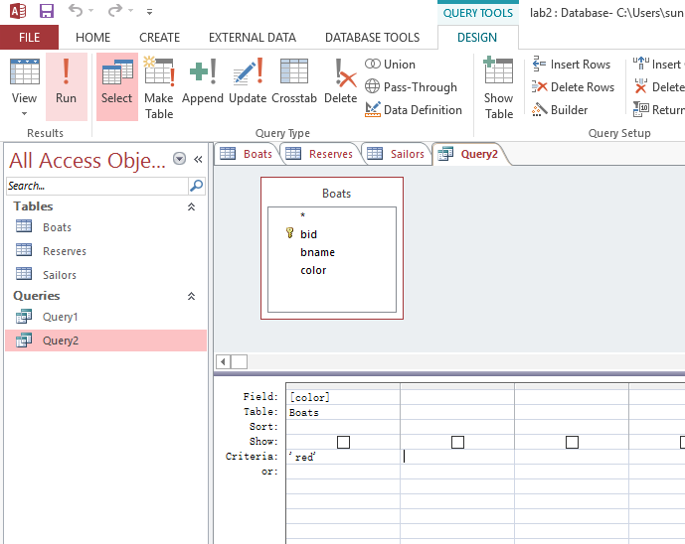
Datasheet View AND Design View
Notes:
Besides, you can change the sql query between Datasheet View and Design View

Slide 14
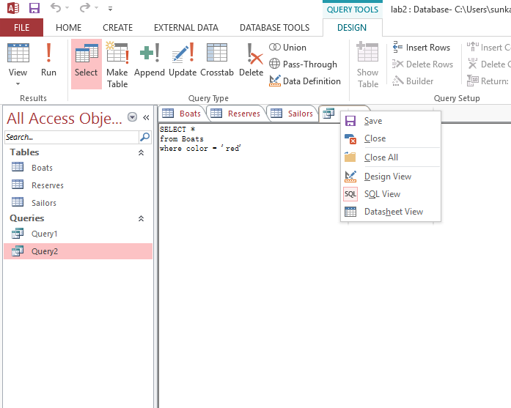
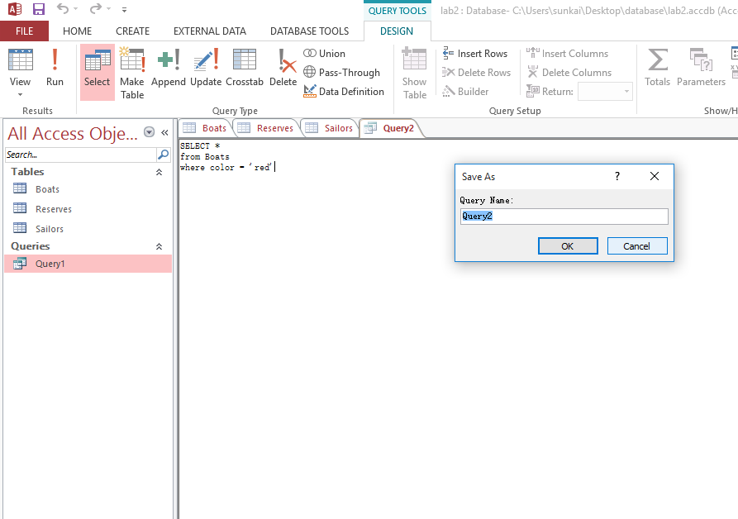
4) Save Query
Notes:
Finally, remember save the query file and give it a name.

Slide 15
3. Lab project
3.1 print name and sid of sailors whose age >40 And rating>7
3.2 print the names of sailors who reserved boats in 2018
3.3 print names of sailors who reserved “rose” boat
3.4 print sid, name, age of sailors(order by age ) who reserved boats in 2019
Notes:
Now we have four interesting tests, finish it in your laptop and we will give you our solution.

Slide 16
Assignment2
Notes:
Now this is the second assignment

Slide 17
Content
SQL queries on university database
Write SQL queries that answer the questions below (one query per question) and run them on the Microsoft ACCESS Database System using its SQL interpreter. The query answers must not contain duplicates, but you should use the SQL keyword distinctonly when necessary.
Notes:
The content of assignment are listing in ppt
You should Write SQL queries that answer the questions below (one query per question) and run them on the Microsoft ACCESS Database System using its SQL interpreter.
Note that one query per question
And for each question you have to write exactly one SQL statement. And creation of temporary tables is not allowed

Slide 18
Content
The SQL interpreter in ACCESS is not quite the same as the one described in the textbook. If the query you write is not accepted by ACCESS (usually it gives you some strange errors), try different ways until you get one that works with ACCESS. For this assignment, creation of temporary tables is not allowed, i.e., for each question you have to write exactly one SQL statement.
Notes:
The content of assignment are listing in ppt
You should Write SQL queries that answer the questions below (one query per question) and run them on the Microsoft ACCESS Database System using its SQL interpreter.
Note that one query per question
And for each question you have to write exactly one SQL statement. And creation of temporary tables is not allowed

Slide 19
Database Schema
The schema of the database is provided below (keys are in bold, field types are omitted):
student(sid, sname, sex, age, year, gpa)
dept(dname, numphds)
prof(pname, dname)
course(cno, cname, dname)
major(dname, sid)
section(dname, cno, sectno, pname)
enroll(sid, grade, dname, cno, sectno)
Before you start writing SQL, it is a good idea to take a look at the database and familiarize yourself with its contents.
Notes:
The database schema is the university database same with your assignment 1.
Which include 7 tables, student, dept, prof, course ……

Slide 20
Data Files
Download the following data files from https://github.com/zygardxerneas/database
course.txt
dept.txt
enroll.txt
major.txt
prof.txt
section.txt
student.txt
Notes:
The data file is also same with last assignment1,and if you already create the university database, you don’t need download these txt file.
If you not , you can download these file and create university database.

Slide 21
Question
Print the names of professors who work in departments that have fewer than 50 PhD students.
Print the name(s) of student(s) with the lowest gpa
For each Computer Sciences class, print the cno, sectno, and the average gpa of the students enrolled in the class.
Print the course names, course numbers and section numbers of all classes with less than six students enrolled in them.
Print the name(s) and sid(s) of the student(s) enrolled in the most classes
Print the names of departments that have one or more majors who are under 18 years old.
Notes:
Here are the question 1 to 6 of this assignment, you should analysis these question and write sql query in access

Slide 22
Question
Print the names and majors of students who are taking one of the College Geometry courses. (Hint: You'll need to use the "like" predicate and the string matching character in your query.)
For those departments that have no majors taking a College Geometry course, print the department name and the number of PhD students in the department.
Print the names of students who are taking both a Computer Sciences course and a Mathematics course.
Print the age difference between the oldest and youngest Computer Sciences major(s).
For each department that has one or more majors with a GPA under1.0, print the name of the department and the average GPA of its majors.
Print the ids, names, and GPAs of the students who are currently taking all of the Civil Engineering courses.
Notes:
Here are the question 7 to 12 of this assignment, you should analysis these question and write sql query in access

Slide 23
Demand
This is an individual assignment –no group submissions are allowed. Hand in an ACCESS database that contains the answers to the twelve questions. The database should contain twelve queries, named as follows:
Query1
Query2
…
Query12
Test the function of index with query related with student table
Hand in a report which indicates your answers
Notes:
This is the demand of this assignment
Note that for any question, when you finish SQL query, you must save it
And the database should contains the answers to the twelve questions, twelve queries should be named as :query1, query 2……
And hand in a report

Slide 24
Submission
File name format:
Sno_A2.zip
including:
report_A2.doc
university_A2.accdb
Deadline:
Beijing time, October, 29th ,23:59:59
Notes:
Finally, the submission demand are as follows:
Attention: the the deadline is

