Slide 1
1
Operator Client (OC)
Tester
Step 1
ST-1 Test System
Request(s)
Asp.net Web Application
Form to:
Select Request Type
Issue HTTP request
Display Response
Display Req Player Info
Display Enter OTP
Send request to ST-1
Send to Wrapper
Response(s)
Request(s)
MAC Wrapper
1
Step 2
Response(s)
Step 3
Request(s)
Request
Response
Handling
Request(s)
1
Response(s)
Response(s)
Test Data
Request(s)
Step 4,5,6
- Text containing test player data to speed up testing
Response(s)
OTP Handling
Database
Step 1 – Direct interface to ST-1 (15 Requests, 24 Responses)
Step 2 – Wrapper loopback, Logging to database (2-3 Request Response)
Database
Request/Response correlation
Activity Log
Step 3 – Wrapper pass through to ST-1 (All request / responses)
MAC OTP System
Step 4 – Database correlation logic
Get Client info
Register Player
Send OTP
Verify OTP
Opr Client Display Enter OTP request /response
Step 5 – OTP processing logic
MAC Wrapper
Process request(s) from Client
Process response(s) from ST-1
Call MAC OTP Services
Send extended response(s) to Opr client
Step 6 – Modify Operator Interface, adding Enter OTP handling
1

Slide 2
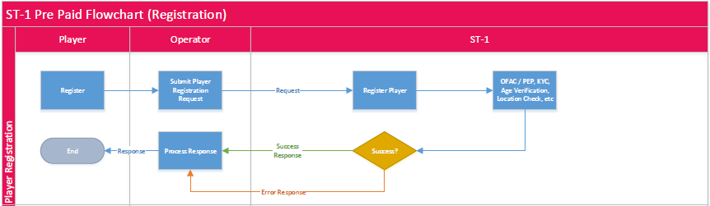
MAC Wrapper(Registration )
MAC OTP System
MAC Registration Wrapper Service (Happy Path)
Catch Request
Create temp record of user info
Pass request to ST-1
Get Response from ST-1
If success
Call MAC Registration (User key from ST-1)
Need: Player’s unique ID, full Name, Phone number, email address.
Call MAC Send OTP
Display Enter OTP Screen to End User
Get End User Entered OTP
If valid reply Success to Operator
Done

Slide 3
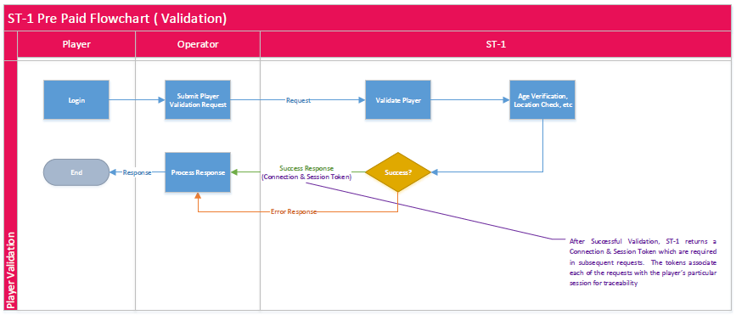
MAC Wrapper(Validation)
MAC OTP System
MAC Validation Wrapper Service (Happy Path)
Catch Request
Create temp request record with Player info
Pass request to ST-1 to validate Player
Get Response from ST-1
If success from ST-1
Check if Player is known to MAC using End User Unique ID generated by ST-1
If not Call MAC Registration
Need: Player’s unique ID, full Name, Phone number, email address.
Reply Success to Operator
Done

Slide 4
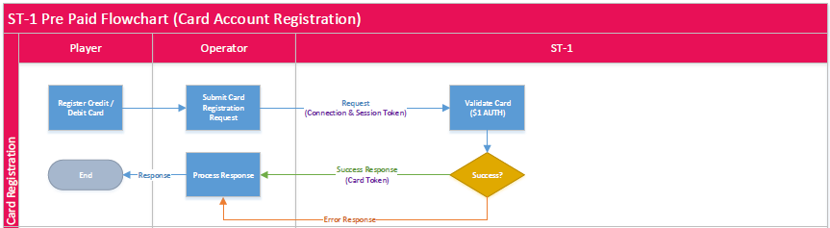
MAC Wrapper(Registration)
MAC OTP System

Slide 5
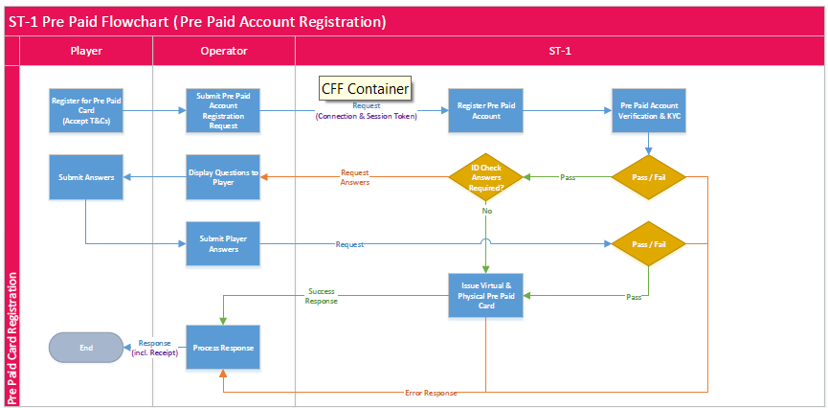
MAC Wrapper(Registration)
MAC OTP System

Slide 6
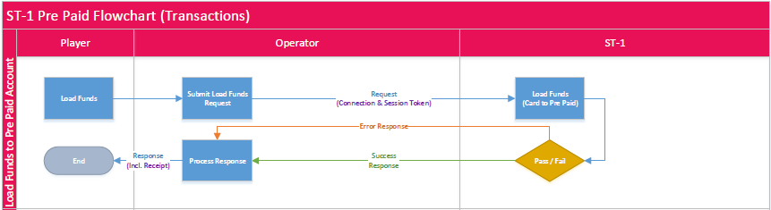
MAC Wrapper(Transaction)
MAC OTP System

Slide 7
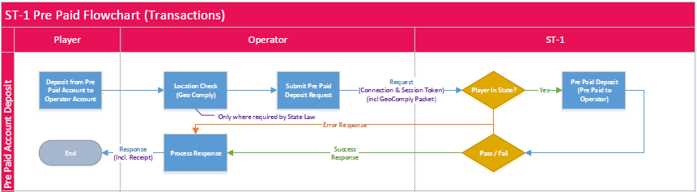
MAC Wrapper(Transaction)
MAC OTP System

Slide 8
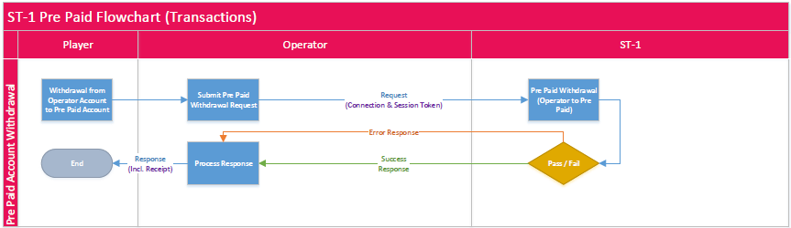
MAC Wrapper(Transaction)
MAC OTP System

Slide 9
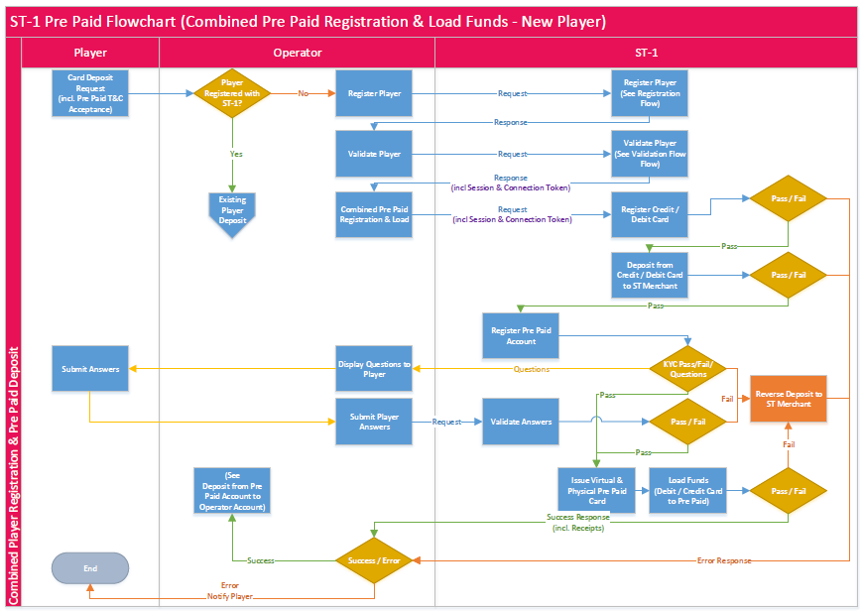
MAC Wrapper(Combined New Player)
MAC OTP System

Slide 10
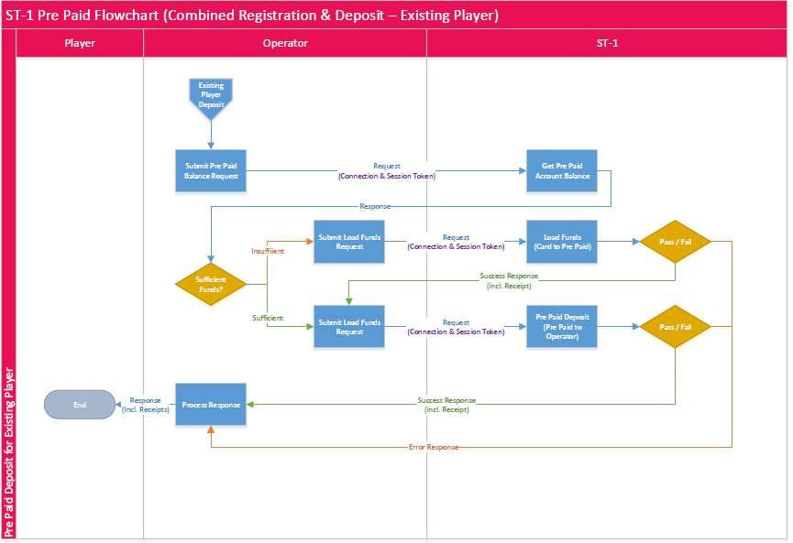
MAC Wrapper(Combined)
MAC OTP System

