Slide 1

C++面向对象程序设计-2015级
陈伟 软件工程教研室 吉林大学
email：ccchenwei@163.com; chenw@jlu.edu.cn 2015-2016-2学期

Slide 2
内容
1
依赖+继承
2
关联+继承
3
字符图像例
4
补充说明
5

Slide 3
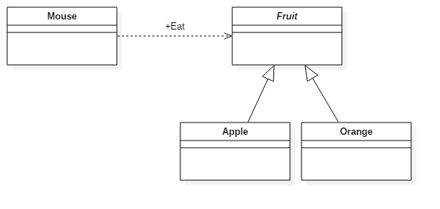
依赖+继承（基本）
class Mouse {
public:
void Eat(Fruit& fruit) ;
};

Slide 4
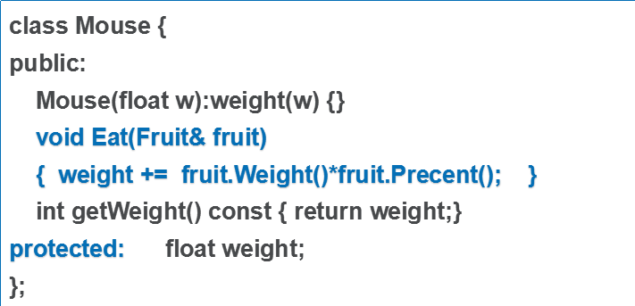
依赖+继承（基本-例）
class Orange:public Fruit {
public:
Orange(int w1,int w2)
:weight1(w1),weight2(w2) {}
virtual int Weight() const
{ return weight2; }
virtual float Precent() const
{ return 0.7; }
private:
int weight1; int weight2;
};
int main(){
Apple apple(100);
Orange orange(20,50);
Mouse mouse(120);
cout<<mouse.getWeight()<<endl;
mouse.Eat(apple);
cout<<mouse.getWeight()<<endl;
mouse.Eat(orange);
cout<<mouse.getWeight()<<endl;
return 0;
}
class Fruit {
public:
virtual ~Fruit() {}
//重量
virtual int Weight() const = 0;
//可用部分的百分比
virtual float Precent() const = 0;
};
class Apple:public Fruit {
public:
Apple(int w):weight(w) {}
virtual int Weight() const
{ return weight; }
virtual float Precent() const
{ return 0.8; }
private:
int weight;
};

Slide 5
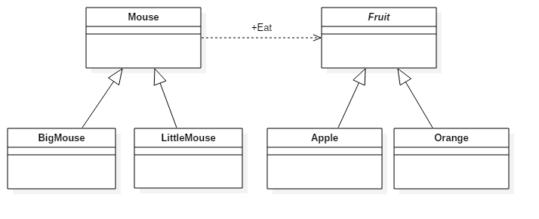
依赖+继承（变化1）

Slide 6
依赖+继承（变化1-例）Mouse的子类提供Eat的实现细节
class Fruit {/*不变};
class Apple:public Fruit{/*不变};
class Orange:public Fruit{/*不变};
class Mouse {
public:
Mouse(float w):weight(w) {}
virtual ~Mouse() {}
virtual void Eat(Fruit& fruit)
{ weight += fruit.Weight()*fruit.Precent(); }
int getWeight() const { return weight;}
protected: float weight;
};
int main() {
Apple apple(100);
Orange orange(20,50);
BigMouse mouse(120,0.5);
mouse.Eat(apple);
...
}
class BigMouse:public Mouse {
public:
BigMouse(float w,float fac)
:Mouse(w),factor(fac) {}
virtual void Eat(Fruit& fruit)
{ weight += fruit.Weight()*fruit.Precent()*factor; }
private: float factor;
};
class LittleMouse:public Mouse {
public:
LittleMouse(float w)
:Mouse(w){}
virtual void Eat(Fruit& fruit)
{ weight += fruit.Weight()*fruit.Precent()*0.2; }
};

Slide 7
依赖+继承（变化2-例）Mouse的子类提供Factor()细节
class Fruit {/*不变};
class Apple:public Fruit{/*不变};
class Orange:public Fruit{/*不变};
class Mouse {
public:
Mouse(float w):weight(w) {}
virtual ~Mouse() {}
void Eat(Fruit& fruit)
{ weight +=
fruit.Weight()*fruit.Precent() * Factor( ); }
virtual float Factor( ) = 0;
int getWeight() const { return weight;}
protected: float weight;
};
int main() {
Apple apple(100);
Orange orange(20,50);
BigMouse mouse(120,0.5);
mouse.Eat(apple);
...
}
class BigMouse:public Mouse {
public:
BigMouse(float w,float fac)
:Mouse(w),factor(fac) {}
virtual float Factor( ) { return factor; }
private: float factor;
};
class LittleMouse:public Mouse {
public:
LittleMouse(float w) :Mouse(w){}
virtual void Eat(Fruit& fruit)
virtual float Factor( )
{ return 0.2; }
};

Slide 8
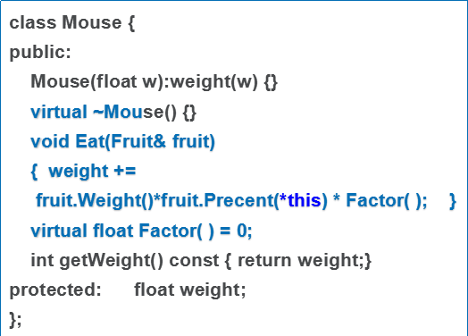
依赖+继承（变化3-例） Mouse/Fruit双向依赖
class Fruit {
public:
virtual ~Fruit() {}
//重量
virtual int Weight() const = 0;
//可用部分的百分比
virtual float Precent(Mouse& mouse) const = 0;
};
class Orange:public Fruit {
public:
Orange(int w1,int w2)
:weight1(w1),weight2(w2) {}
virtual int Weight() const
{ return weight2; }
virtual float Precent(Mouse & m) const
{ return 0.7+
m.getWeight()>=80 ? 0.015 : 0.02; }
private:
int weight1; int weight2;
};
class BigMouse:public Mouse { /*不变*/};
class LittleMouse:public Mouse { /*不变*/};

Slide 9
回调函数的例
C++中：
class MyClass { //
public：
virtual ~MyClass() {}
virtual void F( )const { } //子类可具体实现
}；
void someFunc( const MyClass & funcobj )
{ funcobj.F( ); }
void caller( )
{ someFunc(Sub1MyClass());
someFunc(Sub1MyClass());
}
这时的MyClas,常称为函数对象类。
C中：
void caller( ) { someFunc( ); }
void someFunc() { myFunc(); }
如何让用户在运行时指定myFunc（）呢？
C中:
void F1() { cout<<1<<endl;}
void F2() { cout<<2<<endl;}
typedef void (*MyFuncType)();
//定义参数类型为函数的函数
void someFunc(MyFuncType F)
{ F( ); }
void caller( )
{ someFunc(F1);
someFunc(F2);
}
如果F1,F2 是类的成员函数呢？
如果caller也是MyClass的成员函数，F()被回调。class MyClass {
public:
virtual ~Caller() {}
virtual void F( );
void Caller( ) { doSome( *this); }
};

Slide 10
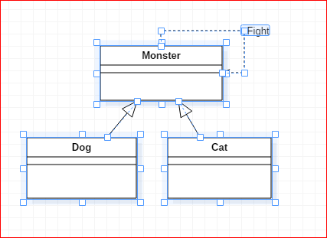
依赖+继承（变化4-例）
bool Monster::Fight(Monster & other) {
while(1) {
if (Attack(other)) return WIN;
if (other.Attack(*this) return LOSE;
}
}

Slide 11
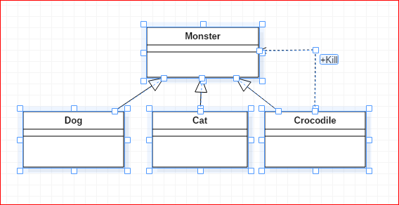
依赖+继承（变化5-例）

Slide 12
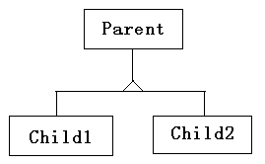
关联+继承(基本)---没有进一步区分组合、聚合、普通关联
A
class Parent;
class A {
public:
virtual ~A( );
void Func( );
protected:
Parent * p;
};

Slide 13
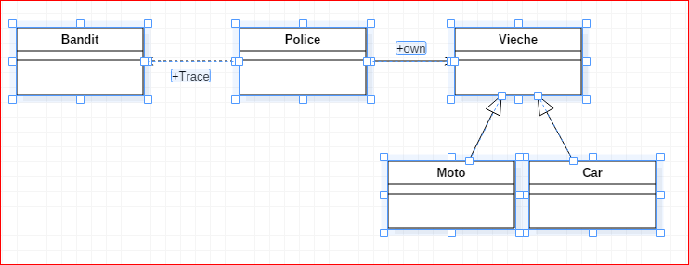
关联+继承（基本-例1）
class Police {
public:
bool Trace(Bandit & bandit, int hours) {
return vieche->getMaxSpeed( ) > bandit.Speed();
}
private:
Vieche * vieche;
}；

Slide 14
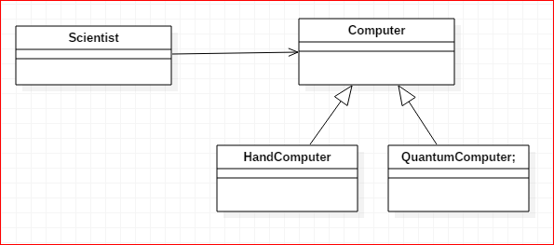
关联+继承（基本-例2）-- 委托、代理
class Scientist {
public:
float CircleArea(float r ) {
return computer->caculateArea(r);
}
private:
Computer * computer;
}；
对于一对一的情况，还可表示客户类中某个函数的功能，全部或部分委托给其它对象完成。

Slide 15
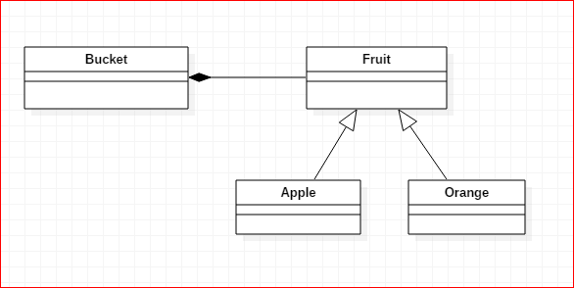
关联+继承（基本-例3）-- 组合
class Bucket {
public:
Bucket() {
for(int i=0;i<5;++i) fruit[i] = new Apple;
for(int i=0;i<5;++i) fruit[5+i] = new Orange;
}
~Bucket()
{ for(int i=0;i<5;++i) delete fruit[i]; }
private:
Fruit * fruit[10];
}；

Slide 16
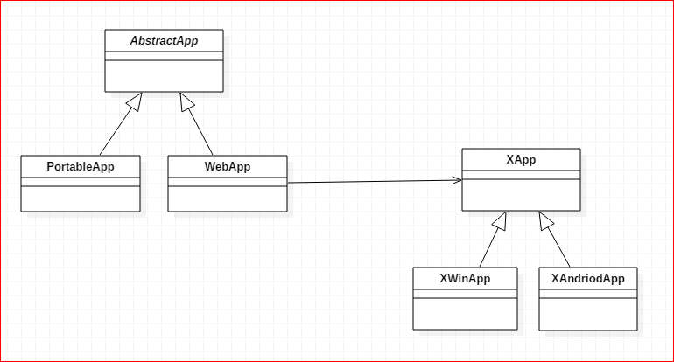
关联+继承（变化-例1）
class XApp {
public:
virtual ~XApp() {}
virtual void XFunc() = 0;
};
class AbstractApp {
public:
virtual ~AbstractApp() {}
virtual void Func( ) = 0;
}；
class WebApp: public AbstractApp {
public:
WebApp(XApp & x):xApp(x) { }
virtual void Func( )
{ xApp.XFunc( ); }
private:
XApp & xApp;
};

Slide 17
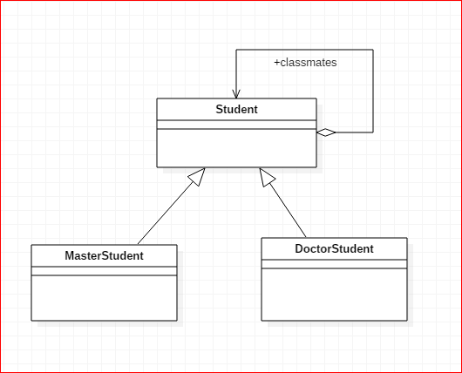
关联+继承（变化-例2）

Slide 18
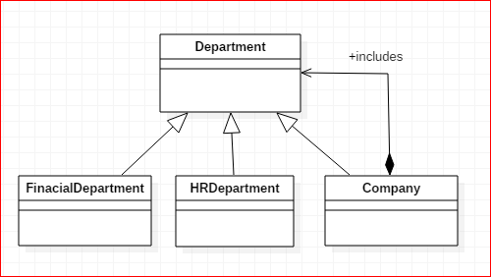
关联+继承（变化-例3）

Slide 19
字符图像例
字符图像是：
  单行字符串
  将字符图像加框
  两个字符图像水平连接
  两个字符图像垂直连接
给出合适的类结构，描述字符图像要方便以后对字符图像的功能扩展
  如改变边框的字符
  如水平连接时，间隔指定的字符宽度

