Slide 1





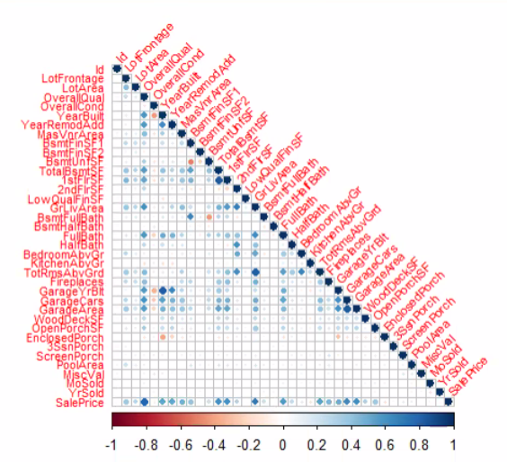
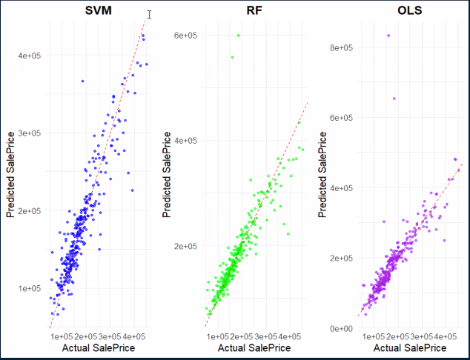
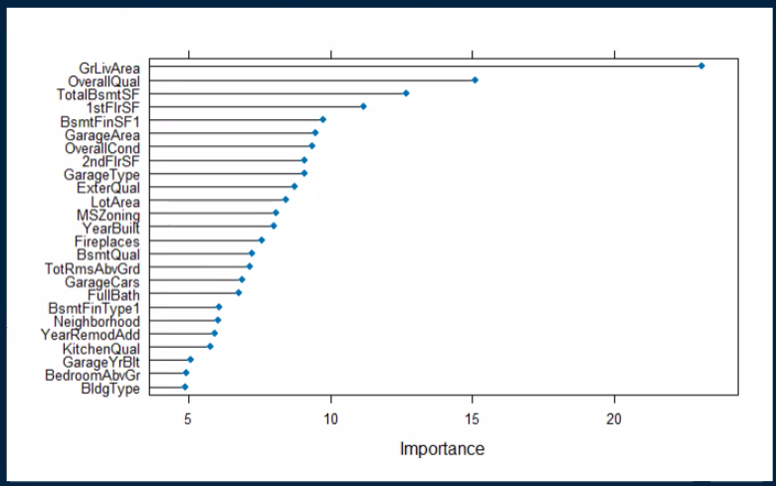
Comparative Analysis of Predictive Models for Ames, Iowa Housing Prices
Will Hyltin, Tim Harrison and Holly Milazzo
The University of Texas at San Antonio, San Antonio TX, 78249
Abstract
Methods
Results - con’t
Conclusions (Disc. or Summary)
In this study, we develop multiple predictive models to estimate housing prices based on a comprehensive dataset that includes various characteristics of houses within Ames, Iowa. We employed a range of modeling techniques—Ordinary Least Squares (OLS), Partial Least Squares (PLS), Neural Networks (NNET), Support Vector Machines (SVM), and Multivariate Adaptive Regression Splines (MARS)—to handle the diverse nature of the data, from linear relationships to complex, non-linear interactions. Each method was chosen for its specific strength in dealing with different aspects of the data: OLS for basic linear relationships, PLS for dimensionality reduction in highly correlated data, NNET for capturing complex patterns, SVM for its robustness in high-dimensional space, and MARS for flexible non-linear modeling. This comparative approach not only enhances the accuracy of the predictions but also provides insights into the factors most affecting housing prices, aiding in more informed decision-making in the real estate market.
Can include summary figure; flow chart, image, photographs. Can bullet to shorten. Few words as possible. sure to include subjects, experimental design, statistical methods, drugs and equipment used
To achieve our objective in building a predictive model that accurately estimates house prices, we used the following methods:
Data Preparation: Tackling missing entries and ensuring data quality.
Exploratory Analysis: Examining the data visually and statistically to identify patterns.
Feature Engineering: Creating and selecting relevant features to improve model accuracy.
Model Development: Training and tuning several models, focusing on their performance metrics.
Model Assessment: Employing cross-validation to evaluate model performance and prevent overfitting.
Predictor Correlation Matrix
Many Characteristics have a clear influence on housing prices.
GrLivArea, OverallQual, TotalBsmtSF, GarageCars, and FullBath led to the best predictive performance.
An SVM model with Radial Basis Function is best able to handle prediction due to robustness to outliers^{[1]}.
Further study may include deeper model tuning, and identifying more variables that may improve predictive performance.
 | RMSE | Rsquared | MAE
OLS | 54366.86 | 0.6521157 | 21517.07
RF | 41949.82 | 0.7213076 | 18726.9
SVMr | 30746.72 | 0.841221 | 20888.24
Introduction (Background)
Figure 3. Post Resample performance measures for each model are listed above. The SVM model with a Radial Basis Function performed the best in both R-Squared and RMSE, although was worse than Random Forest in MAE.
Results
This project explores predictive modeling techniques to estimate housing prices in Ames, Iowa using a detailed dataset. We apply multiple methods—OLS, PLS, NNET, SVM, and MARS—to analyze diverse data characteristics, aiming to enhance prediction accuracy and understand key factors influencing real estate values.
Cleaning the data consisted primarily with the handling of missing values, which involved logical imputations when the missing value was itself meaningful, and imputation using various case dependent methods during pre-processing when the missing values did not appear to be meaningful. Other pre-processing steps consisted of BoxCox transformations, centering, scaling, removing near Zero Variance predictors, and creating dummy variables for use in OLS.
Once cleaned and pre-processed, an Ordinary Least Squares model was fit to the data, to see how responsive our variable of interest was to a simple solution and provide a baseline for future solutions. The model performed well in resampling the training set but poorly on the test data, suggesting there could be some overfitting. A Random Forest model was then trained to the data, chosen to better handle the categorical variables and give an understanding of variable importance. This model performed better in both the training and test set, but still left something to be desired in terms of explained variance and error.
Here the variables that the Random Forest stated were most important were observed (figure 2), which was cross referenced with an earlier correlation matrix from the data exploration steps (figure 1). Many variables were in common between the two, and five such were chosen to be included in our next model: GrLivArea, OverallQual, TotalBsmtSF, GarageCars, and FullBath. These five were chosen to be unique enough from each other and to simplify the model to reduce predictor noise. The predictors were then fit to an SVM model with a Radial Basis Function, chosen for its robustness to outliers^{[1]} in the data, which can be seen in the residual/ actual vs predicted plot (figure 4). This resulted in our best model, and would be our recommendation to use for predictive power. Resampling performance statistics can be seen in figure 3.
Model Performance: Predicted vs Actual
Figure 1. The correlation matrix seen above was created for exploratory analysis, to confirm if there were any highly correlated predictors that would need to be removed to improve model performance. The plot ultimately ended up being crucial when choosing important variables to be included in the final model.
Purpose (Objective, Aim, Goal)
The structural characteristics and location of houses in Ames, Iowa, significantly influence their market prices. By applying various machine learning methods, we can effectively predict housing prices based on these features with varying degrees of accuracy and interpretability.
Random Forest Variable Importance
H₀ (Null Hypothesis): The structural characteristics and location of houses in Ames, Iowa, do not have a significant effect on their market prices.
H₁ (Alternative Hypothesis): The structural characteristics and location of houses in Ames, Iowa, significantly influence their market prices.
Figure 4. Prediction vs Actual value is plotted above, resulting in a plot similar to a residual plot. Here it is clear that both OLS and RF suffered from outlier values, which the SVM model handled nicely.
References
Figure 2. The Random Forest model provides the variables with the greatest importance to the model performance, seen above. This was then utilized to decide on variables to include in the final model.
Kuhn, Max, and Kjell Johnson. Applied predictive modeling. Vol. 26. New York: Springer, 2013.

