Slide 1

Telco Customer Retention
DA-6213 Data Driven Decision Making
Spring 2025
William Hyltin, Holly Milazzo, Tim Harrison
Notes:
Slide for wald test

Slide 2
Business Problem and Research Objective
Background: The business has observed rising customer churn rates and wants to understand which factors (e.g., contract type, service usage, billing method, demographics) are most associated with customers leaving. By identifying high-risk groups through a logistic regression model, the business can better prioritize retention strategies, such as offering discounts, improving service quality, or modifying contract terms.
Business Question: Which customer characteristics are most predictive of churn, and how can the business target interventions to reduce churn risk among at-risk customers?

Slide 3

Data Set Description
Dataset Size: 7,032 customer records with 21 variables
Target Variable: Churn (Yes/No) — whether a customer left the company
Variable Types:
17 categorical (e.g., gender, contract type, payment method)
4 numeric (tenure, monthly charges, total charges, senior citizen indicator)
Churn Distribution: Imbalanced — fewer customers churned than stayed
Notable Predictors (based on EDA and modeling):
Contract Type: Month-to-month customers churn more
Payment Method: Electronic check associated with higher churn
Internet Service: Fiber optic users churn at higher rates
Tenure and Charges: Shorter tenure and higher charges linked to churn

Slide 4
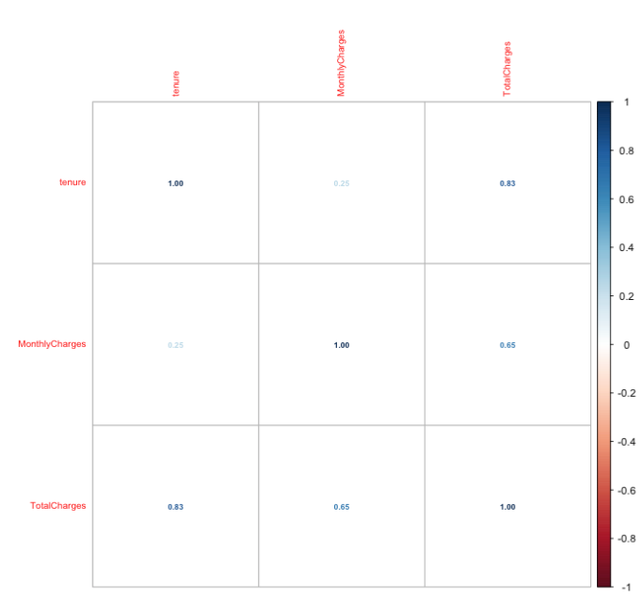
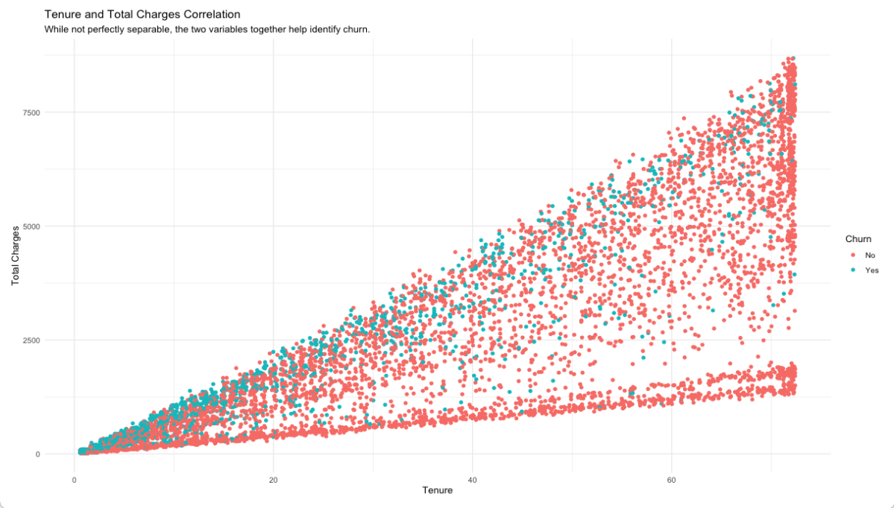
Data Cleaning and Preparation
Removed customerID - It was an identifier with no predictive value for churn.
Converted SeniorCitizen from numeric (0/1) to categorical
Converted all character variables to factors
Addressed perfect correlations between service variables
Created dummy variables for services (e.g., OnlineSecurity, DeviceProtection) and dropped levels perfectly correlated with not having internet or phone service (avoided perfect separation errors).
Dropped redundant variables before modeling
TotalCharges initially dropped (due to high correlation with tenure), but reintroduced later as part of an interaction with tenure based on exploratory findings.
Split data into training (70%) and test (30%) sets

Slide 5
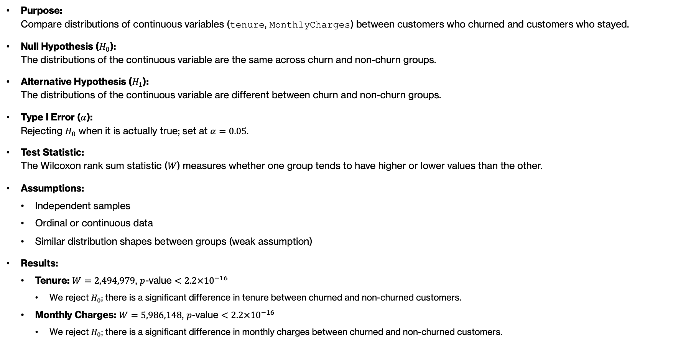
Statistical Test: Wilcoxon Rank Sum Test
Purpose: Compare distributions of continuous variables (tenure, MonthlyCharges) between customers who churned and customers who stayed.
Null Hypothesis ($H_{0}$): The distributions of the continuous variable are the same across churn and non-churn groups.
Alternative Hypothesis ($H_{1}$): The distributions of the continuous variable are different between churn and non-churn groups.
Type I Error ($α$): Rejecting $H_{0}$ when it is actually true; set at $α=0.05$.
Test Statistic: The Wilcoxon rank sum statistic ($W$) measures whether one group tends to have higher or lower values than the other.
Assumptions:
Independent samples
Ordinal or continuous data
Similar distribution shapes between groups (weak assumption)
Results:
Tenure: $W=2,494,979$, $p$-value $<2.2×{10}^{−16}$
We reject $H_{0}$; there is a significant difference in tenure between churned and non-churned customers.
Monthly Charges: $W=5,986,148$, $p$-value $<2.2×{10}^{−16}$
We reject $H_{0}$; there is a significant difference in monthly charges between churned and non-churned customers.

Slide 6
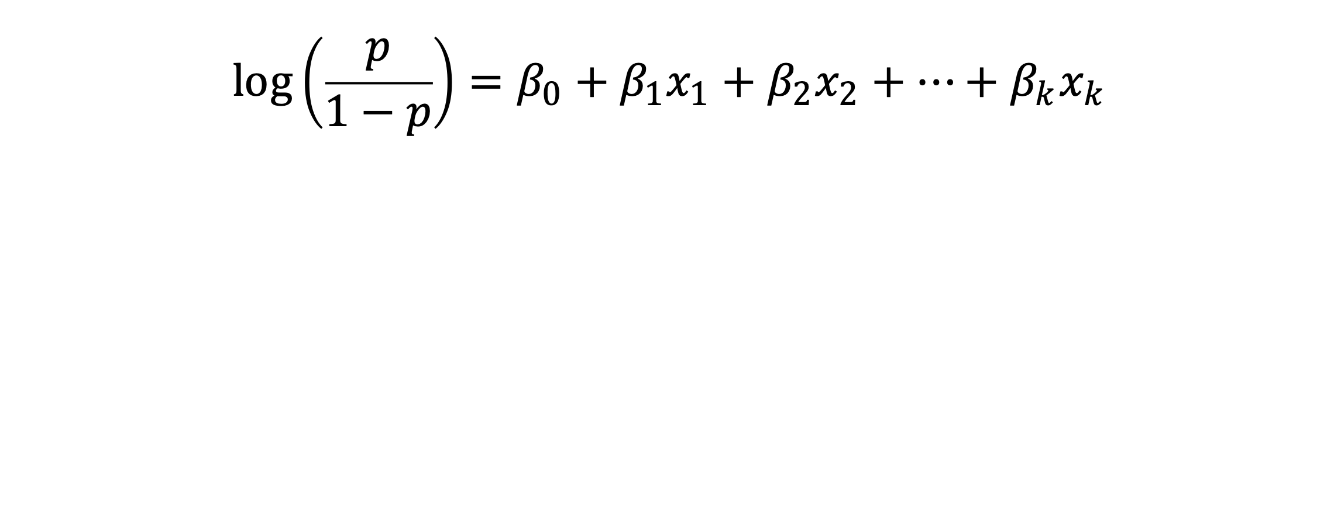


Predictive Modeling: Logistic Regression
Purpose: Model the probability that a customer churns based on customer demographics, account information, and service usage.
Null Hypothesis ($H_{0}$): None of the predictors are significantly associated with customer churn (all regression coefficients $β_{j}=0$).
Alternative Hypothesis ($H_{1}$): At least one predictor is significantly associated with customer churn (at least one $β_{j}≠0$.
Type I Error ($α$): Rejecting $H_{0}$ when it is actually true; set at $α=0.05$.
Test Statistic: Wald $z$-test for each coefficient ($β_{j}$) and overall model deviance reduction (likelihood ratio test).
Assumptions:
Binary outcome variable (Bernoulli Distribution)
Independence of observations
Linearity of continuous predictors with log-odds
No perfect multicollinearity among predictors
Large sample size for reliable Wald tests

Slide 7
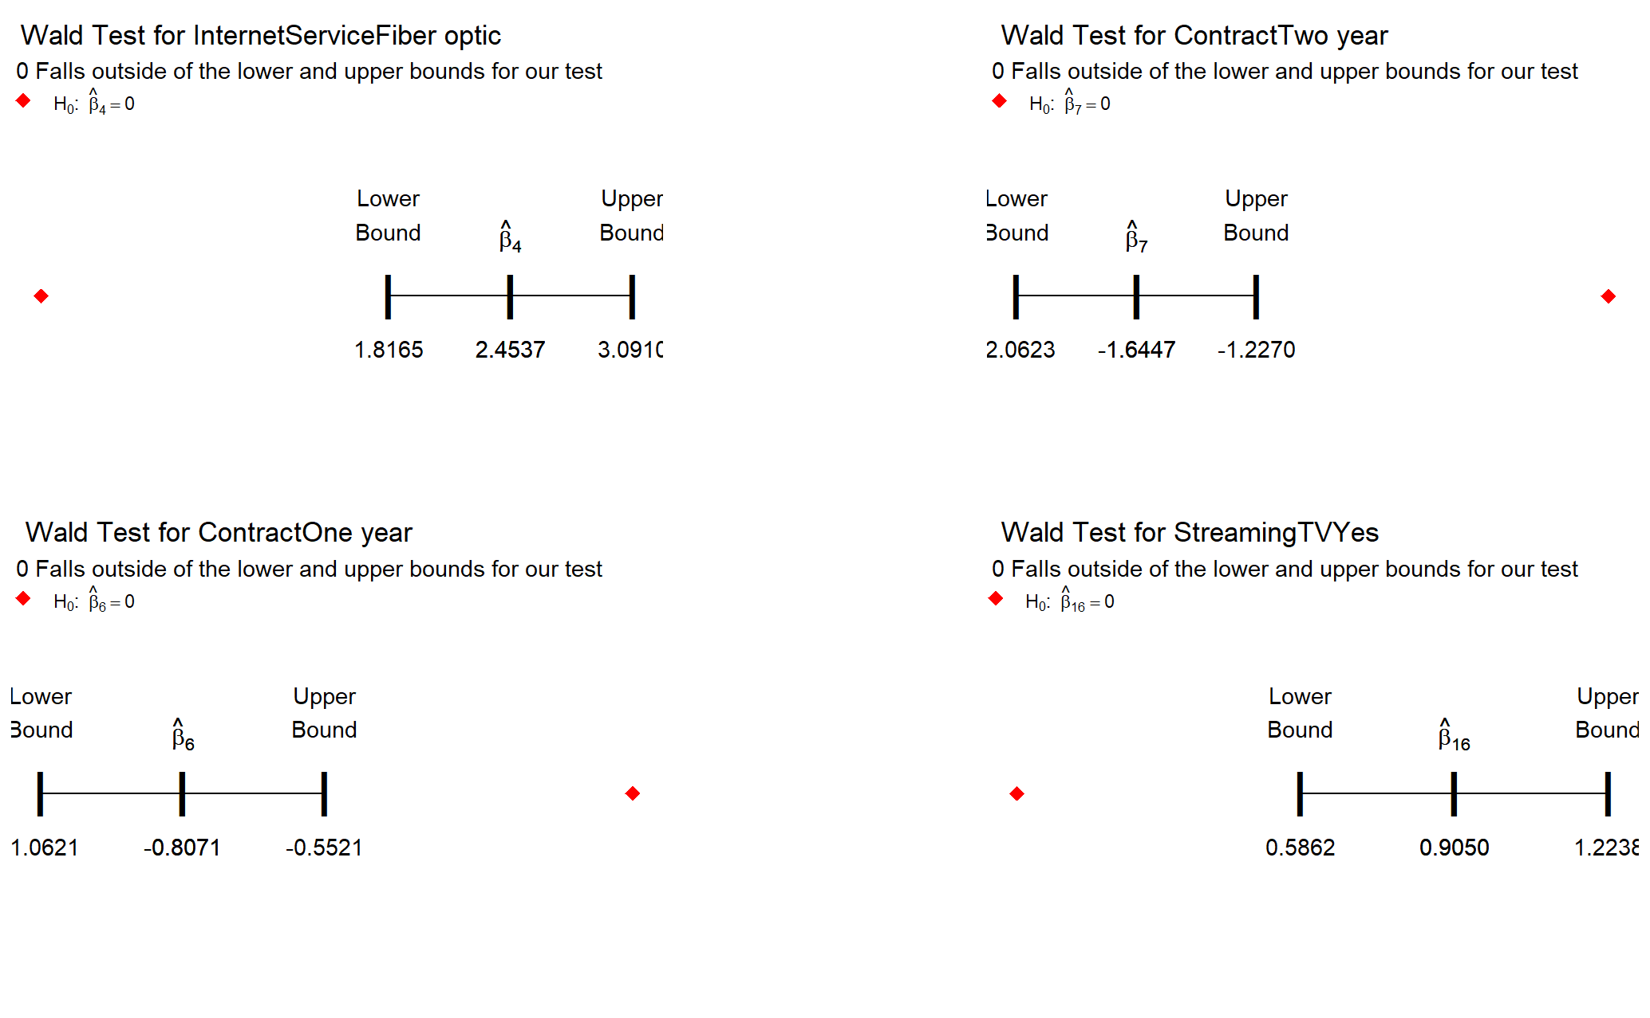
Predictive Modeling: Logistic Regression
Results:
Accuracy on test data: 81.9%
Sensitivity (Recall): 54.6%
Specificity: 91.8%
Significant predictors included:
Contract Type (One/Two Year)
Internet Service Type (Fiber optic vs DSL)
Payment Method (Electronic check)
Monthly Charges
Odds ratios indicated that customers
with month-to-month contracts
and fiber optic service
were significantly more likely to churn.

Slide 8
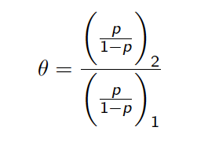
Odds Ratio
Predictor | Odds Effect | Interpretation
MultipleLinesYes | 1.99 | Having multiple lines nearly doubles churn odds.
InternetServiceFiber optic | 11.63 | Fiber optic users are nearly 12x more likely to churn than those with DSL.
OnlineBackupYes | 1.26 | Customers with online backup are 26% more likely to churn.
DeviceProtectionYes | 1.38 | Customers with device protection are 38% more likely to churn.
StreamingTVYes | 2.47 | Streaming TV users are 2.5x more likely to churn.
StreamingMoviesYes | 2.55 | Streaming Movies users are 2.6x more likely to churn.
PaperlessBillingYes | 1.34 | Paperless billing customers are 34% more likely to churn.
PaymentMethodElectronic check | 1.26 | Paying by electronic check increases churn odds by over 25% compared to Bank Transfer.
tenure:TotalCharges | 1 + 3.87e-06 | As both tenure and Total Charges increase, the odds of churn increase by a small amount.

Slide 9
Odds Ratio
Predictor | Odds Effect | Interpretation
DependentsYes | 0.81 | Customers with dependents are 19% less likely to churn than those without.
InternetServiceNo | 0.10 | Customers with no internet service are much less likely to churn than those with.
ContractOne year | 0.45 | One-year contract customers are 55% less likely to churn than month to month.
ContractTwo year | 0.19 | Two-year contract customers are 81% less likely to churn than month to month.
PaymentMethodMailed check | 0.83 | Paying by mailed check slightly reduces churn risk compared to Bank Transfer.
MonthlyCharges | 0.94 | Slight effect — higher monthly charges very slightly decrease churn risk.

Slide 10

Business Recommendation: Test Retention Strategies
Recommendation: Implement a Champion/Challenger A/B test to evaluate the impact of targeted retention strategies based on significant churn predictors.
Champion Group: Business-as-usual retention efforts (control group).
Challenger Group: Customers receiving enhanced interventions based on model insights:
Incentivize customers on month-to-month contracts to switch to 1- or 2-year terms
Offer personalized outreach or discounts to fiber optic users
Provide bundling or loyalty perks to customers with streaming services
Encourage switching away from electronic check to more stable payment methods
Evaluation Method: After sufficient sample collection, conduct a Chi-Square Test of Independence to determine whether churn rates differ significantly between groups.
Why Chi-Square:
Outcome is binary (churn vs no churn)
Independent samples
Suitable for comparing proportions across categorical groups
Goal: Determine whether proactive changes lead to a statistically significant reduction in churn.

