Slide 1

Group# 4
Vihang Gosavi 09005016
Ashish Yadav 09005018

Slide 2
The Idea
A robot which roams around in your house and detects unnecessarily “ON” devices and shuts them off, and notifies the owner.
Robot will be a servant bot controlled by an Android Phone.
User interacts with bot using his own Android phone.
The idea is to make a smart and ingenious servant to Stop electricity wastage in households.

Slide 3
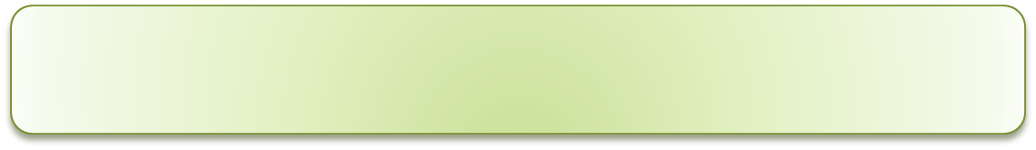
The Idea (ctd…)
POWER SUPPLY
SMART
SOCKET
Electronic Device
USER
Wi-Fi
Android
Interface
(GPRS)
Environment
Android
Phone
Wi-Fi modules
Sensors
Light
Motion
breeze
PSS BOT

Slide 4
Key Challenges
Building a communication interface between Firebird and Android Phone.
Accurate sensing of the environment.
Wireless communication between sockets and the bot.
Path traversing.
Tackling the externalities, or any outside interference.

Slide 5
Response
Accurate sensing of the environment.
- Properly calibrated sensors are assumed to be available.

Slide 6
Response
Wireless communication between sockets and the bot.
- Smart Sockets are assumed to be of this capability. Robot will communicate with them. Wi-Fi communication API’s of firebird to be used.

Slide 7
Response
Path traversing.
- We plan to demonstrate the robot on white lines , which eliminates this challenge.
- GPS navigation
- Manual Drive

Slide 8
Response
Externalities
- Bot should never enter , unwanted states.
- Communication failure
- Power failure
- Hardware Failure
- Pre-coded commands / orders.

Slide 9
Response
Simulation:
Room: 1
Room: 2
Start
Room: 3
Room: 4

Slide 10
Additional Hardware
Motion Sensor
Light sensor
Breeze sensor
Smart Socket
Android Phones
Wireless communication module.

Slide 11
Where can we fail
Sensor failure.
Improper command by user.
Lack of Network (GSM) coverage.
Hardware failure.

