Slide 1


Basic Programming in Python
4. Session: Functions
Nohayr Muhammad Abdelmoneim
Summer Term 2023
May 15th, 2023
Nohayr Muhammad – IKW, Osnabrück
Basic Programming in Python – SoSe 2023

Slide 2
Overview
Recap on methods
Functions vs. Methods
How to define Functions
How to call Functions
Variable Scope
Recursive Functions
Nohayr Muhammad – IKW, Osnabrück
Basic Programming in Python – SoSe 2023

Slide 3
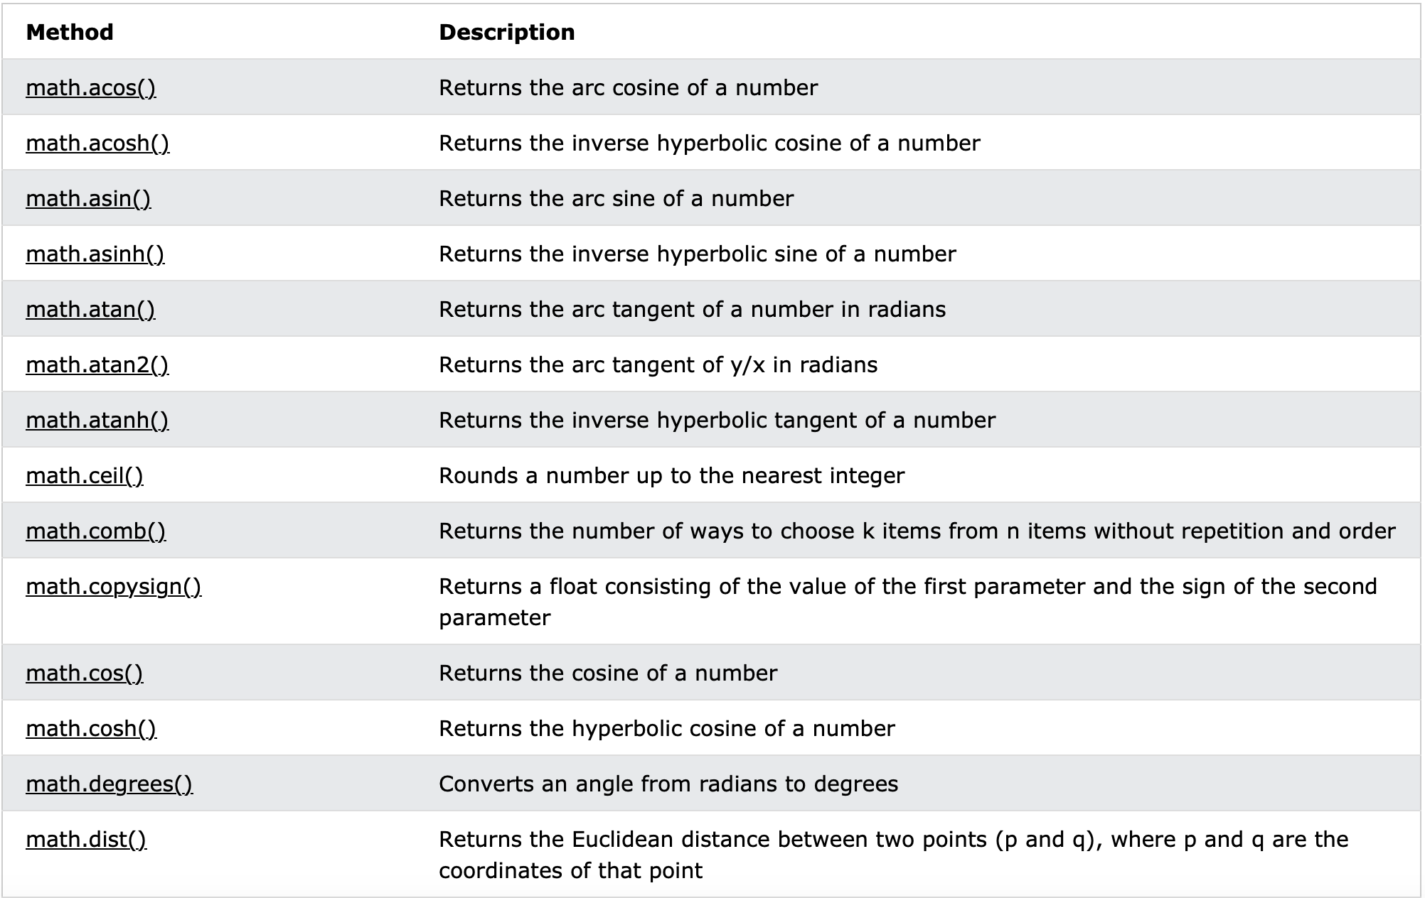
Math module methods
https://www.w3schools.com/python/module_math.asp
Nohayr Muhammad – IKW, Osnabrück
Basic Programming in Python – SoSe 2023

Slide 4
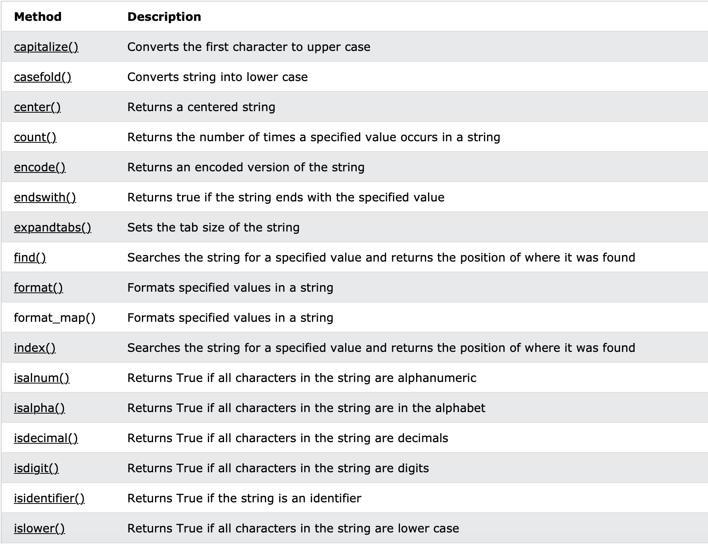
String Methods
https://www.w3schools.com/python/python_strings_methods.asp
Nohayr Muhammad – IKW, Osnabrück
Basic Programming in Python – SoSe 2023

Slide 5
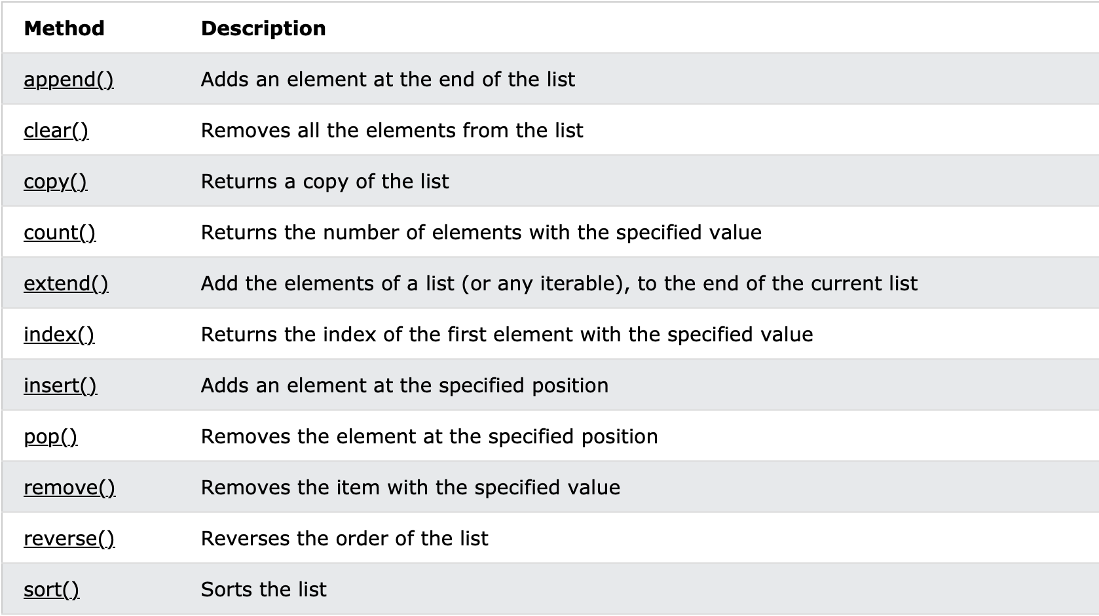
List Methods
https://www.w3schools.com/python/python_lists_methods.asp
Nohayr Muhammad – IKW, Osnabrück
Basic Programming in Python – SoSe 2023

Slide 6
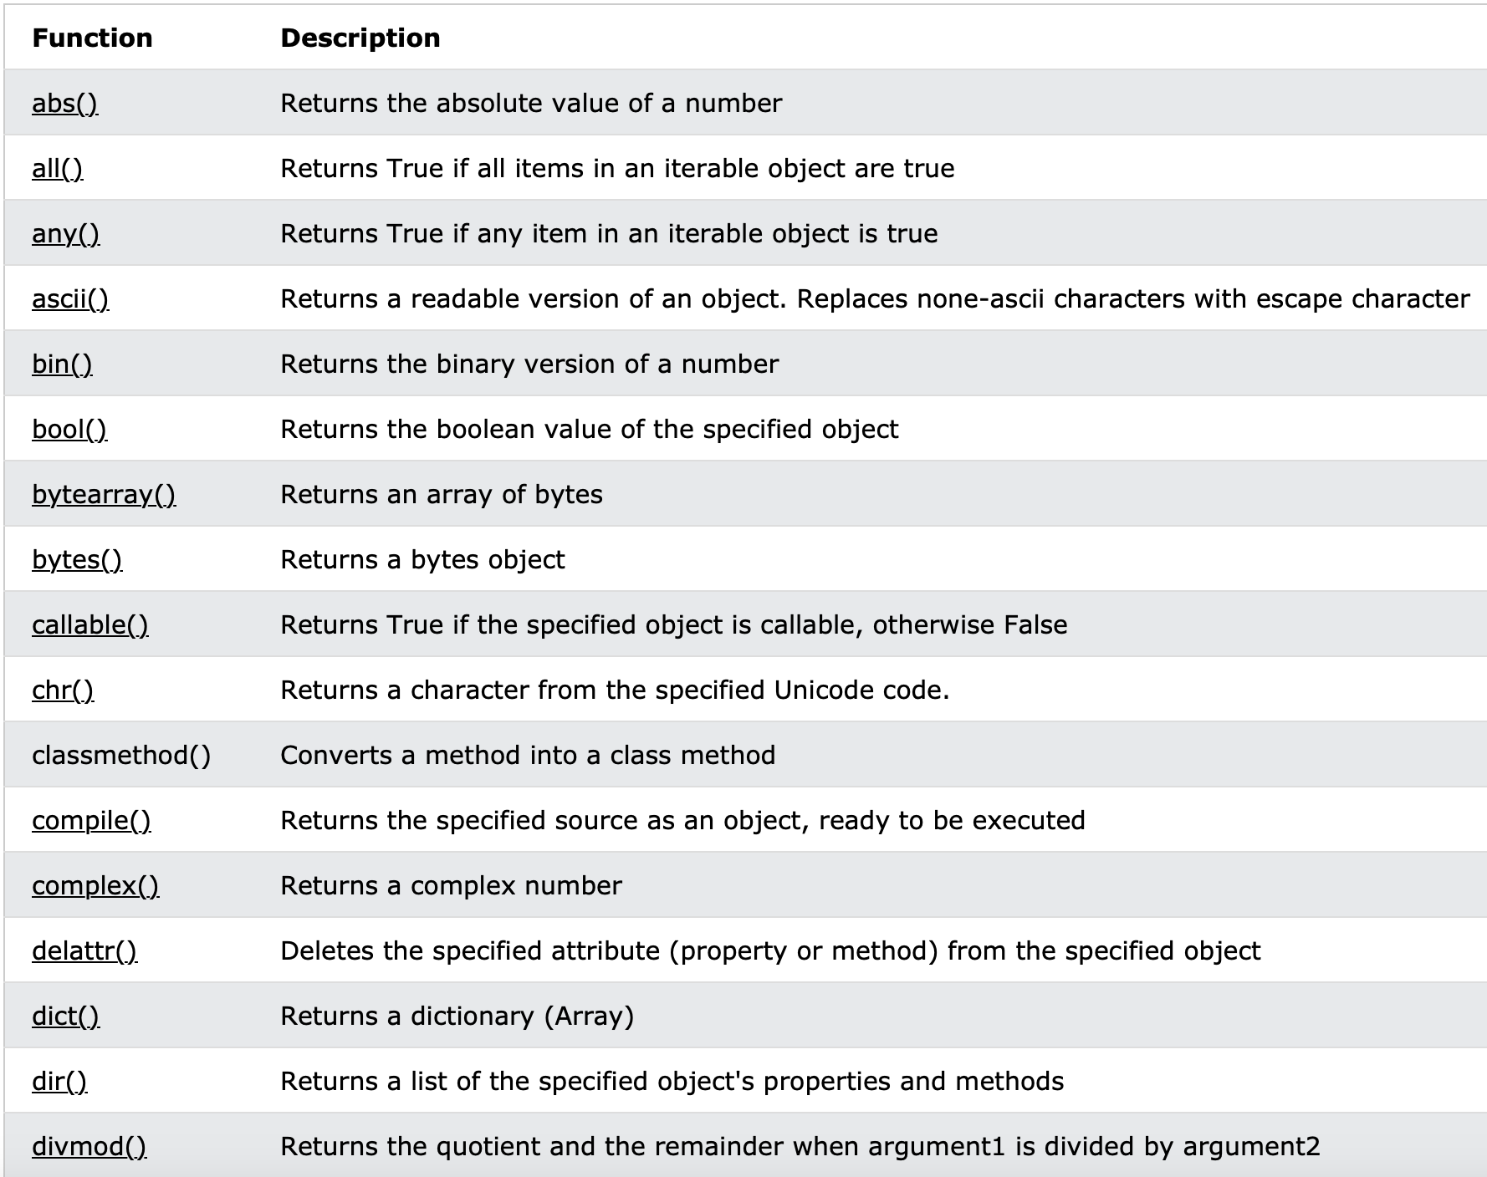
Built in functions
https://www.w3schools.com/python/python_ref_functions.asp
Nohayr Muhammad – IKW, Osnabrück
Basic Programming in Python – SoSe 2023

Slide 7
What is a function/method?
A function is a block of code given a certain name, that performs a specific task.
A function can take one or more parameters/arguments as an input.
A function can return one or more variables as an output.
A function is defined once and can be used many times.
A function is only executed when it is “called”
Nohayr Muhammad – IKW, Osnabrück
Basic Programming in Python – SoSe 2023

Slide 8
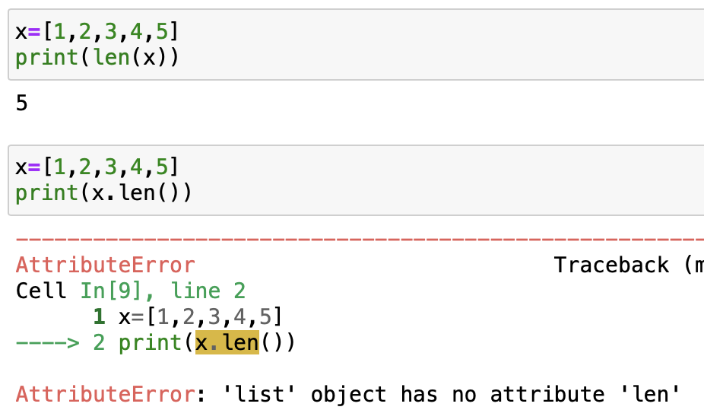
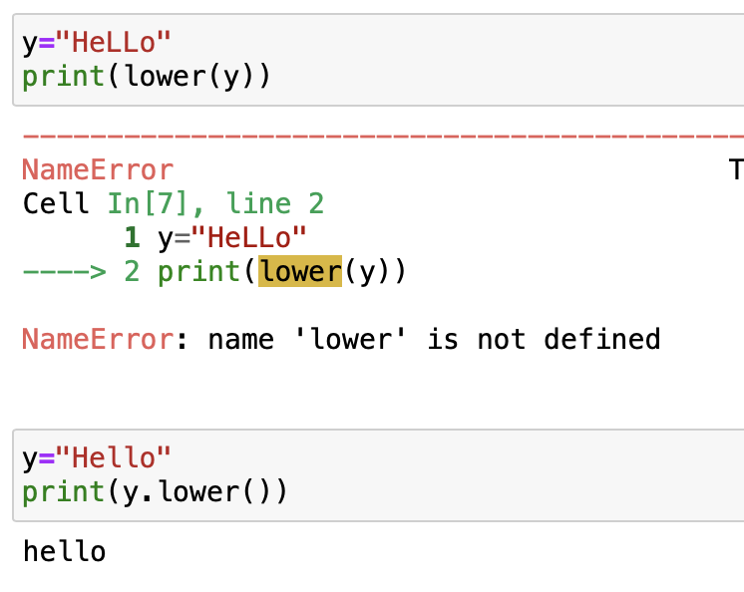
Functions Vs. Methods
A function doesn't need any object and is independent.
A method is a function that is linked with an object.
We can directly call the function with its name.
A method is called by the object's name.
Function
Method
Nohayr Muhammad – IKW, Osnabrück
Basic Programming in Python – SoSe 2023

Slide 9
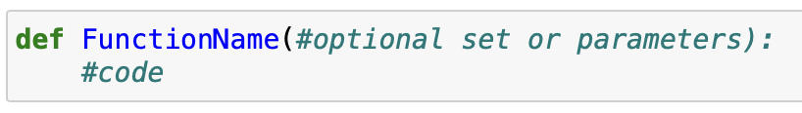
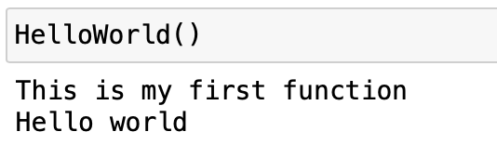
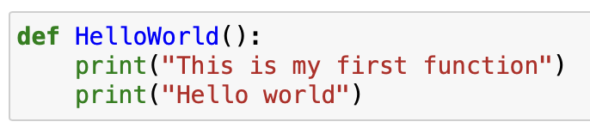
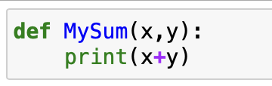
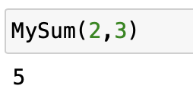
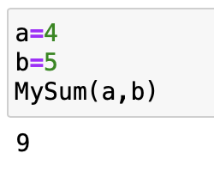
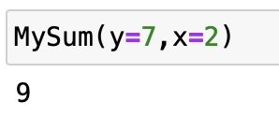
User defined functions
Defining a function
Calling a function
Nohayr Muhammad – IKW, Osnabrück
Basic Programming in Python – SoSe 2023

Slide 10
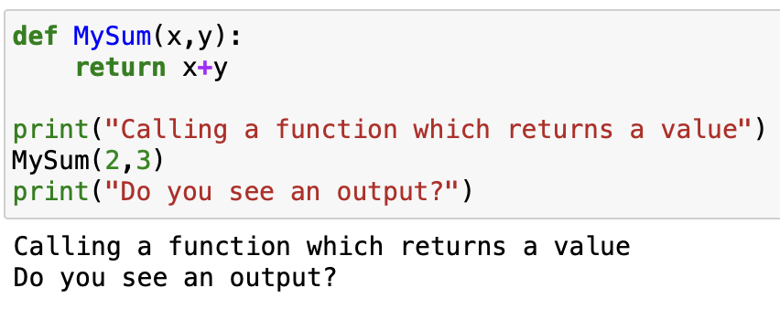
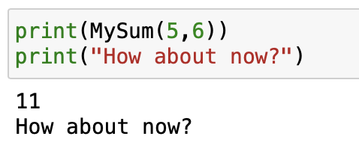
Return value
A function can either perform a block of code without returning a value, or it can return one or more values
There is a difference between printing a value within a function and returning a value
Nohayr Muhammad – IKW, Osnabrück
Basic Programming in Python – SoSe 2023

Slide 11
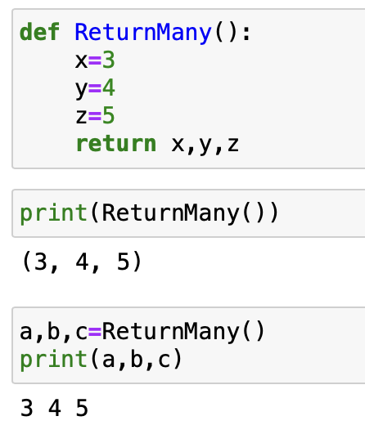
Return many values
A function can return more than a value.
All values can be used when calling, according to the required task
Nohayr Muhammad – IKW, Osnabrück
Basic Programming in Python – SoSe 2023

Slide 12
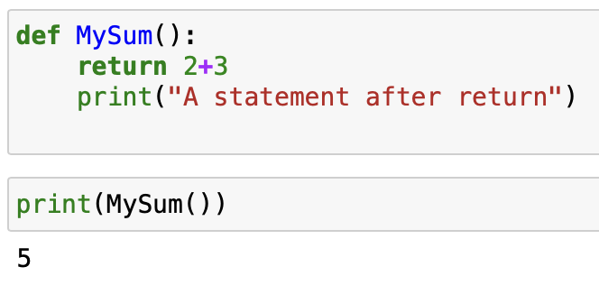
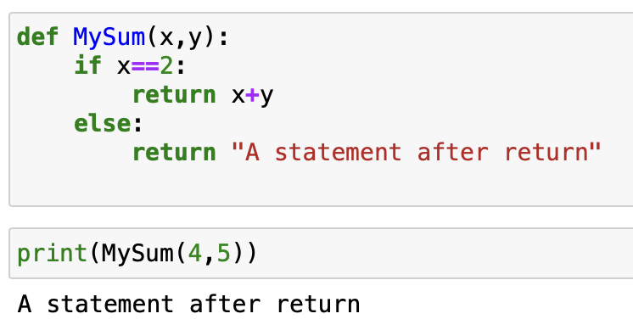
Return Note
Return statement terminates the function and returns the value.
I.e., a code written after return will not be executed (unless within a condition)
Nohayr Muhammad – IKW, Osnabrück
Basic Programming in Python – SoSe 2023

Slide 13
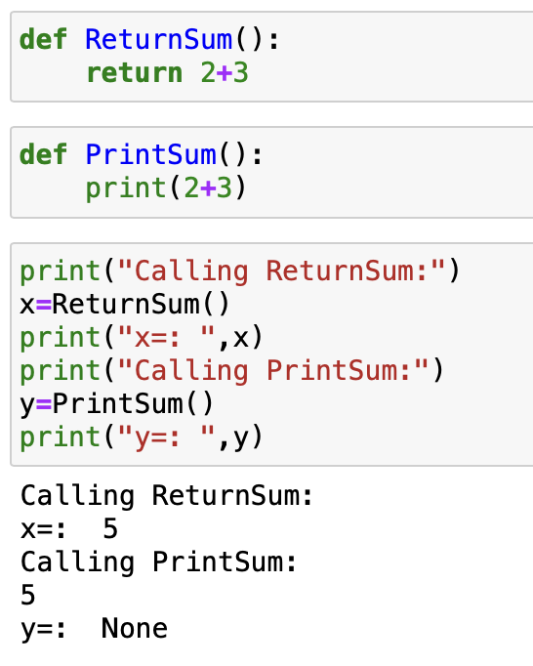
Print vs. return
Nohayr Muhammad – IKW, Osnabrück
Basic Programming in Python – SoSe 2023

Slide 14
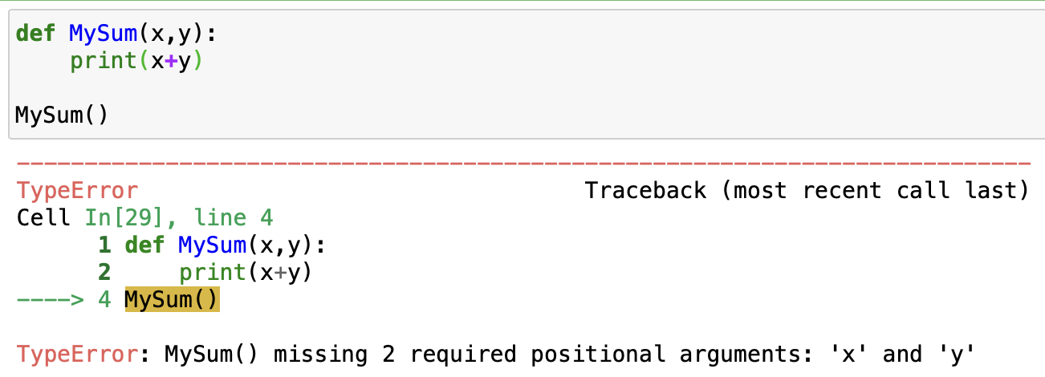
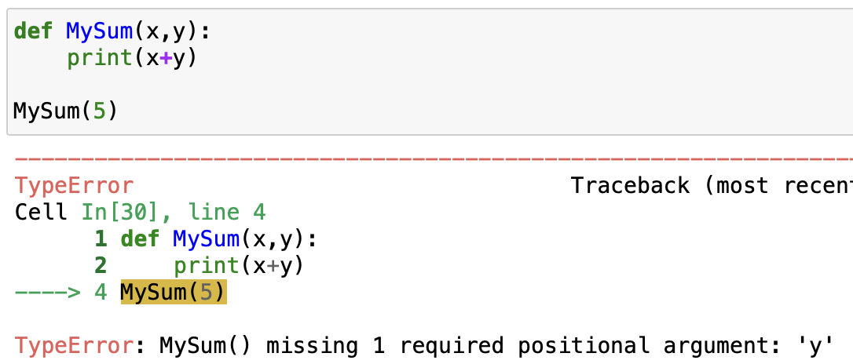
Default arguments
Default arguments are used in case the user didn’t input parameter values.
Nohayr Muhammad – IKW, Osnabrück
Basic Programming in Python – SoSe 2023

Slide 15
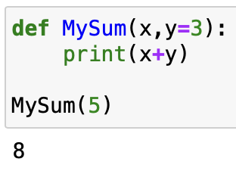
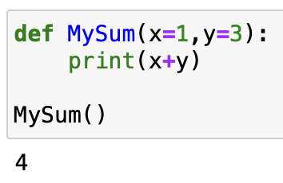
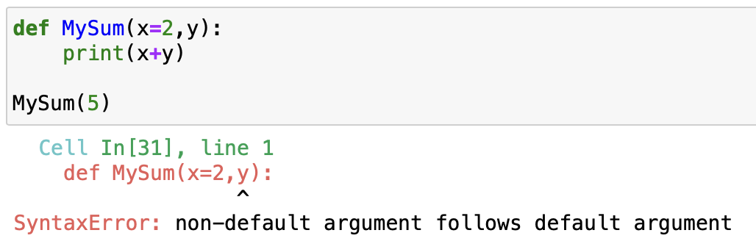
Default arguments
Default arguments are used in case the user didn’t input parameter values.
Nohayr Muhammad – IKW, Osnabrück
Basic Programming in Python – SoSe 2023

Slide 16
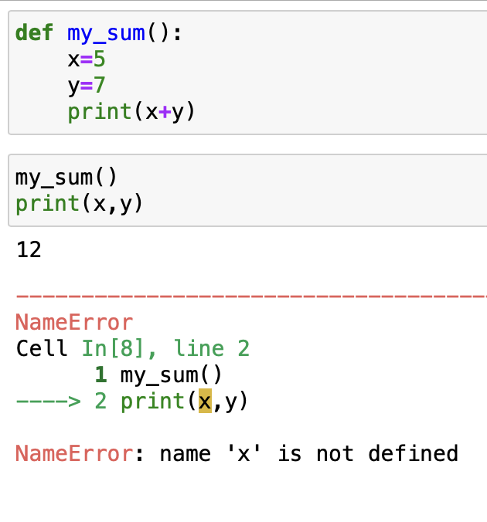
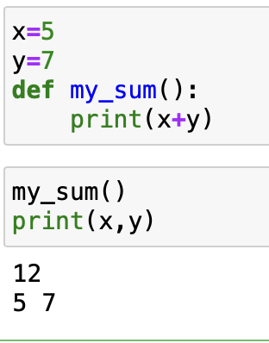
Variable scope (local vs. global)
Variable scope determines which part of the program it’s defined and can be used at.
A variable which is created inside a function, is only defined within the function.
Local variable
Global variable
Nohayr Muhammad – IKW, Osnabrück
Basic Programming in Python – SoSe 2023

Slide 17
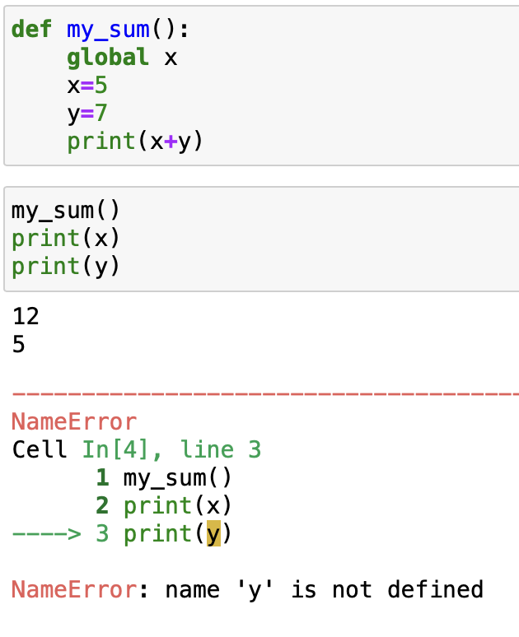
global keyword
The global keyword is used to define a global variable that is defined throughout the program.
Nohayr Muhammad – IKW, Osnabrück
Basic Programming in Python – SoSe 2023

Slide 18
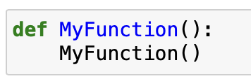
Recursive functions
A recursive function is a function that calls itself inside its body.
A recursive function can be considered as a loop. Hence, a condition must be specified to stop execution.
Nohayr Muhammad – IKW, Osnabrück
Basic Programming in Python – SoSe 2023

Slide 19
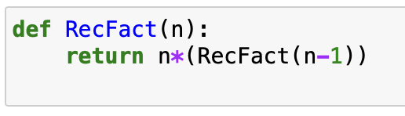
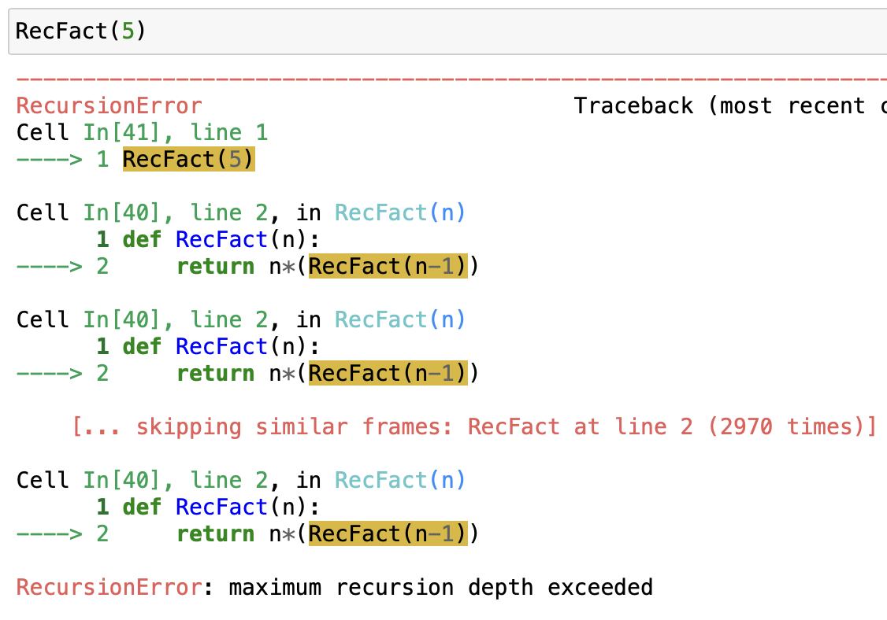
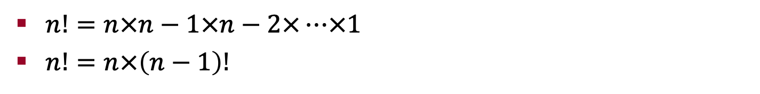
Recursive factorial
$n!=n×n−1×n−2×…×1$
$n!=n×\left(n−1\right)!$
Nohayr Muhammad – IKW, Osnabrück
Basic Programming in Python – SoSe 2023

Slide 20
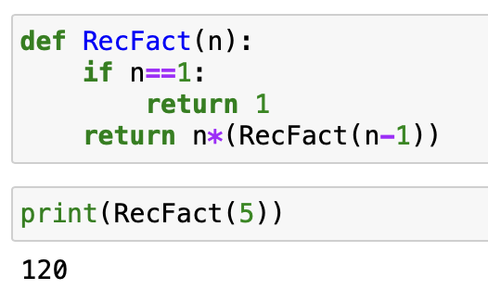

Recursive factorial
$n!=n×n−1×n−2×…×1$
$n!=n×\left(n−1\right)!$
Tracing:
$$RecFact\left(5\right)$$
Is n==1? No
$$RecFact\left(5\right)=5×RecFact\left(4\right)$$
Is n==1? No
$$RecFact\left(4\right)=4×RecFact\left(3\right)$$
Is n==1? No
$$RecFact\left(3\right)=3×RecFact\left(2\right)$$
Is n==1? No
$$RecFact\left(2\right)=2×RecFact\left(1\right)$$
Is n==1? Yes
$$RecFact\left(1\right)=1$$
=120
=120
=24
=24
=6
=6
=2
=2
=1
Nohayr Muhammad – IKW, Osnabrück
Basic Programming in Python – SoSe 2023

Slide 21
Recursive factorial Notes
$n!=n×n−1×n−2×…×1$
$n!=n×\left(n−1\right)!$
Notes:
Can you see the difference between print and return?
What would happen if we replace return with print?
Can you modify the function so that it only accepts positive numbers?
Does the order within the function matter?
What would happen if we switch the order of if statement and return?
Nohayr Muhammad – IKW, Osnabrück
Basic Programming in Python – SoSe 2023

Slide 22
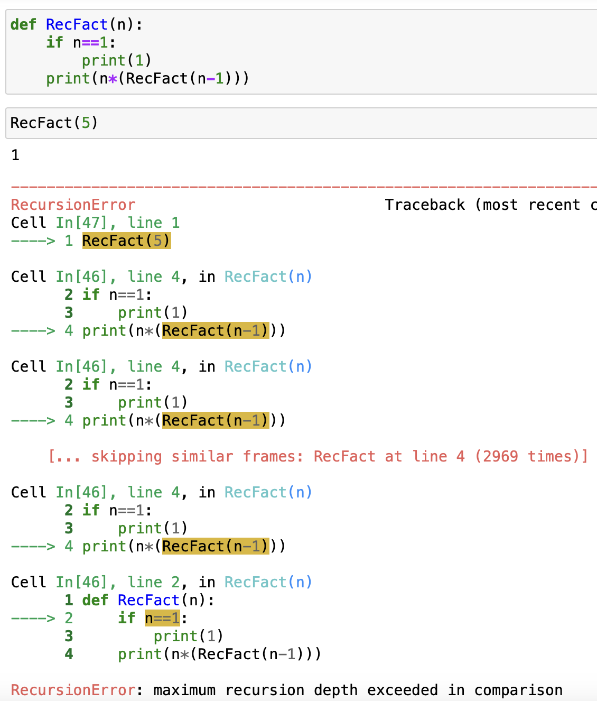
Print vs. return
Print: only prints certain values/messages to the user.
Print doesn’t return an actual value. I.e., printed values are not usable.
return: returns an actual value that can be used in any operation.
Using return replaces the entire function with the returned value
Nohayr Muhammad – IKW, Osnabrück
Basic Programming in Python – SoSe 2023

Slide 23
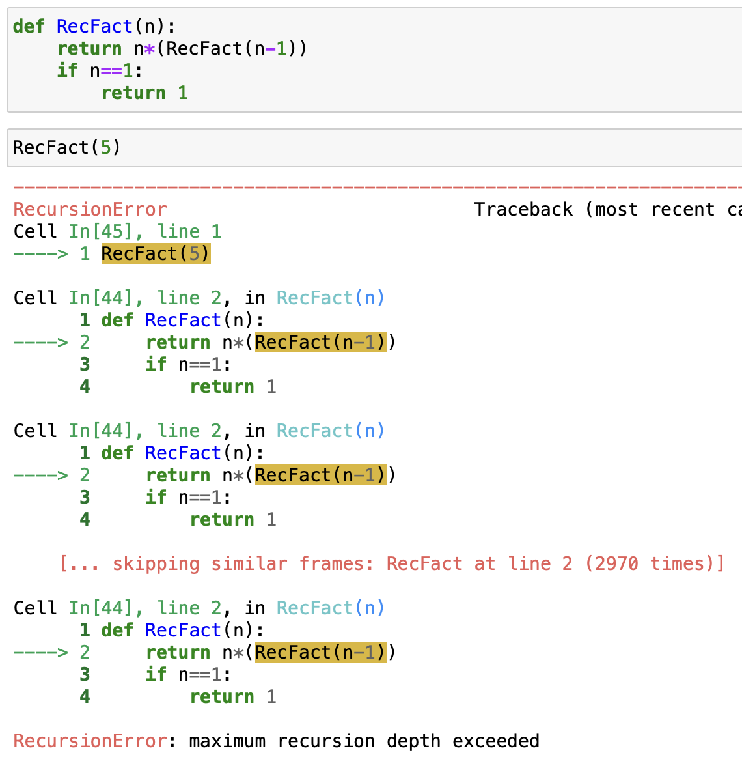
Order of code
When switching orders, the function keeps looping and never executes the if statement.
Nohayr Muhammad – IKW, Osnabrück
Basic Programming in Python – SoSe 2023

Slide 24
QUESTIONS?
Nohayr Muhammad – IKW, Osnabrück
Basic Programming in Python – SoSe 2023

