Slide 1
Deploy Guideline
Acemuc

Slide 2
Task
Database
File Permission
Configuration Connection String

Slide 3
Database
Attack database (sitefinity.mdf)
Tạo user đủ quyền truy cập database vừa tạo
Note: Version sql server 706

Slide 4
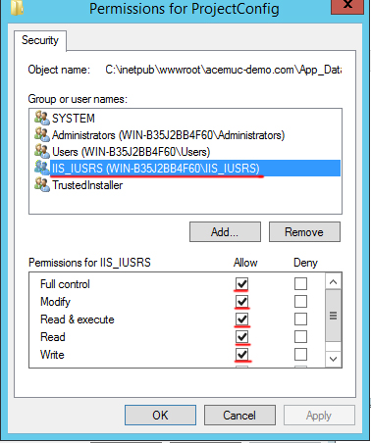
File Permission
Permission full control cho tất cả file trong App_Data\Sitefinity\Configuration

Slide 5
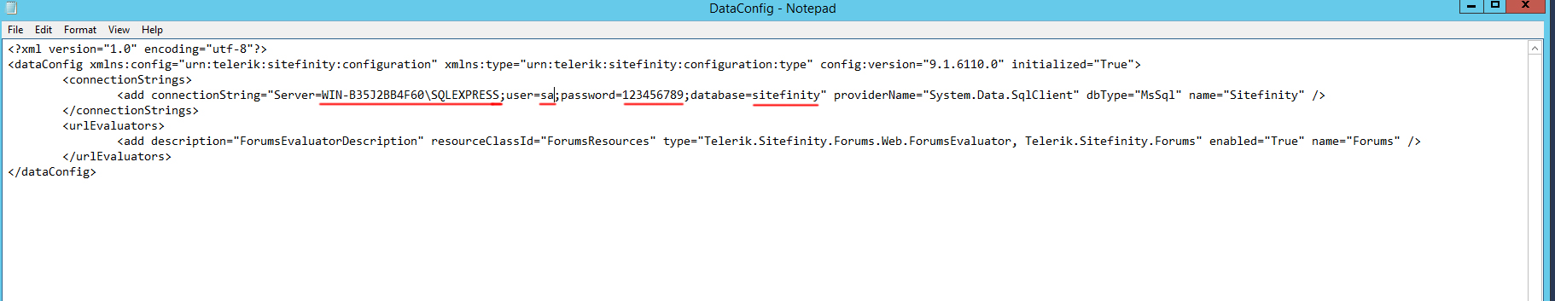
Configuration Connection String
Edit file App_Data\Sitefinity\Configuration\ DataConfig.config
1: server name
2: user name
3: password
4: database name

Slide 6
Thanks

