Slide 1


Slide 2
MBO
Management guru Peter Drucker -first to introduce Management by Objectives (MBO).
An approach for increasing organizational effectiveness.
He observes that every manager, from the highest to the lowest levels in the organisation, should have clear objectives to pursue.

Slide 3
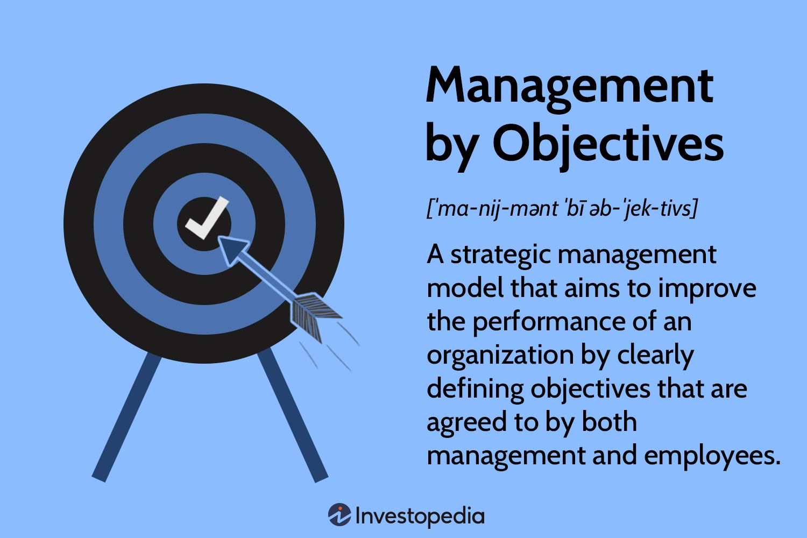

Slide 4
According to him, such a process would enable each manager to have a clear understanding of what the organisation expects of him or her and how their individual objectives are integrated with the overall organizational objectives.

Slide 5
“MBO is a process whereby the superior and subordinate managers of an organisation jointly identify the common goals, define each individual’s major areas of responsibility in terms of the results expected of him, and use these resources as guides for operating the unit and assessing the contribution of each of its members”.
-George Odiorne

Slide 6
Different goals are sought to be achieved by the introduction of MBO in organizations.
MBO, as a management tool, thus, is so versatile that it is used;
a) to integrate the organizational goals with the individual goals;
b) as a motivational technique wherein individuals are driven towards the achievement of goals;
c) to appraise the performance of managers; and
d) to control the activities as they are performed.

Slide 7
Drucker suggests that objectives are to be specified in the key result areas of business (KRAs).
A key result area may be understood as one the performance of which, directly and vitally affect the success and survival of the business.
Accordingly, for a manufacturing firm production, productivity, profitability, market share, social responsibilities, employer and employee relations, manager and worker development, development of physical resources, constitute the important key result areas.

Slide 8
It may be understood that the KRAs vary from business to business.
Since MBO involves a systematic effort towards the achievement of objectives, utmost care has to be exercised in setting the objectives for all the key result areas.

