Slide 1
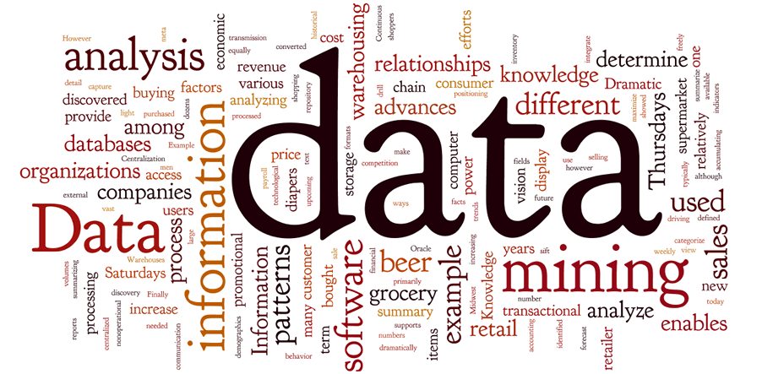
Data Mining Probability and Statistics (Cyber Lecture)
Hee-Cheol KiM

Slide 2
Presentation Outline
Why do we need data mining?
Knowledge Discovery in Databases (KDD)
Data Mining and Business Intelligence (BI)
Confluence of Multiple Disciplines
Why Not Traditional Data Analysis?
Multi-Dimensional View of Data Mining
What Kinds of Data?
Data mining functionality
Examples (K-means algorithm, collaborative filtering, Apriori algorithm)

Slide 3
Why do we need data mining?
The explosive growth of data from terabytes to petabytes cause two issues:
Data collection and data availability
Automated data collection tools.
database systems.
Web.
computerized society.

Slide 4

Why do we need data mining?
Major sources of numerous data
Business: Web, e-commerce, transactions, stocks, …
Science: Remote sensing, bioinformatics, scientific simulation, …
Society and everyone: news, digital cameras, YouTube
“We are drowning in data, but starving for knowledge!”

Slide 5
Definition
Data mining in general (knowledge discovery from data)
Extraction of interesting (non-trivial, implicit, previously unknown and potentially useful) patterns or knowledge from huge amount of data
Alternative names
Knowledge discovery (mining) in databases (KDD), knowledge extraction, data/pattern analysis, data archeology, data dredging, information harvesting, business intelligence, etc.
Watch out: Is everything “data mining”?
Simple search and query processing
(Deductive) expert systems

Slide 6

Definition
Data mining : is the computational process of discovering patterns in large data sets involving methods at the intersection of artificial intelligence, machine learning, statistics, and database systems.
The overall goal of the data mining process is to extract information from a data set and transform it into an understandable structure for further use.

Slide 7
Knowledge Discovery in Databases (KDD)
Knowledge discovery in databases (KDD) : is the process of discovering useful knowledge from a collection of data. This widely used data mining technique is a process that includes data preparation and selection, data cleansing, incorporating prior knowledge on data sets and interpreting accurate solutions from the observed results.
Major KDD application areas include:
marketing.
fraud detection.
telecommunication.
manufacturing.

Slide 8
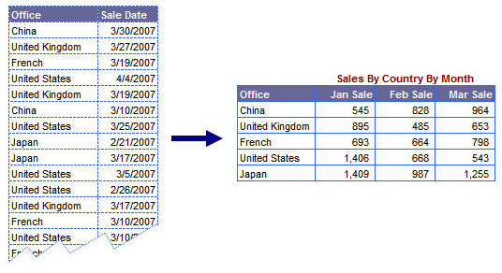
Knowledge Discovery in Databases (KDD)
The following tables is about sales of company that has
many branches in many countries
Table from data warehouse
Data mining technique
Table represent Knowledge

Slide 9
Data Mining and Business Intelligence (BI)
Business intelligence (BI): is the set of techniques and tools for the transformation of raw data into meaningful and useful information for business analysis purposes.
BI technologies are capable of handling large amounts of unstructured data to help identify, develop and otherwise create new strategic business opportunities.
The goal of BI is to allow for the easy interpretation of these large volumes of data.

Slide 10
Data Mining and Business Intelligence (BI)
Increasing potential
to support
business decisions
End User
Decision Making
Data Presentation
Business
Analyst
Visualization Techniques
Data Mining
Data
Analyst
Information Discovery
Data Exploration
Statistical Summary, Querying, and Reporting
Data Preprocessing/Integration, Data Warehouses
Data Sources
DBA
Paper, Files, Web documents, Scientific experiments, Database Systems

Slide 11
Confluence of Multiple Disciplines
Database
Technology
Statistics
Machine
Learning
Data Mining
Visualization
Pattern
Recognition
Other
Disciplines
Algorithm

Slide 12
Confluence of Multiple Disciplines
A statistical model: is a set of mathematical functions that describe the behavior of the objects in a target class in terms of random variables and their associated probability distributions.
A data mining algorithm: is a set of heuristics and calculations that creates a data mining model from data.
To create a model, the algorithm first analyzes the data you provide, looking for specific types of patterns or trends.
The algorithm uses the results of this analysis to define the optimal parameters for creating the mining model. These parameters are then applied across the entire data set to extract actionable patterns and detailed statistics.

Slide 13
Confluence of Multiple Disciplines
Machine learning: investigates how computers can learn (or improve their performance) based on data. A main research area is for computer programs is to automatically learn how to recognize complex patterns and make intelligent decisions based on data.
For example, a typical machine learning problem is to program a computer so that it can automatically recognize handwritten postal codes on mail after learning from a set of examples.
Pattern recognition: is the study of methods and algorithms for putting data objects into categories. While classical pattern recognition techniques are rooted in statistics and decision theory, the machine learning paradigm is commonly used to design practical systems.

Slide 14
Confluence of Multiple Disciplines
Database management systems are computer software applications that interact with the user, other applications, and the database itself to capture and analyze data. A general-purpose DBMS is designed to allow the definition, creation, querying, update, and administration of databases. Well-known DBMSs include MySQL, PostgreSQL, Microsoft SQL Server, Oracle, Sybase and IBM DB2.
Database technology: it provides an internal Representation (model) of the external world of interest.
Examples are the representation of a particular date/time/flight/aircraft in airline reservation or of item code/item description/quantity on hand/reorder level/reorder quantity in a stock control system.

Slide 15

Other Disciplines
Information retrieval (IR) is the science of searching for documents or information in documents. Documents can be text or multimedia, and may reside on the Web.
The differences between traditional information retrieval and database systems are twofold: Information retrieval assumes that
(1) the data under search are unstructured; and (2) the queries are formed mainly by keywords, which do not have complex structures
(unlike SQL queries in database systems).

Slide 16
Why Not Traditional Data Analysis?
Because:
Tremendous amount of data
Algorithms must be highly scalable to handle such as tera-bytes of data
High-dimensionality of data
Micro-array may have tens of thousands of dimensions

Slide 17
Why Not Traditional Data Analysis?
High complexity of data
Data streams and sensor data
Time-series data, temporal data, sequence data
Structure data, graphs, social networks and multi-linked data
Heterogeneous databases and legacy databases
Spatial, spatiotemporal, multimedia, text and Web data
Software programs, scientific simulations
New and sophisticated applications

Slide 18
Multi-Dimensional View of Data Mining
Data to be mined
Relational, data warehouse, transactional, stream, object-oriented/relational, active, spatial, time-series, text, multi-media, heterogeneous, legacy, WWW.
Knowledge to be mined
Characterization, discrimination, association, classification, clustering, trend/deviation, outlier analysis, etc.
Multiple/integrated functions and mining at multiple levels.

Slide 19
Multi-Dimensional View of Data Mining
Techniques utilized
Database-oriented, data warehouse (OLAP), machine learning, statistics, visualization, etc.
Applications adapted
Retail, telecommunication, banking, fraud analysis, bio-data mining, stock market analysis, text mining, Web mining, etc.

Slide 20
What Kinds of Data?
Database-oriented data sets and applications
Relational database, data warehouse, transactional database.
Advanced data sets and advanced applications
Data streams and sensor data.
Time-series data, temporal data, sequence data (incl. bio-sequences).
Structure data, graphs, social networks and multi-linked data.
Object-relational databases.
Heterogeneous databases and legacy databases.
Spatial data and spatiotemporal data.
Multimedia database.
Text databases.
The World-Wide Web.

Slide 21
Data Mining Functionalities
Multidimensional concept description: Characterization and discrimination
(For Example if we have mall database)
Example of data Characterization: Summarize the characteristics of customers who spend more than $5000 a year.
Example of data discrimination: a user may want to compare the general features of software products with sales that increased by 10% last year against those with sales that decreased by at least 30% during the same period.

Slide 22
Data Mining Functionalities
Frequent patterns : are patterns that occur frequently in data.
There are many kinds of frequent patterns, including frequent item sets, frequent subsequences , and frequent substructures.
Example of Frequent patterns: milk and bread, which are frequently bought together.
Association analysis we have two types:
single-dimensional association rule.
Example: where X is a variable representing a customer. A confidence, or certainty, of 50% means that if a customer buys a computer, there is a 50% chance that he/she will buy software as well. A 1% support means that 1% of all the transactions under analysis show that computer and software are purchased together.

Slide 23
Data Mining Functionalities
buys(X, “computer”) ⇒ buys(X, “software”) [support = 1%,confidence = 50%],
multidimensional association rule.
Example: customers under study, 2% are 20 to 29 years old with an income of $40,000 to $49,000 and have purchased a laptop.
age(X, “20..29”) ∧ income(X, “40K..49K”) ⇒ buys(X, “laptop”) [support = 2%, confidence = 60%].
Single factor so we call it single dimensional
Multi factors so we call it multi dimensional

Slide 24
Data Mining Functionalities
Classification and prediction
Construct models (functions) that describe and distinguish classes or concepts for future prediction
E.g., classify countries based on (climate), or classify cars based on (gas mileage)
Predict some unknown or missing numerical values

Slide 25
Data Mining Functionalities
Cluster analysis
Class label is unknown: Group data to form new classes, e.g., cluster houses to find distribution patterns.
Maximizing intra-class similarity & minimizing interclass similarity.
Outlier analysis
Outlier: Data object that does not comply with the general behavior of the data (Irregular data behavior).
Noise or exception? Useful in fraud detection, rare events analysis.
Trend and evolution analysis
Trend and deviation: e.g., regression analysis.
Sequential pattern mining: e.g., digital camera → large SD memory.
Periodicity analysis.
Similarity-based analysis.
Other pattern-directed or statistical analyses

Slide 26
Top-10 Most Popular Data Mining Algorithms
Classification
Num1. C4.5
Num2. CART
Num3. K Nearest Neighbors (kNN)
Num4. Naive Bayes Hand
Statistical Learning
Num5. SVM
Num6. EM
Num7. APrior
Link Mining
Num8. PageRank
Clustering
Num9. K-Means
Bagging and Boosting
Num10. AdaBoost

Slide 27
Major Issues in Data Mining
Mining methodology
Mining different kinds of knowledge from diverse data types, e.g., bio, stream, Web
Performance: efficiency, effectiveness, and scalability
Pattern evaluation: the interestingness problem
Incorporation of background knowledge
Handling noise and incomplete data
Parallel, distributed and incremental mining methods
Integration of the discovered knowledge with existing one: knowledge fusion

Slide 28
Major Issues in Data Mining
User interaction
Data mining query languages and ad-hoc mining
Expression and visualization of data mining results
Interactive mining of knowledge at multiple levels of abstraction
Applications and social impacts
Domain-specific data mining & invisible data mining
Protection of data security, integrity, and privacy

Slide 29
Examples : K-means algorithm
Step 0 :
Select K objects as initial centroids.
Step 1 : (Assignment)
For each object compute distances to k centroids.
Assign each object to the cluster to which it is the closest.
Step 2 : (New Centroids)
Compute a new centroid for each cluster.
Step 3: (Converage)
Stop if the change in the centroids is less than the selected covergence criterion.
Otherwise repeat Step 1.

Slide 30
Examples : K-means algorithm
Input Data
Random Centroids
Assignment
New Centroids
& (Check)
New Centroids
& (check)
Assignment
Centroids & (check)
Assignment

Slide 31
Examples : K-means algorithm (Weakness on Outlier, i.e. noise)

Slide 32
Examples : Collaborative Filtering (Personalized recommendation)
like
A
B
high
correlation
Recommend
A
B
C
like
Example case :
http://www.amazon.com (Shopping mall)

Slide 33
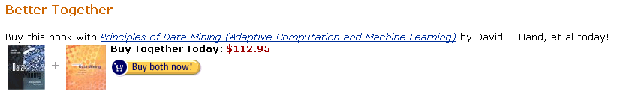
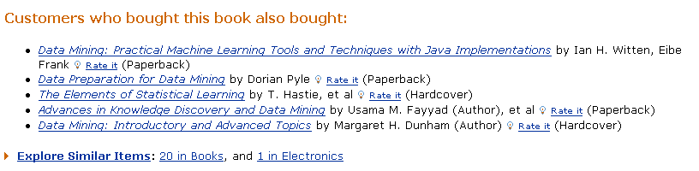
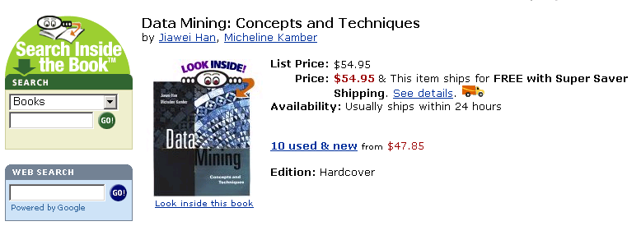
Examples : Collaborative Filtering (Personalized recommendation)
http://www.amazon.com
Selected item
Similar item
Recommendation

Slide 34
Examples : Collaborative Filtering (Personalized recommendation)
Liked by
A
high
correlation
A
B
C
D
B
Liked by
A
B
C
D
E
Example case :
http://citeseer.nj.nec.com (Article search)

Slide 35
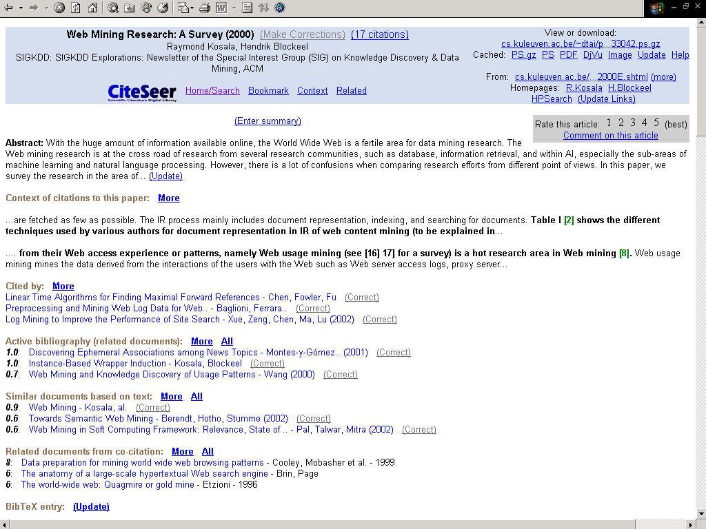
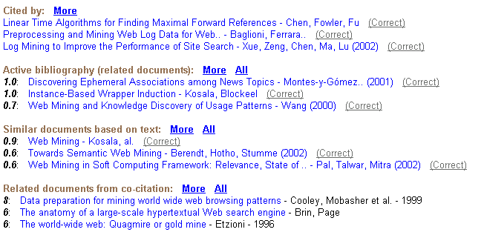
Examples : Collaborative Filtering (Personalized recommendation)
http://citeseer.nj.nec.com
Preference

Slide 36
Examples: Apriori algorithm (Frequent pattern finiding)
Apriori pruning principle: If there is any itemset which is infrequent, its superset should not be generated/tested!
Method:
Initially, scan DB once to get frequent 1-itemset
Generate length (k+1) candidate itemsets from length k frequent itemsets
Test the candidates against DB
Terminate when no frequent or candidate set can be generated

Slide 37
Examples: Apriori Algorithm (Pseudo-Code)
C_{k}: Candidate itemset of size k
L_{k} : frequent itemset of size k
L₁ = {frequent items};
for (k = 1; L_{k} !=∅; k++) do begin
C_{k+1} = candidates generated from L_{k};
for each transaction t in database do
increment the count of all candidates in C_{k+1} that are contained in t
L_{k+1} = candidates in C_{k+1} with min_support
end
return ∪_{k} L_{k};

Slide 38
Examples: Apriori algorithm
Sup_{min} = 2
Itemset | sup
{A} | 2
{B} | 3
{C} | 3
{D} | 1
{E} | 3
Database TDB
Itemset | sup
{A} | 2
{B} | 3
{C} | 3
{E} | 3
L₁
Tid | Items
10 | A, C, D
20 | B, C, E
30 | A, B, C, E
40 | B, E
C₁
1st scan
C₂
Itemset | sup
{A, B} | 1
{A, C} | 2
{A, E} | 1
{B, C} | 2
{B, E} | 3
{C, E} | 2
C₂
Itemset
{A, B}
{A, C}
{A, E}
{B, C}
{B, E}
{C, E}
L₂
Itemset | sup
{A, C} | 2
{B, C} | 2
{B, E} | 3
{C, E} | 2
2nd scan
C₃
Itemset
{B, C, E}
3rd scan
L₃
Itemset | sup
{B, C, E} | 2

