Slide 1
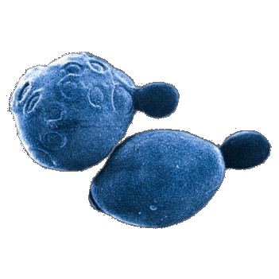
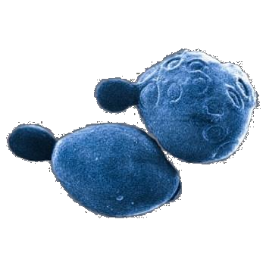
Dynamic Flux Balance Analysis of Yeast Metabolism in Fed-Batch Culture
Jared L. Hjersted & Michael A. Henson
Department of Chemical Engineering
University of Massachusetts
Amherst, MA
Radhakrishnan Mahadevan
Genomatica, Inc.
San Diego, CA
Yeast picture from wwwuser.gwdg.de/~molmibio/

Slide 2
Outline
Motivation
Dynamic flux balance analysis
Dynamic modeling of yeast metabolism
  Small-scale model
  Genome-scale model
Analysis of yeast metabolism
  Comparison of dynamic flux balance models
  Effect of gene knockouts in fed-batch culture
Conclusions & future work

Slide 3
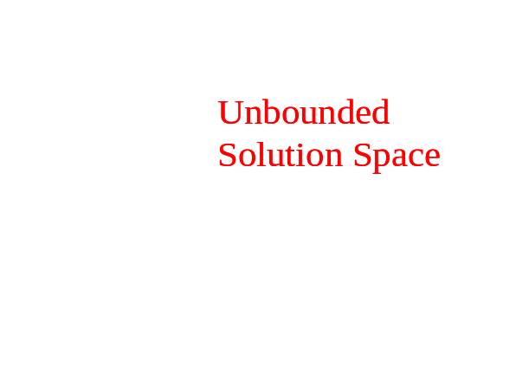
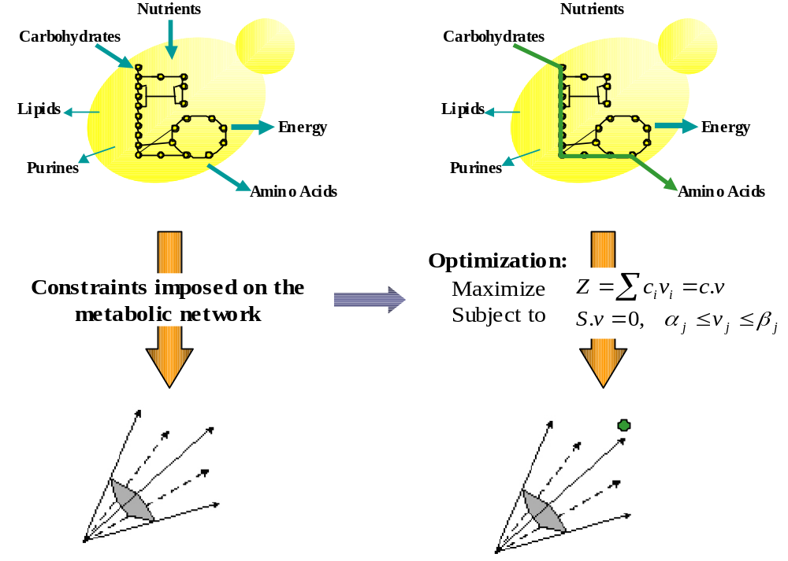

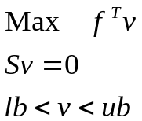
Classical Flux Balance Analysis
Metabolic Network Outputs
Unbounded
Solution Space
Metabolic
Network
Inputs
(v_{C})
(v_{A})
(v_{B})
Phenotype Calculation:
Determine Metabolic Flux Distribution
Physicochemical
Constraints
Stoichiometry
Mass Balance
Hypothesis: Evolutionary pressures enforce optimal resource utilization
C
Optimal
Bounded
C
C
Flux
C
Flux
Flux
Solution
Flux
Solution Space
(v_{C})
(v_{C})
Maximize Growth
(v_{A})
(v_{A})
(v_{B})
Flux
(v_{B})
Flux
Flux
B
Flux
B
B
A
B
A
A
Flux
A
Flux
Flux
Flux

Slide 4
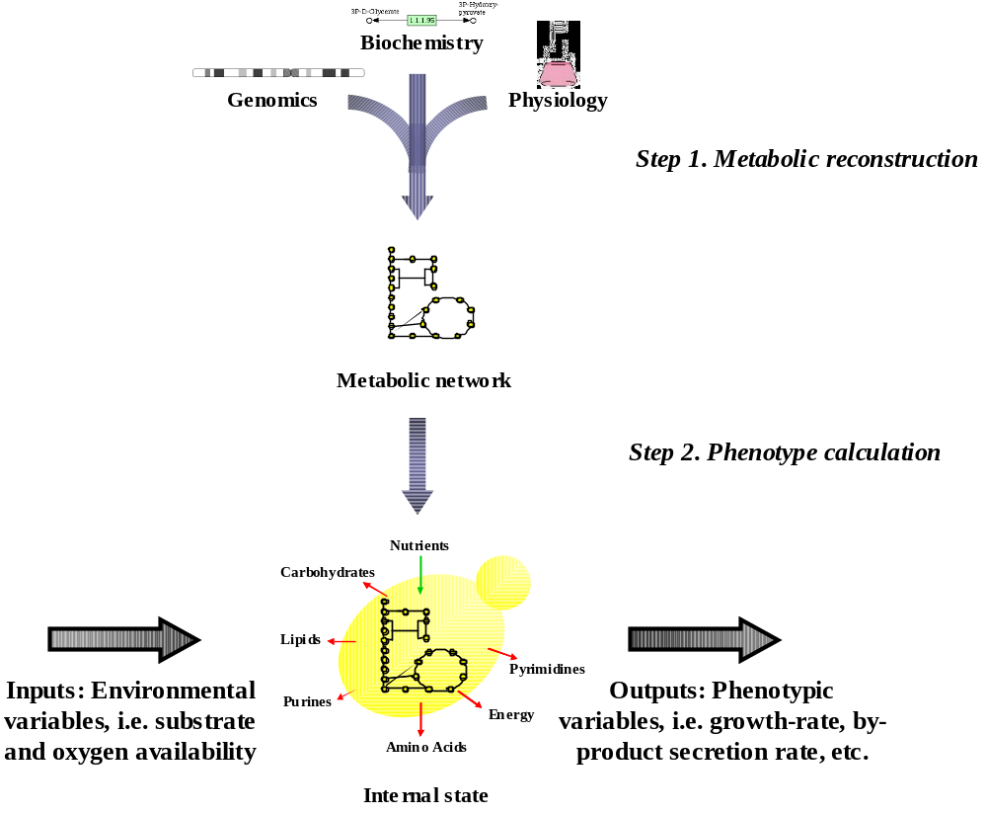
Genome-Scale Flux Balance Models
Escherichia coli
Helicobacter pylori
Haemophilus influenzae
Mannheimia succiniproducens
Aspergillus niger
Staphylococcus aureus
Saccharomyces cerevisiae
http://systemsbiology.ucsd.edu

Slide 5
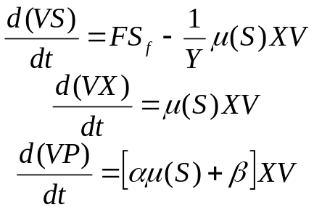
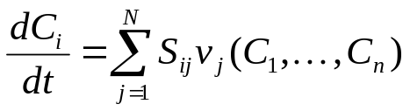
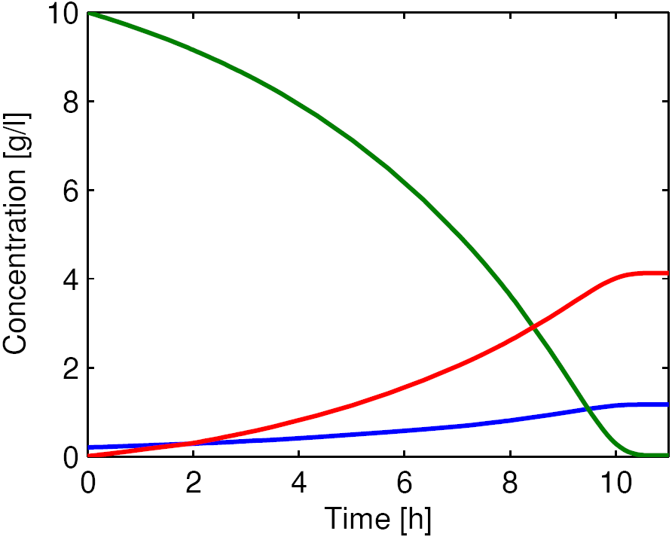
Batch & Fed-Batch Fermentations
Dynamic Models of Metabolism
Unstructured
Kinetic
Require enzyme kinetics
Limited predictive capability
Need alternative modeling framework!

Slide 6
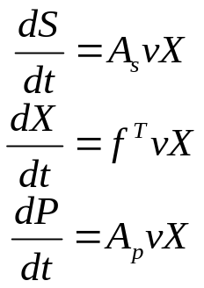
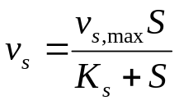
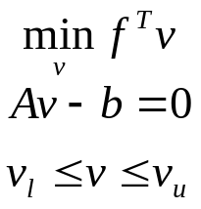
Dynamic Flux Balance Models
Fast intracellular dynamics
Extracellular mass balances
Nutrient uptake kinetics
Flux balance model
v_{s}
v
S
Previous studies
Varma & Palsson (1994): growth & product formation in E. coli
Van Riel et al. (2002): central nitrogen metabolism in S. cerevisiae
Mahadevan et al. (2002): diauxic growth in E. coli
Sainz et al. (2003): nitrogen starvation & ethanol toxicity in S. cerevisiae
All known studies consider batch growth & utilize small-scale flux models

Slide 7
Objectives of this Study
Develop first dynamic flux balance model based on genome-scale reconstruction
Utilize dynamic model to investigate yeast metabolism in batch & fed-batch culture
Compare to less detailed dynamic flux balance model based on small-scale reconstruction
Analyze the effect of gene knockouts in fed-batch culture
Caveats
Intracellular regulation is largely neglected
Uptake kinetic parameters extracted from literature
Gene knockout study preliminary

Slide 8
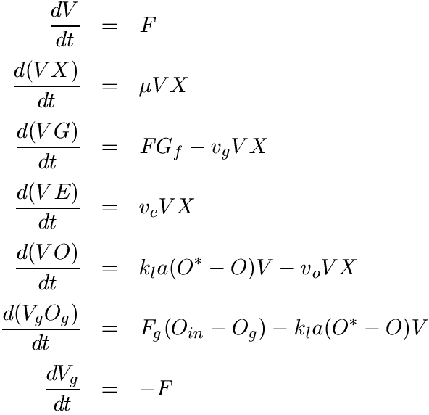
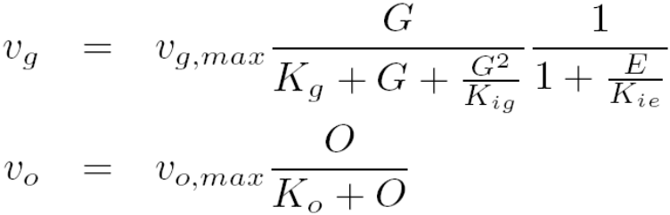
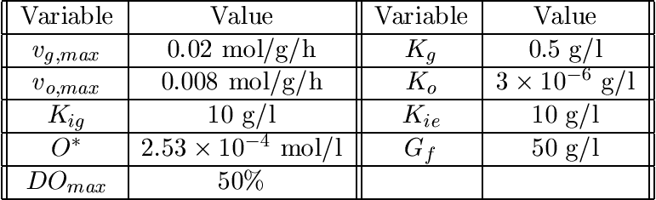
Dynamic Modeling of Yeast Metabolism
Extracellular Balances
Substrate uptake kinetics
Assumptions
Perfect dissolved oxygen concentration control
Inhibition of glucose uptake at high glucose concentrations
Inhibition of cellular growth at high ethanol concentrations

Slide 9
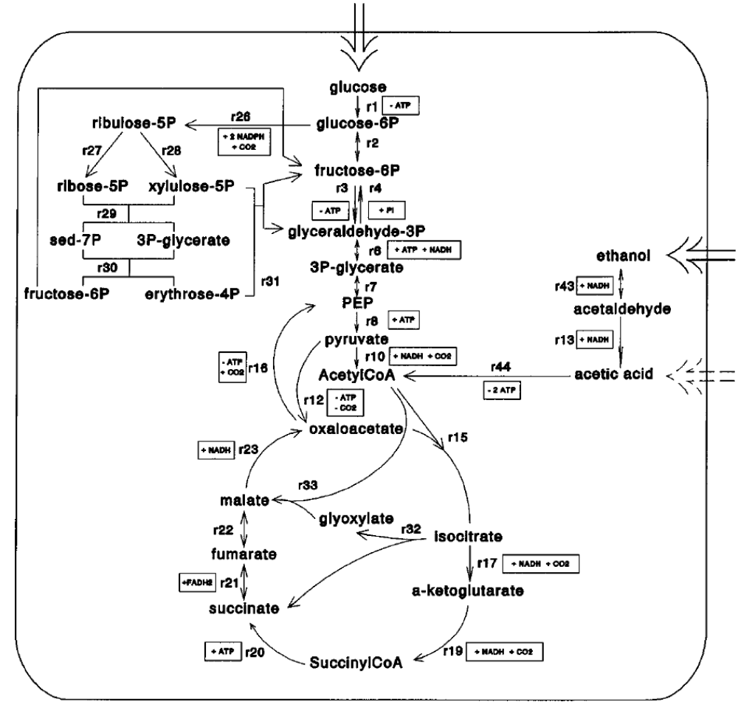
Small-Scale Model
Scope
Glycolysis, TCA cycle, pentose phosphate cycle, glyoxylate shunt
Oxidative phosphorylation
Amino acid synthesis & polymerization
Fatty acid & polsaccharide synthesis
Nucleotide & RNA synthesis
Biomass formation
Transport processes
No compartmentalization
Stoichiometric model
68 metabolites & 85 fluxes
Van Gulik & Heijnen, Biotechnol. Bioeng., 1995; Vanrolleghem et. al., Biotechnol. Prog., 1996

Slide 10

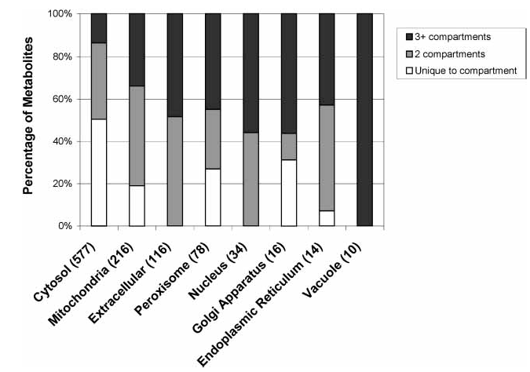
Genome-Scale Model
Scope
Accounts for 750 genes & their associated transcripts, proteins & reactions
Fully compartmentalized & charge balanced
Extensive transport reactions
Stochiometric model
646 metabolites & 1149 reactions
Constant glucose flux of 10 mmol/g/h
Forster et al., Genome Research, 2003; Duarte et al., Genome Research, 2004

Slide 11
Computational Issues
Simultaneous solution strategy
  Embed LP problem within integration subroutine
  Use MOSEK interface to Matlab
  Sequential solution proved problematic
Computation time
  Small-scale model: 7.3 sec
  Genome-scale model: 13.5 sec
  Complexity of inner flux balance model has little effect
  Appropriate model depends on ultimate use
11h batch simulation on 3Ghz Pentium 4

Slide 12
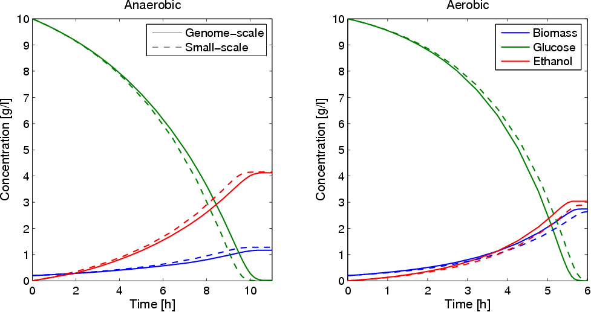
Batch Culture

Slide 13
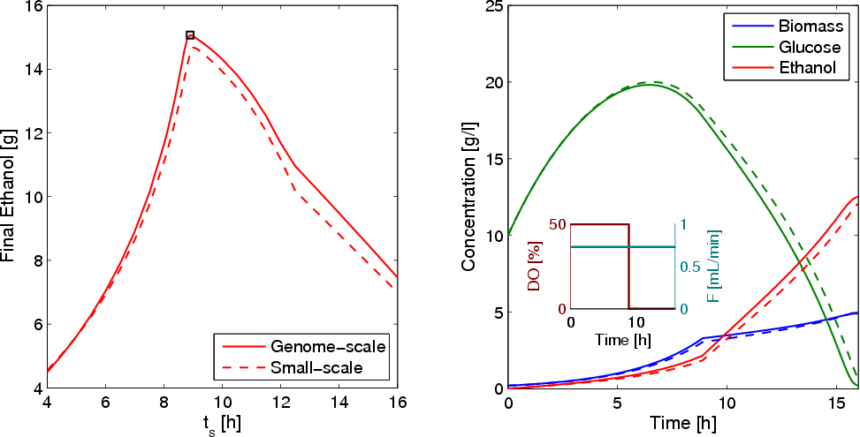
Fed-Batch Culture

Slide 14
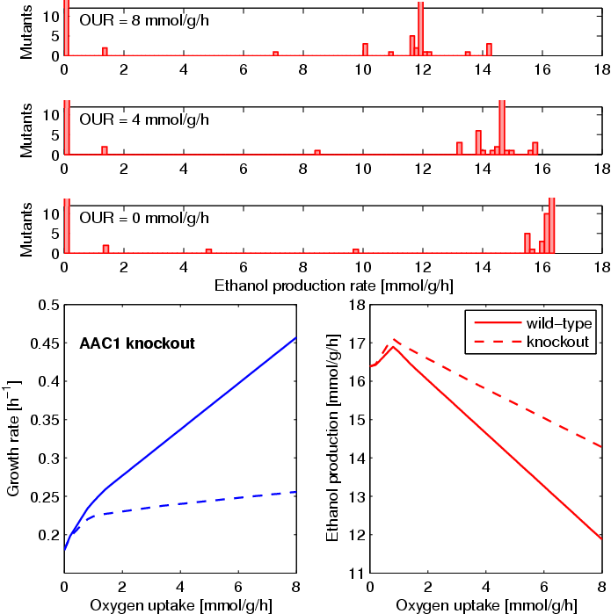
Gene Knockout Analysis
AAC1
Steady-state FBA
  531 mutants
  Multiple knockouts for genes of isoenzymes
Ethanol overproducing mutants
  No mutants exceed wild-type production under anaerobic conditions
  Increased ethanol production at expense of growth rate
AAC1
  Mitochondrial ADP/ATP carrier
  Transport of ATP from mitochondria to cytosol
  Repressed under anaerobic conditions
  Experimentally viable knockout*
AAC1
glucose uptake = 10 mmol/g/h
*Lawson et. al., J. Biol. Chem., 1990; Giaver et. al., Nature, 2002

Slide 15
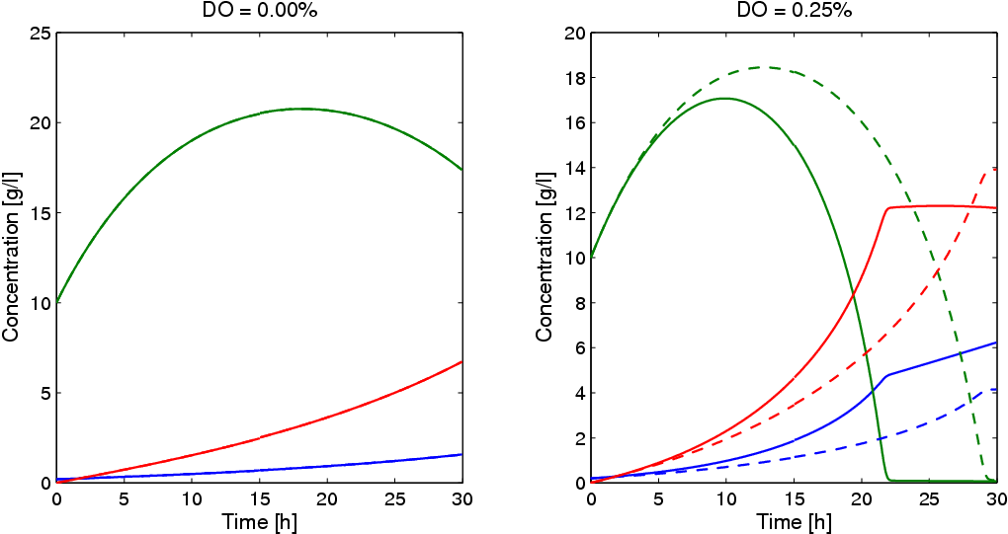
Fed-Batch Culture
Yields | Wild Type | Mutant
Steady State | 0.43 g/g | 0.44 g/g
Dynamic | 0.37 g/g | 0.42 g/g
Wild-type and AAC1 knockout mutant dynamics identical

Slide 16
Conclusions & Future Work
Dynamic flux balance modeling
  Provides a powerful framework for the development of structured models
  Very large stoichiometric models can be accommodated without difficulties
  Increased detail of genome-scale flux models justified
  Allows the study of gene knockouts in batch & fed-batch culture
Future work
  Inclusion of regulatory mechanisms
  Parameter estimation & model validation
  Fed-batch culture optimization
Engineered Mutants
Optimal Knockouts
for Dynamic Cultures
Fed-Batch Optimization
Flux Balance Analysis

