Slide 1
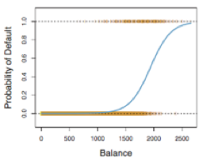
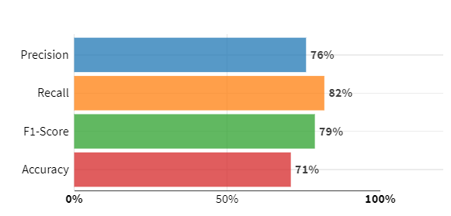
Model diagnostic
The model computes the probability of success
Threshold should be selected to predict 1 and 0
Actuals and predicted values are compared
Example on Confusion Matrix for the testing set
P(Y=1|x) =f(X)
Threshold =0.4
MexicoF2F | Predicted 1 | Predicted 0 | Total
Actually 1 | 6,300 | 1,408 | 7,708
Actually 0 | 2,015 | 1,995 | 4,010
Total | 8,315 | 3,403 | 11,718
6.,300/8,315
6,300/7,708
Average Recall & Precision
(6,300+1,995)/11,718
Recall or sensitivity – Pct. of true 1 correctly predicted
Specificity – Percentage of True 0 correctly predicted
Accuracy – Total percent correct predictions
Precision – Pct. of true 1 among the predicted 1

Slide 3
Use the Boston Data to answer the rest of the questions
What percent of suburbs have values of medv between 20 and 40 assuming a normal distribution of medv?
#Q-8 What percent of suburbs have values of medv between 20 and 40 assuming a normal distribution of medv?
## Probability till 20
pnorm(20,mean(Boston$medv),sd(Boston$medv),lower.tail=TRUE)
# 0.3915077## Probability till 40
pnorm(40,mean(Boston$medv),sd(Boston$medv),lower.tail=TRUE)#0.9712313##Probability between 20 and 40
pnorm(40,mean(Boston$medv),sd(Boston$medv),lower.tail=TRUE) - pnorm(20,mean(Boston$medv),sd(Boston$medv),lower.tail=TRUE)
# Probability between 20 and 40 is 0.5797236 , rounded to 58%

Slide 4
###########################################################################
Q-9 What percent of medv suburbs are above 25 assuming a normal distribution?
## Probability till 25
pnorm(25,mean(Boston$medv),sd(Boston$medv),lower.tail=TRUE)# 0.6057495
##Probability larger than 25
1-pnorm(25,mean(Boston$medv),sd(Boston$medv),lower.tail=TRUE)
# Probability larrer than 25 is 0.3942505 approx 39%##########################################################################
############################################################################
Q-10 What percent of medv are below 30 assuming a normal disdistribution?
## Probability till 30
pnorm(30,mean(Boston$medv),sd(Boston$medv),lower.tail=TRUE)
#79%
##########################################################################

Slide 5
Q12 Describe the distribution of medv
Skewed to the right with outliers(反着的)
Aggregate(medv ~ rm_round+bostron$chars, data = , mean)

