Slide 1
Assignment 5

Slide 2
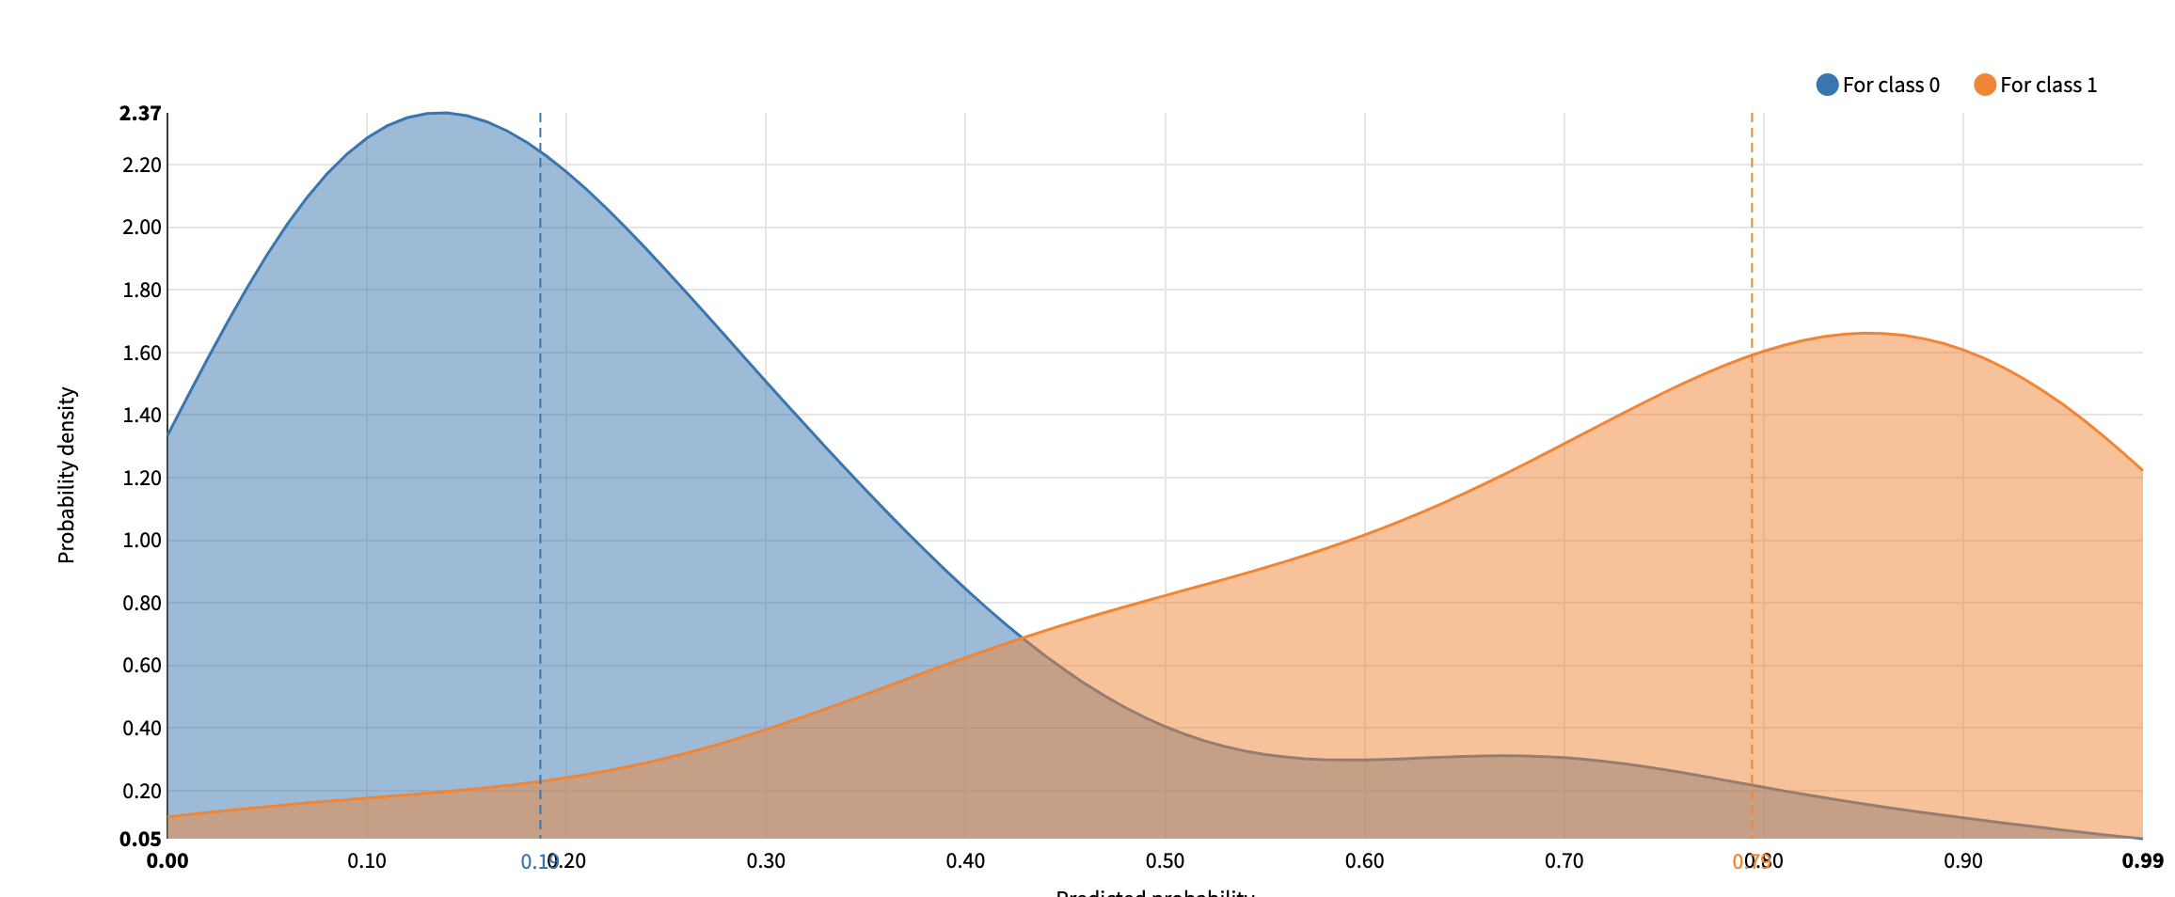
Logistic regression

Slide 3
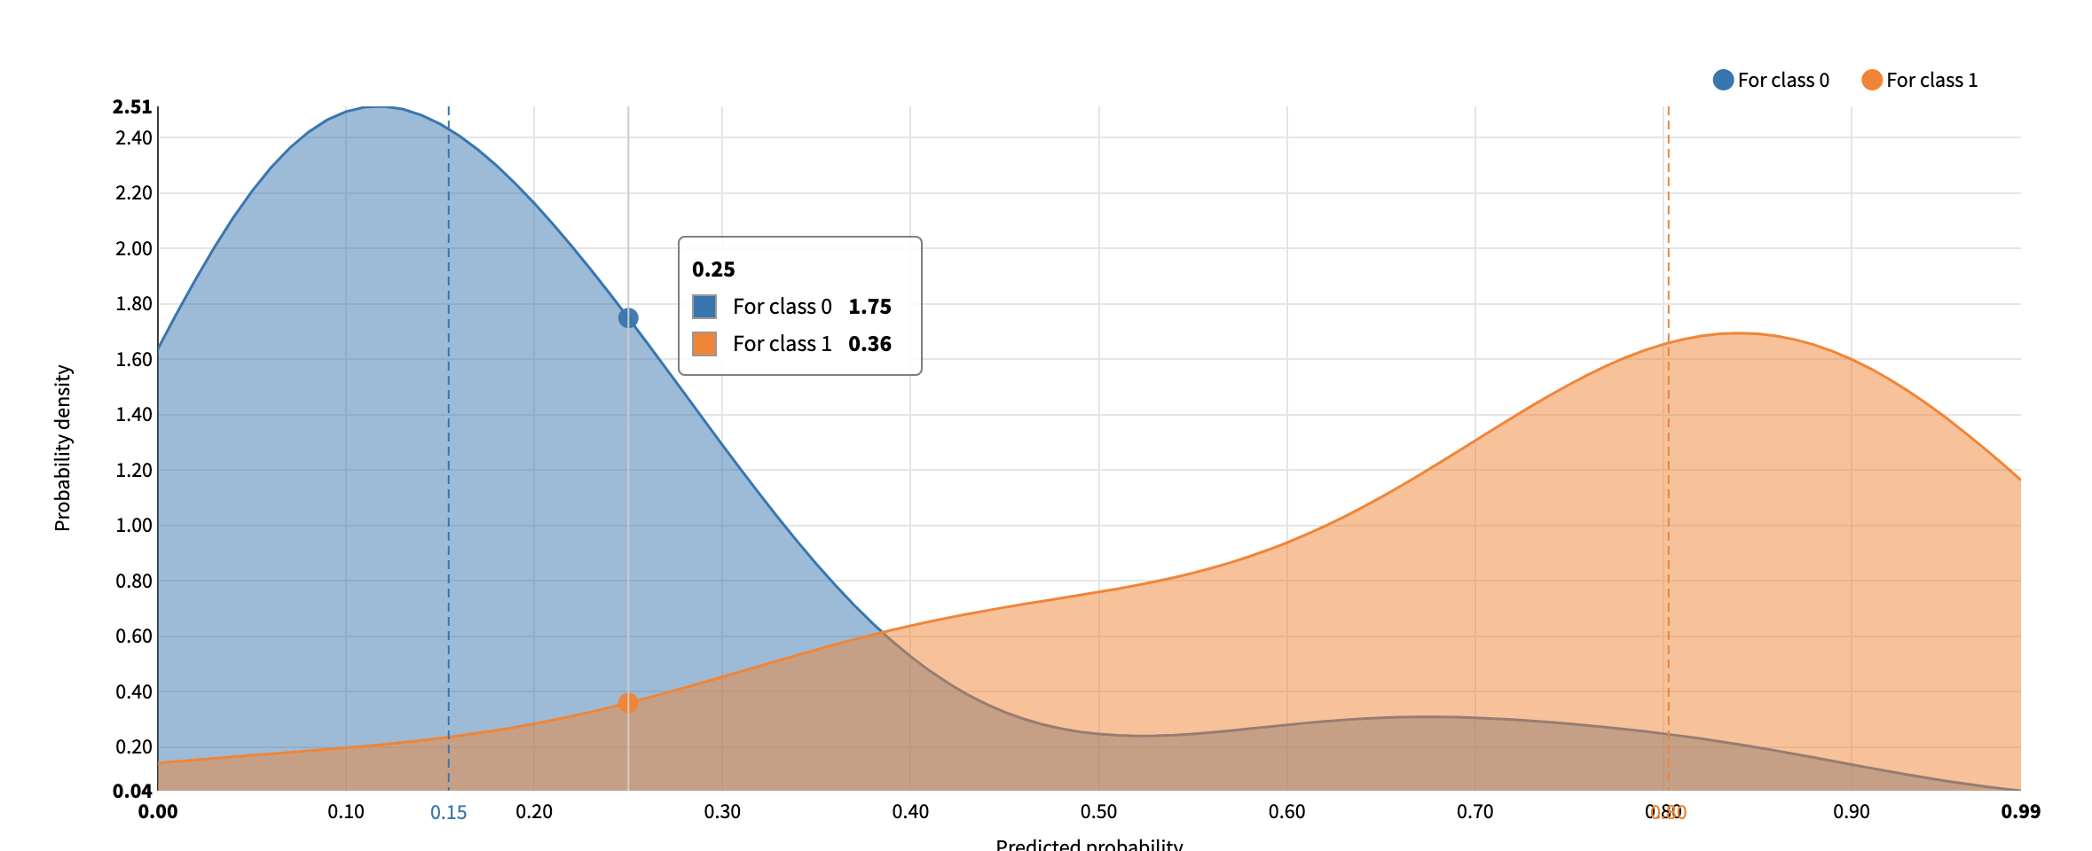
SGD

Slide 4
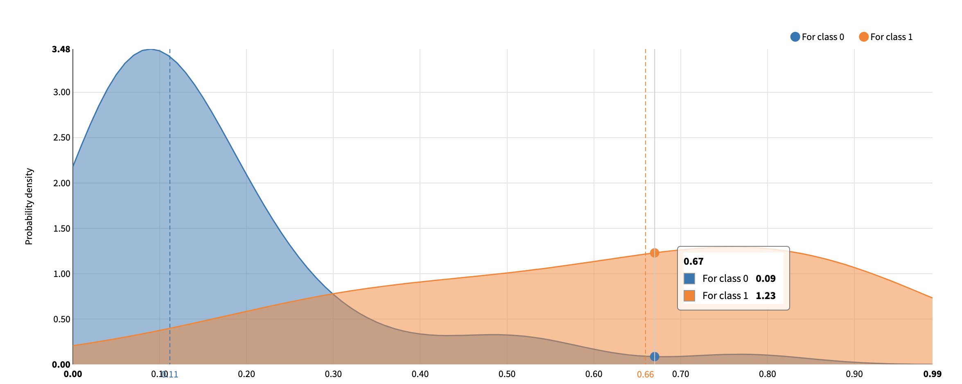
LASSO_lars

Slide 5
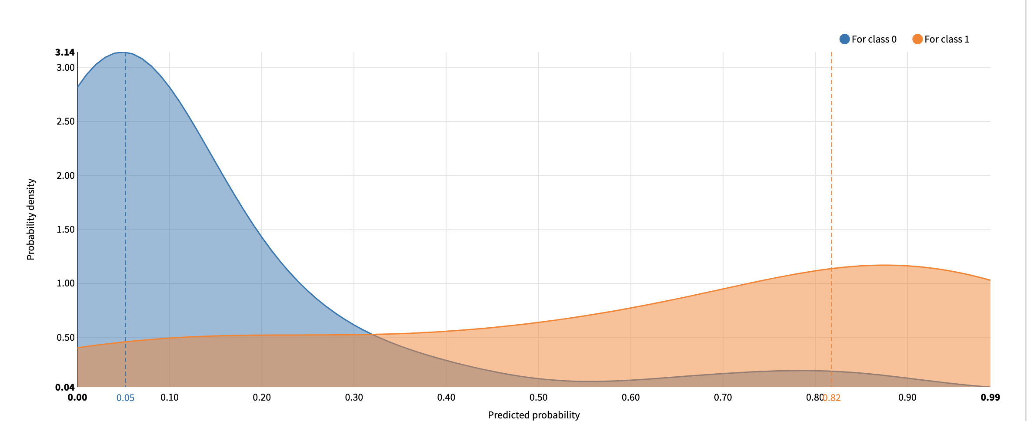
Gradient Boosted Trees

Slide 6
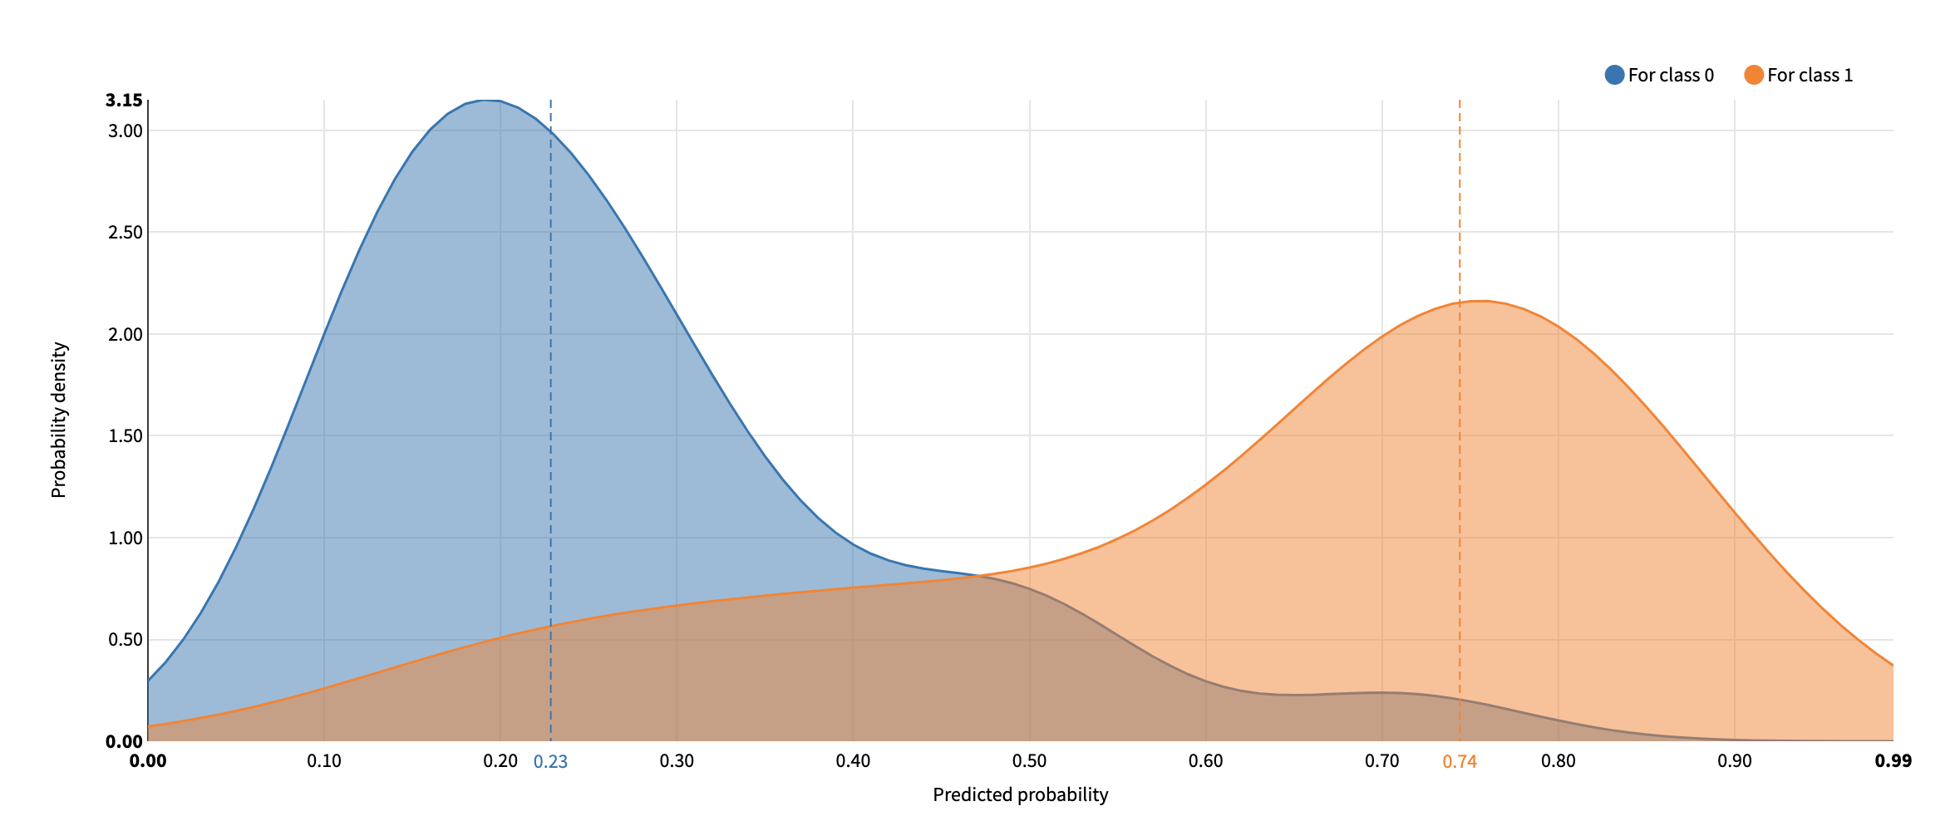
Light GBM

Slide 7
Model choosing
As showed on the density chart, only first 2 charts and the last one the have the two obvious peak. And the first and the second one the peak is on the far left and right side plus Logistic regression has best F-1 score so we choose the model of Logistic regression.

Slide 8
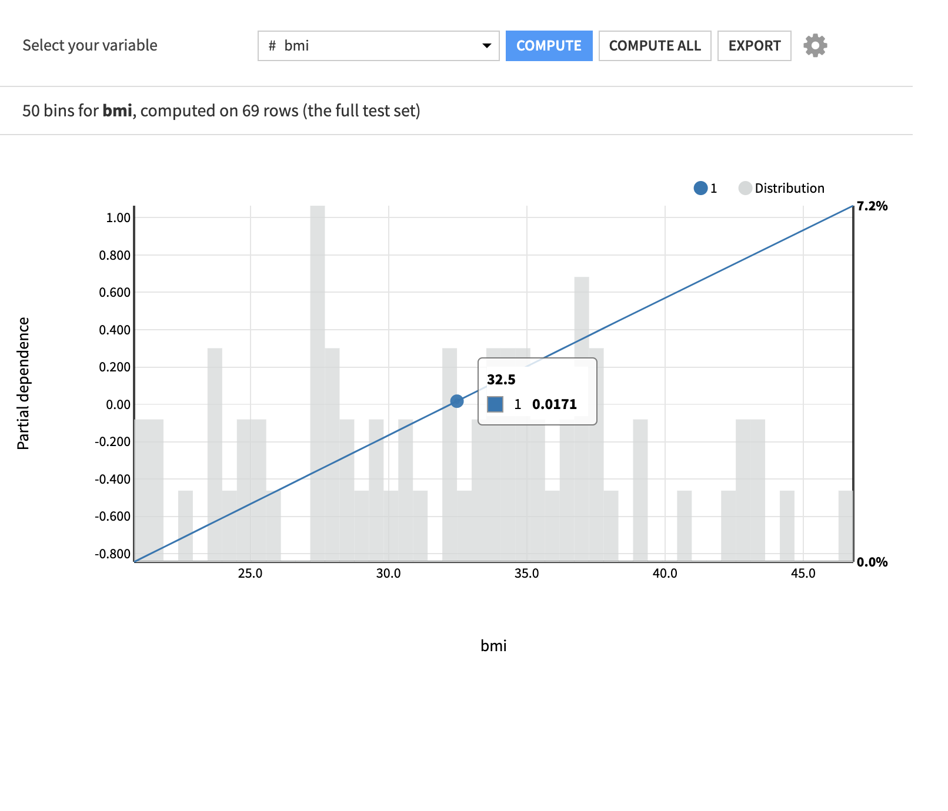
As it showed on the plot the partial
dependence here is a fixed number
Which indicate that a consistent grow
if bmi increase which is not true.
So we should switch to a none linear
model to show the dependence.

Slide 9
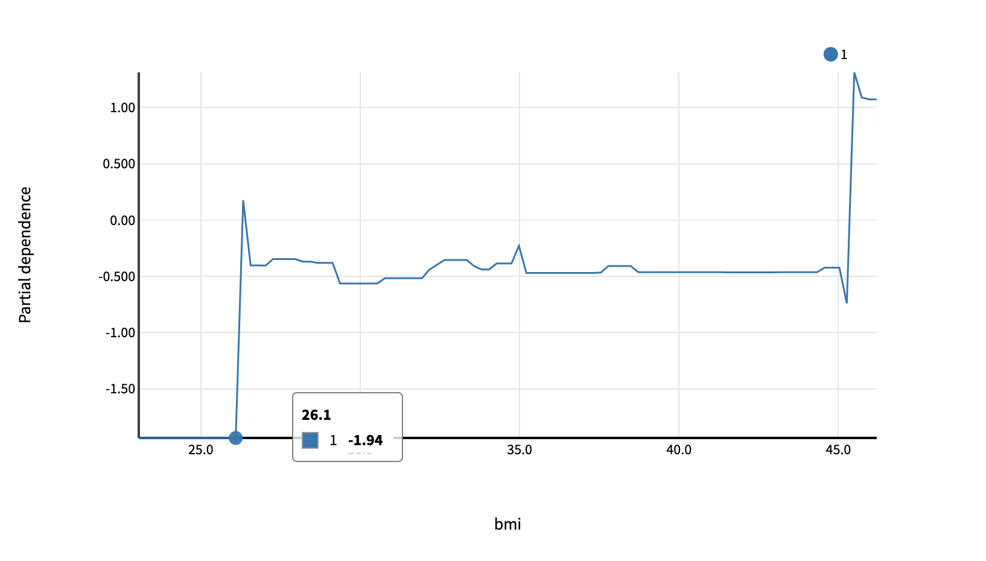
Suggestions
We choose the Gradient Boosted Trees as the model since the F-1 scores is highest in non linear model.
And we can see that since the BMI > 261. There is a rapid growth in the partial dependence.
So the rules to the health department is that to avoid or prevent citizens over BMI over 26.1 in order to decrease the chance to get diabetes.

Slide 10
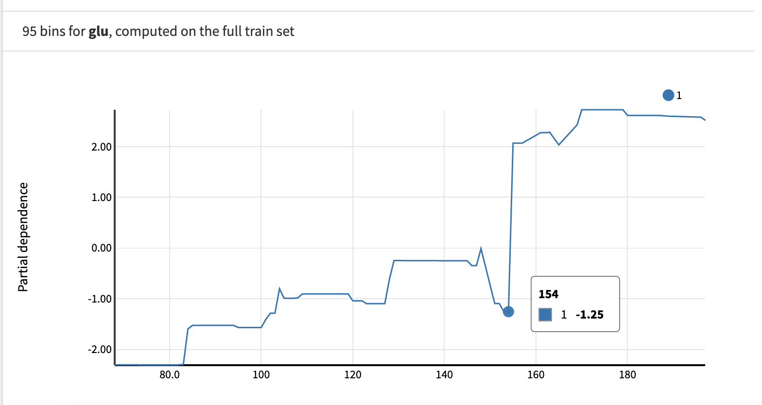
For the glu, it remain in a reasonable increasing chance of getting diabetes, but after 154 it grows rapidly and it the first tree split condition.

Slide 11
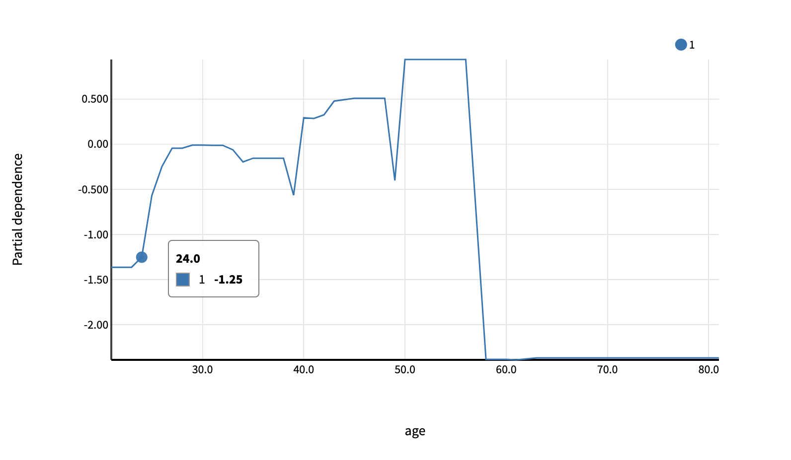
Since age 24, people start to have a growing trend of getting diabetes.
And the decision tree showed was 25.5

Slide 12
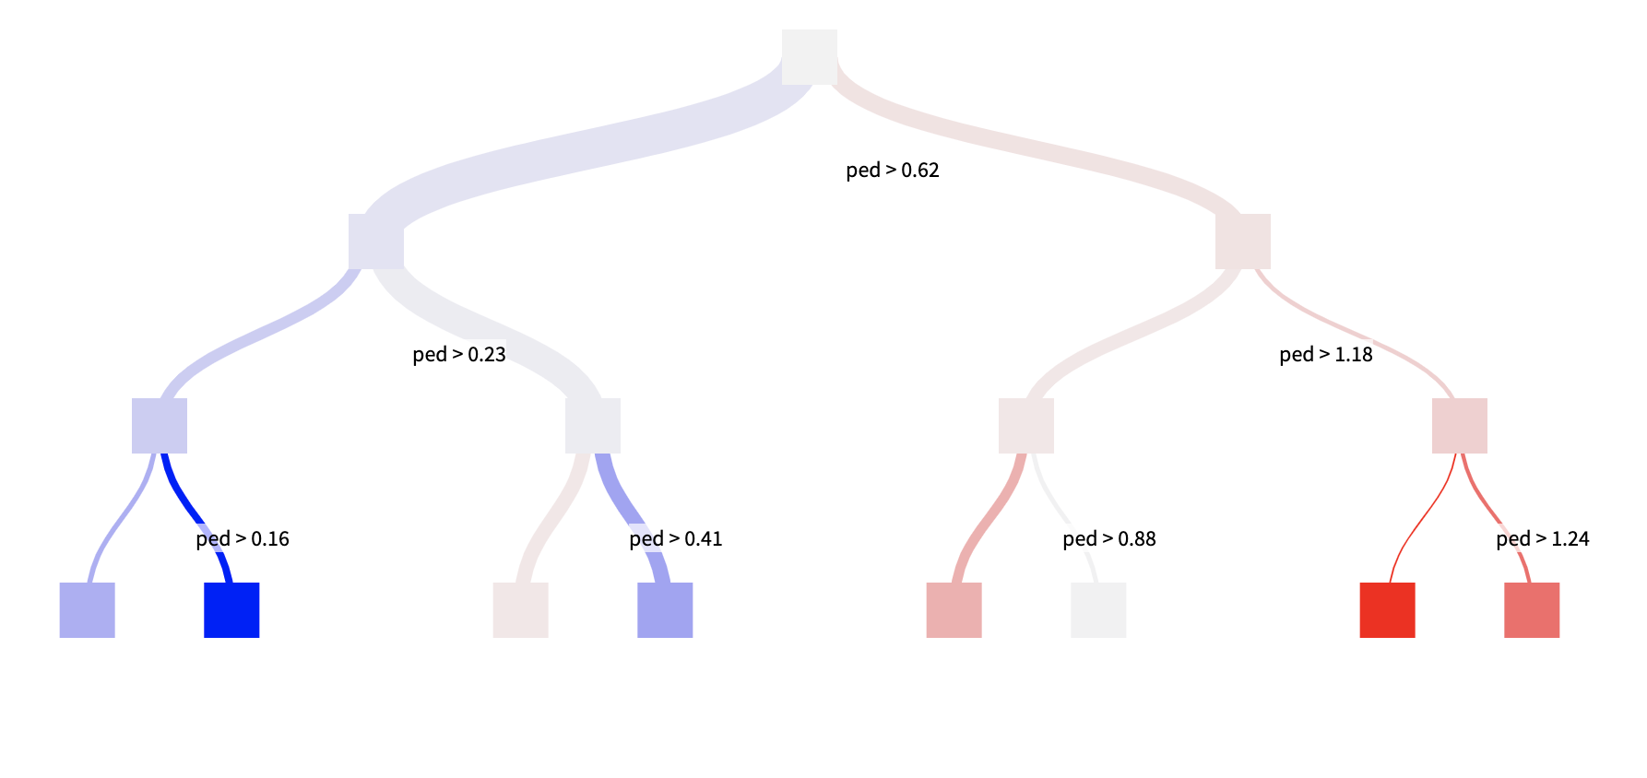
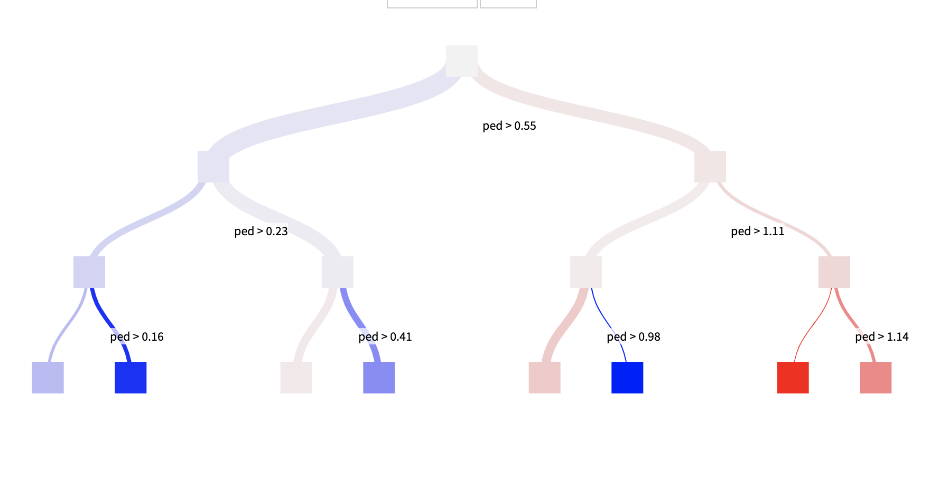
From the plot, we can tell that if ped if over something around 50, you have higher chance to get diabetes.
But it is hard to get others’ medical records so no suggestion on this variable.

Slide 13
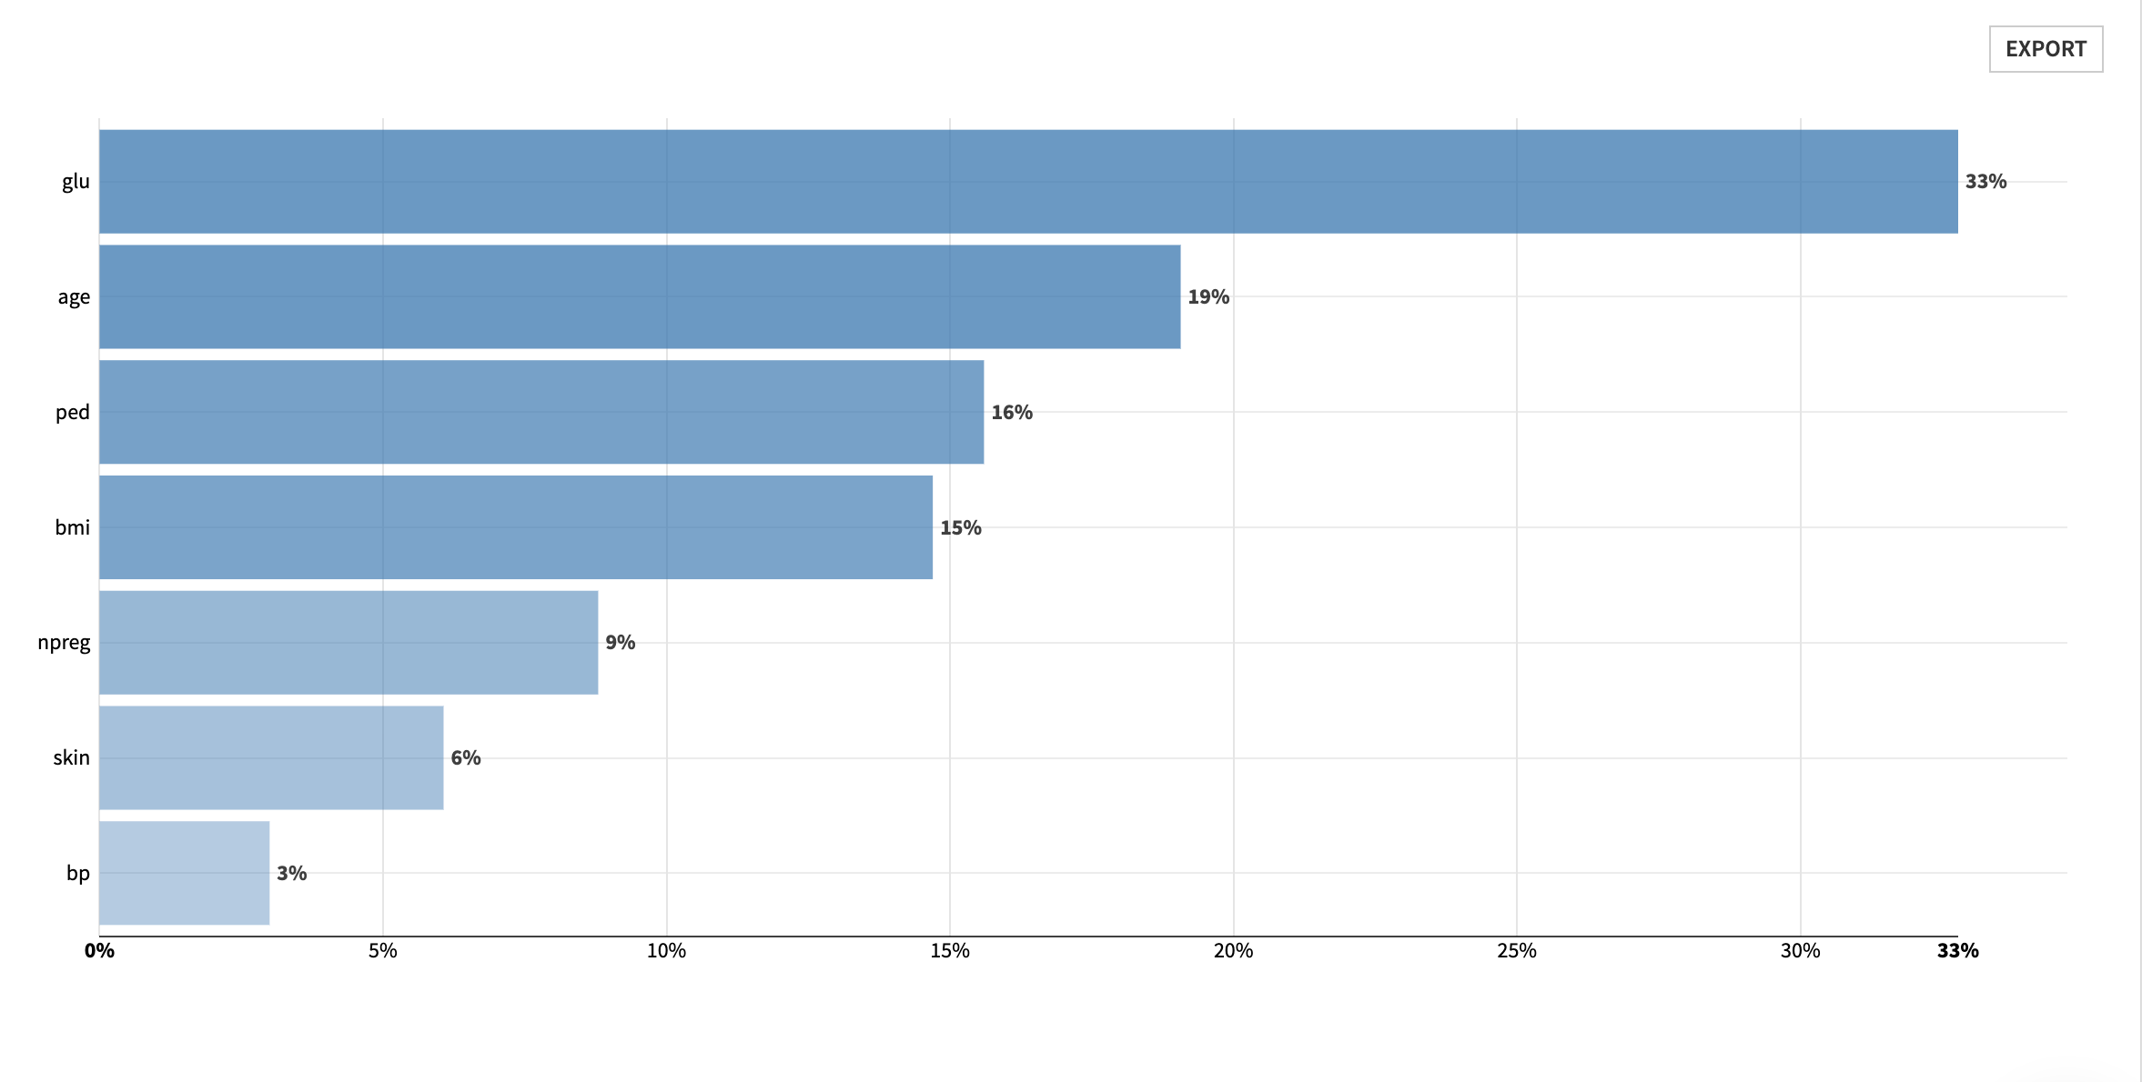
Since nperg, skin and bp significant are not significant important to the objective variable so we will no t make suggestion on these two variable.
Also nperg is a personal matter which is impropriate to make suggestion.

