Slide 1
Analytics FOR BUSINESS Intelligence
Fall 2021
Nuria Diaz-Tena

Slide 2
Introduction & Explanatory Data Analysis
Introduction
Goal of the Course
Assignments
Office Hours: 5 to 6:00pm on Thursdays using Zoom (same as the course)
Understanding Data Sets
Intro to Tableau
Canvas will provide all materials for the course and it will be updated weekly

Slide 3
Course Planning
Lecture | Date | Topic | Assignments | Wg
1 | 9/01/21 | Introduction, Visualizations & Exploratory Data Analysis - Chapter 1
2 | 9/15/21 | Introduction to R - Chapter 2
3 | 9/22/21 | Statistical Experiments | Homework #1 | 5%
4 | 9/29/21 | Regression – Chapter 3 | Homework #2 | 5%
5 | 10/06/21 | Bayesian Models
6 | 10/13/21 | Models Review | Project #1 | 15%
7 | 10/20/21 | Midterm Exam | Midterm | 20%
8 | 10/27/21 | Classification Models – Chapter 4
9 | 11/03/21 | Cross Validation and Advance Classification – Chapter 5 to 9 | Homework #3 | 5%
10 | 11/10/21 | Advance Classification | Homework #4 | 5%
11 | 11/17/21 | Support Vector Machines - Chapter 9
12 |  | Thanksgiving Recess
13 | 12/01/21 | Clustering - Chapter 10
14 | 12/06/21 | Project Discussion
15 | 12/08/21 | Final Exam Preparation Project2 | Project #2 | 15%
16 | 12/22/21 | Final Exam | Final | 30%

Slide 4



Using Data Analysis & Visualizations to Answer Questions FAST
?
Insight…
Answer…
?
?
Real-time
Collaborative
Transparent
?
Data analytics and visualization is an emerging field concerned with analyzing, modeling, and visualizing complex high dimensional data. This course will introduce state-of-the-art modeling, analysis and visualization techniques. It will emphasize practical challenges involving complex real world data and include several case studies and hands-on work with Tableau and R programming language.

Slide 5
What is the question?
When will be safe not to wear masks ?
What is the effect of COVID on drug sales?
Do Americans prefer to know about new products on TV or online ?
Where is the data?
Is the data already collected?
Do we need to collect the data?
How will we analyze the data?

Slide 6
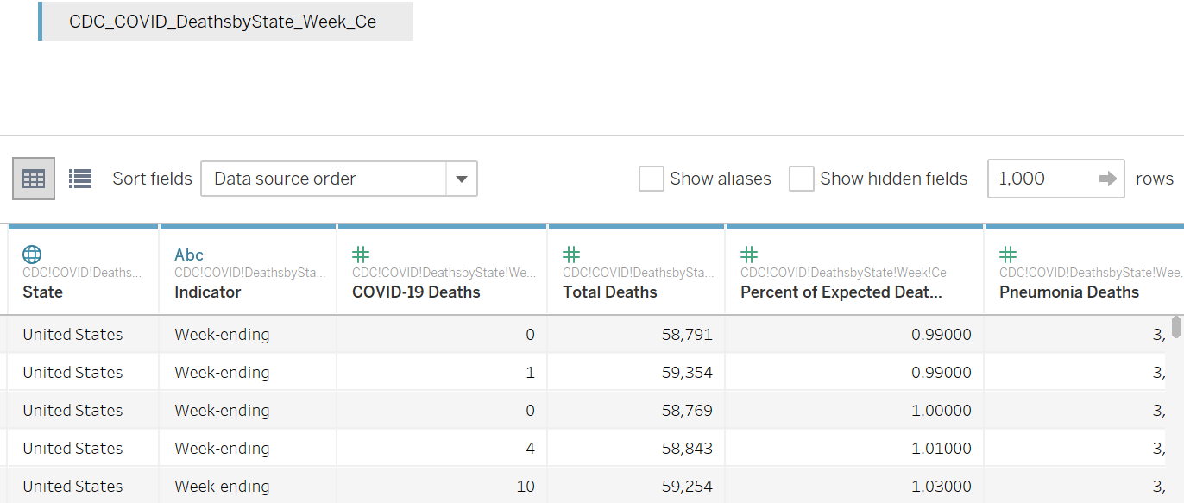
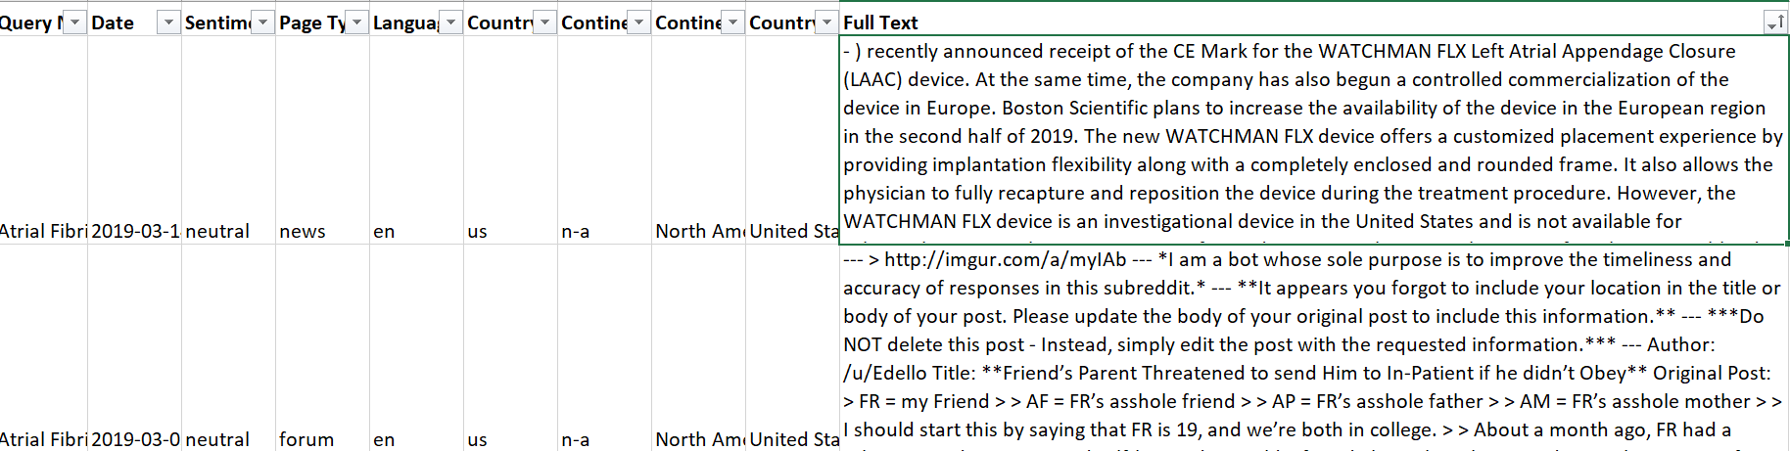
Structured vs Unstructured Data
What is the difference between structured and unstructured data?
Structured data is highly-organized and formatted in a way so it's easily searchable in relational databases.
Unstructured data has no pre-defined format or organization, making it much more difficult to collect, process, and analyze
Rows - What is the data granularity?

Slide 7
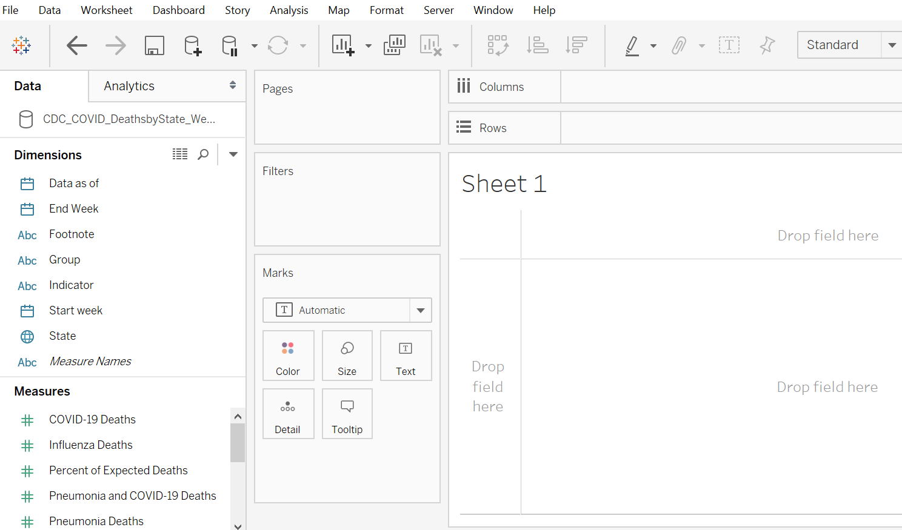
Types of Variables
Dimensions and Measurements (Tableau)
Classifiers and Metrics
Discrete or continuous
Categorical and Numerical

Slide 8
Visualize Amounts and Distributions

Slide 9
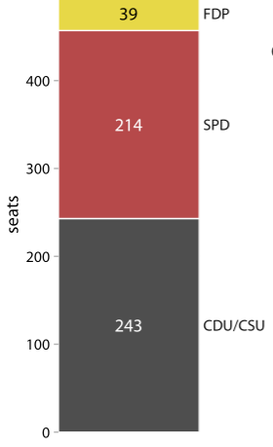
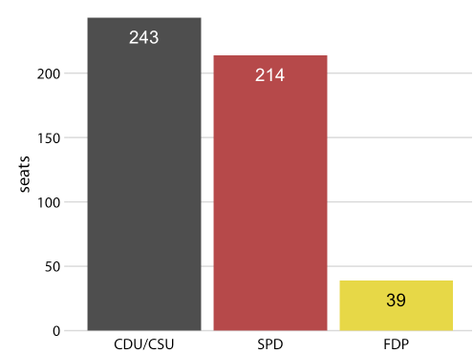
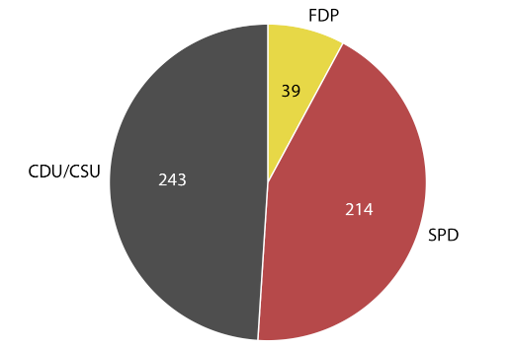
Proportions – Pie charts
Party composition of the 8th German Bundestag, 1976–1980
Pie chart
This visualization shows clearly that the ruling coalition of SPD and FDP had a small majority over the opposition CD
Stacked bars.
It is not immediately obvious that SPD and FDP jointly had more seats than CDU/CSU. However, the stacked bar shows the total number of seats
Side-by-side bars.
Tt is not immediately obvious that SPD and FDP jointly had more seats than CDU/CSU. The bars easily compare the three parties.

Slide 10
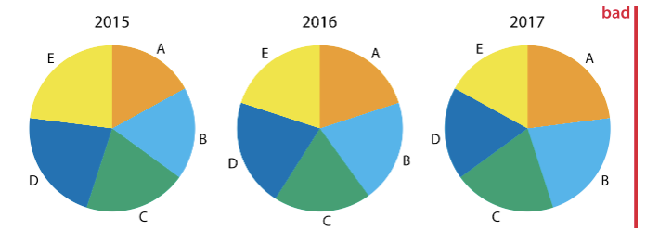
Proportions – Pie charts
Market share of five hypothetical companies, A–E, for the years 2015–2017
This visualization has two major problems:
A comparison of relative market share within years is nearly impossible.
Changes in market share across years are difficult to see

Slide 11
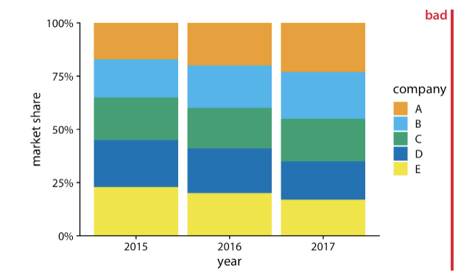
Proportions – Stack bars
Market share of five hypothetical companies, A–E, for the years 2015–2017
This visualization has two major problems:
A comparison of relative market shares within years is difficult.
Changes in market share across years are difficult to see for the middle companies B, C, and D, because the location of the bars changes across years.

Slide 12
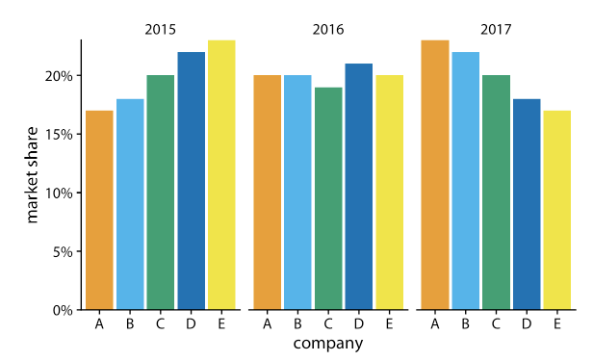
Proportions – Side by side bars
Party composition of the 8th German Bundestag, 1976–1980
For this hypothetical data set, side-by-side bars are the best choice. This visualization highlights that both companies A and B have increased their market share from 2015 to 2017 while both companies D and E have reduced theirs. It also shows that market shares increase sequentially from company A to E in 2015 and similarly decrease in 2017.

Slide 13
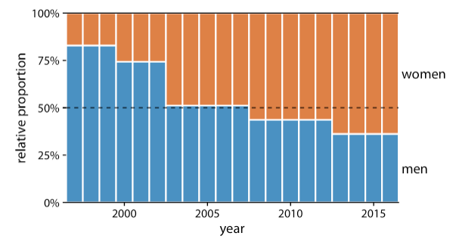
Proportions – Stack bars
Change in the gender composition of the Rwandan parliament over time, 1997 to 2016. Data source: Inter-Parliamentary Union (IPU), ipu.org.
Rwanda has had a majority female parliament since 2008, and since 2013 nearly two-thirds of its members of parliament are female. This figure provides an immediate visual representation of the changing proportions over time. To help the reader see exactly when the majority turned female, I have added a dashed horizontal line at 50%. Without this line, it would be near impossible to determine whether from 2003 to 2007 the majority was male or female. I have not added similar lines at 25% and 75%, to avoid making the figure too cluttered.

Slide 14
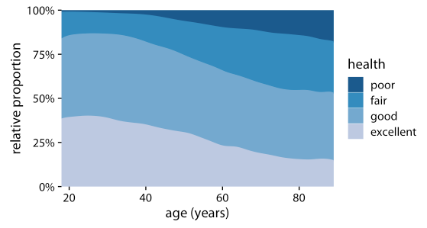
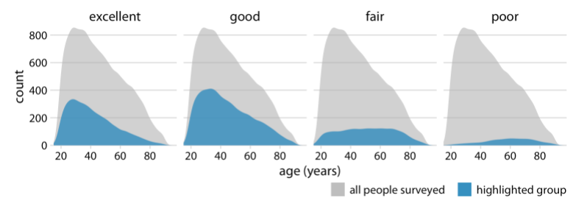
Proportions
Health status by age, as reported by the general social survey (GSS)
Stacked densities
The densities consider the health status of people as a function of age. Age can be considered a continuous variable, and visualizing the data in this way works reasonably well. We can see clearly that overall health declines as people age, and we can also see that despite this trend, over half of the population remain in good or excellent health until very old age.
Separate plot for each group
Each plot is showing the respective group relative to the whole. The overall age distribution in the dataset is shown as the shaded gray areas, and the age distributions for each health status are shown in blue. This figure highlights that in absolute terms, the number people with excellent or good health declines past ages 30–40, while the number of people with fair health remains approximately constant across all ages.

Slide 15
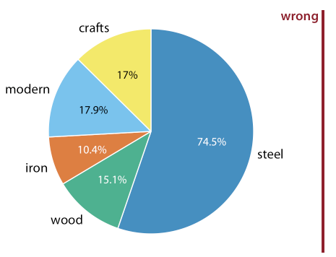
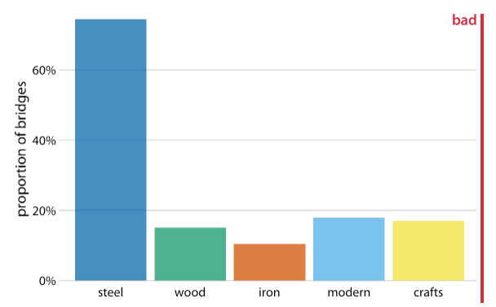
Proportions
Bridges in Pittsburgh by construction material (steel, wood, iron) and by date of construction (crafts, before 1870, and modern, after 1940) Data source: Yoram Reich and Steven J. Fenves, via the UCI Machine Learning Repository (Dua and Karra Taniskidou 2017)
These figures are invalid, because the percentages add up to more than 100%. There is overlap between construction material and date of construction.

Slide 16
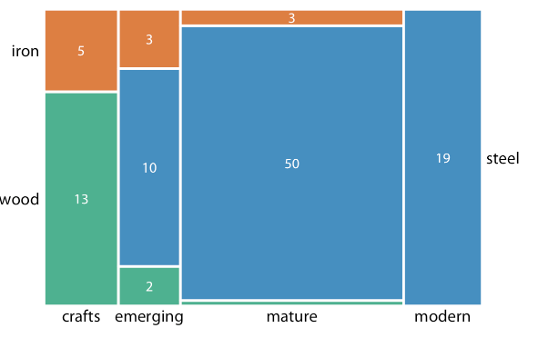
Mosaic Plots
Bridges in Pittsburgh by construction material (steel, wood, iron) and by date of construction (crafts, before 1870, and modern, after 1940) Data source: Yoram Reich and Steven J. Fenves, via the UCI Machine Learning Repository (Dua and Karra Taniskidou 2017)
Whenever we have categories that overlap, it is best to show clearly how they relate to each other. On first glance, a mosaic plot looks similar to a stacked bar plot. However, unlike in a stacked bar plot, in a mosaic plot both the heights and the widths of individual shaded areas vary. The plot shows two additional construction eras, emerging (from 1870 to 1889) and mature (1890 to 1939). In combination with crafts and modern, these construction eras cover all bridges in the dataset, as do the three building materials. This is a critical condition for a mosaic plot: Every categorical variable shown must cover all the observations in the dataset.

Slide 17
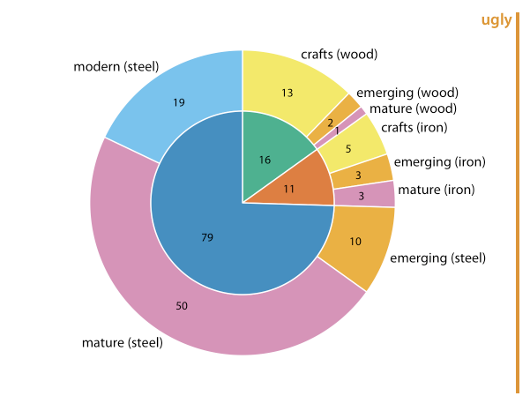
Nested Pies
Bridges in Pittsburgh by construction material (steel, wood, iron) and by date of construction (crafts, before 1870, and modern, after 1940) Data source: Yoram Reich and Steven J. Fenves, via the UCI Machine Learning Repository (Dua and Karra Taniskidou 2017)
Nested Pies (inner and outer circles)
The inner circle shows the breakdown of the data by one variable (here, building material) and the outer circle shows the breakdown of each slice of the inner circle by the second variable (here, era of bridge construction). This visualization is reasonable. However, it is difficult to comprehend

Slide 18
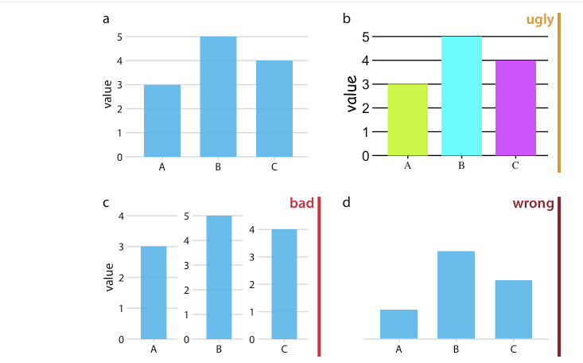
Plotting Categorical Variables Pie charts and Bar Charts
UGLY? BAD? WRONG?
why?

Slide 19
UGLY, BAD and WRONG why?
(a) Reasonable
(c) Bad
Misleading - Each bar is shown with its own y-axis scale. One can easily get the impression that the three values are closer together than they actually are.
(b) Ugly
Technically correct
Not aesthetically pleasing
The colors are too bright and not useful
The background grid is too prominent
The text is displayed using three different fonts in three different sizes
(d) Wrong
Misleading - Without an explicit y axis scale, the numbers represented by the bars cannot be ascertained. The bars appear to be of lengths 1, 3, and 2, even though the values displayed are meant to be 3, 5, and 4.

Slide 20
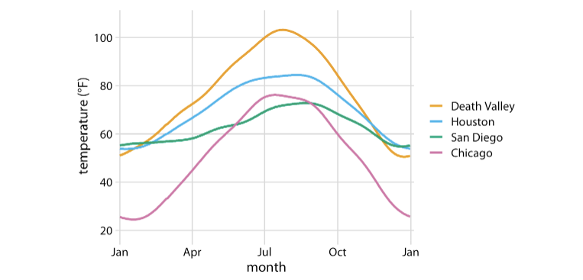
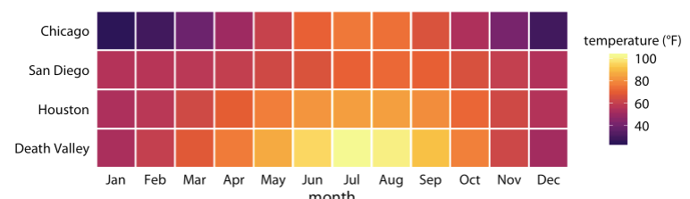
What is the difference? When will you use the top plot? When will you use the bottom plot?

Slide 21
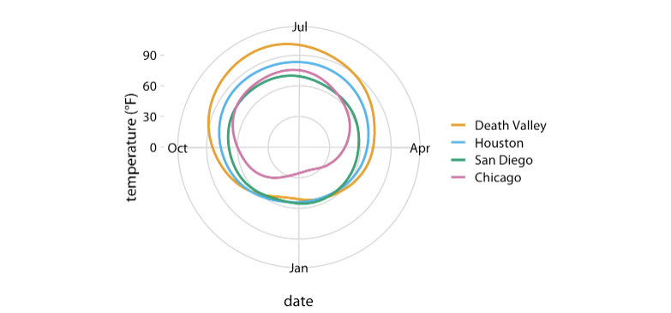
What is the difference?

Slide 22
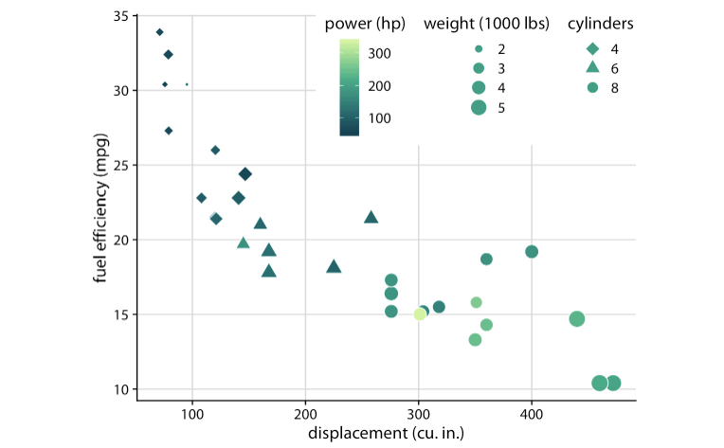
Using 5 scales
Displacement – x axis
MPG - y axis
Power - color
Weight – size
Cylinders - shape

Slide 23
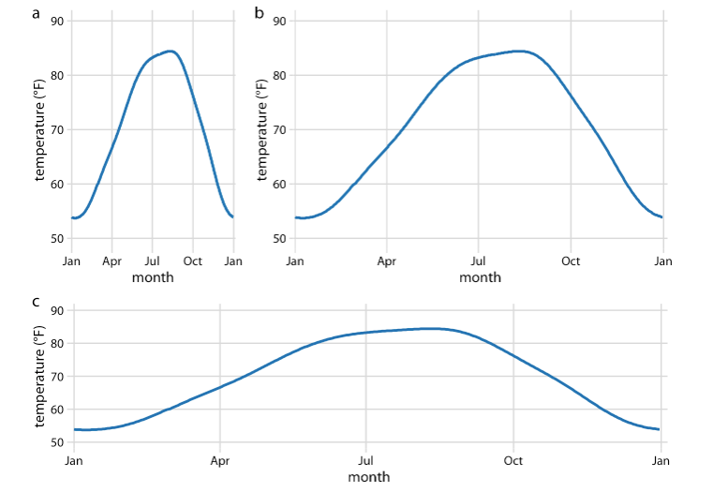
What is the difference?

Slide 24
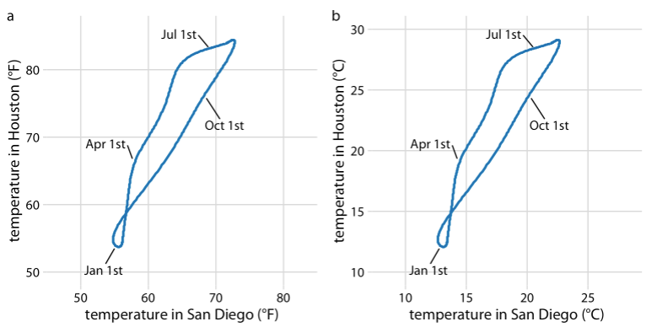
X and Y axes using same Units and equal grid spacing
Where are the highest temperatures in Houston or San Diego?

Slide 25
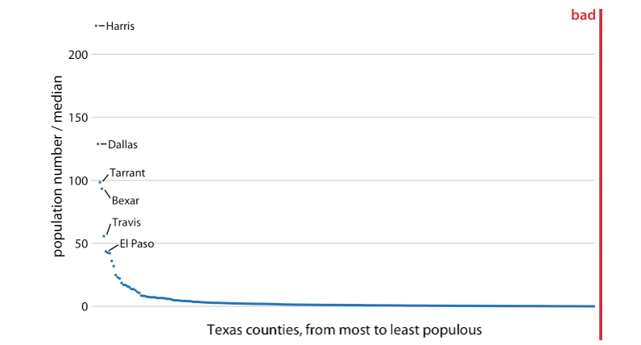
Can you improve this plot?
What is the problem?

Slide 26
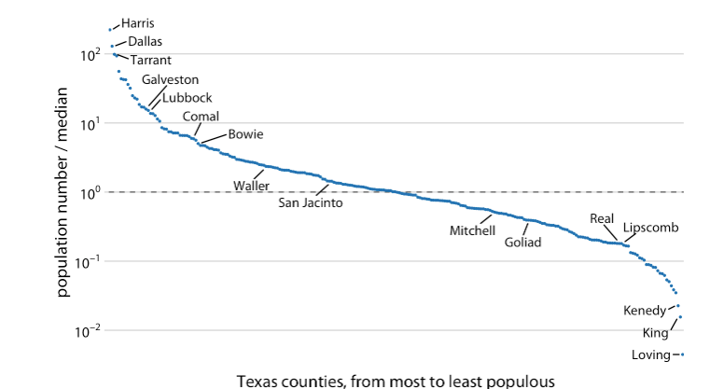
Same Plot, different scale on Y axis
Take logs

Slide 27
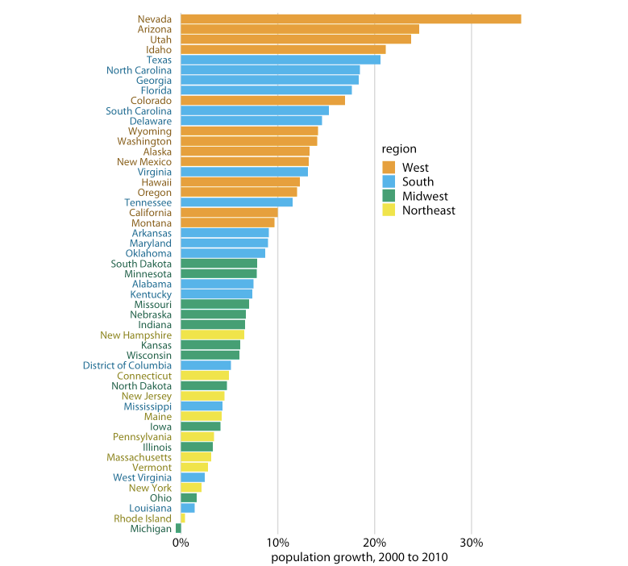
The colors show that states in the West and South have seen the largest population growth

Slide 28
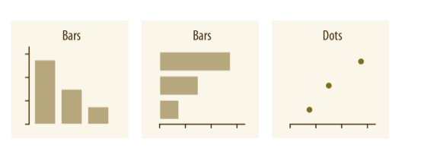
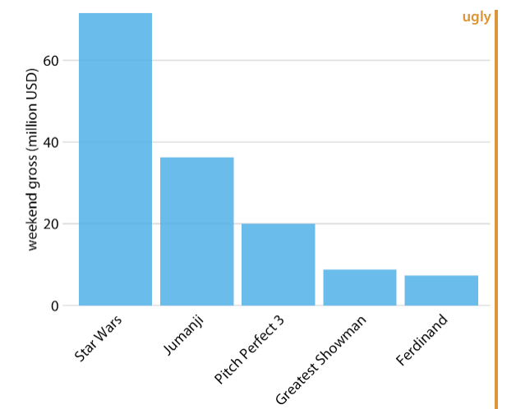
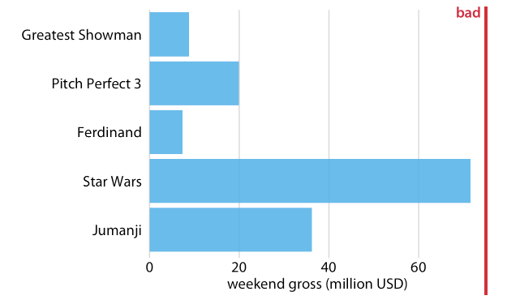
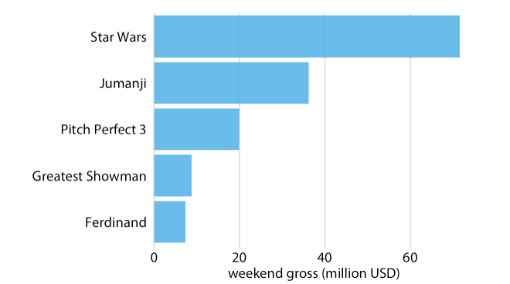
Amounts for One Category
Weekend Movies Gross Profit on Dec 22-24 2017
No space for Movie titles Sorting by Profits will improve plot

Slide 29
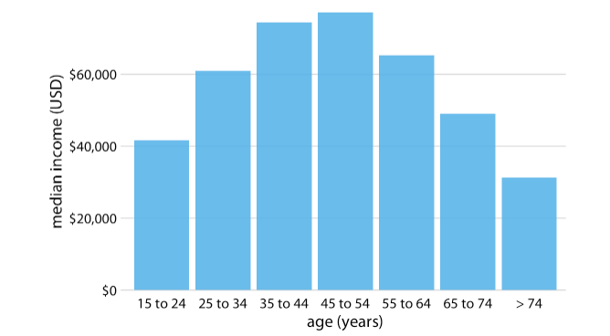
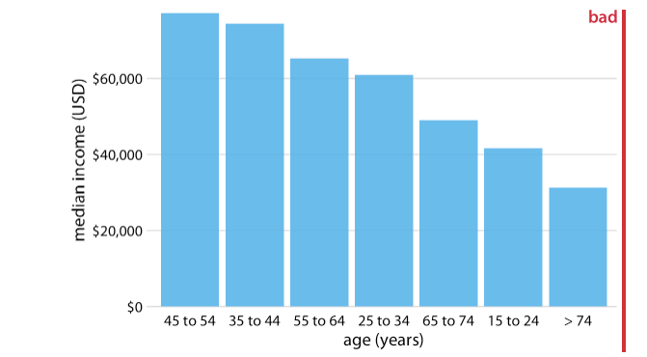
Amounts for One Category Histograms
US Median Income by Age group
Should not be sorted by Profits

Slide 30
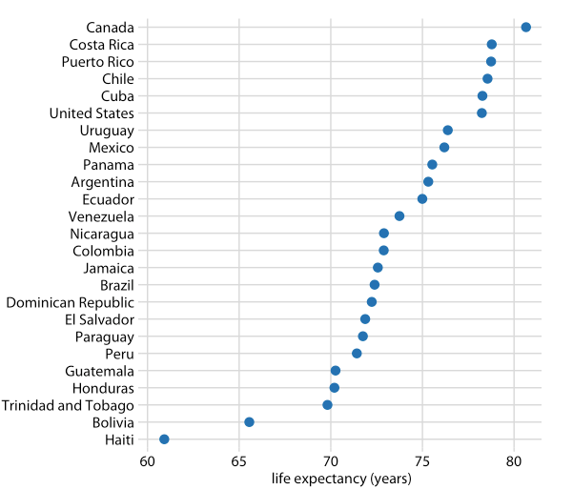
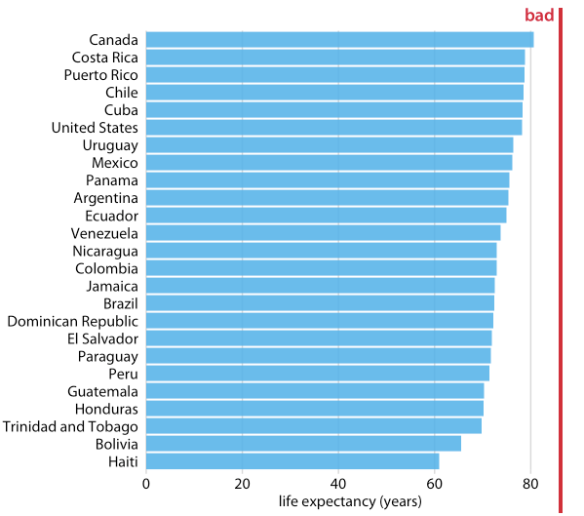
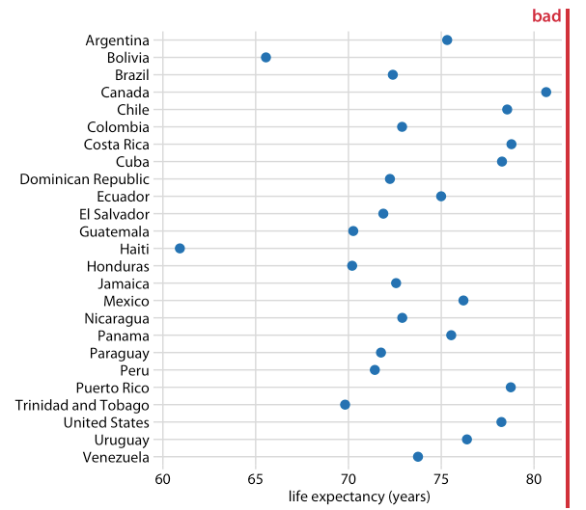
Amounts for One Category Dots
Life Expectancy in the Americas
K Too much emphasis to the length It is not meaningful to sort on
of the bar instead of the end of it alphabetical order

Slide 31
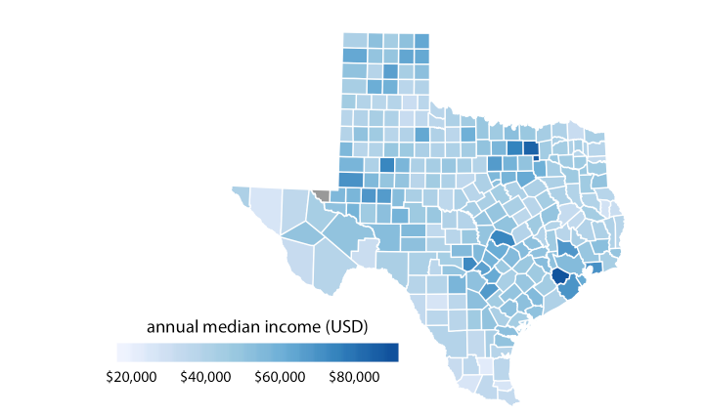
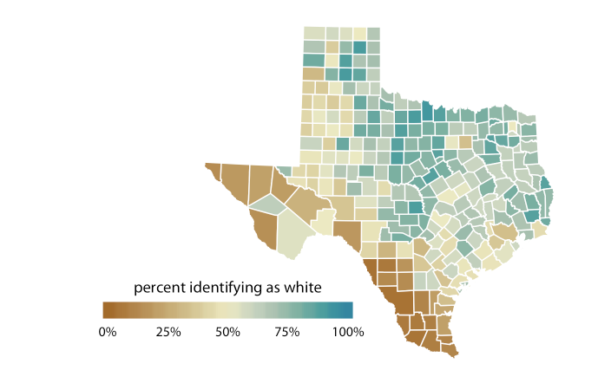
The colors can show values using a sequential scale
Important to Distinguish greater then or smaller than 50%

Slide 32
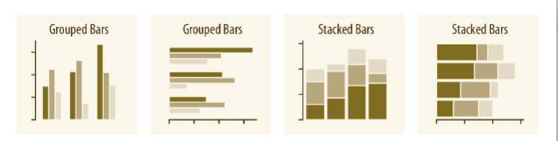
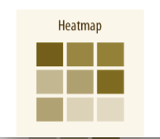
Amounts for Several Categories

Slide 33
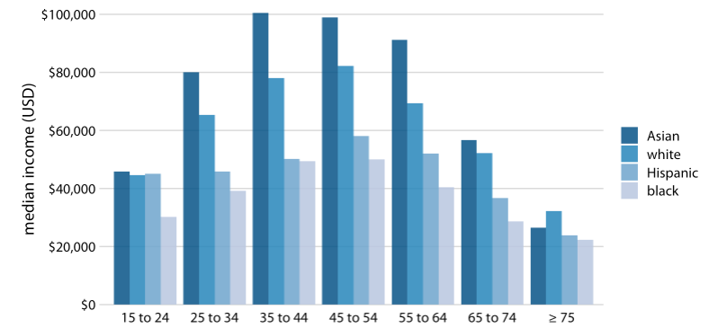
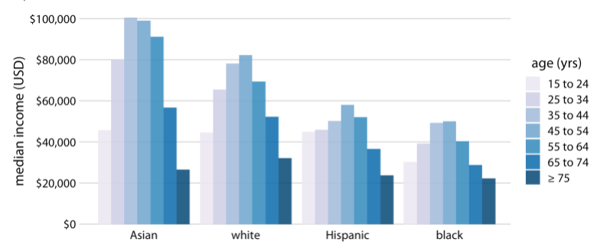
Amounts for Several Categories – Group Bars
US Median Income by Age and Race
OK
It is difficult to compare median incomes across age groups for a given racial group.
It is appropriate if we are primarily interested in the differences in income levels among racial groups
OK
Same observations as previously
Do not use stack bars (no meaning adding the median

Slide 34
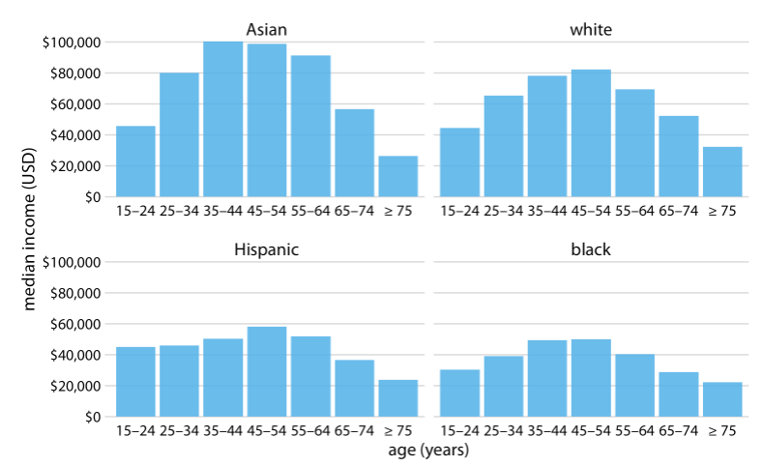
Amounts for Several Categories – Group Bars
US Median Income by Age and Race
PREFERABLE
OK
Same observations as previously

Slide 35
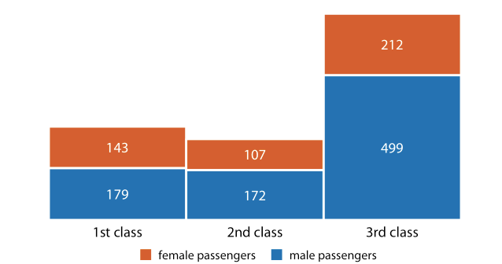
Amounts for Several Categories – Stack Bars
# Passengers on a flight by class and gender
PREFERABLE
OK
Same observations as previously

Slide 36
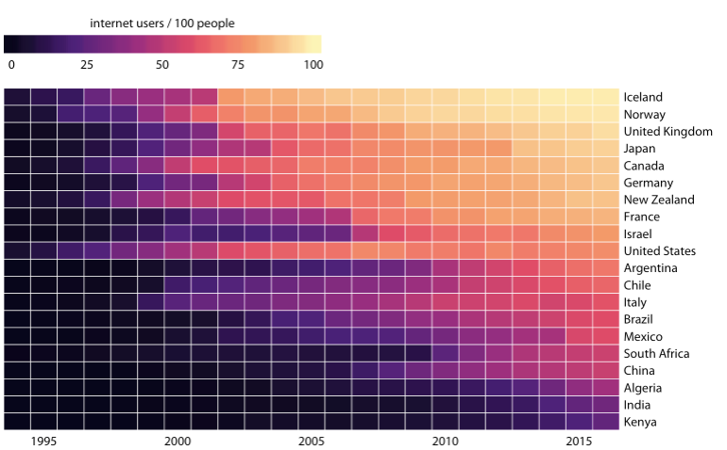
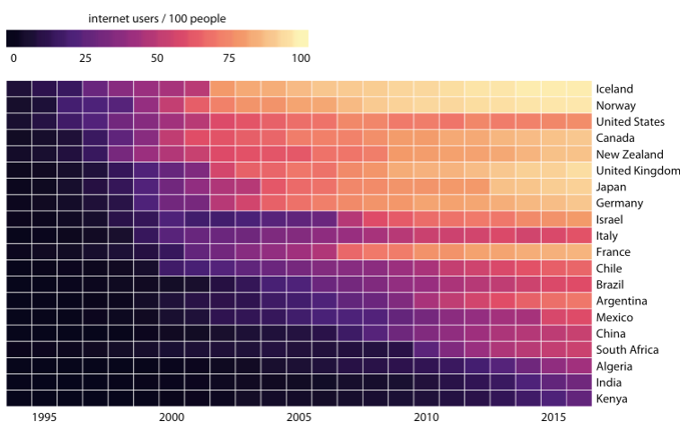
Amounts for Several Categories – Heat Maps
# Internet users by country and Year
How are these heat maps sorted?

Slide 37
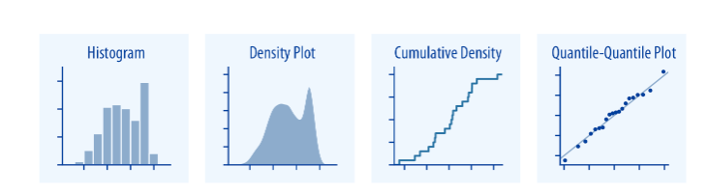
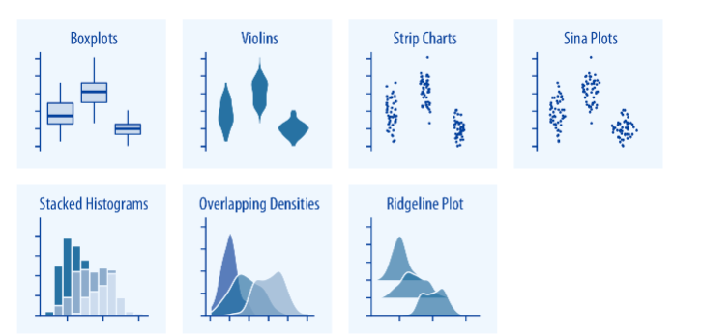
Distributions
How are these heat maps sorted?

Slide 38
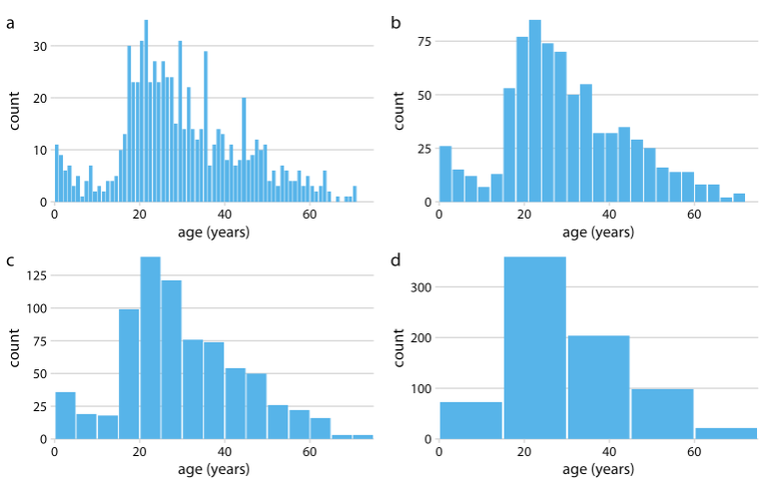
Distributions – Histograms
# Passengers at the Titanic by age groups
Age Bins width of one year are too small
Age bins are OK
Age bins are OK
Age Bins width of fifteen years are too large

Slide 39
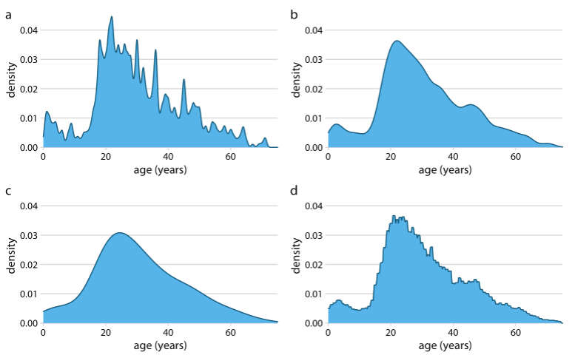
Distributions– Density Plots Good choice for large data sets
This curve is estimated from the data using a kernel density estimation procedure that uses a small width (controlled by a parameter called bandwidth).The most widely used kernel is a Gaussian kernel.
# Passengers at the Titanic by age
Gaussian Kernel, Bandwidth = 2
Rectangular Kernel, Bandwidth = 2
Gaussian Kernel, Bandwidth = 0.5
The shape is peaky and busy
Gaussian Kernel, Bandwidth = 5
The shape is too smooth loosing small patterns of the data

Slide 40
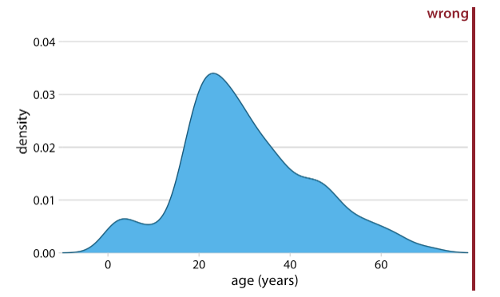
Distributions– Density Plots
# Passengers at the Titanic by age
What is wrong?

Slide 41

Distributions for two categories – Two histograms
# Passengers at the Titanic by age and gender
Age Pyramid

Slide 42

Distributions for two categories – Various density plots
Butterfat percentage in the milk of four cattle breeds

Slide 43

Cumulative Distributions
Number of inhabitants by US county on 2010
This distribution has a very long tail to the right. Even though most counties have relatively small numbers of inhabitants (the median is 25,857), a few counties have extremely large numbers of inhabitants (e.g., Los Angeles County, with 9,818,605 inhabitants). If we try to visualize the distribution of population counts as either a density plot or an cumulative frequency, we obtain figures that are essentially useless

Slide 44

Cumulative Distributions
Number of inhabitants by US county on 2010
Log transform

Slide 45

Quantile-quantile Plots Q-Q Plots
Grades of 12th grade students versos the expected ones
Quantile–quantile (q-q) plots are a useful visualization when we want to determine to what extent the observed data points do or do not follow a given distribution.
Most commonly, q-q plots are constructed using a normal distribution as the reference.

Slide 46


Box Plots
Temperatures in Lincoln, NE in 2016

Slide 47

Violin Plots
Temperatures in Lincoln, NE in 2016
Violin plots, which are equivalent to the density estimates but rotated by 90 degrees and then mirrored
Violins can be used whenever one would otherwise use a boxplot, and they provide a much more nuanced picture of the data. In particular, violin plots will accurately represent bimodal data whereas a boxplot will not.
November seems to have had two temperature clusters, one around 50 degrees and one around 35 degrees Fahrenheit.

Slide 48


Strip Chart
Temperatures in Lincoln, NE in 2016
Dots may fall on top of each other
The points have been jittered along the x axis to better show the density of points at each temperature value.

Slide 49

Sina Plot
Temperatures in Lincoln, NE in 2016
The Sina Plot is a Combination of:
spreading out the dots in the x axis
spreading out the dots in proportion to the point density at a given y coordinate.
This sina plot can be thought of as a hybrid between a violin plot and jittered points, and it shows each individual point while also visualizing the distributions.
The sina plots are drawn on top of the violins to highlight the relationship between these two approaches

Slide 50

Ridgeline Plot
Temperatures in Lincoln, NE in 2016
Staggering the distribution plots in the vertical direction

Slide 51

Ridgeline Plot
Movie lengths from 1913 to 2005
This figure contains almost 100 distinct distributions and yet it is very easy to read. We can see that in the 1920s, movies came in many different lengths, but since about 1960 movie length has standardized to approximately 90 minutes.

Slide 52
Summarizing Numerical data – Histograms and Box Plots (One variable – Univariate Plots)
Checking Numbers
Location
Median
Mean
Variability
Range
IQR
Standard deviation
Shape
Binomial
Normal
Long Tail

Slide 53

Box Plots
Max
Upper whisker = upper hinge + 1.5 IQR
3rd quantile (upper hinge)
Median
1rst quantile (lower hinge)
Lower whisker = lower hinge – 1.5 IQR
Min
IQR = Upper hinge – Lower hinge)

Slide 54




Normal Distribution
Binomial Distribution
The binomial distribution B(n,p) is approximately normal with mean np and variance np(1-p) for large n and for p not too close to 0 or 1.
The parameter mu is the mean or expectation of the distribution, while the parameter sigma is its standard deviation.

Slide 55
Missing data

Slide 56
Data Problems
Missing data
In statistics, missing data, or missing values, occur when no data value is stored for the variable in an observation.
Strange Values?
Outliers?
In statistics, an outlier is a data point that differs significantly from other observations.] An outlier may be due to variability in the measurement or it may indicate experimental error; the latter are sometimes excluded from the data set. An outlier can cause serious problems in statistical analyses.

Slide 57
How should you handle missing data
Can I dropped the missing data?
Yes, if you are sure you are not going to be dropping essential information for your analysis
Should I impute it?
Yes if you can
Situations when dropping missing data can cause problems:
Time series data can not miss the time series pattern
Analyzing Emails in 2020.
You can not loose counts if you dropped the missing specialties.
Date | Beer’s sales | Bread sales
Week1 | 34 | 68
week2 | 44 | 88
week3 | 54 | 108
week4 | 56 | 112
week5 | 43 | 86
week6 | … | 44
week7 | 34 | 68
week8 | 44 | 88
week9 | 54 | 108
week10 | 56
HCP_id | spec | Emails in 2020
3456 | PCP | 100
24434 | Onc | 250
4563 | Der | 430
34564 |  | 540
45675 | PA | 560
56786 | NP | 450
67897 | dentist | 430
78908 | periodontics | 560
12349 | Unknown | 430
23410 |  | 654

Slide 58
What questions should you ask yourself?
Is the data granularity appropriate to analyze the data?
The Tracking COVID data is daily by State. Can I use weekly by state? Can that fix the missing data problem? Can that fix the huge daily variability in some metrics?
Do I need January or February data? Should I analyze the data starting in March or Mid March?
If you decide to group the data weekly or monthly, which variables will you keep and how will you group them?
You can not add cumulative metrics
Which States will you keep?
Which dates will you keep?
Which metrics will you keep?

Slide 59




Merging data sets is a great source of LOST/MISSING data
HCP with sales & emails
Count 5,000
Sum emails 500,000
Sum of sales $40,000
HCP with emails
Count 10,000
Sum emails 1,000,000
HCP with sales
Count 6,000
Sales $50,000
Keep all HCPs in email data set
Count 10,000
Sum emails 1,000,000
Sum of sales $40,000
Missing sales
Keep all HCPs in both data sets
Count 11,000
Sum emails 1,000,000
Sum of sales $50,000
Missing sales and emails
Keep all HCP in sales data sets
Count 6,000
Sum of emails 500,000
Sales $50,000
Missing emails

Slide 60
Exploring the Data
1. Data – Upload file
2. Go to Sheet and Explore
Menu
Toolbar
Dimensions - Measures
3. Plot
Estimates of Location
Estimates of Variability
Univariate Graphs
Bivariate Graphs
Multivariate Graphs
Time Dependent Graphs
Structured Data
Data granularity
Accessing Excel and/or Tableau

