Slide 1
Analytics FOR BUSINESS Intelligence
Fall 2021
Nuria Diaz-Tena
Notes:
Attendance and Seating

Slide 2
To Do from Previous Class:
To Do from Previous Class:
Assignment 1
Solve R problems
Packages included in Tidyverse
ggplot2- for data visualization
dplyr - for data manipulation.
tidyr - for data tidying.
readr - for data import.
purrr - for functional programming.
tibble - for tibbles, a modern re-imagining of data frames.
stringr - for strings.
Forcats - for factors.
How to avoid data issues when “?” Included in data set
Read chapter 2

Slide 3
Course Planning
Lecture | Date | Topic | Assignments | Wg
1 | 9/01/21 | Introduction, Visualizations & Exploratory Data Analysis - Chapter 1
2 | 9/15/21 | Introduction to R
3 | 9/22/21 | Statistical Experiments | Homework #1 | 5%
4 | 9/29/21 | Regression – Chapter 2 and 3 | Homework #2 | 5%
5 | 10/06/21 | Bayesian Models
6 | 10/13/21 | Models Review | Project #1 | 15%
 | 10/20/21 | Midterm Exam | Midterm | 20%
7 | 10/27/21 | Classification Models – Chapter 4
8 | 11/03/21 | Cross Validation and Advance Classification – Chapter 5 to 9 | Homework #3 | 5%
9 | 11/10/21 | Advance Classification | Homework #4 | 5%
10 | 11/17/21 | Support Vector Machines - Chapter 9
 |  | Thanksgiving Recess
 | 11/29/21 | Review of Machine Learning Models
11 | 12/01/21 | Clustering - Chapter 10
12 | 12/06/21 | Project Discussion
13 | 12/08/21 | Final Exam Preparation | Project #2 | 15%
 | 12/22/21 | Final Exam | Final | 30%

Slide 4
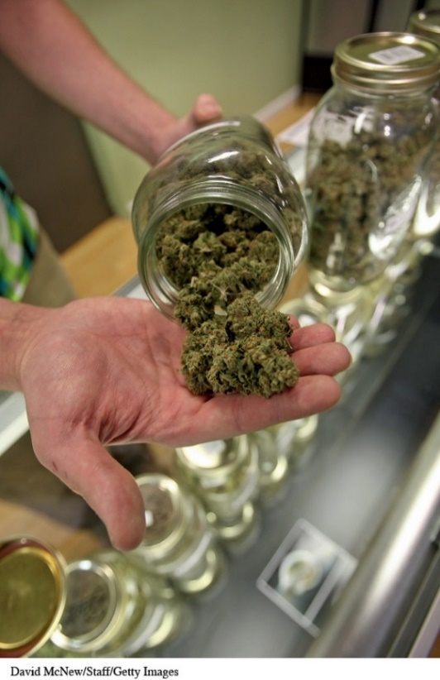
Poll in Michigan in favor of legalizing Marijuana
In January 2014 the Michigan news site MLive ran the story, “Take Our Online Poll: Should Michigan Legalize Marijuana?”
Of 9,684 respondents,
7,906 (81.84%) said, “Yes”
1,190 (12.2%) said, “No”
588 (6.07%) said, “Decriminalize but don’t legalize”
This appears to be overwhelming support for legalization.

Slide 5
Poll from Pew Research Center in favor of legalizing Marijuana – Different Percentages
The Pew Research Center conducted a poll on March 25–29, 2015, in which they asked, “Do you think the use of marijuana should be made legal or not?”
53% of the 1,500 randomly selected adult Americans in the survey favor the legal use of marijuana.
This is a majority of those surveyed but not the overwhelming majority that MLive found.
There is a large discrepancy in the findings of these two polls.

Slide 6
Comparing Results
 | Michigan Poll | Pew Research
Date of Survey | January 2014 | March 2015
Target Population | Michiganians | Americans
Sample Size | 9,684 | 1,500
Question | Should Michigan Legalize marijuana? | Do you think the use of marijuana should be made legal or not?”
Percent “Yes” | 81.84% | 53%
Percent “No” | 12.2% | 47%
Percent “Decriminalize, but not legalize” | 6.07%
The large discrepancy may be because
the polls were conducted at different times
the populations sampled were different (Michigan versus all adult Americans)
the MLive poll had a much larger sample than the Pew poll
the questions asked were not identical
the data from one or both polls are bad

Slide 7
Sampling Learning Objectives
Understand differences between populations and samples
Understand how samples can go wrong
Understand how bias is defined
Identify potential sources of bias in a sample
Understand how to best obtain random samples
Understand there is variability in samples and how it’s affected by a sample’s attributes
Estimate margins of error and confidence intervals
Identify sampling frames and how they might differ from populations
Identify potential sources of bias that can occur even in well-designed studies and how they can be managed

Slide 8
We select a sample in order to get information about some population.
A sample is an unbiased number of observations taken from a population. In simple terms, a population is the total number of observations (i.e., individuals, animals, items, data, etc.) ... A sample, in other words, is a portion, part, or fraction of the whole group, and acts as a subset of the population.
Population
Sample

Slide 9
A Good Sample should be unbiased
Unbiased Samples
Biased Samples
The Simple Random Sample (SRS) - of size n consists of n individuals from the population chosen in such a way that every set of n individuals has an equal chance to be the sample actually selected.
The Stratified Sample - of size n1, n2,…np consists of n1, n2,… individuals from p different stratum of the population chosen in such a way that every set of n1 individuals has an equal chance to be the sample in their strata.
The design of a statistical study systematically favors certain outcomes
Convenience sampling - selection of whichever individuals are easiest to reach
Voluntary response sample - chooses itself by responding to a general appeal (write-in or call-in opinion polls)

Slide 10
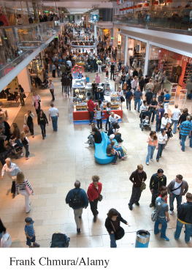
Convenience Sampling at the Mall
Advertising agencies often interview at shopping malls, which is fast and cheap.
People contacted at shopping malls are not representative of the U.S. population. They are richer and more likely to be teenagers or retirees, and the interviewers tend to select neat, safe-looking individuals.
The opinions of such a convenience sample may be very different from those of the population as a whole.

Slide 11
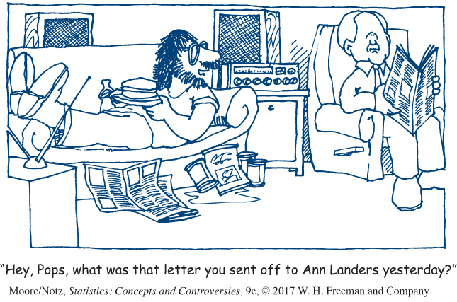
Example: Write-In Opinion Polls
Ann Landers once asked the readers of her advice column, “If you had it to do over again, would you have children?” She received nearly 10,000 responses, almost 70% saying no.
Is it true that 70% of parents regret having children?
No! This is an example of a voluntary response sample, in which the respondents are often those who have a strong and negative opinion.

Slide 12
Selecting Randomly
A table of random digits is a long string of the digits 0, 1, 2, 3, 4, 5, 6, 7, 8, 9 with these two properties:
Each entry in the table is equally likely to be any of the 10 digits 0 through 9
The entries are independent of each other. That is, knowledge of one part of the table gives no information about any other part
Example: Use random digits to select an SRS of 4 hotels.
01 Aloha Kai 08 Captiva 15 Palm Tree 22 Sea Shell
02 Anchor Down 09 Casa del Mar 16 Radisson 23 Silver Beach
03 Banana Bay 10 Coconuts 17 Ramada 24 Sunset Beach
04 Banyan Tree 11 Diplomat 18 Sandpiper 25 Tradewinds
05 Beach Castle 12 Holiday Inn 19 Sea Castle 26 Tropical Breeze
06 Best Western 13 Lime Tree 20 Sea Club 27 Tropical Shores
07 Cabana 14 Outrigger 21 Sea Grape 28 Veranda

Slide 13


Table to Generate an SRS
Use the random digits provided to select an SRS of 4 hotels.
01 Aloha Kai 08 Captiva 15 Palm Tree 22 Sea Shell
02 Anchor Down 09 Casa del Mar 16 Radisson 23 Silver Beach
03 Banana Bay 10 Coconuts 17 Ramada 24 Sunset Beach
04 Banyan Tree 11 Diplomat 18 Sandpiper 25 Tradewinds
05 Beach Castle 12 Holiday Inn 19 Sea Castle 26 Tropical Breeze
06 Best Western 13 Lime Tree 20 Sea Club 27 Tropical Shores
07 Cabana 14 Outrigger 21 Sea Grape 28 Veranda
69051648178717409517845340648987201 97245
69 05 16 48 17 87 17 40 95 17 84 53 40 64 89 87 20
Our SRS of 4 hotels is: 05 Beach Castle, 16 Radisson, 17 Ramada, and 20 Sea Club.

Slide 14
Statistics in Summary
We select a sample in order to get information about some population.
Convenience samples and voluntary response samples are common but do not produce trustworthy data. These sampling methods are usually biased. That is, they systematically favor some parts of the population over others in choosing the sample.
The deliberate use of chance in producing data is one of the big ideas of statistics. Random samples use chance to choose a sample, thus avoiding bias due to personal choice.
The basic type of random sample is the simple random sample, which gives all samples of the same size the same chance to be the sample we actually choose.

Slide 15
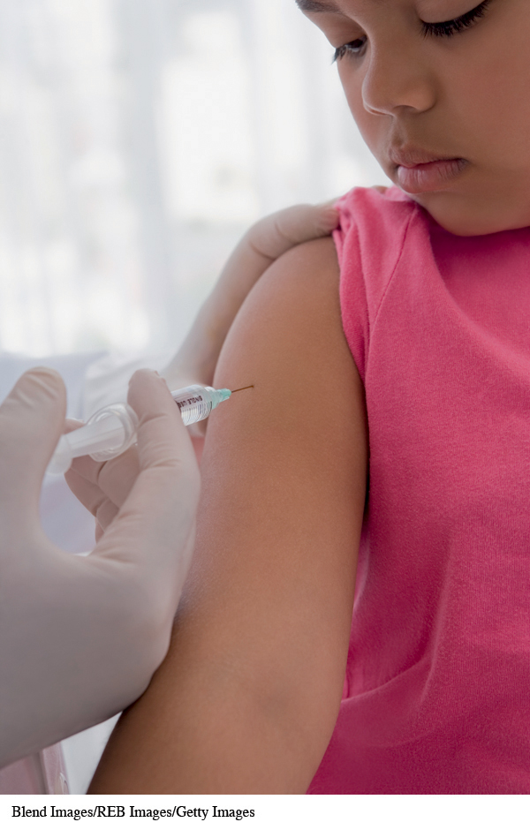
How important is that parents get their children vaccinated?
A Gallup Poll conducted February 28–March 1, 2015, asked the following question:
“How important is it that parents get their children vaccinated—extremely important, very important, somewhat important, or not at all important?”
They found that 54% of respondents said, “extremely important” (down from 64% who responded to a similar Gallup Poll in 2001).
Can we trust this conclusion?

Slide 16
The Sample included 0.0004% of the Population
Reading further, we find that Gallup talked with 1,015 randomly selected adults to reach these conclusions.
The U.S. Census Bureau said that there were about 258 million adults in the United States in 2013.
How can 1015 people tell us about the opinions of 258 million people?
Is the 54% who feel that it is extremely important, in fact, the majority of Americans who feel this way? By the end of this chapter, you will learn the answers to these questions.

Slide 17

Parameters and Statistics
A parameter is a number that describes the population.
A parameter is a fixed number, but in practice we don’t know its value.
A statistic is a number that describes the sample.
The value of a statistic is known when we have taken a sample, but it can change from sample to sample.
We often use a statistic to estimate an unknown parameter.
Population
describe by a
Parameter p
Sample
describe by a
Statistic $\hat{p}$

Slide 18
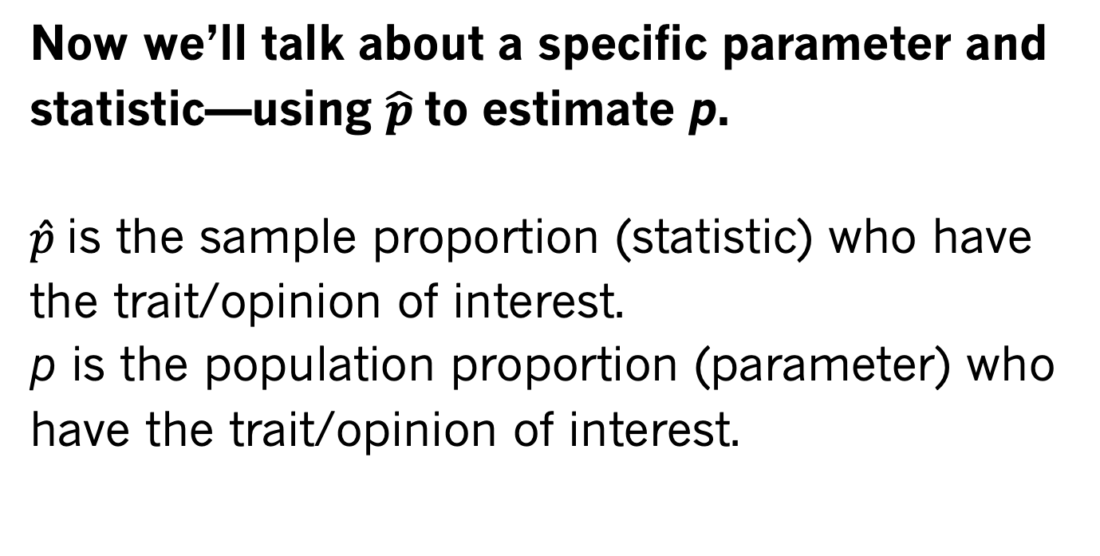
True Proportion (parameter) Estimated Proportion (statistic)
Now we’ll talk about a specific parameter and statistic—using $\hat{p}$ to estimate p.
$\hat{p}$ is the sample proportion (statistic) who have the trait/opinion of interest.
p is the population proportion (parameter) who have the trait/opinion of interest.

Slide 19
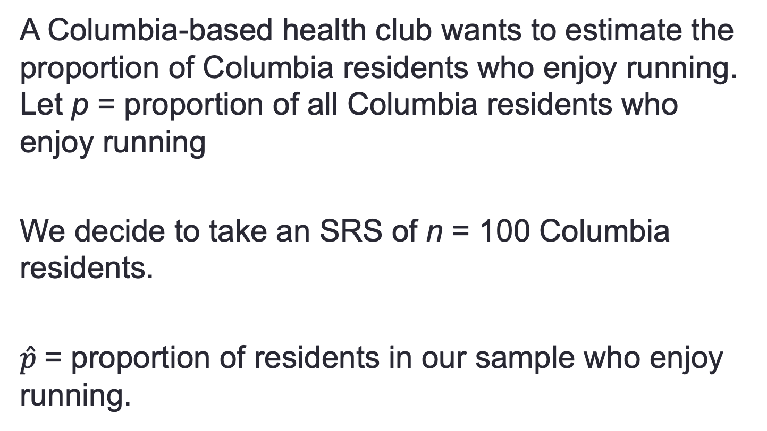
Choosing a Sample to estimate a proportion
A Columbia-based health club wants to estimate the proportion of Columbia residents who enjoy running. Let p = proportion of all Columbia residents who enjoy running
We decide to take an SRS of n = 100 Columbia residents.
$\hat{p}$= proportion of residents in our sample who enjoy running.

Slide 20
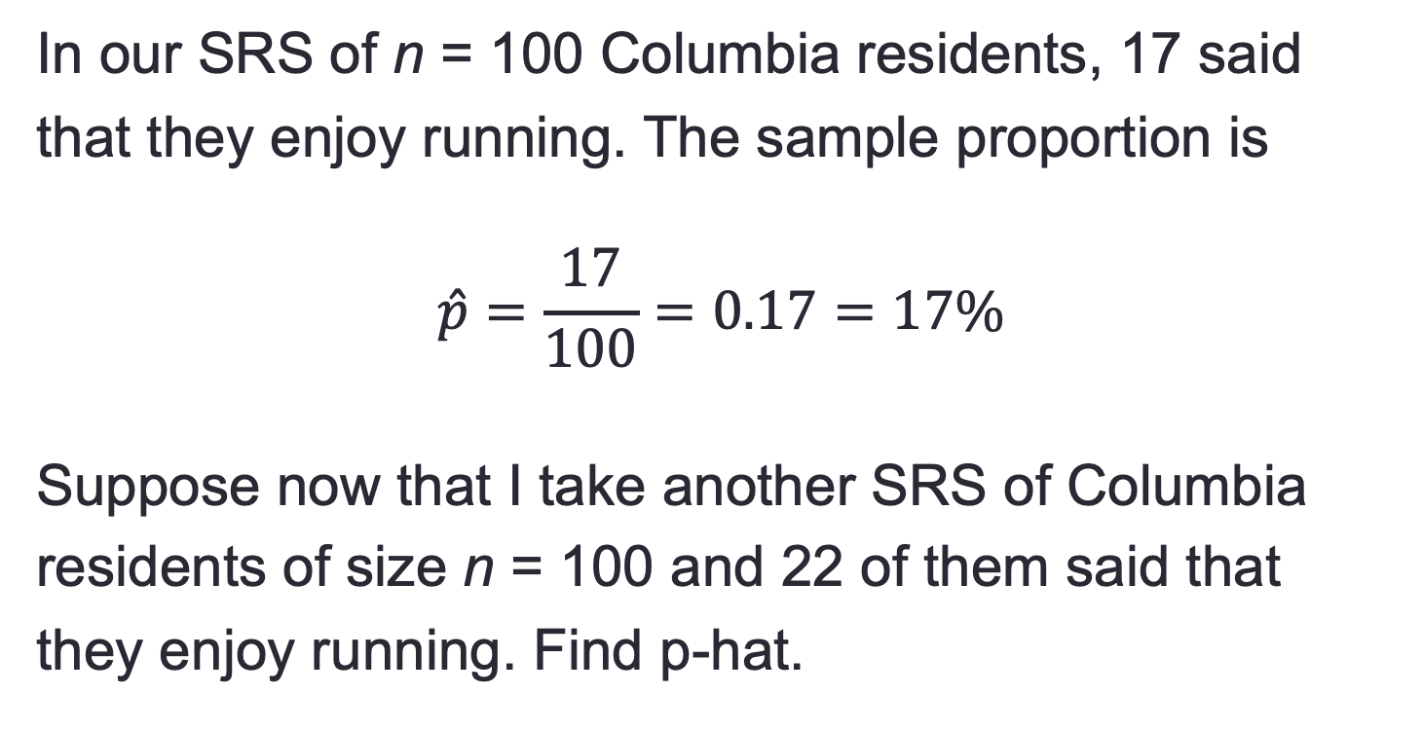
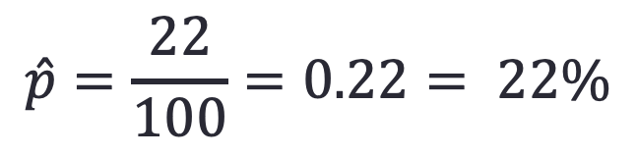
Two different Samples may estimate different proportions
In our SRS of n = 100 Columbia residents, 17 said
that they enjoy running. The sample proportion is
$$\hat{p}=\frac{17}{100}=0.17=17\%$$
Suppose now that I take another SRS of Columbia
residents of size n = 100 and 22 of them said that
they enjoy running. Find p-hat.
$$\hat{p}=\frac{22}{100}=0.22= 22\%$$

Slide 21
Sampling Variability
Notice that we have two samples from the same population and our sample proportions are different from each other.
Question: Are statistics from the different samples (but drawn from the same population) going to be exactly the same? No!
Question: Is our statistic, calculated from any one sample, going to exactly match the population parameter it is attempting to estimate? No!

Slide 22
Sampling Variability
The fact that our statistics will not be the same from sample to sample is called sampling variability (because all samples are going to be a little different from each other).
We hope that as long as we have a good sampling scheme, we will be estimating the population parameter fairly well when we take our one shot at estimating it.

Slide 23
A good sample should have a small Bias and small Variability
Bias is consistent, repeated deviation of the statistic from the parameter in the same direction when we take many samples.
Variability describes how spread out the values of the statistic are when we take many samples.
Large variability means the result of sampling is not repeatable.

Slide 24
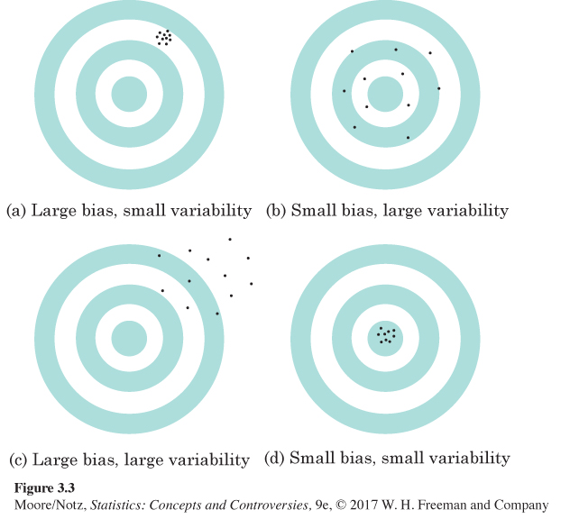
Bias and Variability

Slide 25
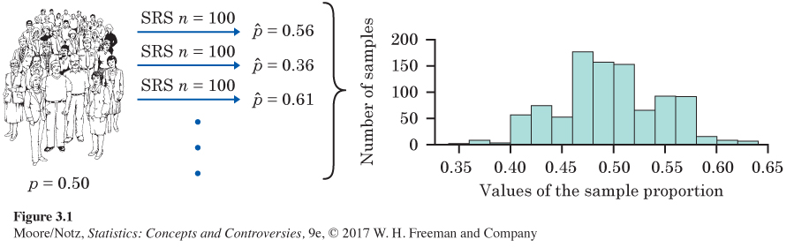
Variability of p-hat
1000 of size n = 100

Slide 26
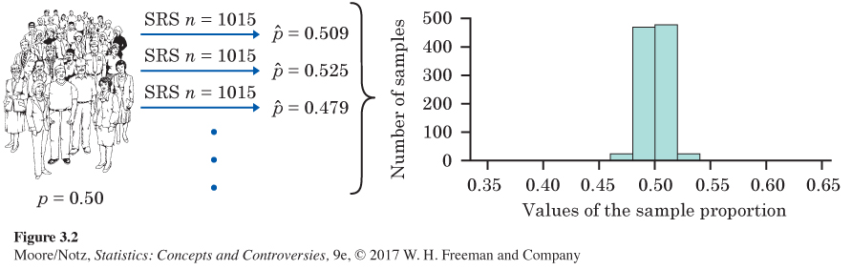
Variability of p-hat when choosing a larger sample size
1000 of size n = 1015
Notice that with larger samples (1015 vs. 100), there is a lot less variability, but the distribution is still centered at p = 0.50 (so p-hat is unbiased for p).

Slide 27
Reducing Bias and Variability
To reduce bias, use random sampling.
To reduce variability of your statistic when sampling with an SRS, use a larger sample. You can make the variability as small as you want by taking a large enough sample.
Large random samples almost always give an
estimate that is close to the truth (population
parameter).

Slide 28
52% of Smartphone Owners check their phone at least hourly
Source: news.gallup.com, April 17–May 18, 2015, in the report Most U.S. Smartphone Owners Check Phone at Least Hourly, stated that 52% ± 1% of American smartphone owners check their devices several times an hour or more frequently.
Where does the plus or minus 1% come from?
This is called margin of error (MOE).

Slide 29
Margin of Error
The margin of error (MOE) is a value that quantifies the uncertainty in our estimate.
When using the sample proportion to estimate the population proportion, the MOE is a measure of how close we believe the sample proportion is to the population proportion. We usually report this through a confidence interval.

Slide 30
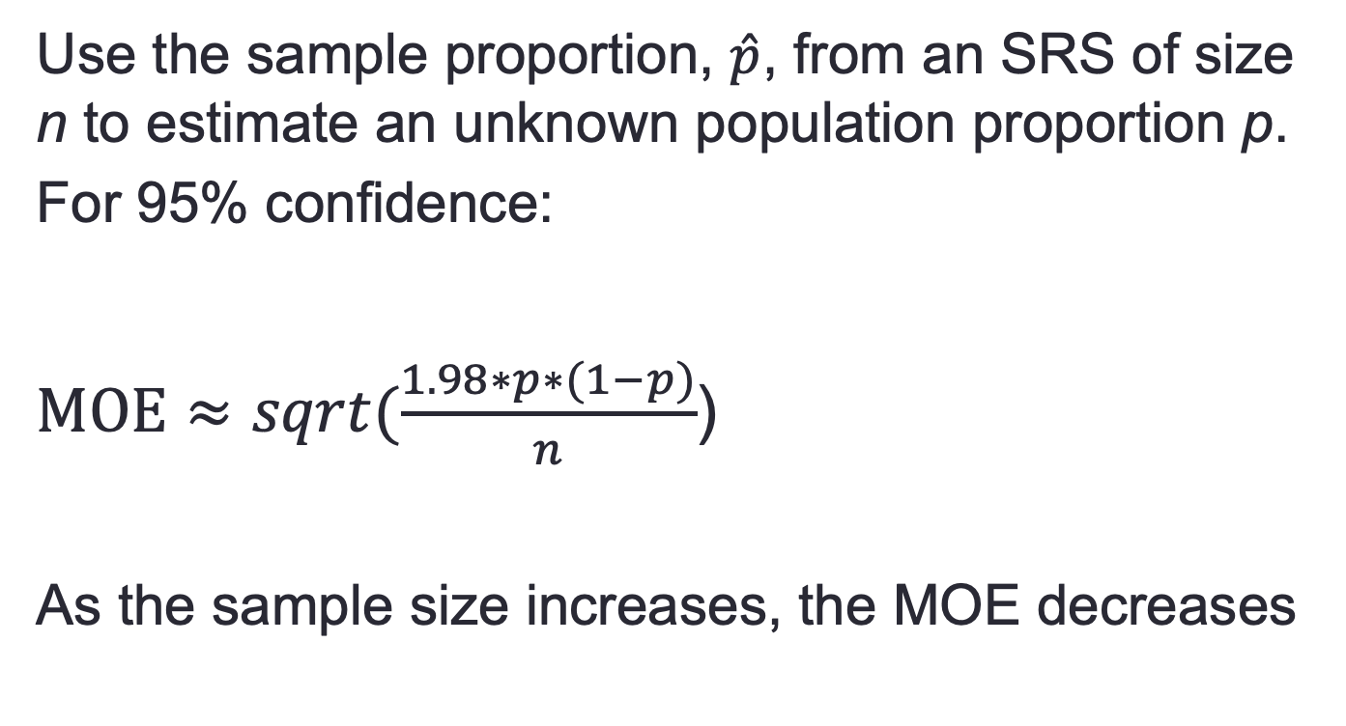
Calculating Margin of Error
Use the sample proportion, $\hat{p}$, from an SRS of size n to estimate an unknown population proportion p.
For 95% confidence:
$MOE≈sqrt(\frac{1.98∗p∗(1−p)}{n}$)
As the sample size increases, the MOE decreases

Slide 31
Confidence Statements
A confidence statement interprets a confidence interval and has two parts: a margin of error and a level of confidence.
Margin of error says how close the statistic lies to the parameter.
Level of confidence says what percentage of all possible samples results in a confidence interval which contains the true parameter.

Slide 32
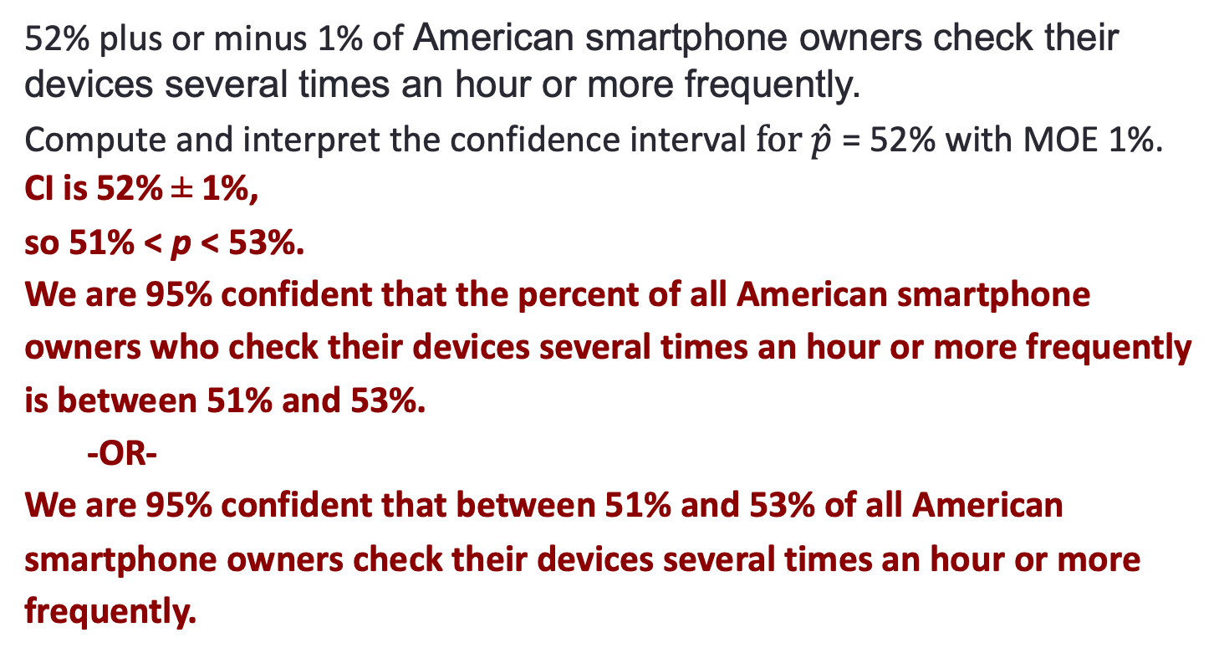
There is a 95% confidence that 51% to 53% of smartphone owners checktheir phone hourly
52% plus or minus 1% of American smartphone owners check their devices several times an hour or more frequently.
Compute and interpret the confidence interval $for \hat{p}$ = 52% with MOE 1%.
CI is 52% ± 1%,
so 51% < p < 53%.
We are 95% confident that the percent of all American smartphone owners who check their devices several times an hour or more frequently is between 51% and 53%.
-OR-
We are 95% confident that between 51% and 53% of all American smartphone owners check their devices several times an hour or more frequently.

Slide 33
Statistics in Summary
The purpose of sampling is to use a sample to gain information about a population. We often use a sample statistic to estimate the value of a population parameter.
One big idea: To describe how trustworthy a sample is, ask, “What would happen if we took a large number of samples from the same population?” If almost all samples would give a result close to the truth, we can trust our one sample even though we can’t be certain that it is close to the truth.

Slide 34
Statistics in Summary
In planning a sample survey, first aim for small bias by using random sampling and avoiding bad sampling methods such as voluntary response. Next, choose a large enough random sample to reduce the variability of the result. Using a large random sample guarantees that almost all samples will give accurate results.

Slide 35
Statistics in Summary
To say how accurate our conclusions about the population are, make a confidence statement. News reports often mention only the margin of error. Most often this margin of error is for 95% confidence. That is, if we chose many samples, the truth about the population would be within the margin of error 95% of the time.

Slide 36
The non-response rate is 58%
Most polls are taken by telephone, dialing numbers at random to get a random sample of households. After eliminating fax and business numbers:
Never answered phone | 938
Answered but refused | 678
Not eligible: no persons aged 18 or older, or language barrier | 221
Incomplete interview | 42
Complete interview | 1000
Total Called | 2879

Slide 37
Errors in Sampling
Sampling errors are errors caused by the act of taking a sample. They cause sample results to be different from the results of a census.
Nonsampling errors are errors not related to the act of selecting a sample from the population. They can be present even in a census.

Slide 38
1. Sampling Errors
A. Random Sampling Error
Deviation between the statistic and parameter
Caused by chance in selecting a random sample
ONLY error accounted for in the margin of error in a confidence statement
B. Bad Sampling Methods
Convenience and voluntary response samples
An incomplete sampling frame can cause undercoverage, where certain groups of the population are left out.

Slide 39
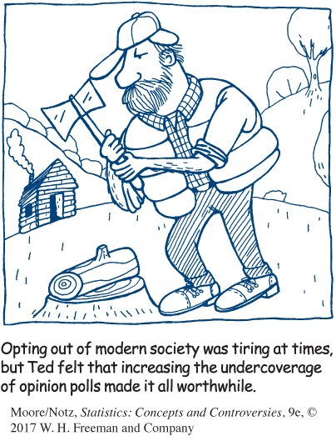
Example: Undercoverage
Most opinion polls can’t afford to attempt full coverage of the population of all adult residents of the United States.
The interviews are done by telephone, thus missing the 2% of households without phones.
Only households are contacted, so students in dormitories, prison inmates, most members of the armed forces, the homeless, and people staying in shelters are left out.
Many polls interview only in English, which leaves some immigrant households out of their samples.

Slide 40
2. Nonsampling Errors
A. Processing Errors
Mistakes in mechanical tasks such as arithmetic or data entry
B. Poorly Worded Questions
Question is slanted to favor one response over the other
C. Response Error
Response from an individual in the survey that is inaccurate from lying, bad memory, etc.
D. Nonresponse Error
Failure to obtain data from an individual selected for a sample

Slide 41
Poorly Worded Questions
Look at the difference with a few changed words!
Is our government providing too much money for welfare programs?
44% said yes
Is our government providing too much money for assistance to the poor?
13% said yes

Slide 42
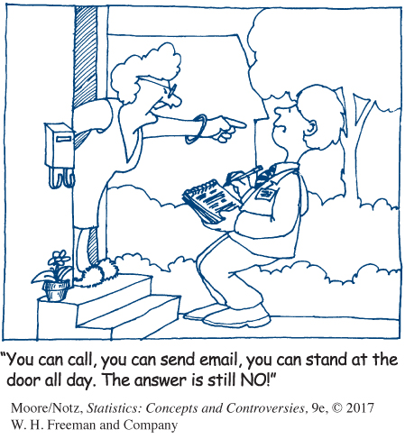
What the Margin of Error Can’t Say
The announced margin of error for a sample survey covers only random sampling error.
Undercoverage, nonresponse, and other practical difficulties can cause large bias that is not covered by the margin of error.

Slide 43
Other Random Sampling Methods
With an SRS, because each sample of size n has the same chance of being selected, we cannot obtain information for separate groups of individuals (e.g., individuals of different gender, race, income class, or religion).
Identify some separate groups we may want to hear from when asking the following question: “Do you think our health-care system works well?”

Slide 44
How to Live with Nonsampling Errors
Substitute other households for the nonresponders. Because nonresponse is higher in cities, replacing nonresponders with other households in the same neighborhood may reduce bias.
Once the data are in, all professional surveys use statistical methods to weight the responses in an attempt to correct sources of bias.

Slide 45
Stratified Random Sampling
Step 1: Divide the sampling frame into
distinct groups of individuals, called strata.
Choose strata because you have an interest in the groups or because the individuals within each group are similar.
Step 2: Take a separate SRS in each stratum and combine these to make up the complete sample.

Slide 46
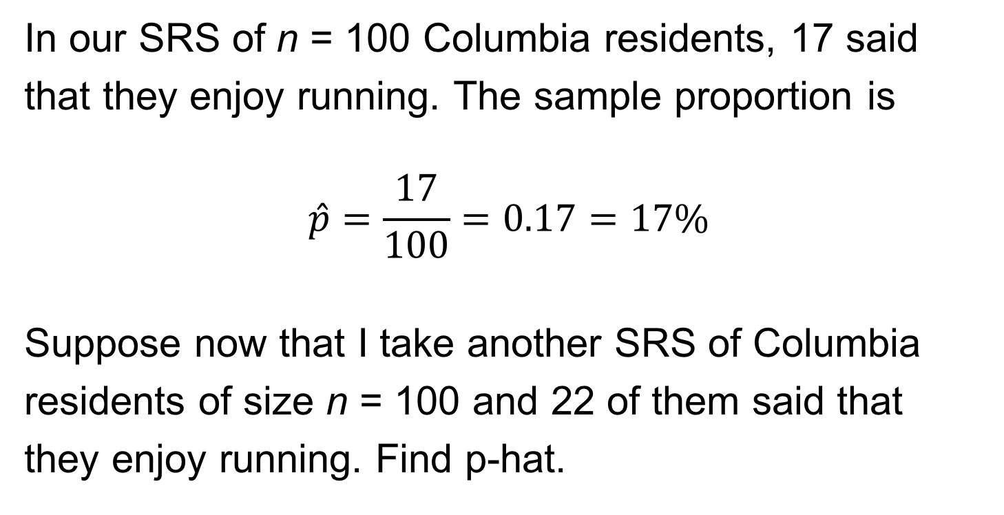
Example: Stratifying a Sample of Students
A large university has 30,000 students, of whom 3000 are graduate students.
An SRS of 500 students gives every student the same chance to be in the sample. That chance is
$$\frac{500}{30,000}=\frac{1}{60}$$

Slide 47
Example: Stratifying a Sample of Students
To make sure we have a certain number of
grad students (200) and undergraduate
students (300) represented, we can stratify.
Label the graduate students 0001 to 3000 and use Table A to select an SRS of 200.
Then label the undergraduates 00001 to 27000 and use Table A a second time to select a sample of 300 of them.

Slide 48
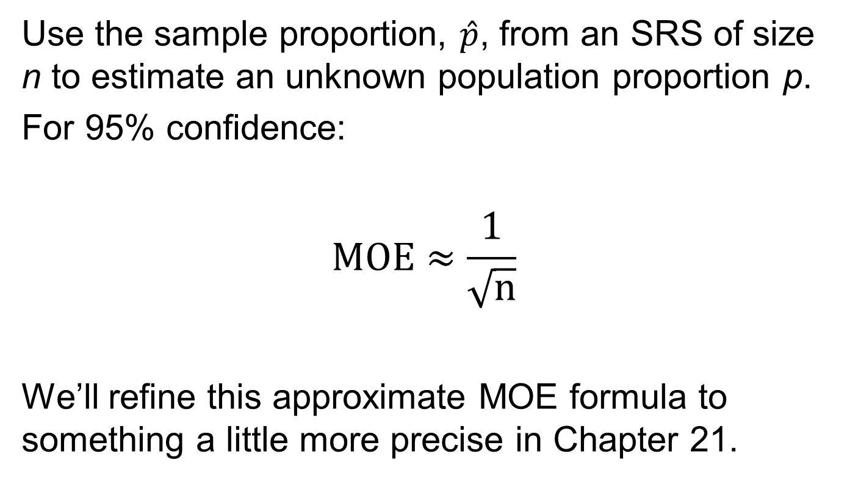
Example: Stratifying a Sample of Students 3
In the stratified sample, each graduate student has a $\frac{200}{3,000}=\frac{1}{15}$chance to be chosen.
Each undergraduate has a $\frac{300}{27,000}=\frac{1}{90}$ chance to be chosen.

Slide 49
The Challenge of Internet Surveys
Using the Internet for “Web surveys” is becoming
increasingly popular.
Advantages:
Easy to collect large amounts of data
Costs less money
Allows for delivery of multimedia content
Disadvantages:
Not easy to do well
Voluntary response, undercoverage, nonresponse

Slide 50
Collecting Data from Open Source conversations
There is already lots of opinions about lots of topics on twitter, blogs, etc.
Can we use this data to gather information?

Slide 51
Questions to Ask before You Believe a Poll
Who carried out the survey? Even a political party should hire a professional sample survey firm whose reputation demands that they follow good survey practices.
What was the population? That is, whose opinions were being sought?
How was the sample selected? Look for mention of random sampling.
How large was the sample? Even better, find out both the sample size and the margin of error within which the results of 95% of all samples drawn, as this one was, would fall.

Slide 52
Questions to Ask before You Believe a Poll (continued)
What was the response rate? That is, what percentage of the original subjects actually provided information?
How were the subjects contacted? By telephone? Mail? Face-to-face interview?
When was the survey conducted? Was it just after some event that might have influenced opinion?
What were the exact questions asked?

Slide 53
Statistics in Summary
Sampling in the real world is complex. Even professional sample surveys don’t give exactly correct information about the population.
There are many potential sources of error in sampling. The margin of error announced by a sample survey covers only random sampling error, the variation due to chance in choosing a random sample.

Slide 54
Statistics in Summary
Other types of error are in addition to the margin of error and can’t be directly measured. Sampling errors come from the act of choosing a sample.
Random sampling error and undercoverage are common types of sampling error.
Undercoverage occurs when some members of the population are left out of the sampling frame, the list from which the sample is actually chosen.

Slide 55
Statistics in Summary
The most serious errors in most careful surveys, however, are nonsampling errors. These have nothing to do with choosing a sample; they are present even in a census.
The single biggest problem for sample surveys is nonresponse: subjects can’t be contacted or refuse to answer.

Slide 56
Statistics in Summary
Mistakes in handling the data (processing errors) and incorrect answers by respondents (response errors) are other examples of nonsampling errors.
Finally, the exact wording of questions has a big influence on the answers.

Slide 57
Statistics in Summary
People who design sample surveys use statistical techniques that help correct nonsampling errors, and they also use probability samples more complex than simple random samples, such as stratified samples.
You can assess the quality of a sample survey quite well by just looking at the basics: use of random samples, sample size and margin of error, the rate of nonresponse, and the wording of the questions.

Slide 58
TO DO:
To Do for next class:
Assignment #2
Watch Tableau videos (recommended)

