Slide 1
IMPROVE ASSIGNMENT # 1
Assignment 1 in Pairs or alone
Due on 9/22/21
On CANVAS
Notes:
Attendance and Seating

Slide 2
EDUCATION FOR 25+ COMPARISON

Slide 3
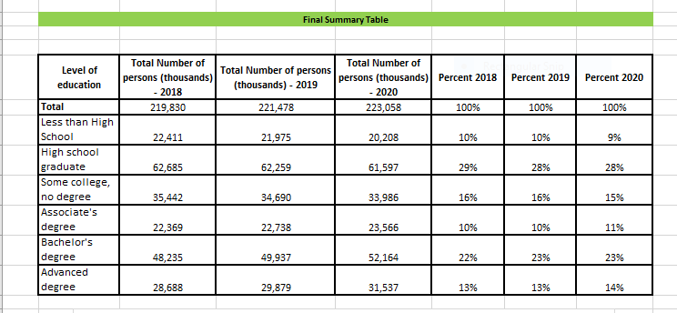
Summary Table :
CHOUHAN, GARIMA

Slide 4
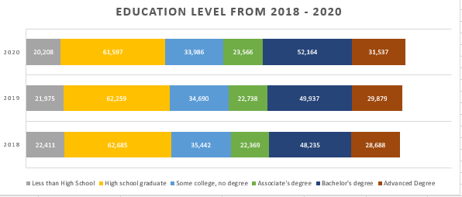
Education Level Comparison :

Slide 5
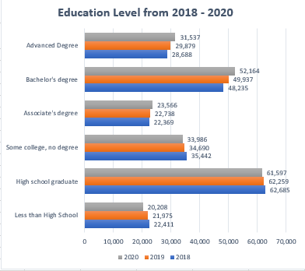
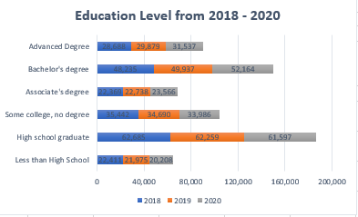
Stacked Bar Charts and Side by Side Bar Charts :

Slide 6
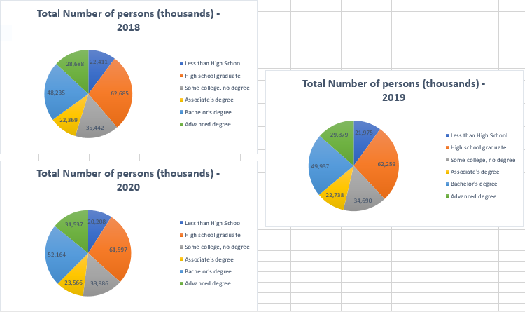
Pie Charts :

Slide 7
Main Finding of education changes
STUDENT ANSWER
Compare the education level for 25+ between 2018 and 2020 using graphs and provide conclusions -
Firstly, in the education level for people with 25+ age, a greater number of people completed high school from 2018 - 2020.
2. Secondly, in 2020 there is an increase in the number of people completing Bachelor's degree and advanced degrees as compared to 2019 and 2018. Similarly, there is a decrease in number of people who are just completing high school or some college in 2020 as compared to 2019 and 2018 as we can see from the graph below.
Plots and table available on CANVAS- Week2 – (first file on DATA)

Slide 8
COVID COMPARISONS

Slide 9
Are NJs COVID deaths by Population lower or higher than in FL?
PEIXIN YE
Let’s start by exploring a data set using excel:
Make a table of variables of the COVID data set and decide if there are categorical or quantitative.
Which variables could bring duplication when adding quantitative variables?
Gender: there are male, female and all gender but all gender includes male and female.
Same thing with age group, there are overlaps between age groups which could bring duplication.
Which variable should you filter to provide monthly COVID deaths?
Group-By month
Why is New York City a “State”? Can you find reasons for New York City to appear as a state? New York City appears as a state because the COVID death number is even higher than New York State. Since a city is relatively small compares to a state, separating New York City from New York State could make people really pay attention to New York City’s data.
Filter the data a the “Month Level”, “All Ages”, All genders” and NJ and plot a time trend of the COVID deaths.
Plot the Florida trend and discuss if that is a fair comparison.
It is unfair to use the automatically generated chart for comparison. Because the maximum bounds of NJ and FL are different.
Plots and table available on CANVAS- Week2 – Second file on Data

Slide 10
Describe main trend and shape of NJ COVID deaths
Provide comparison between different time periods of the line plot
From March 2020 to May 2020 in NJ, the total death number reached its peak. Number of deaths increased dramatically and then decreased dramatically.
During winter, that is November 2020 to February 2021, the number of deaths went up again compared to the summertime.
Provide similarities and differences between NJ and FL trends
During November 2020 to February 2021 period, both states’ number of death went up compared to summertime.
NJ’s number of deaths reached its peak around April 2020 whereas FL’s number of deaths reached its peak around July 2020.

Slide 11
3. Suggestions on how to improve the previous graph comparisons
Put actual number of those peak points.

Slide 12
Level of Education in US of people 25 years and over in 2020
More than 90% of Americans 25 years and over graduated form High School and more than a Third of Americans graduated from College in 2020
Level of education | Number of persons (thousands) | Percent
Total | 223,058 | 100%
Less than High School | 20,208 | 9%
High school graduate | 61,597 | 28%
Some college, no degree | 33,986 | 15%
Associate's degree | 23,566 | 11%
Bachelor's degree | 52,164 | 23%
Advanced degree | 31,537 | 14%

Slide 13
How has the education of 25+ in US change over time?
How has the education of 25+ in US change over time?
Source use Table 2 Both Sexes:
https://www.census.gov/data/tables/2020/demo/educational-attainment/cps-detailed-tables.html
https://www.census.gov/data/tables/2019/demo/educational-attainment/cps-detailed-tables.html
https://www.census.gov/data/tables/2018/demo/education-attainment/cps-detailed-tables.html
Create a Task spreadsheet on excel to accomplish your homework. Each task has to be done by one student and QC by the other to catch any mistake and fix it.
Create one dataset with the three years of data
Summarize data by a small number of educational levels
Compute Percentages
Plot Pie Charts
Plot Stack Charts
Plot Side by side bar graphs
Make Table

Slide 14
Organize the team to explore the educational level data
STUDENT ANSWER
Task | Owner | Date started | Date finished | Comments
Download 2018 data
Download 2019 data
Combine the data sets from 2018, 2019 and 2020
QC the data
Summarize the data
Discuss metrics for table
Make table
Plot Pie charts
Plot Stack Bars
Plot Side by side bars chart

Slide 15
Main Finding of education changes
STUDENT ANSWER
Compare the education level for 25+ between 2018 and 2020 using graphs and provide conclusions
Xxx
Xxx
xxx
Plots and table available on CANVAS- Week2 – (first file on DATA)

Slide 16
Are NJs COVID deaths by Population lower or higher than in FL?
Let’s start by exploring a data set using excel:
Make a table of variables of the COVID data set and decide if there are categorical or quantitative
Which variables could bring duplication when adding quantitative variables?
Which variable should you filter to provide monthly COVID deaths?
Why is New York City a “State”? Can you find reasons for New York City to appear as a state?
Filter the data a the “Month Level”, “All Ages”, All genders” and NJ and plot a time trend of the COVID deaths.
Plot the Florida trend and discuss if that is a fair comparison
Plots and table available on CANVAS- Week2 – Second file on Data

Slide 17
First Look at the COVID data
STUDENT ANSWER
Variable Name | Categorical/Quantitative | Possible duplication if filter not used? | Use as filter to see the COVID monthly deaths | Any missing data?
Date
Gender
Age
How will you fix the New York and New York city data problem?
Xxx
Xxx
xxx

Slide 18
Describe main trend and shape of NJ COVID deaths
STUDENT ANSWER
Provide comparison between different time periods of the line plot
Xxx
Xxx
Provide similarities and differences between NJ and FL trends
Xxx
xxx
Suggestions on how to improve the previous graph comparisons
Xxx
Xxx
xxx
Plots and table available on CANVAS- Week2 – (thirdt file on DATA)

Slide 19
EDA of additional sets
Explore the follow data sets in Excel and R
Auto – Gas mileage, horse power, and other car information
Bike share
Boston
BrainCancer
Explain what each row means in each data set
Understand what each column means and provide distribution
Are there missing values?
Are there outliers?

Slide 20
Data for Questions 1 to 4
During the semester, all the students in a statistics class kept track of the number of mailings they received from a predatory payday lender. The count for each is displayed below:
Student | Bob | Sue | Pam | Lee | Mary | Carl | Ace | Moe | Ann
# Mailings | 16 | 17 | 11 | 21 | 15 | 14 | 17 | 18 | 19

Slide 21
Question 1
Zhe Li
1. The median number of mailings for these students is
15.
16.
17.
17.5.
18.

Slide 22
Zhe Li
Question 2
2. The third quartile for the number of mailings for these students is
17.
17.5.
18.
18.5.
19.
C or D???

Slide 23
Zhe Li
Question 3
3. The mean number of mailings is
9.
16.
16.44.
17.
21.
C or D?

Slide 24
UNDERLINE THE CORRECT ANWER
Zhe Li
Question 4
4. The standard deviation for these mailings data is
2.75.
2.92.
7.58.
8.53.
68.22.
A, B or D?

Slide 25
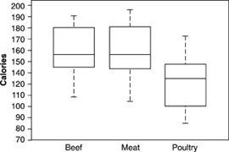
Data for questions 5 to 10.
Here are boxplots of the number of calories in 20 brands of beef hot dogs, 17 brands of meat hot dogs, and 17 brands of poultry hot dogs.

Slide 26
UNDERLINE THE CORRECT ANWER
Question 5
Zhe Li
5. The main advantage of boxplots over stemplots and histograms is that
boxplots make it easy to compare several distributions, as in this example.
boxplots show more detail about the shape of the distribution.
boxplots use the five-number summary, whereas stemplots and histograms use the mean and standard deviation.
boxplots show skewed distributions, whereas stemplots and histograms show only symmetric distributions.
A or ?

Slide 27
UNDERLINE THE CORRECT ANWER
Question 6
6. This plot shows that
all poultry hot dogs have fewer calories than the median for beef and meat hot dogs.
about half of poultry hot dog brands have fewer calories than the median for beef and meat hot dogs.
hot dog type is not helpful in predicting calories because some hot dogs of each type are high and some of each type are low.
most poultry hot dog brands have fewer calories than most beef and meat hot dogs, but a few poultry hot dogs have more calories than the median beef and meat hot dog.

Slide 28
UNDERLINE THE CORRECT ANWER
Question 7
7. We see from the plot that the median number of calories in a beef hot dog is about
190.
179.
153.
139.
129.

Slide 29
Zhe Li
UNDERLINE THE CORRECT ANWER
Question 8
8. The box in each boxplot marks the
full range covered by the data.
range covered by the middle half of the data.
range covered by the middle three-quarters of the data.
span one standard deviation on each side of the mean.
span two standard deviations on each side of the mean.
B, C or D?

Slide 30
UNDERLINE THE CORRECT ANWER
Question 9
9. The calorie counts for the 17 poultry brands are: 129 132 102 106 94 102 87 99 170 113 135 142 86 143 152 146 144
The median of these values is
129.
132.
130.5.
121.
170.

Slide 31
Zhe Li
Question 10
UNDERLINE THE CORRECT ANWER
10. The calorie counts for the 17 poultry brands are
129 132 102 106 94 102 87 99 170 113 135 142 86 143 152 146 144
The first quartile of the 17 poultry hot dog calorie counts is
99.
102
100.5.
143.5.
143.
A, B or C?

Slide 32
Auto
STUDENT ANSWER

Slide 33
Bike share
STUDENT ANSWER

Slide 34
Boston
STUDENT ANSWER

Slide 35
Brain Cancer
STUDENT ANSWER

