Slide 1
EDA of additional sets
Explore the follow data sets in Excel and R
Auto – Gas mileage, horse power, and other car information
anorexia
Boston
Pima.te
Explain what each row means in each data set
Understand what each column means and provide distribution
Are there missing values?
Are there outliers?

Slide 2
Auto
STUDENT ANSWER

Slide 3
anorexia
STUDENT ANSWER

Slide 4
Boston
STUDENT ANSWER
Q1:
A record of housing values in suburbs of Boston.
Q2:
crime: per capita crime rate by town.
prop_res: proportion of residential land zoned for lots over 25,000.
indus: proportion of non-retail business acres per town.
chas: Charles River dummy variable(=1 if tract bounds river,0 otherwise).
nox: nitrogen oxides concentration(parts per 10 million).
rm: average number of rooms per dwelling.
age: proportion of owner-occupied units built prior to 1940.
dis: weighted mean of distances to five Boston employment centers.
rad: index of accessibility to radial highways.
tax: full value property-tax rate per\$10,000.
ptratio: pupil-teacher ratio by town
black: 1000(Bk-0.63)^2 where Bk is the proportion of blacks by town.
lstat: lower status of the population(%)
medv: median value of owner-occupied homes in \$1000s.

Slide 5
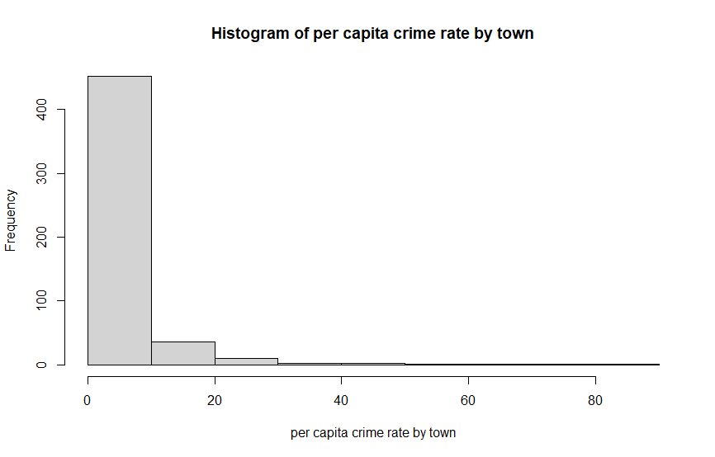

Slide 6
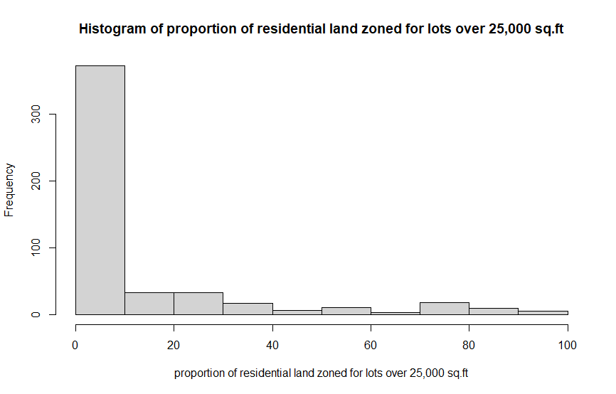

Slide 7
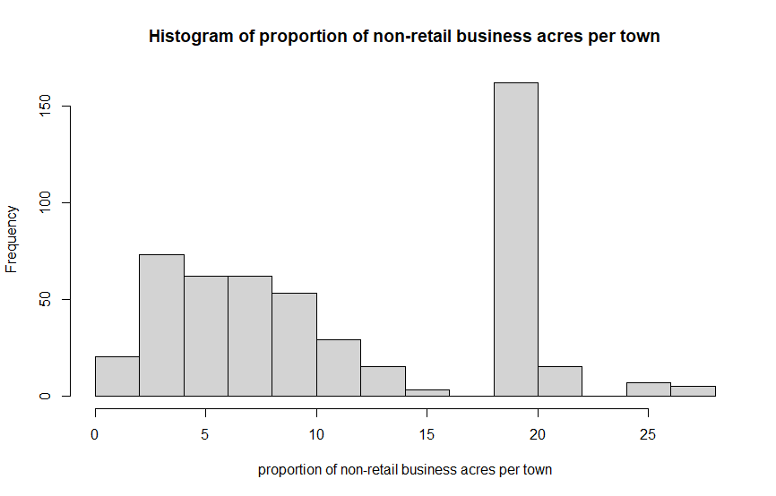

Slide 8
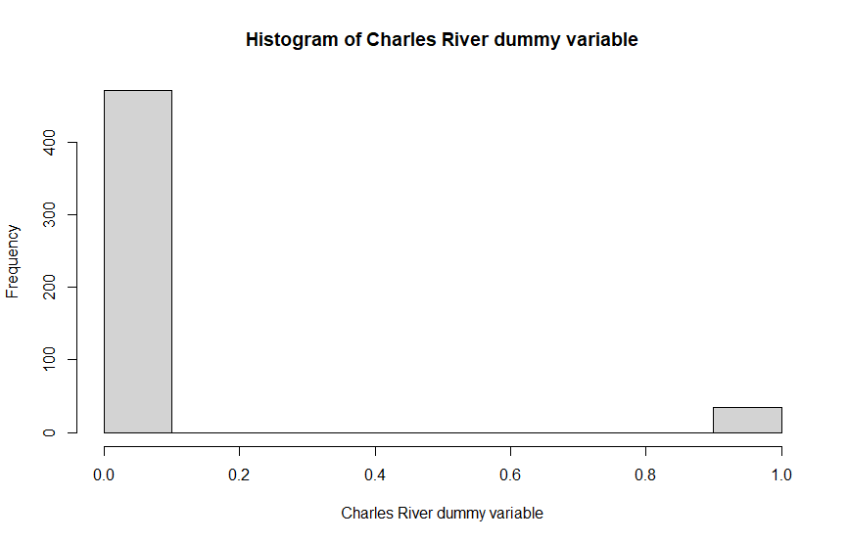

Slide 9
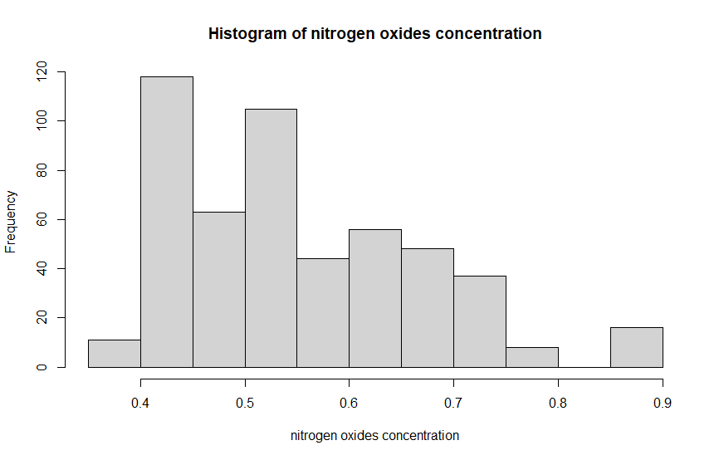

Slide 10
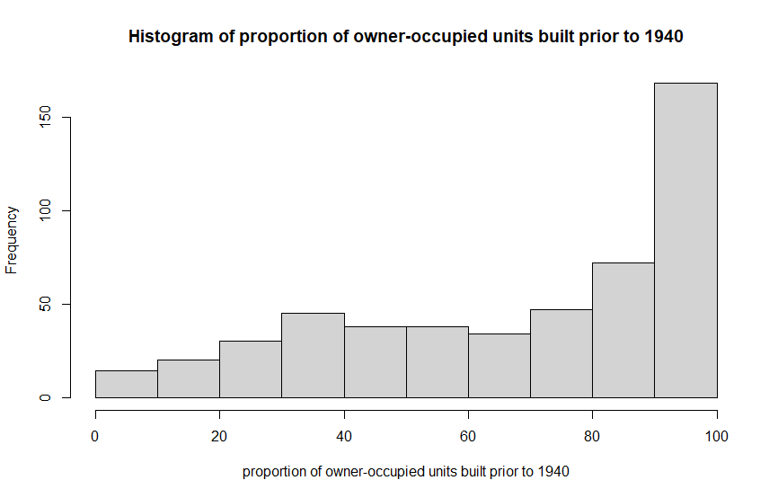

Slide 11
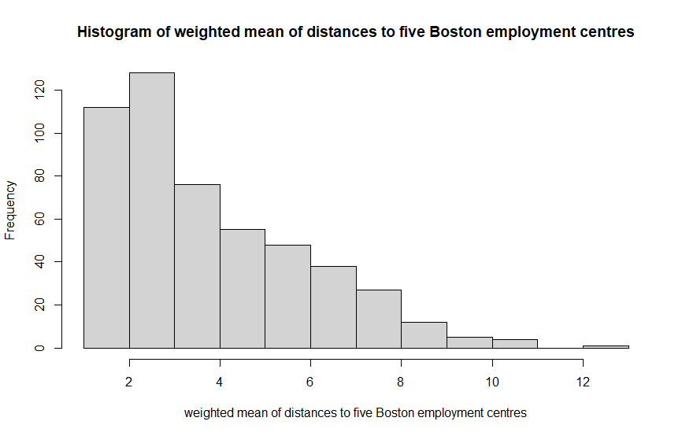

Slide 12
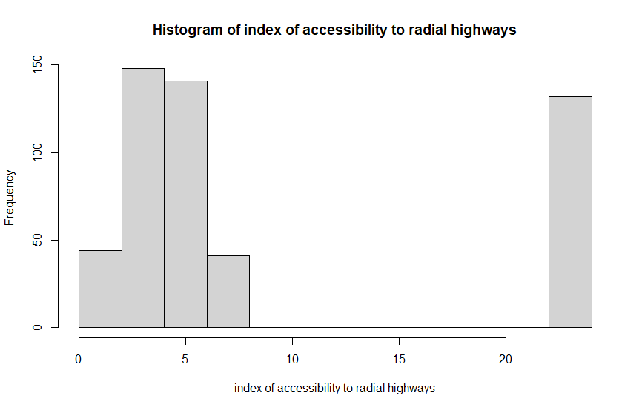

Slide 13
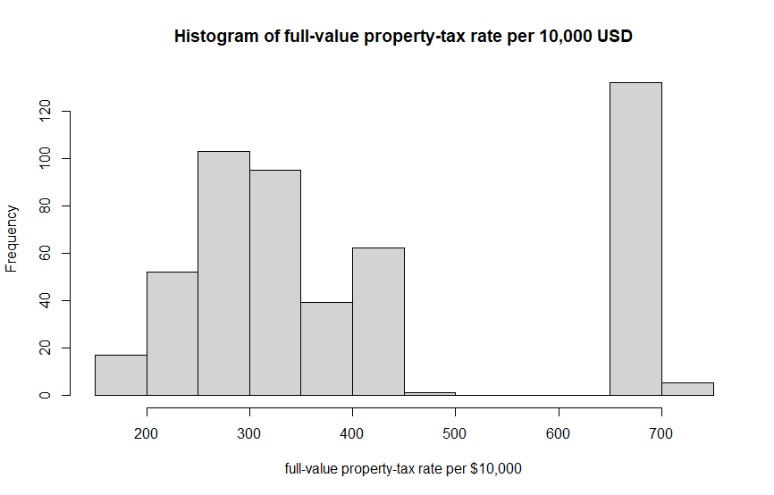

Slide 14
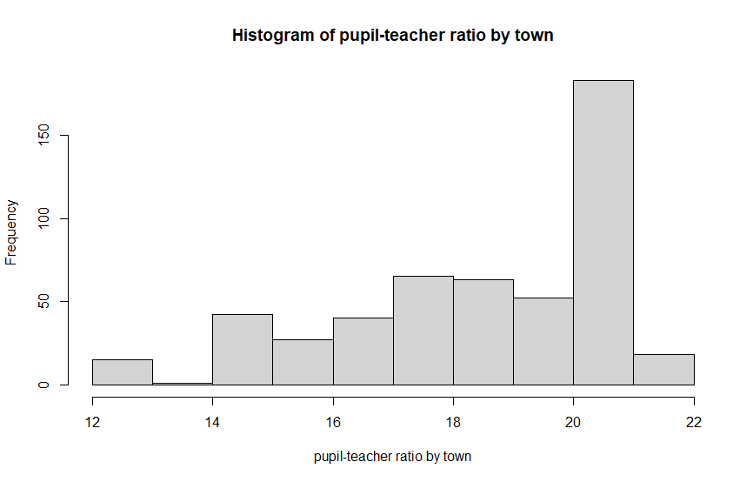

Slide 15
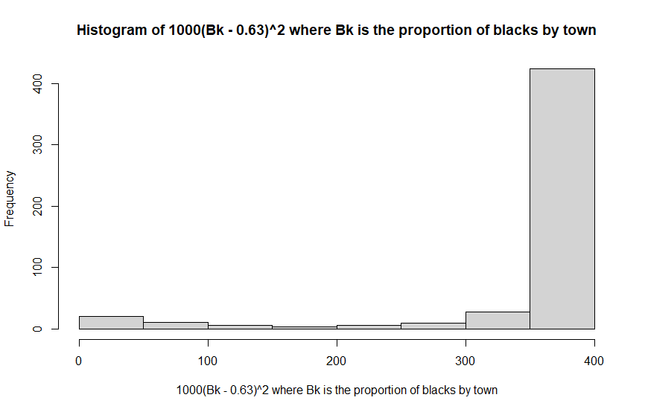

Slide 16
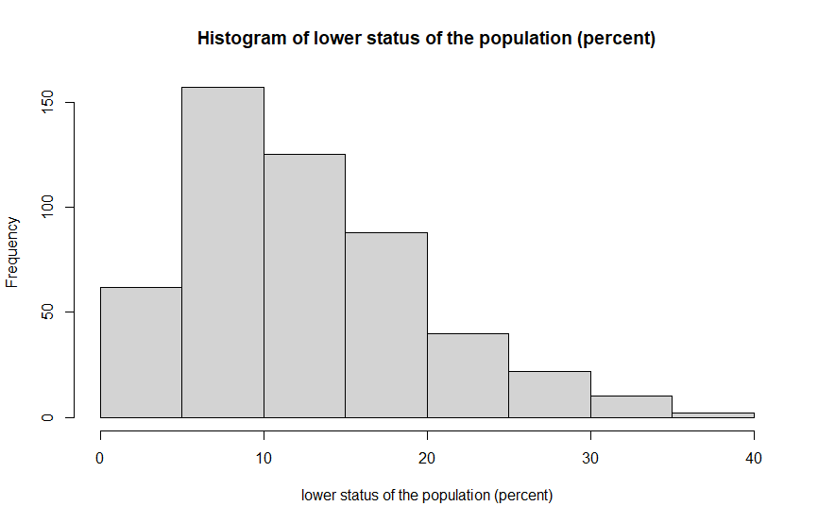

Slide 17
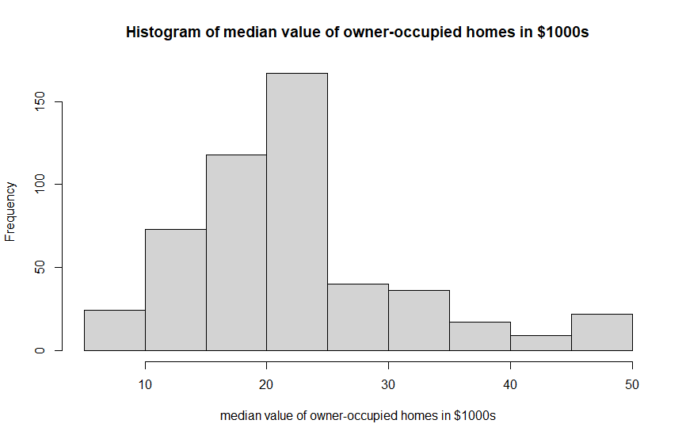

Slide 18
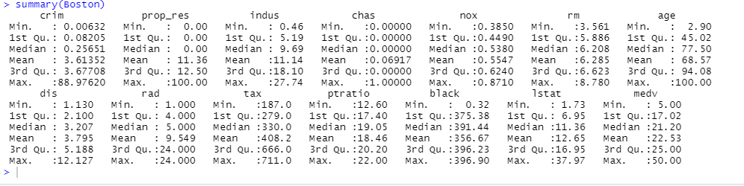
Q3:
There is no missing value in the data set.

Slide 19
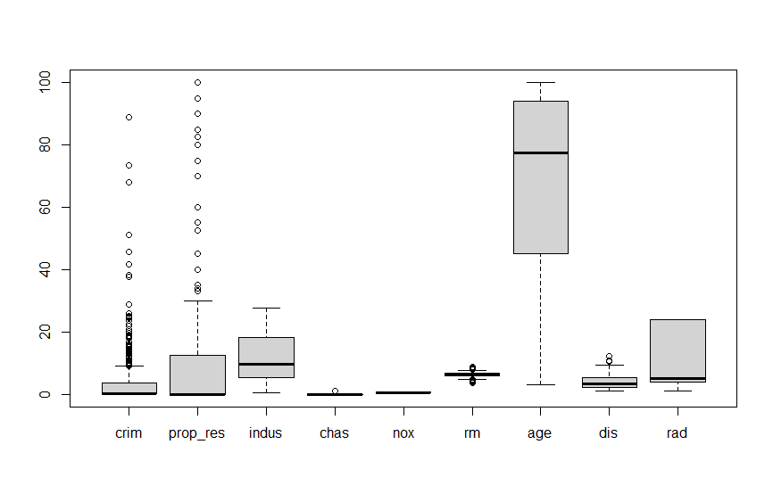
Q4:

Slide 20
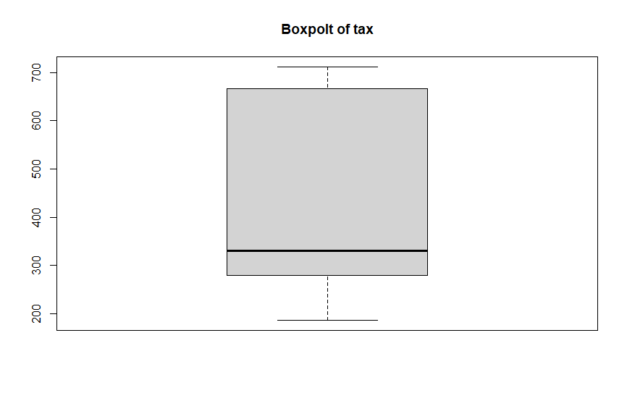

Slide 21
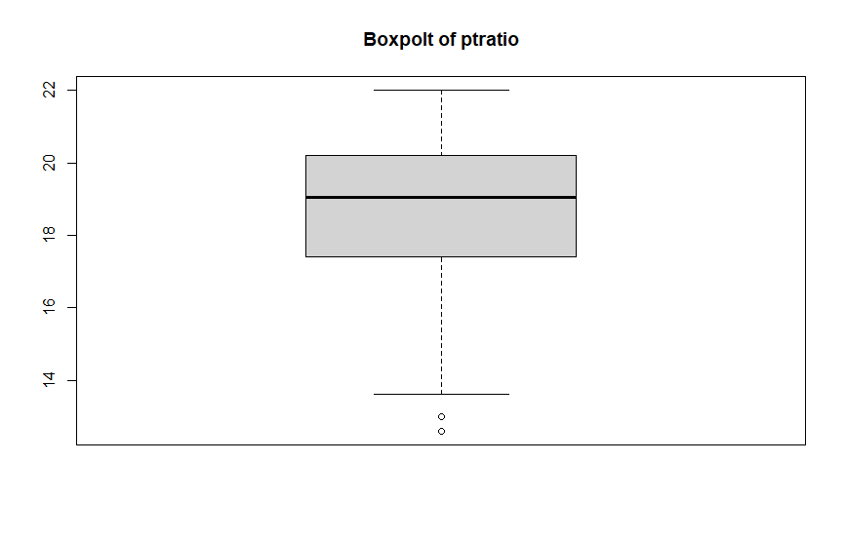

Slide 22
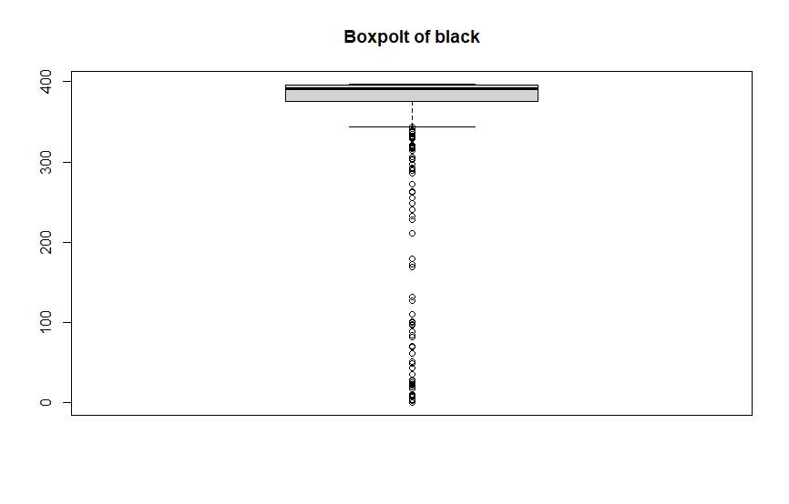

Slide 23
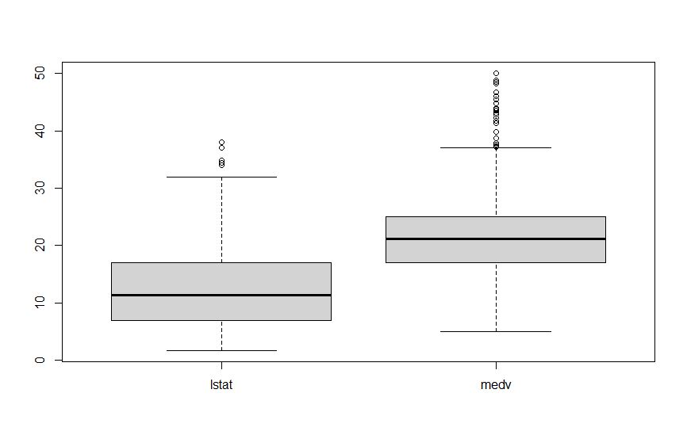

Slide 24
Column crim, prop_res, chas, rm, dis, black, Istat, medv has outliers.

Slide 25
Pima.te
STUDENT ANSWER
Q1:
Records of diabetes in Pima Indian Women
Q2:
npreg: number of pregnancies.
glu: plasma glucose concentration in an oral glucose tolerance test.
bp: diastolic blood pressure (mm Hg).
skin: triceps skin fold thickness (mm).
bmi: body mass index (weight in kg/(height in m)\^2).
ped: diabetes pedigree function.
age: age in years.
type: Yes or No, for diabetic according to WHO criteria.

Slide 26
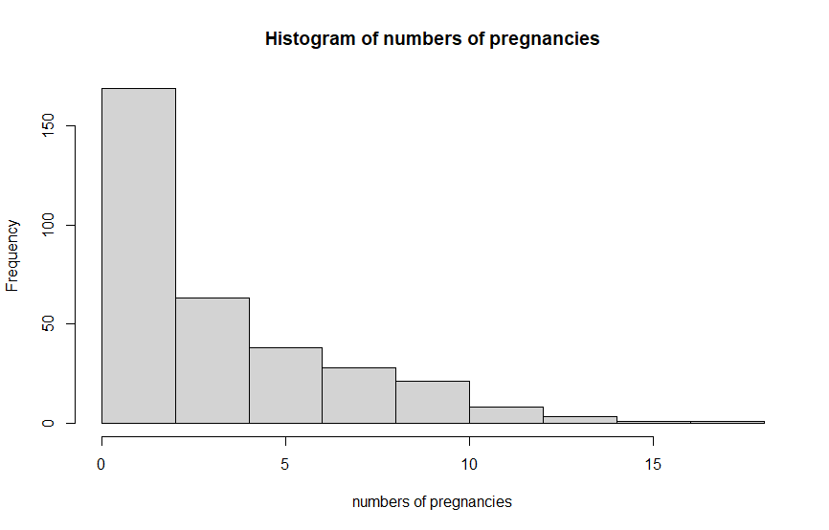

Slide 27
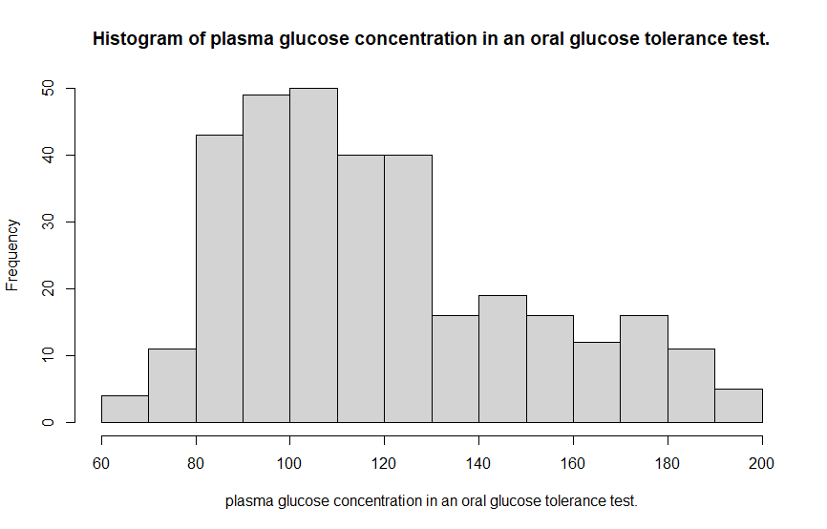

Slide 28
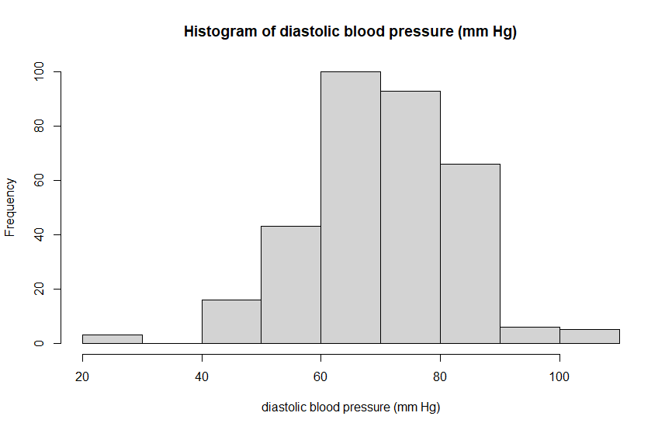

Slide 29
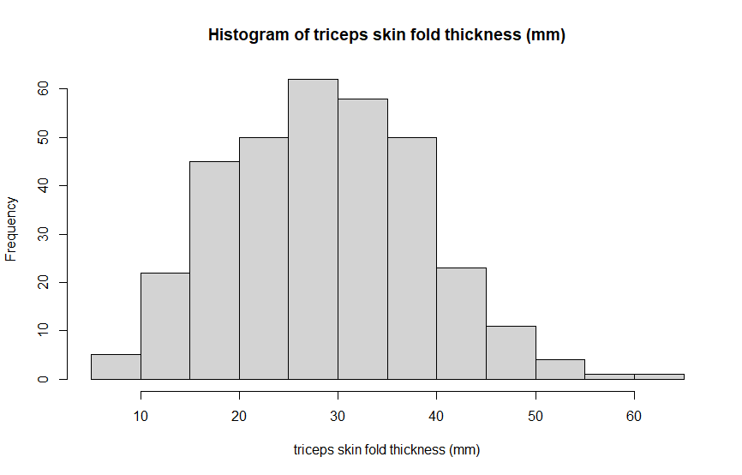

Slide 30
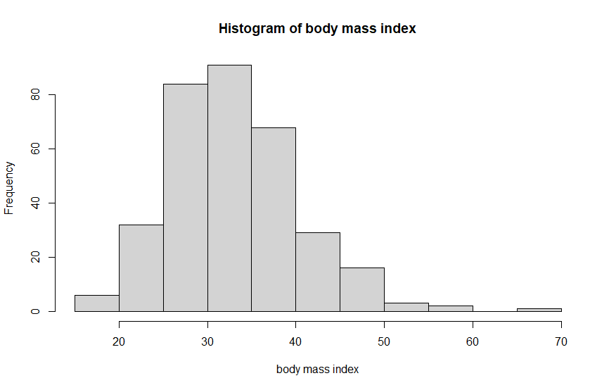

Slide 31
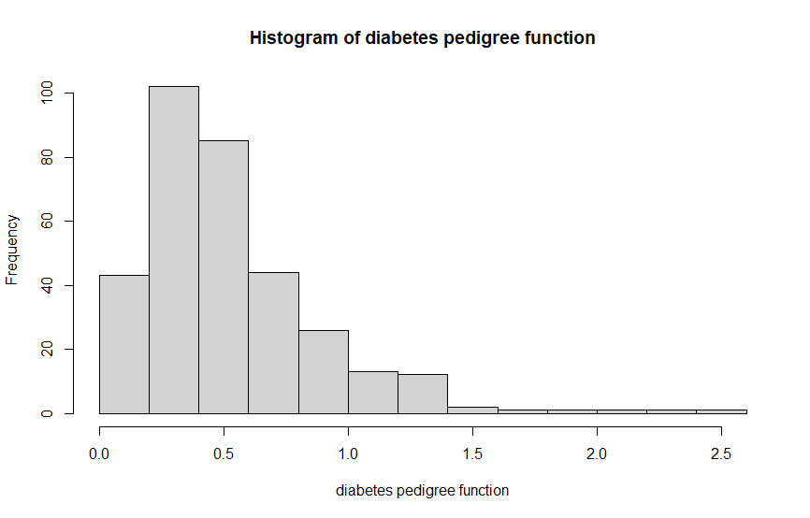

Slide 32
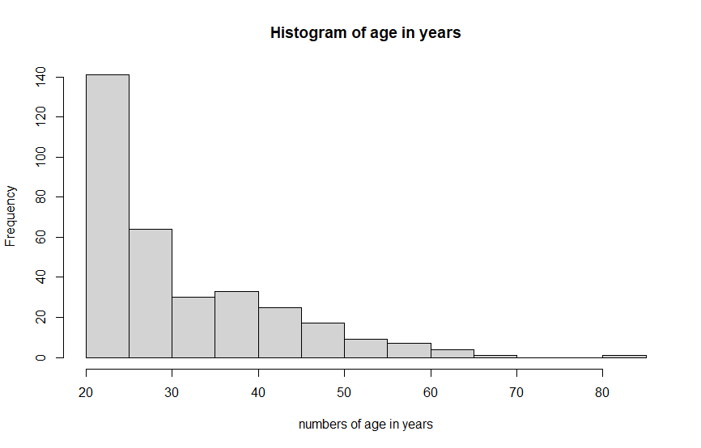

Slide 33
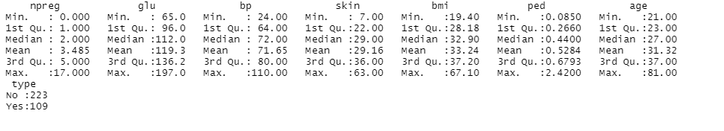
Q3:

Slide 34
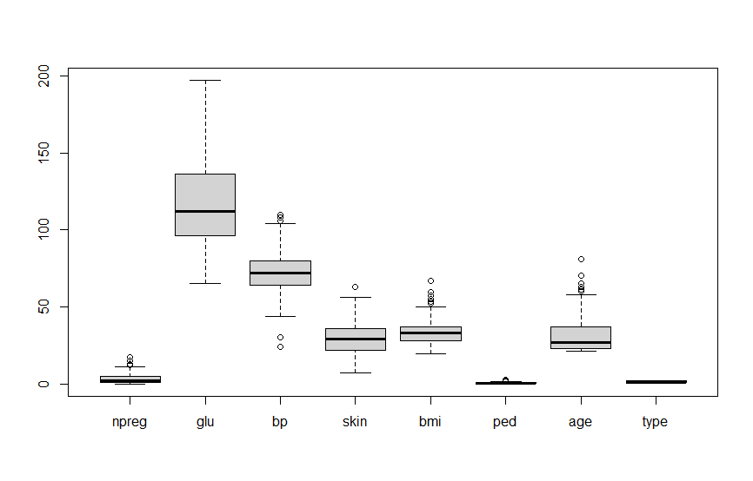
Q4:
Column npreg, bp, skin, bmi, ped, age has outliers.

Slide 35
Data for Questions 1 to 4
During the semester, all the students in a statistics class kept track of the number of mailings they received from a predatory payday lender. The count for each is displayed below:
Student | Bob | Sue | Pam | Lee | Mary | Carl | Ace | Moe | Ann
# Mailings | 16 | 17 | 11 | 21 | 15 | 14 | 17 | 18 | 19
# | Student | # Mailings
1 | Pam | 11
2 | Carl | 14
3 | Mary | 15
4 | Bob | 16
5 | Sue | 17
6 | Ace | 17
7 | Moe | 18
8 | Ann | 19
9 | Lee | 21

Slide 36
Question 1
UNDERLINE THE CORRECT ANWER
1. The median number of mailings for these students is C
15.
16.
17.
17.5.
18.

Slide 37
UNDERLINE THE CORRECT ANWER
Question 2
2. The third quartile for the number of mailings for these students is C
17.
17.5.
18.
18.5.
19.

Slide 38
UNDERLINE THE CORRECT ANWER
Question 3
3. The mean number of mailings is C
9.
16.
16.44.
17.
21.

Slide 39
UNDERLINE THE CORRECT ANWER
Question 4
4. The standard deviation for these mailings data is B
2.75.
2.92.
7.58.
8.53.
68.22.

Slide 40
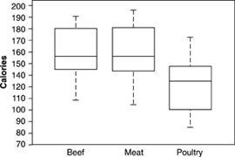
Data for questions 5 to 10.
Here are boxplots of the number of calories in 20 brands of beef hot dogs, 17 brands of meat hot dogs, and 17 brands of poultry hot dogs.

Slide 41
UNDERLINE THE CORRECT ANWER
Question 5
5. The main advantage of boxplots over stemplots and histograms is that C AB
boxplots make it easy to compare several distributions, as in this example.
boxplots show more detail about the shape of the distribution.
boxplots use the five-number summary, whereas stemplots and histograms use the mean and standard deviation.
boxplots show skewed distributions, whereas stemplots and histograms show only symmetric distributions.

Slide 42
UNDERLINE THE CORRECT ANWER
Question 6
6. This plot shows that D
all poultry hot dogs have fewer calories than the median for beef and meat hot dogs.
about half of poultry hot dog brands have fewer calories than the median for beef and meat hot dogs.
hot dog type is not helpful in predicting calories because some hot dogs of each type are high and some of each type are low.
most poultry hot dog brands have fewer calories than most beef and meat hot dogs, but a few poultry hot dogs have more calories than the median beef and meat hot dog.

Slide 43
UNDERLINE THE CORRECT ANWER
Question 7
7. We see from the plot that the median number of calories in a beef hot dog is about C
190.
179.
153.
139.
129.

Slide 44
UNDERLINE THE CORRECT ANWER
Question 8
8. The box in each boxplot marks the B
full range covered by the data.
range covered by the middle half of the data.
range covered by the middle three-quarters of the data.
span one standard deviation on each side of the mean.
span two standard deviations on each side of the mean.

Slide 45
UNDERLINE THE CORRECT ANWER
Question 9
9. The calorie counts for the 17 poultry brands are: 129 132 102 106 94 102 87 99 170 113 135 142 86 143 152 146 144
The median of these values is A
129.
132.
130.5.
121.
170.

Slide 46
UNDERLINE THE CORRECT ANWER
Question 10
10. The calorie counts for the 17 poultry brands are
129 132 102 106 94 102 87 99 170 113 135 142 86 143 152 146 144
The first quartile of the 17 poultry hot dog calorie counts is B
C
99.
102
100.5.
143.5.
143.

