Slide 1
Assignment 5

Slide 2
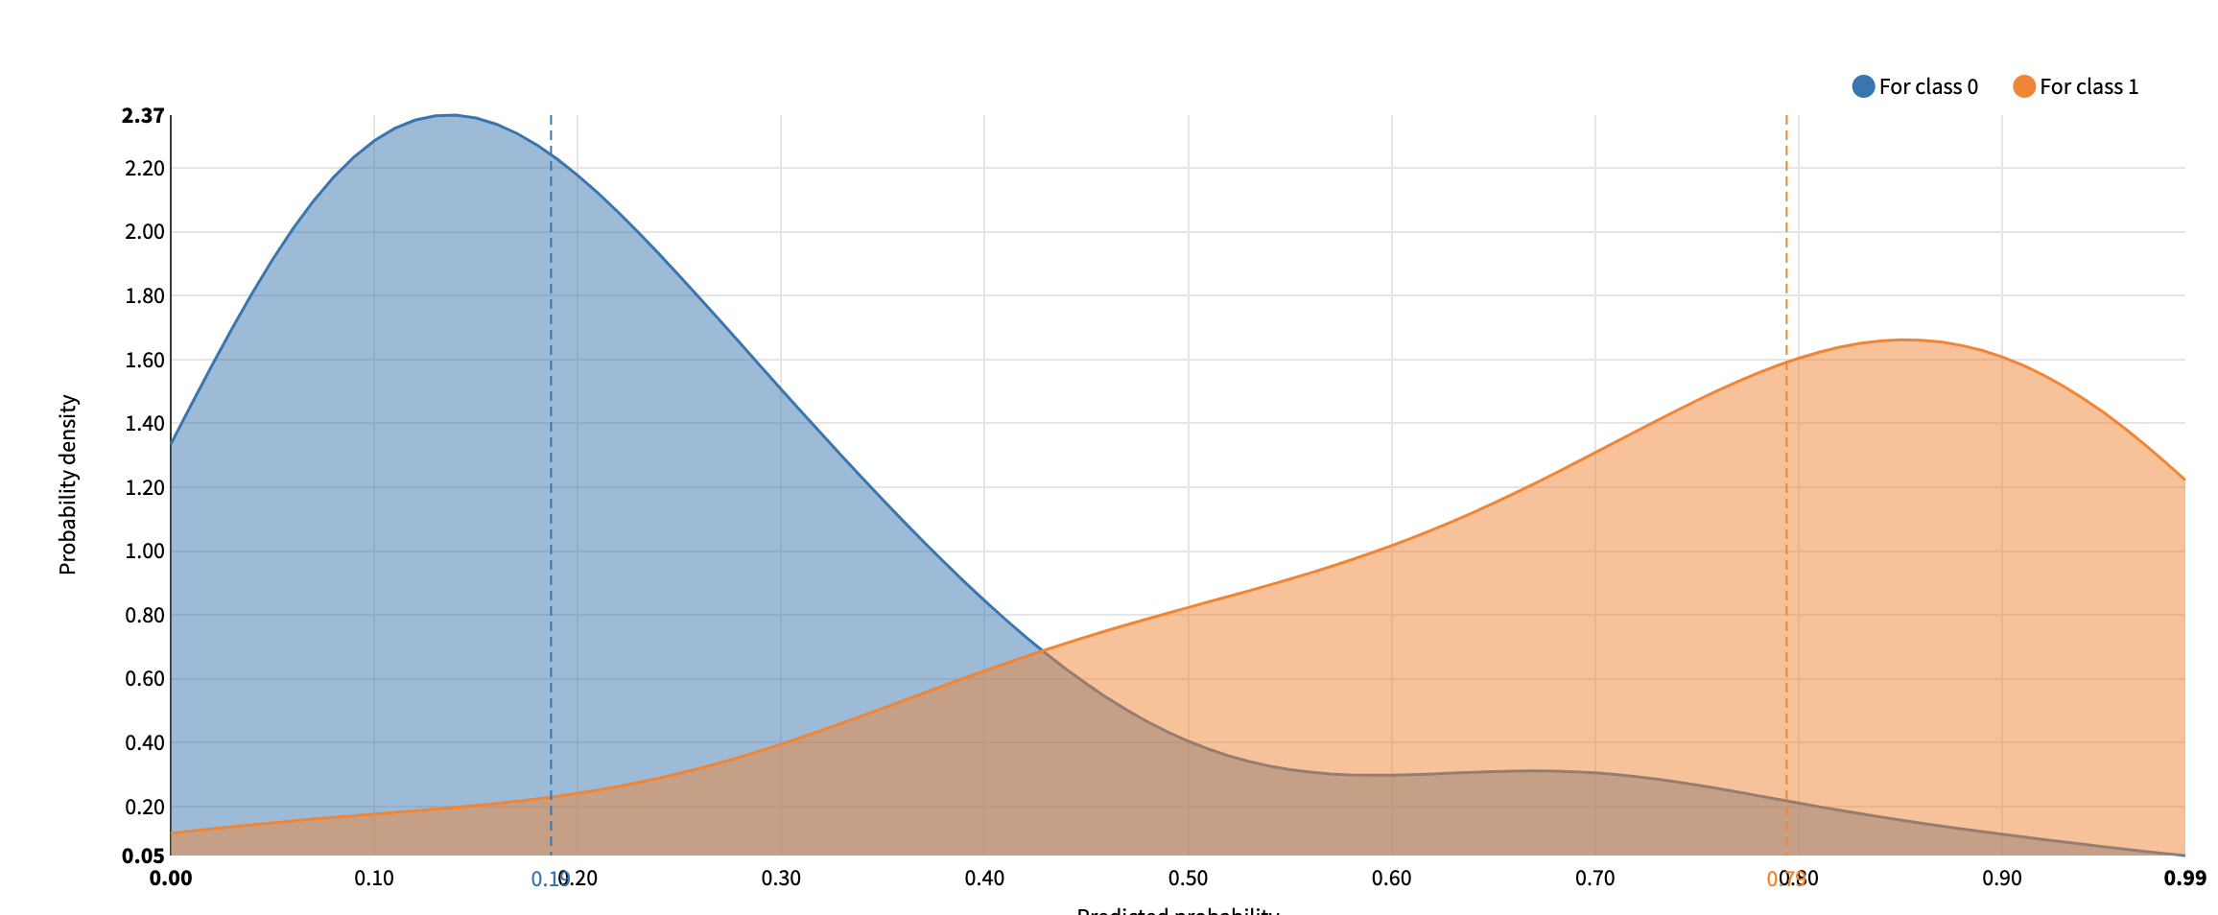
Logistic regression

Slide 3
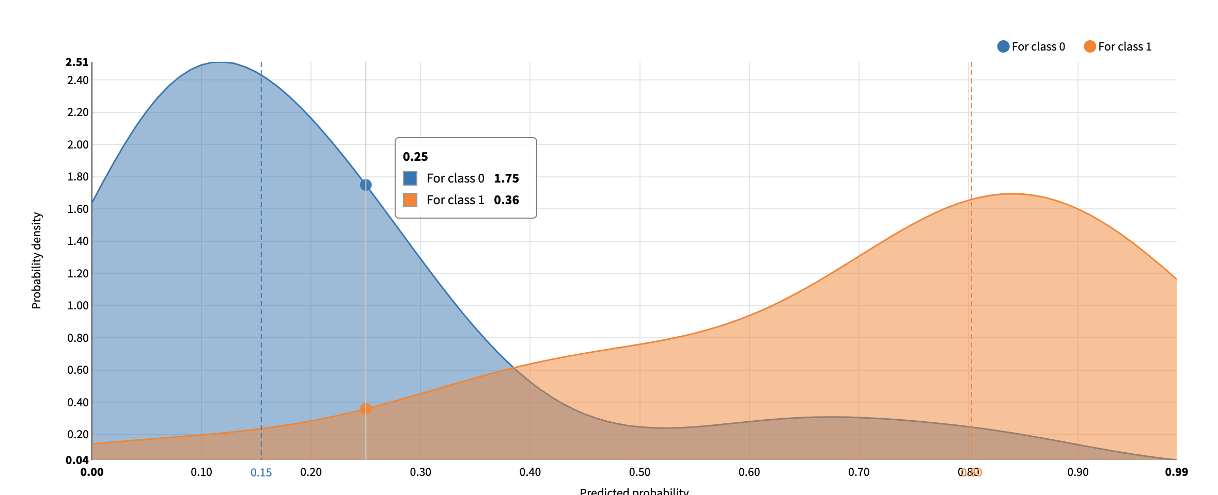
SGD

Slide 4
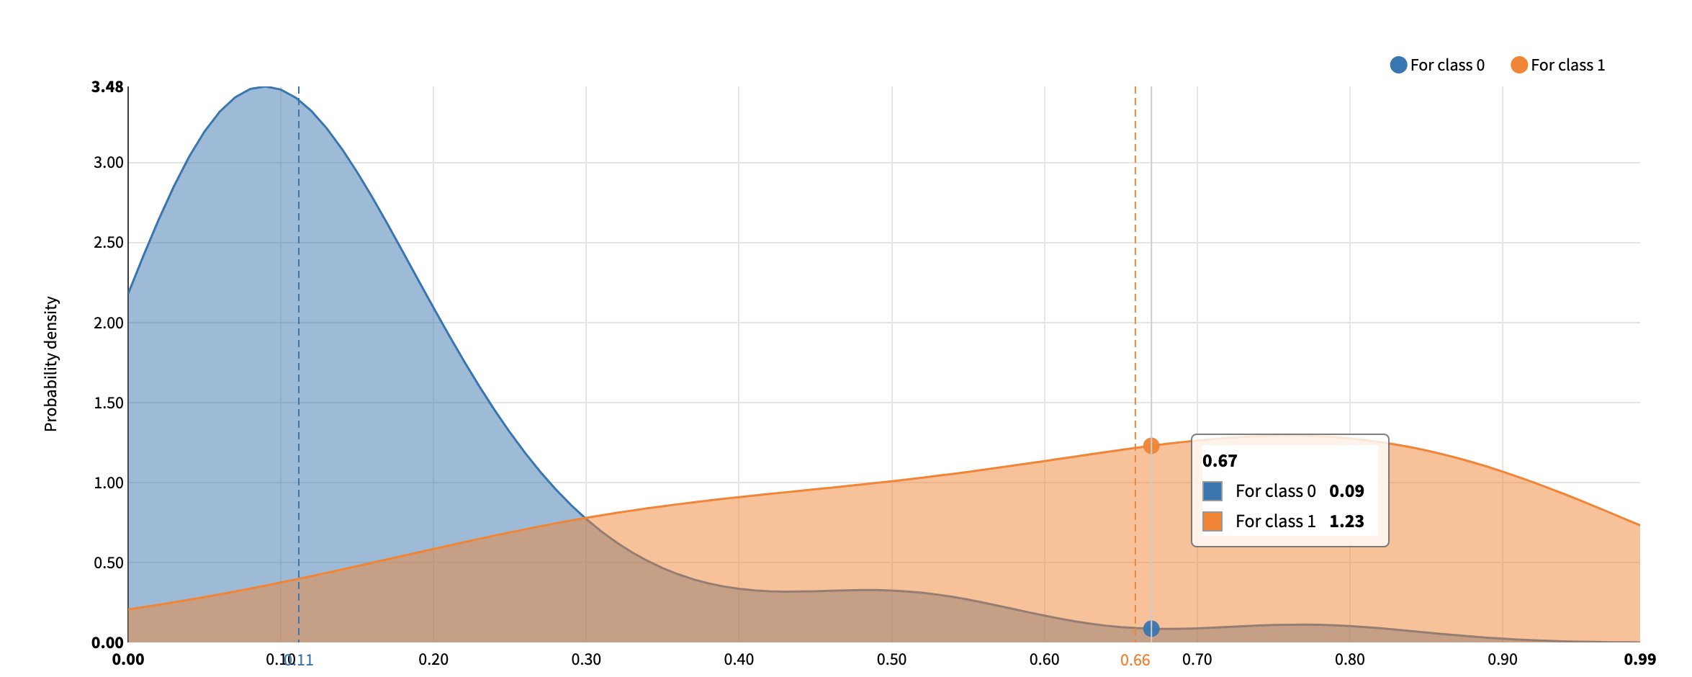
LASSO_lars

Slide 5
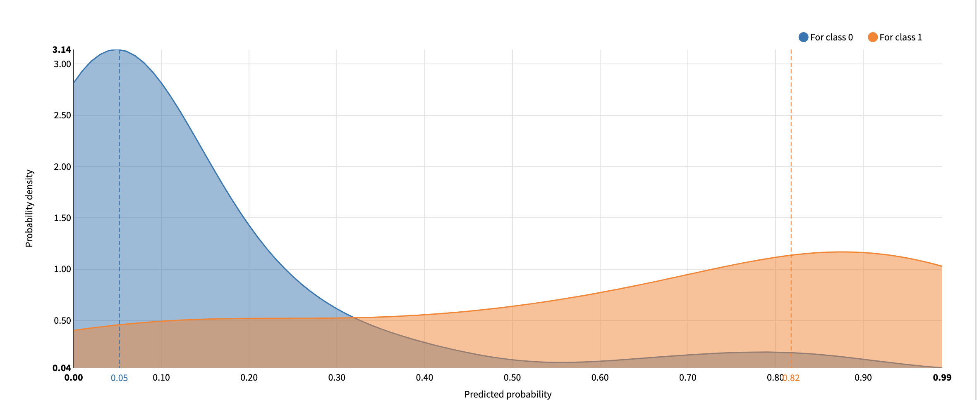
Gradient Boosted Trees

Slide 6
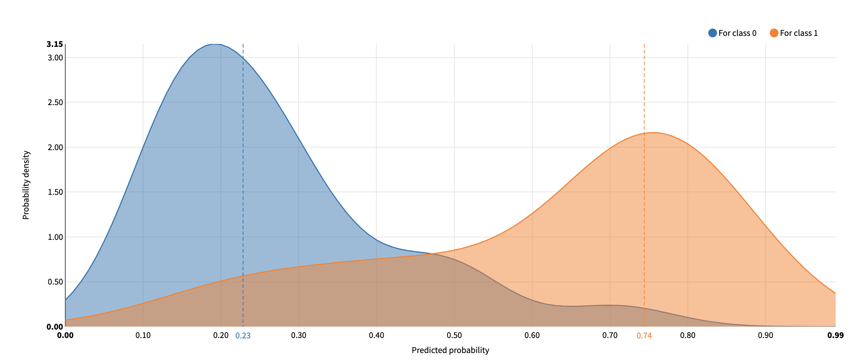
Light GBM

Slide 7
Model choosing
As showed on the density chart, only first 2 charts and the last one the have the two obvious peak. And the first and the second one the peak is on the far left and right side plus Logistic regression has best F-1 score so we choose the model of Logistic regression.

Slide 8
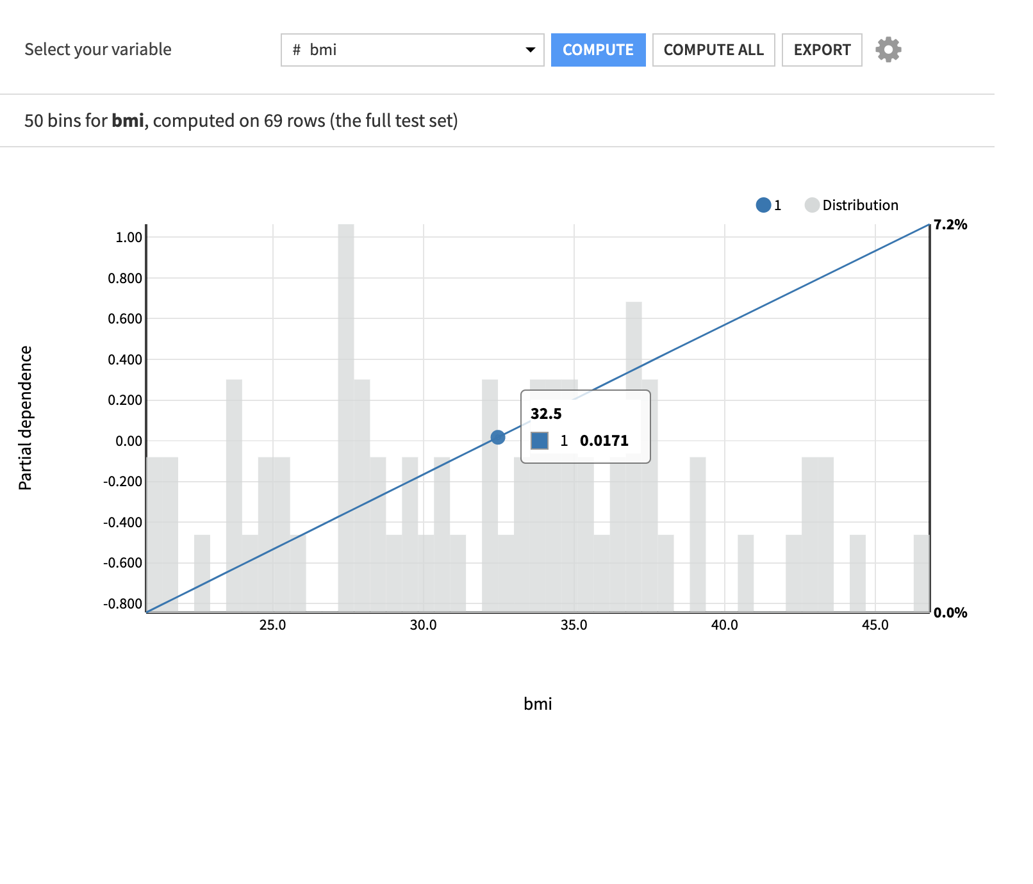
As it showed on the plot the partial
dependence here is a fixed number
Which indicate that a consistent grow
if bmi increase which is not true.
So we should switch to a none linear
model to show the dependence.

Slide 9
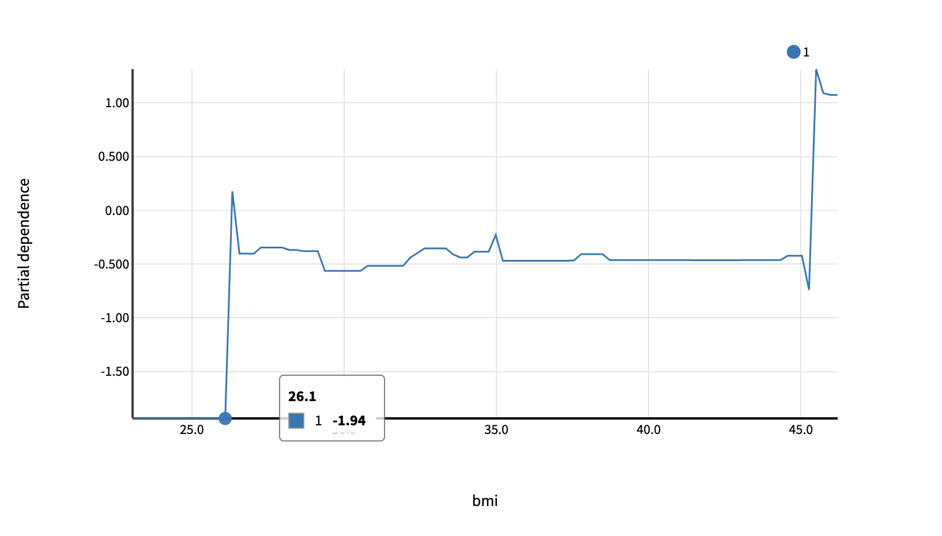
Suggestions
We choose the Gradient Boosted Trees as the model since the F-1 scores is highest in non linear model.
And we can see that since the BMI > 261. There is a rapid growth in the partial dependence.
So the rules to the health department is that to avoid or prevent citizens over BMI over 26.1 in order to decrease the chance to get diabetes.

