Slide 1
Business Database Management
Dr. Meng Qu
Rutgers University

Slide 2
Questions?
Instructor: Dr. Meng Qu
Office Hours: Tuesday 9:00am-10:00am online
Email: mengqu@business.rutgers.edu

Slide 3
Chapter 1
Database Systems

Slide 4
Learning Objectives
In this chapter, you will learn:
The difference between data and information
What a database is, the various types of databases, and why they are valuable assets for decision making
The importance of database design
How modern databases evolved from file systems

Slide 5
Learning Objectives
In this chapter, you will learn:
About flaws in file system data management
The main components of the database system
The main functions of a database management system (DBMS)

Slide 6
Data vs. Information
Data
Information
Raw facts
Raw data - Not yet been processed to reveal the meaning
Building blocks of information
Data management
Generation, storage, and retrieval of data
Produced by processing data
Reveals the meaning of data
Enables knowledge creation
Should be accurate, relevant, and timely to enable good decision making
The key to survival in the information age!

Slide 7
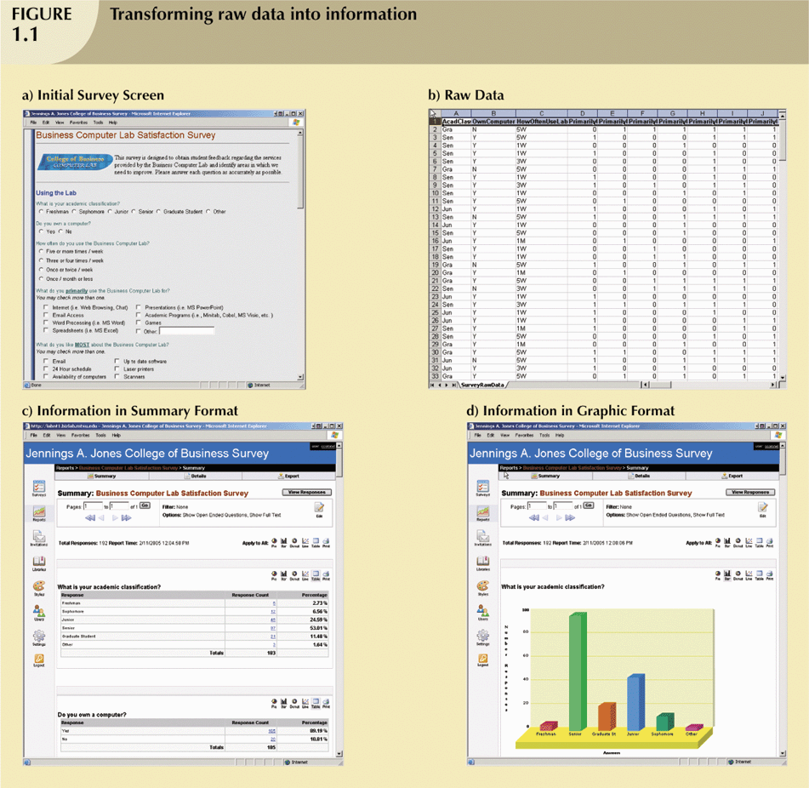
Transforming Raw Data into Information

Slide 8
Transforming Raw Data into Information (continued)

Slide 9
Transforming Raw Data into Information
Simple Statistics

Slide 10
Transforming Raw Data into Information (continued)
Visualizations

Slide 11
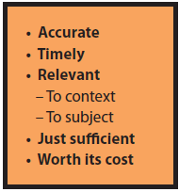
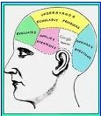
Information Is Subjective
Information in one person’s context is just a data point in another person’s context.
Information is always subjective.
Data Characteristics of Good Information

Slide 12
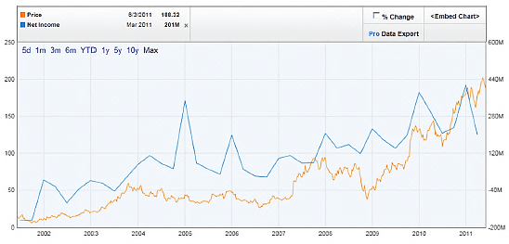
What is Information?
Knowledge derived from data, and data are recorded facts or figures
Does this graph contain information?

Slide 13
Transforming Raw Data into Information (continued)
What elective courses are taken typically by sophomores in information systems?
What computer services should be offered to benefit the most number of students?
What would be an appropriate study plan for students in a particular situation?
Complex Queries
and
Knowledge
Extraction

Slide 14
Database
Shared, integrated computer structure that stores a collection of:
End-user data - Raw facts of interest to end user
Metadata: Data about data, which the end-user data are integrated and managed
Describe data characteristics and relationships
Database management system (DBMS)
Collection of programs
Manages the database structure
Controls access to data stored in the database

Slide 15
Role of the DBMS
Intermediary between the user and the database
Enables data to be shared
Presents the end user with an integrated view of the data
Receives and translates application requests into operations required to fulfill the requests
Hides database’s internal complexity from the application programs and users

Slide 16
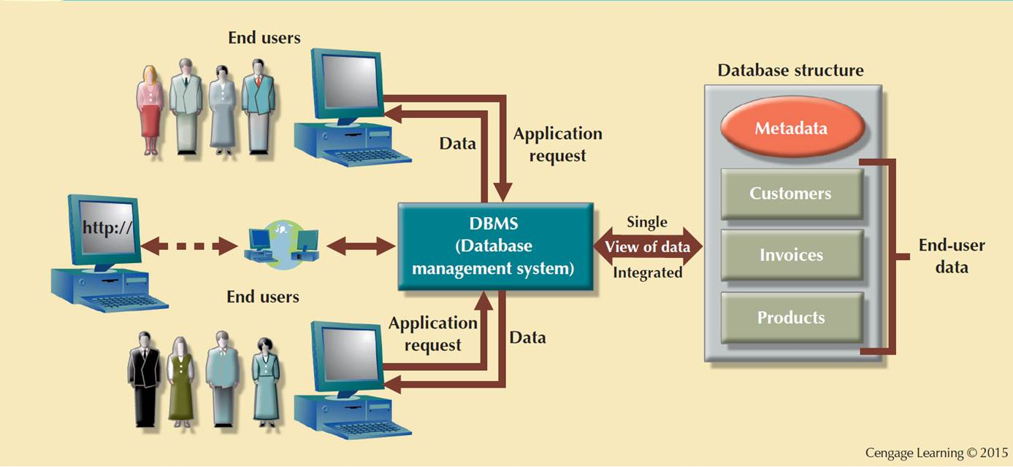
Figure 1.2 - The DBMS Manages the Interaction between the End User and the Database

Slide 17
Advantages of the DBMS
Better data integration and less data inconsistency
Data inconsistency: Different versions of the same data appear in different places
Increased end-user productivity
Improved:
Data sharing
Data security
Data access
Decision making
Data quality: Promoting accuracy, validity, and timeliness of data

Slide 18
Types of Databases
Single-user database: Supports one user at a time
Desktop database: Runs on PC
Multiuser database: Supports multiple users at the same time
Workgroup databases: Supports a small number of users or a specific department
Enterprise database: Supports many users across many departments

Slide 19
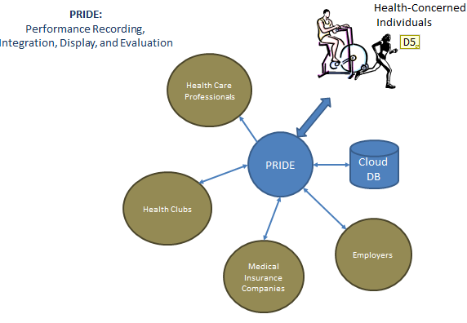
Multiuser database

Slide 20
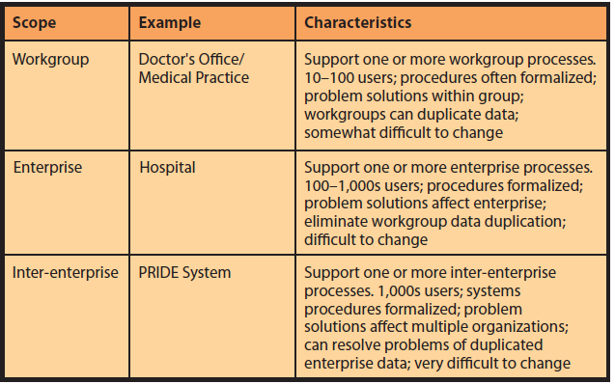
Multiuser database

Slide 21
Types of Databases
Centralized database: Data is located at a single site
Distributed database: Data is distributed across different sites
Cloud database: Created and maintained using cloud data services that provide defined performance measures for the database

Slide 22
Types of Databases
General-purpose databases: Contains a wide variety of data used in multiple disciplines
Newspaper, magazine, journal articles for variety of topics
Discipline-specific databases: Contains data focused on specific subject areas
Academic or research database (ex: GIS database)

Slide 23
Types of Databases
Operational (transactional) database: Designed to support a company’s day-to-day operations
Analytical database: Stores historical data and business metrics used exclusively for tactical or strategic decision making
Data warehouse: Stores data in a format optimized for decision support
See http://www.healthcatalyst.com/database-vs-data-warehouse-a-comparative-review/2/ for a concise discussion of the difference between a database and a data warehouse

Slide 24
Types of Databases
Online analytical processing (OLAP)
Enable retrieving, processing, and modeling data from the data warehouse
Business intelligence: Captures and processes business data to generate information that support decision making

Slide 25
Types of Data
Unstructured data: It exists in their original state
Structured data: It results from formatting unstructured data to facilitate storage, use, and the generation of information.
Structure is applied based on type of processing to be performed
Semistructured data: Processed to some extent
Extensible Markup Language (XML)
A special language used to represent and manipulate data elements in textual format

Slide 26
Database Design
Focuses on the design of the database structure that will be used to store and manage end-user data
Well-designed database
Facilitates data management
Generates accurate and valuable information
Avoids redundant data
Poorly designed database causes difficult-to-trace errors → leads to bad decisions → can lead to failure of organization

Slide 27
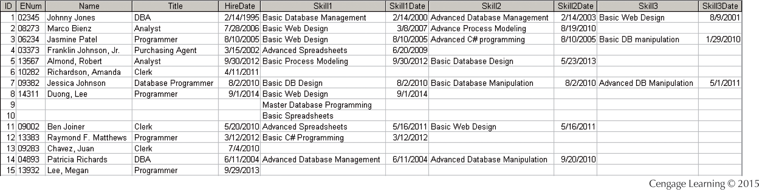
Bad Design Example

Slide 28
Bad Design Example
It would be difficult to produce an alphabetical listing of employees based on their last names.
How many employees are certified in Basic Database Manipulation?
Basic Database Manipulation=?Basic DB Manipulation
Fourth skill? Fifth Skill?

Slide 29
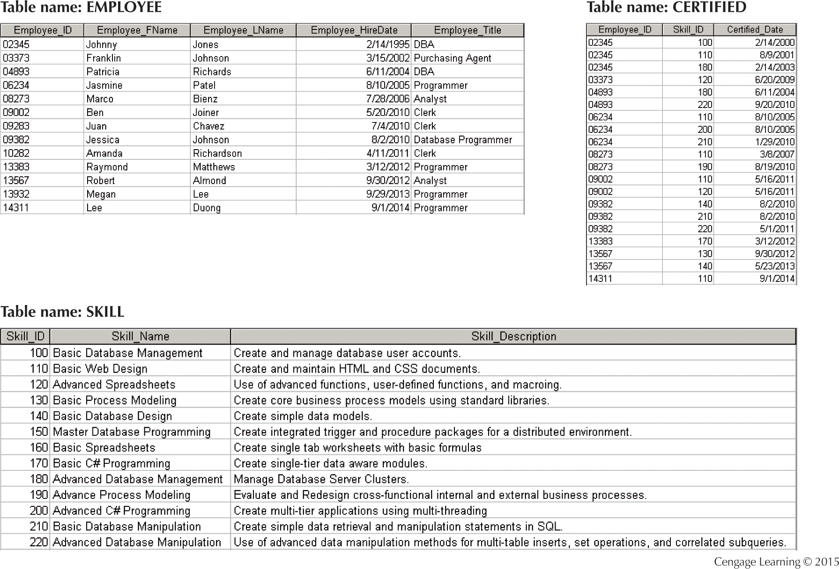

Slide 30
Historical Roots: Files and File Systems
Managing data with file systems is obsolete
Understanding file system characteristics makes database design easier to understand
Awareness of problems with file systems helps prevent similar problems in DBMS
Knowledge of file systems is helpful if you plan to convert an obsolete file system to a DBMS

Slide 31
Evolution of File System Data Processing
Manual File Systems
Accomplished through a system of file folders and filing cabinets
Computerized File Systems
Data processing (DP) specialist: Created a computer-based system that would track data and produce required reports
File System Redux: Modern End-User Productivity Tools
Includes spreadsheet programs such as Microsoft Excel

Slide 32
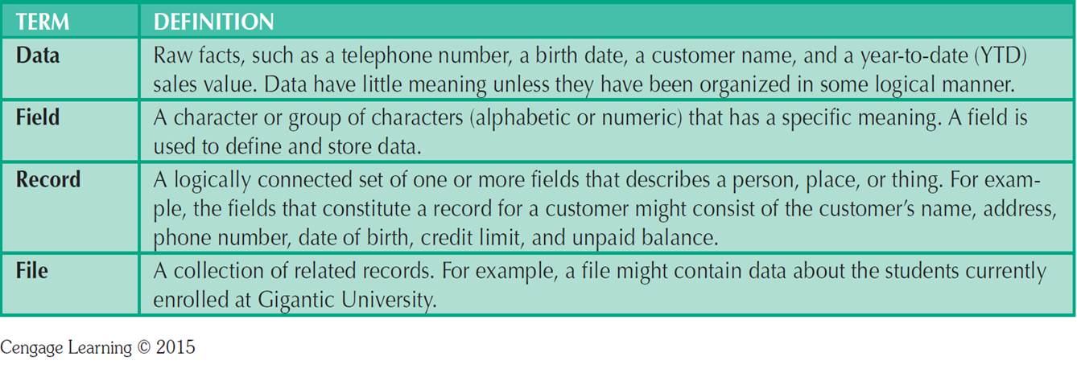
Table 1.2 - Basic File Terminology

Slide 33
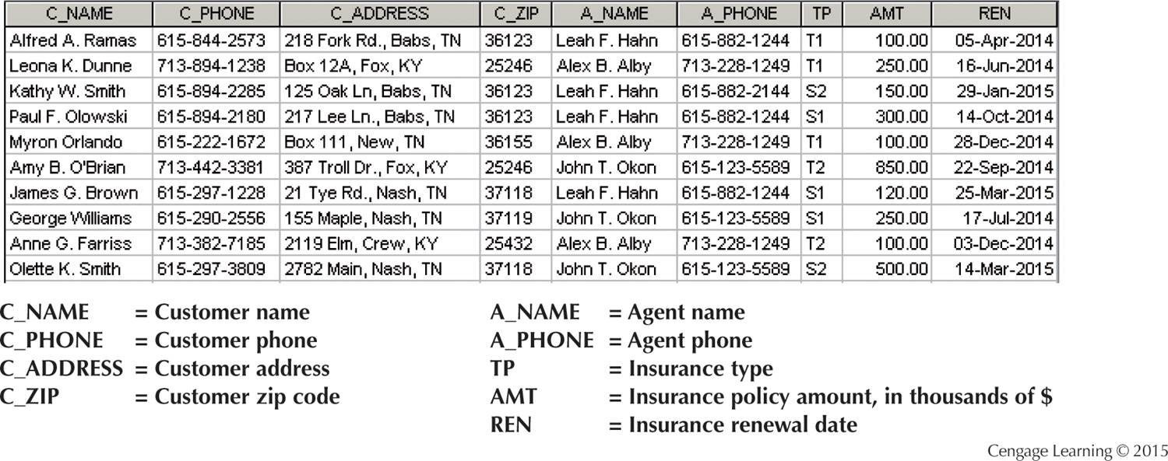
The Customer File
Computerized file systems

Slide 34
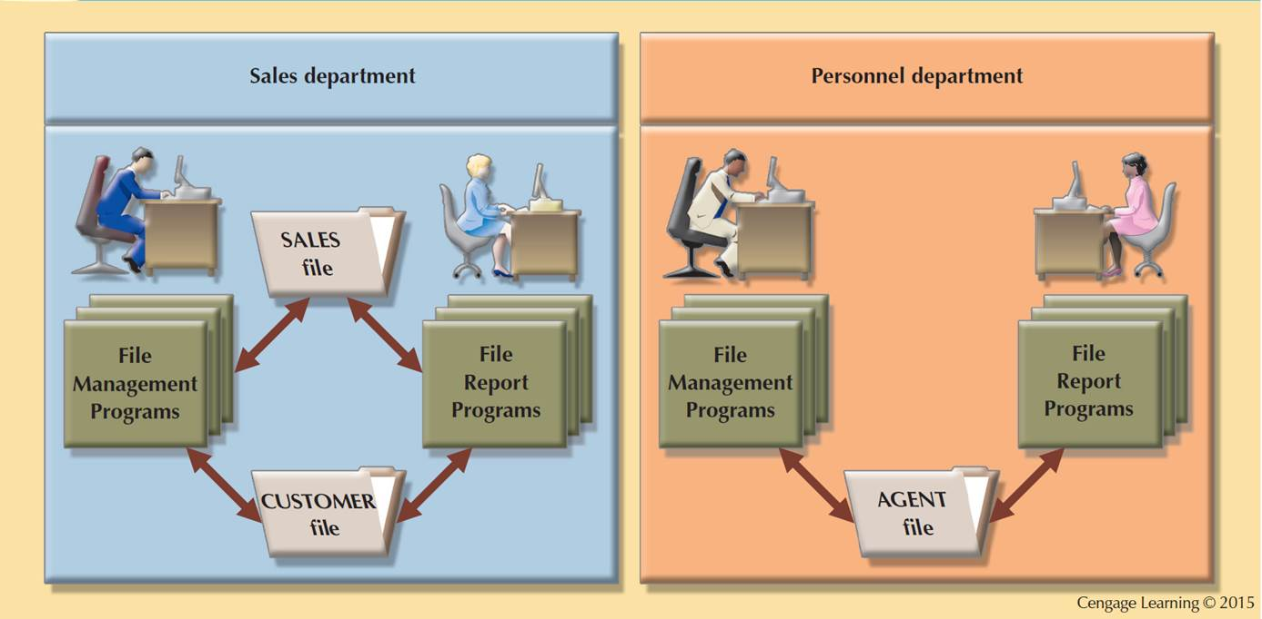
Figure1.6 - A Simple File System

Slide 35
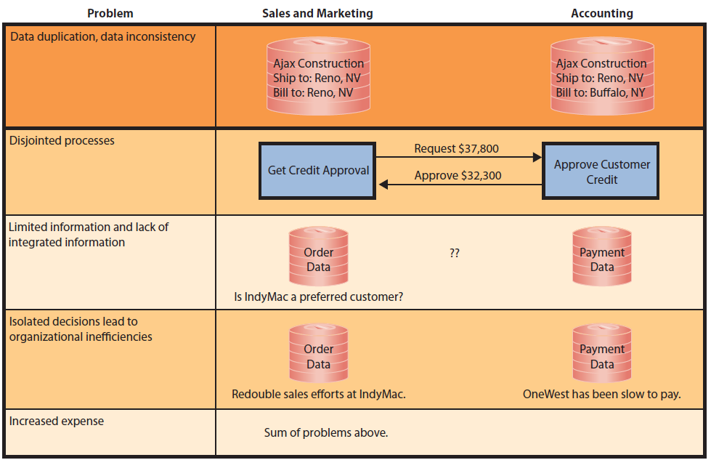
A Simple File System

Slide 36
Problems with File System Data Processing
Lengthy development times
Difficulty of getting quick answers
Complex system administration
Lack of security and limited data sharing
Extensive programming

Slide 37
Structural and Data Dependence
Structural dependence: Access to a file is dependent on its own structure
All file system programs are modified to conform to a new file structure
Structural independence: File structure is changed without affecting the application’s ability to access the data

Slide 38
Structural and Data Dependence
Data dependence
Data access changes when data storage characteristics change
Data independence
Data storage characteristics is changed without affecting the program’s ability to access the data
Practical significance of data dependence is difference between logical (how the human being views the data) and physical format (how the computer must work with the data)

Slide 39
Data Redundancy
Unnecessarily storing same data at different places
Islands of information: Scattered data locations
Increases the probability of having different versions of the same data

Slide 40
Data Redundancy Implications
Poor data security
Data inconsistency
Increased likelihood of data-entry errors when complex entries are made in different files
Data anomaly: Develops when not all of the required changes in the redundant data are made successfully

Slide 41
Types of Data Anomaly
Update Anomalies
Insertion Anomalies
Deletion Anomalies

Slide 42
The Customer File

Slide 43
The Customer File
If agent Alex B. Alby has a new phone number, it must be entered in each of the CUSTOMER file records in which Mr. Alby is shown.
If only the CUSTOMER file existed and you needed to add a new agent, you would also add a dummy customer data entry to reflect the new agent’s addition.
If you delete the customers Amy B .O’Brian, George William, and Olette K.Smith, you will also delete John T. Okon’s agent data.

Slide 44
Lack of Design and Data-Modeling Skills
Evident despite the availability of multiple personal productivity tools being available
Data-modeling skills is vital in the data design process
Good data modeling facilitates communication between the designer, user, and the developer

Slide 45
Database Systems
Logically related data stored in a single logical data repository
Physically distributed among multiple storage facilities
DBMS eliminates most of file system’s problems
Current generation DBMS software:
Stores data structures, relationships between structures, and access paths
Defines, stores, and manages all access paths and components

Slide 46
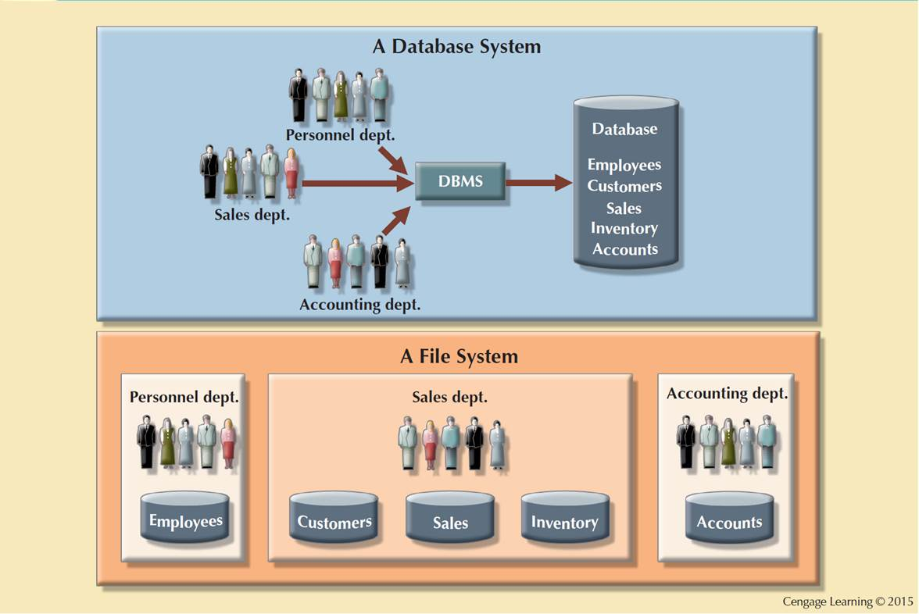
Figure 1.8 - Contrasting Database and File Systems

Slide 47
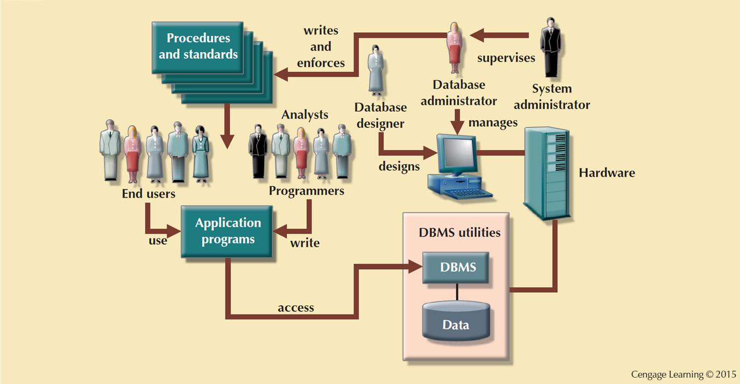
Figure 1.9 - The Database System Environment

Slide 48
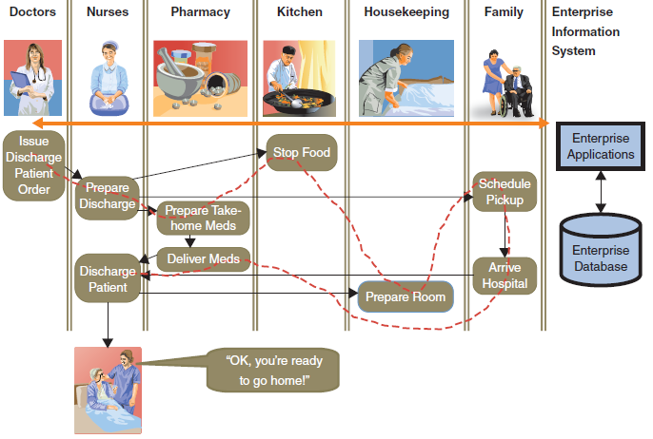
Database Systems

Slide 49
DBMS Functions
Data dictionary management
Data dictionary: Stores definitions of the data elements and their relationships
Data storage management
Performance tuning: Ensures efficient performance of the database in terms of storage and access speed
Data transformation and presentation
Transforms entered data to conform to required data structures
Security management
Enforces user security and data privacy

Slide 50
DBMS Functions
Multiuser access control
Sophisticated algorithms ensure that multiple users can access the database concurrently without compromising its integrity
Backup and recovery management
Enables recovery of the database after a failure
Data integrity management
Minimizes redundancy and maximizes consistency

Slide 51
DBMS Functions
Database access languages and application programming interfaces
Query language: Lets the user specify what must be done without having to specify how
Structured Query Language (SQL): A query language and data access standard supported by the majority of DBMS vendors
Database communication interfaces
Accept end-user requests via multiple, different network environments

Slide 52
Disadvantages of Database Systems
Increased costs
Management complexity
Maintaining currency
Vendor dependence
Frequent upgrade/replacement cycles

Slide 53
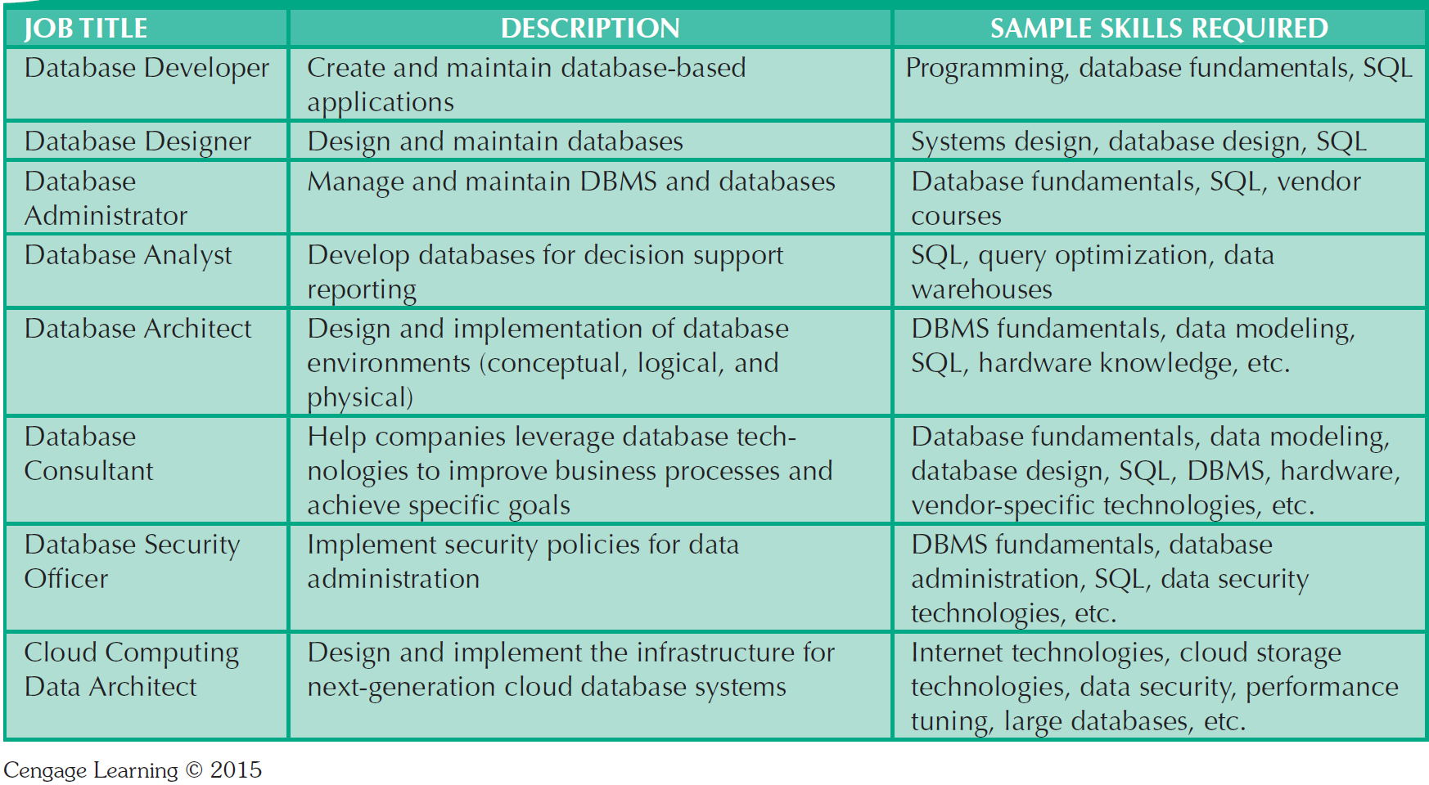
Table 1.3 - Database Career Opportunities

Slide 54
Summary
Data are raw facts. Information is the result of processing data to reveal its meaning.
To implement and manage a database, use a DBMS.
Database design defines the database structure.
A well-designed database facilitates data management and generates accurate and valuable information.
A poorly designed database can lead to bad decision making, and bad decision making can lead to the failure of an organization.

Slide 55
Summary (continued)
Databases were preceded by file systems.
Limitations of file system data management:
requires extensive programming
system administration complex and difficult
making changes to existing structures is difficult
security features are likely to be inadequate
independent files tend to contain redundant data
DBMS’s were developed to address file systems’ inherent weaknesses

