Slide 1
Experiments
Under Three Different Scenarios Utilzling Variable Controls

Slide 2
Three different scenarios
Latency Comparison of Different Write Concern Levels
Quantifying w:1 Write Loss In a FailStop Model
Failover Data from MongoDB Managed Replica Set Deployments

Slide 3
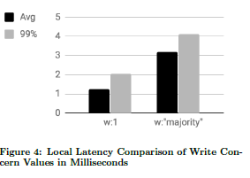

Latency Comparison of Different Write Concern Levels
Local Latency Comparison
In this experiment, all replica set members and the client were in the same AWS Availability Zone (roughly the same datacenter) and Placement Group (roughly the same rack). All replica set members were running MongoDB 4.0.2 with SSL disabled. The cluster was deployed using sys-perf, the internal MongoDB performance testing framework.

Slide 4
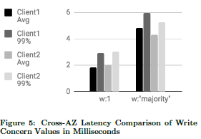

CrossAZ Latency Comparison
Second experiment, all replica sets members were in the same AWS Region (the same geographic area), but they were in different Availability Zones. Client 1 was in the same Availability Zone as the primary, and Client 2 was in the same Availability Zone as a secondary. All replica sets members were running MongoDB 4.0.3 with SSL enabled.

Slide 5
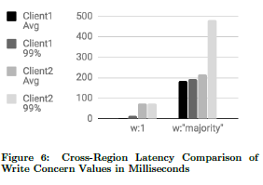

CrossRegion Latency Comparison
In this experiment, all replica set members were in different AWS Regions. The primary was in US-EAST1, one secondary was in EU-WEST-1, and the other secondary was in US-WEST-2. Client 1 was in US-EAST1, and Client 2 was in EU-WEST-1. All replica set members were running MongoDB 4.0.3 with SSL enabled. The cluster was deployed using MongoDB Atlas on M60 instances with 5280 PIOPS.

Slide 6
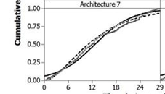
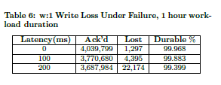
Quantifying w:1 Write Loss In a FailStop Model
As discussed previously, users may choose to trade off latency for consistency depending on their application requirements. We designed a simple workload simulation to estimate the degree of w:1 write loss in a replica set under standard failure modes.
The workload client inserts as many documents as possible until exceeding a specified workload time limit, which was set at 1 hour for our experiments. To simulate failures, the MongoDB process for each replica set node is forcefully killed and restarted at periodic intervals. The processes are shut down with a SIGKILL signal.
The time intervals we need to identify is
(1) the time between a restart and subsequent shut down
(2) the time between shut down and restart, which can be viewed as the "time to repair".

Slide 7
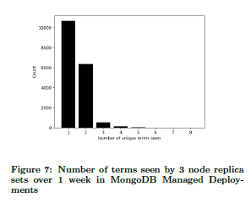
Failover Data from MongoDB Managed Replica Set Deployments
Failover Data from MongoDB Managed Replica Set Deployments, they were not able to directly measure the number of node crashes or restarts with the data collected, but we analyzed the number of unique terms seen by each replica set over this time period. Recall that terms are monotonically increasing integral values maintained on each replica set node and are used as a way to totally order elected replica set leaders. There can be at most one leader for a given term. Thus, by examining the set of all unique terms over some period of time, it is possible to get a sense of how many elections that replica set experienced.

Slide 8
Conclusion and future work
MongoDB allows users to configure each operation's consistency level, allowing them to choose the safety and performance requirements of each operation. As a highly available replicated database, it is important to give operators the choice of whether to view the system as a single-node system-of-record or a low-latency distributed system that permits short periods of inconsistency, and MongoDB allows this flexibility. In MongoDB 3.6 and 4.0, we extended our consistency offerings with causal consistency and transactions with snapshot isolation, and we intend to continue improving our consistency features. In upcoming releases, we plan to reduce the latency of majority writes, which will allow developers to more readily choose this durability guarantee. We also plan to build support for long-running reads at snapshot isolation that have no impact on the rest of the system, where any performance cost is entirely paid for by the operation. As future work, we would like to translate our matrix of readConcern and writeConcern offerings into coherent consistency settings, in order to improve the comprehensibility of these features.

