Slide 1
Prediction Model of Graduate Enrollment Rate Based on Improved Random Forest
Yumin Zhen, Bincheng Xu, Hui Zhong
18126362, 18126341, 18126363

Slide 2
Team members and division of labor
Bingchen Xu(learder):
50%Survey, 20%Writing, 35%Coding,50%idea
Yumin Zhen :
20%Writing, 50%Coding, 40%figure,25%idea
Hui Zhong :
50%Survey, 60%Writing, 15%Coding, 60%figure, 25%idea

Slide 3
01.Project Introduction
02.Data Set Introduction
03.Data Analysis
Directory
04.Algorithms And Techniques
05.Experimental Results And Analysis
06.Conclusion

Slide 4
Project Introduction
01
PART ONE

Slide 5
Project Introduction
01
Background:
The research direction of this paper is to forecast the admission rate of graduate students based on the actual needs of students applying for postgraduate study in the United States. Through data mining technology, students’ performance data are taken as eigenvectors, so that students can have a fair understanding of their own opportunities to be recognized by a university, thus providing decision support for their choice of admission.

Slide 6
Project Introduction
01
The Idea of The Project Implementation:
We select the decision trees with good classification performance in the random forest model for similarity calculation, and form a new random forest model according to the decision trees with different similarity. On this basis, we carried out parameter tuning through the depth of different random forests, and used SMOTE technology to analyze a small number of samples and artificially synthesize new samples according to a small number of samples and add them to the data set, so as to achieve our final random forest improvement and improve the prediction ability of graduate admission.

Slide 7
Dataset introduction
02
PART TWO

Slide 8
02
Dataset Introduction
Data set source：
https://www.kaggle.com/mohansacharya/graduate-admissions
Mohan S Acharya, Asfia Armaan, Aneeta S Antony : A Comparison of Regression Models for Prediction of Graduate Admissions, IEEE International Conference on Computational Intelligence in Data Science 2019

Slide 9
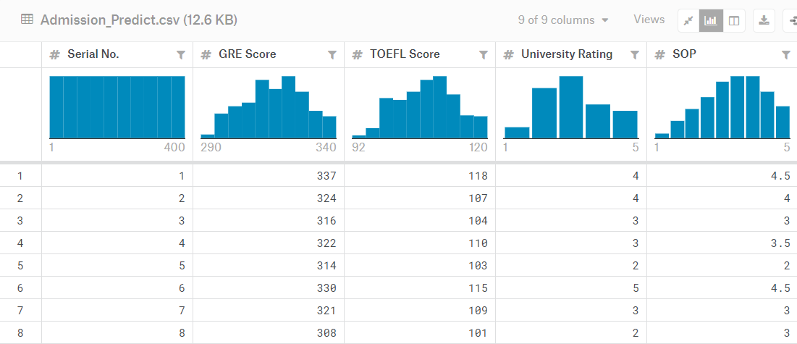
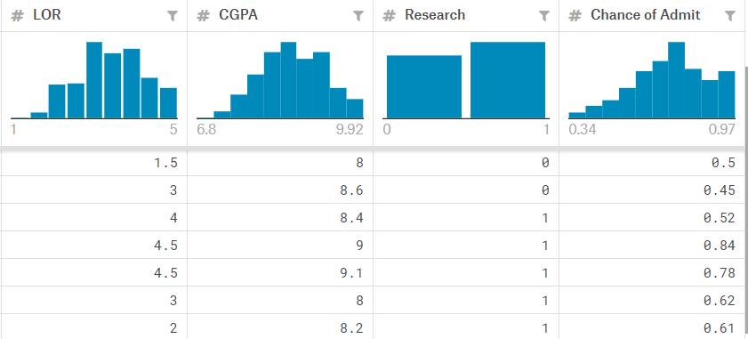
02
Dataset Introduction

Slide 10
02
Dataset Introduction
The dataset contains several parameters which are considered important during the application for Masters Programs.
The parameters included are :
1. GRE Scores ( out of 340 )
2. TOEFL Scores ( out of 120 )
3. University Rating ( out of 5 )
4. Statement of Purpose and Letter of Recommendation Strength ( out of 5 )
5. Undergraduate GPA ( out of 10 )
6. Research Experience ( either 0 or 1 )
7. Chance of Admit ( ranging from 0 to 1 )

Slide 11
Data Analysis
03
PART THREE

Slide 12
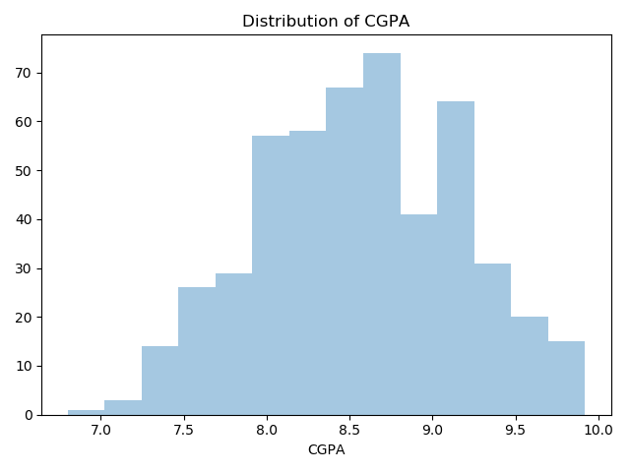
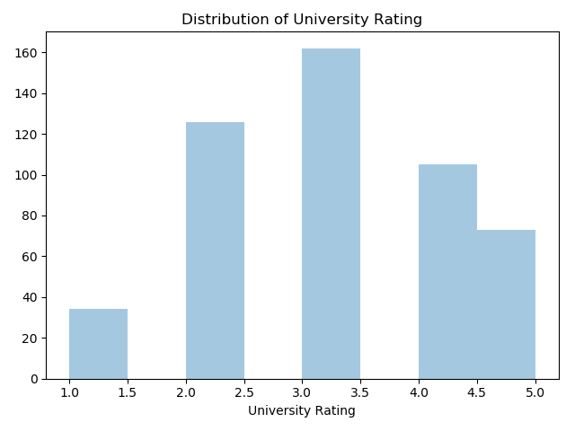
03
Data Analysis
Distribution of GRE Scores
Distribution of University Rating
Distribution of CGPA

Slide 13
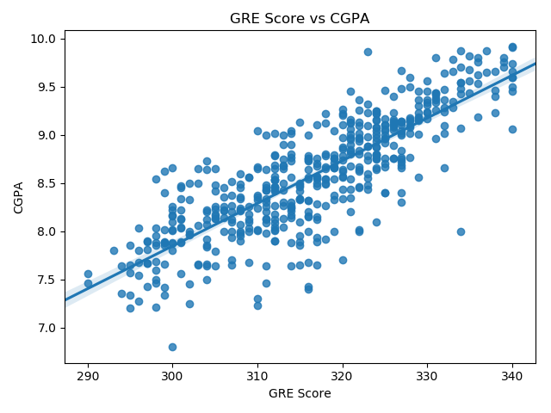
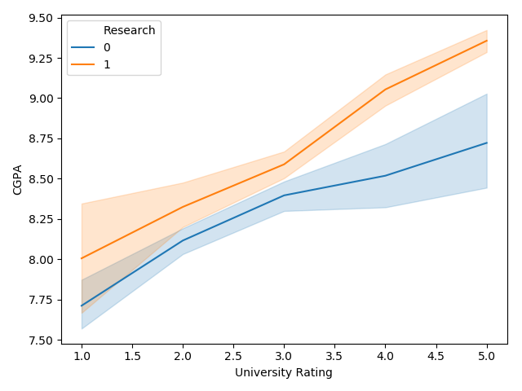
03
Data Analysis
The relationship between University Rating, CGPA and Research
GRE Scores VS CGPA

Slide 14
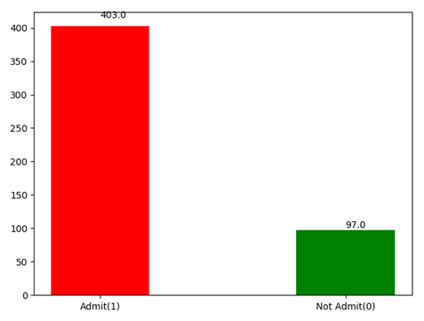
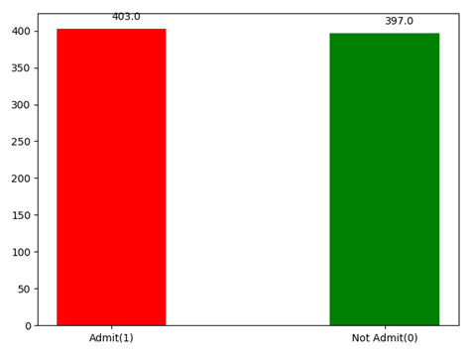
03
Data Analysis
The original data
The optimized data
SMOTE

Slide 15
Algorithms and techniques
04
PART FOUR

Slide 16
04
Algorithms And Techniques——SMOTE
The idea of Smote algorithm is actually very simple.
First, select n samples with few classes randomly, find out the samples with few classes with initial expansion, then find out the m samples with few classes closest to Smote algorithm, and finally generate new samples according to the m samples with few classes closest to Smote algorithm

Slide 17
04
Algorithms And Techniques——SMOTE
(1) Set the sampling data quantity or sampling proportion
(2)Find a few classes
(3) For each minority class sample, find the m minority class samples closest to it
(4)Generate new samples: a small number of class samples are randomly selected. For continuous characteristic variables in the samples, the mean values of m neighbors are taken as the corresponding values of the new samples. For discrete characteristic variables, the mode of m neighbors is taken as the corresponding value of the new sample
(5)Repeat 4 until a small number of class samples reach the set threshold

Slide 18
04
Algorithms And Techniques——Random Forest Algorithm
(1) Bagging algorithm is used to carry out K times of random sampling of the original training set and obtain K training subsets, each training subset corresponding to a tree.
(2) in the process of generating the decision tree, for each node, M features are selected from the feature set each time as the feature subset.
(3) when splitting each node, the optimal feature is selected from the feature subset as the splitting attribute.

Slide 19
04
Algorithms And Techniques——Random Forest Algorithm
(4) generate K decision trees.
(5) combine all the generated decision trees into a random forest. Each test sample has K results.
(6) according to the majority voting principle, the most classified results are selected as the final results.

Slide 20
04
Algorithms And Techniques——AUC,ROC
The confusion matrix
Pred_lable/True_lable | Positive | Negative
Positive | TP | FP
Negative | FN | TN
The horizontal axis of ROC curve is FPR(False Postive Rate) and the vertical axis is TPR(True Postive Rate)：
FPR= FP/(FP+TN)
TPR=TP/(TP+FN)

Slide 21
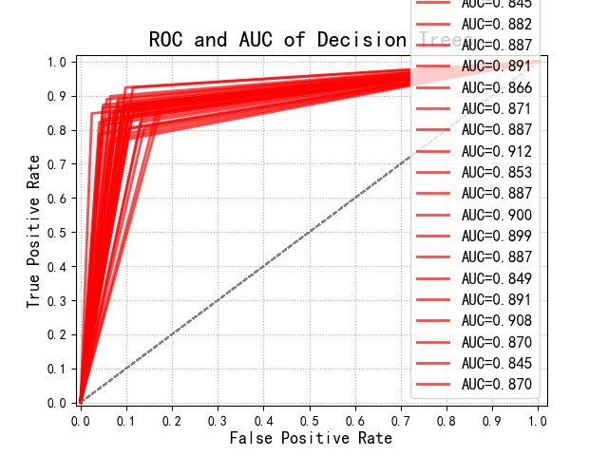
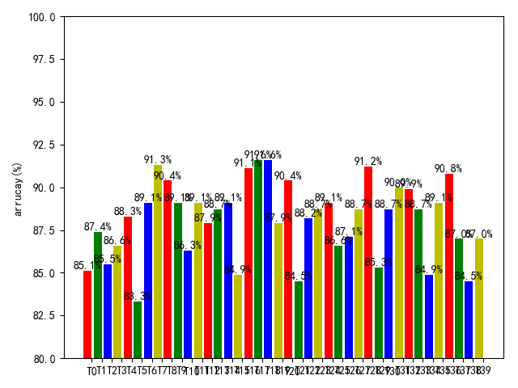
04
Algorithms And Techniques——AUC,ROC
(a). ROC of each decision tree.
(b). AUC distribution for each decision tree.
Description of ROC and AUC

Slide 22
04
Algorithms And Techniques——AUC,ROC
(1) calculate the AUC of each decision tree
(2) sort AUC in descending order
(3) select the decision tree with high AUC value to form a new random forest

Slide 23
04
Algorithms And Techniques——Correlation
Since the training samples generated by each decision tree are random and the selection of node features is also random, there is a certain correlation between decision trees. The greater the correlation between any two trees in the forest, the greater the error rate.

Slide 24
04
Algorithms And Techniques—— Correlation
The parent-child inner product computation is as follows:
the parent node:
parent ⃗=(index_p,value_p )^T，
the child node:
child ⃗=(index_c,value_c )^T
then the inner product calculation formula is as follows:
Inner product=parent^T•child

Slide 25
04
Algorithms And Techniques—— Correlation
(1) sort AUC in descending order, starting from the highest AUC tree, and compare the similarity pairwise.
(2) calculate the inner product between two nodes by using the preorder traversal and save it in the list.
(3) to compare the similarity of two trees is to compare the number of similar inner products in their list. If the similarity is within a certain range, they are considered to be similar. The decision tree with low AUC is deleted and the tree with high AUC is retained. Form a new random forest.

Slide 26
04
Algorithms And Techniques——Parameter tuning
The depth of the decision tree sometimes affects the model of the random forest.
The method we adopted is to select the optimal depth value of the tree as the final depth value before formally generating the random forest model.In other words, the traditional random forest algorithm is used to generate different random forest models for different depth parameters, and the depth values with higher model accuracy and smaller depth are taken as the parameters of the prediction algorithm in this paper. This ensures that the parameters used each time the model is generated are optimal.

Slide 27
Experimental Results And Analysis
05
PART FIVE

Slide 28
05
Experimental Results And Analysis
The experimental steps:
(1)set the number of different decision trees as 20, 30, 40, 50, 60, 70 and 80 respectively.
(2)first tested the improved random forest, and then tested the improved random forest.

Slide 29
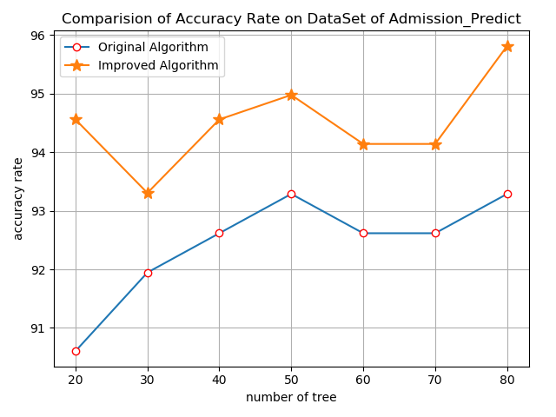
05
Experimental Results And Analysis
Number of decision trees | Random forests of the original one（%） | The improved random forests（%）
20 | 90.60 | 94.56
30 | 91.95 | 93.31
40 | 92.62 | 94.56
50 | 93.29 | 94.98
60 | 92.62 | 94.14
70 | 92.62 | 94.14
80 | 93.29 | 95.82
The comparison of classification accuracy
The comparision of Accuracy Rate on DataSet of Admission_Predict
the improved random forest had the highest correct rate of
3.96% improvement.

Slide 30
Conclusion
06
PART SIX

Slide 31
06
Conclusion
In this study, on the basis of improving the random forest, we conducted SMOTE processing on the data and adjusted the depth parameters of the random forest, so as to obtain the random forest model with higher prediction accuracy. Therefore, we can draw a conclusion that in the process of model training, the accuracy of the model can be improved more effectively through data preprocessing and model parameter optimization.

Slide 32
06
Conclusion
However, negative optimization may occur in some cases, possibly due to the randomness of the random forest. In the future, we hope to solve this problem. In addition, the calculation of similarity can be further optimized.
(Other attempts :
In the process of experiment, we also adopted the decision tree with higher prediction accuracy than the average to form a new forest to replace the forest with trees with high AUC value, so as to solve the problem, but the effect was not good. We will try other things in the future.)

Slide 33
THANKS!

