Slide 1
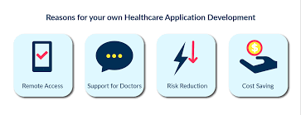
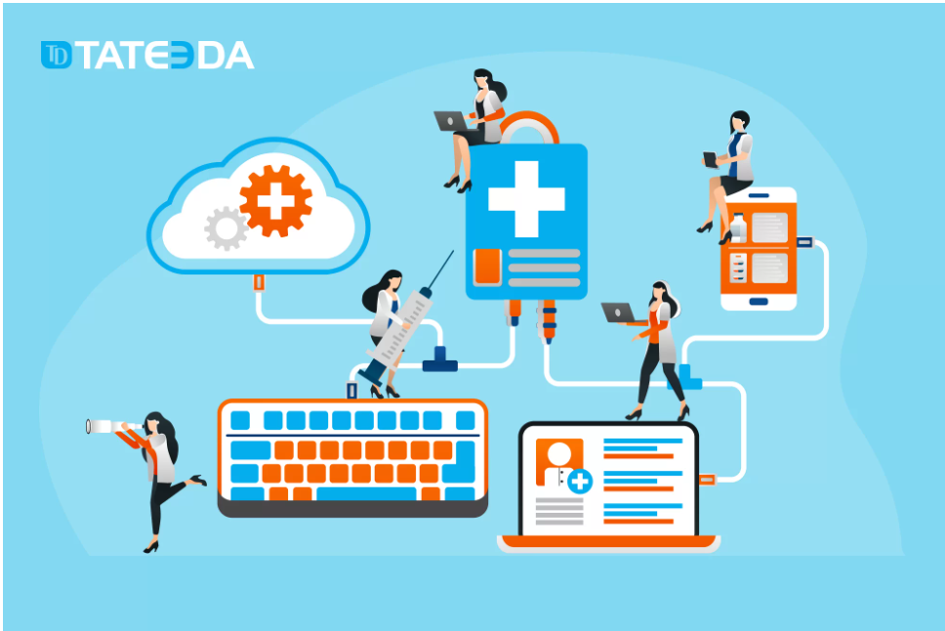
Docter G
TEAM MEMBERS
S. No. | Name | UID
1. | ROHAN GHOSH | 20BCS9671
2. | KIRTI | 20BCS7083
3. | LIZA SHARMA | 20BCS7097
4. | Md. Badruddin | 20BCS5907
5. | JAI BUDHRAJA | 20BCS5816
Professional Healthcare Mobile App on JAVA

Slide 2

The Healthcare industry has gained huge popularity among businesses and professionals in recent years, especially post-pandemic. Similarly, the market for mobile app development in healthcare is in its constantly evolving phase where every professional wants to experiment with healthcare and medical applications and software.
According to a recent survey, the digital healthcare market should reach nearly 660 billion USD by 2025. In the past two years, businesses and digital health investors have invested more than 21 billion in digital healthcare projects. Besides the increasing market size, there’s also a surge in overall app usage. Since the outbreak of Covid-19, the number of healthcare app downloads has increased by 60% worldwide.

Slide 3


Healthcare software development or healthcare app development is the process of developing an app for mobile devices to help its users successfully track and follow their health issues in real time. For instance, mobile health application development is a big yes for EHR (Electronic Health Records), medical service experience, hospital services, digitized medical insurance claims etc.
Healthcare mobile apps development serves different purposes :
For Doctors and medical professionals- It helps in monitoring, patient tracking, staff management, appointment scheduling etc.
For patients- mHealth app development is to track wellbeing, seek medical recommendations and book appointments.

Slide 4

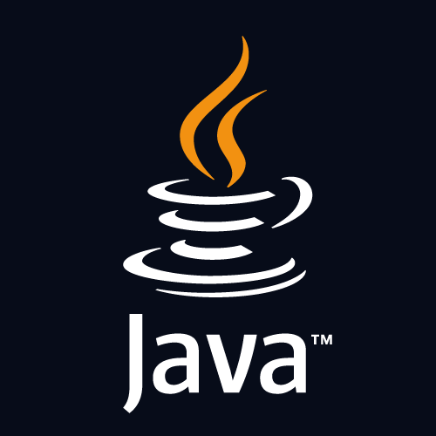
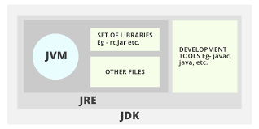
Technology Used
A Java IDE is an integrated development environment for programming in Java; many also provide functionality for other languages,IDEs typically provide a code editor, a compiler or interpreter and a debugger that the developer accesses through a unified graphical user interface (GUI). Java IDEs also include language-specific elements such as Ant and Maven build tools and TestNG and JUnit testing.
NetBeans: a Java-based IDE and underlying application platform framework.
The Java Development Kit (JDK) is a distribution of Java Technology by Oracle Corporation. It implements the Java Language Specification
(JLS) and the Java Virtual.

Slide 5

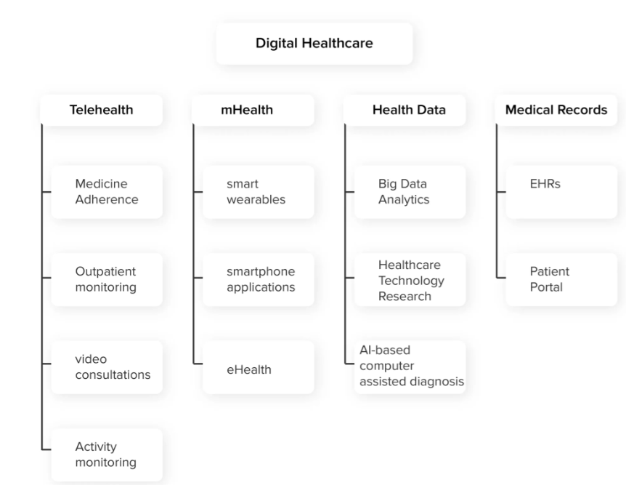
DESIGNS

Slide 6

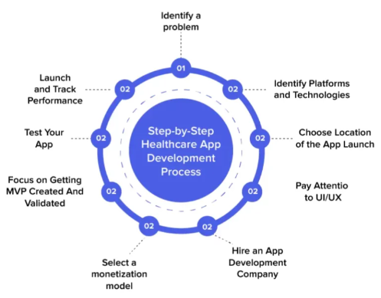
CYCLIC
MODEL

Slide 7
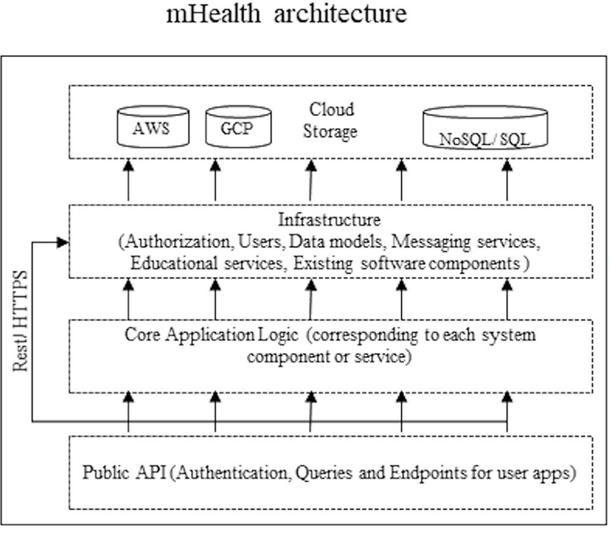
SEQUENCE DIAGRAM

Slide 8

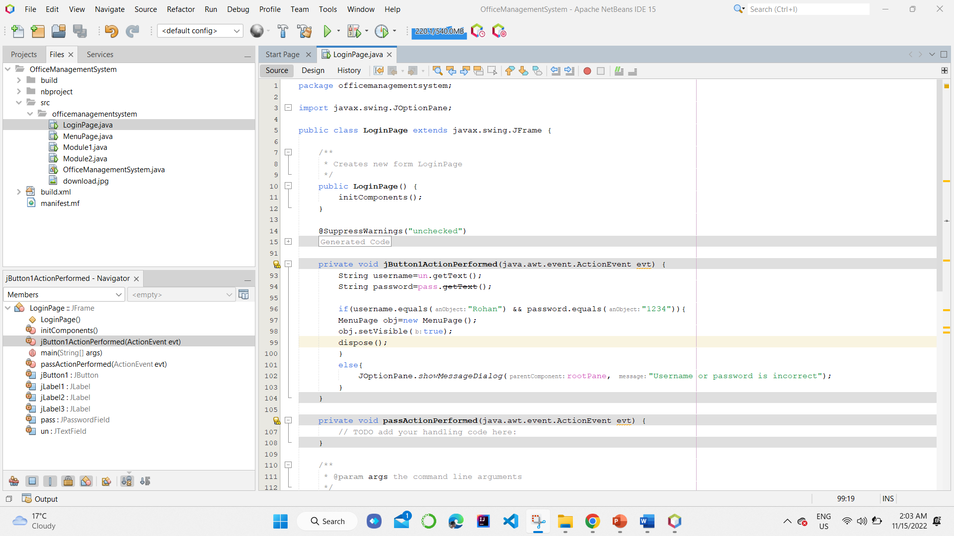
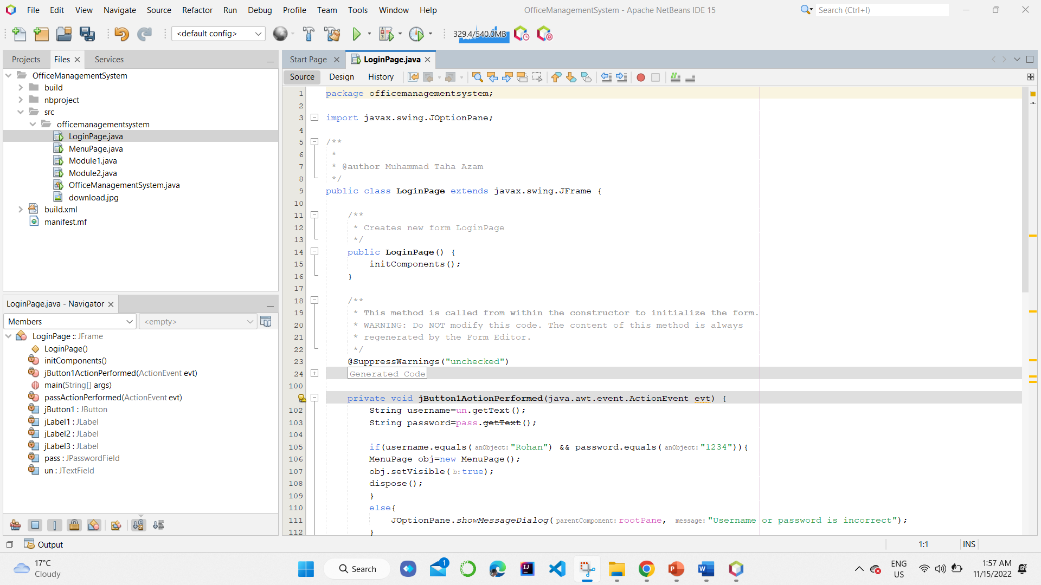
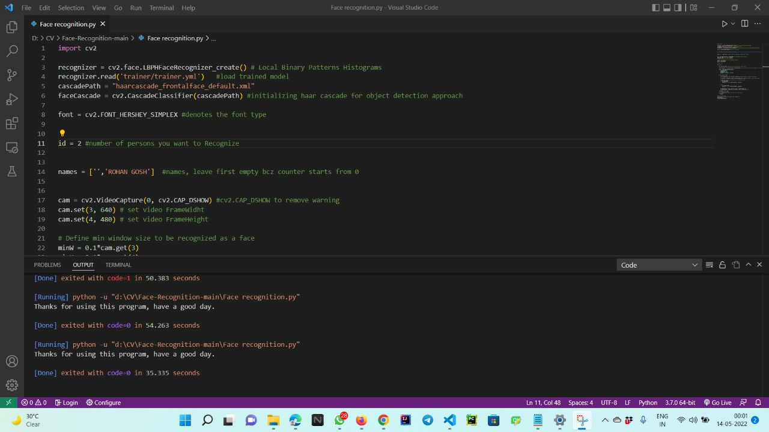
Snapshot-1

Slide 9
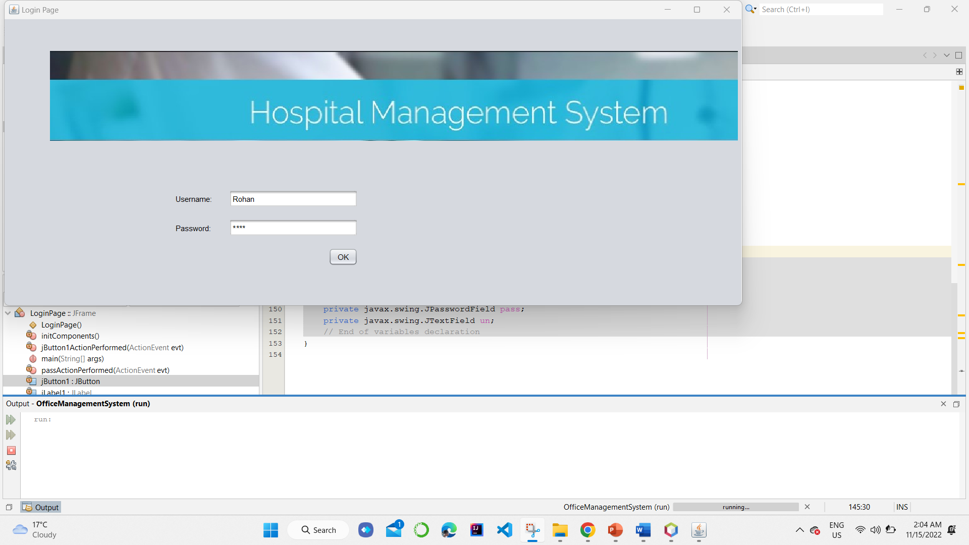

Snapshot-2

Slide 10

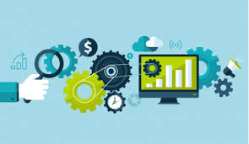
Outcomes
Faster decision making- When professionals have integrated medical records of patients through healthcare apps, they are faster with decisions and prescriptions.
Accurate diagnosis- With accurate diagnosis comes better treatment plans, timely healthcare delivery and effective outcomes. For instance, VisualDx is among top diagnostic support systems and healthcare apps for personalized guidance.
Improved communication- Various telehealth application platforms help doctors connect with each other remotely for important consultations and discussions.
Overall reduced cost of healthcare provision – All the benefits mentioned above, add up to the overall cost reduction of healthcare provision and service.
High quality care – Along with all automation available to providers, users can receive personal health plans and solutions that respect their specific medical needs.

