Slide 1

Department Of Computer Science and Engineering Course title: Research Project Course Code: CSE 5000
Supervised By:
Professor Dr. Mahbuba Begum
Department of CSE, MBSTU
Presented By:
Rupa Rani Das (ID: CE20025)
Session: 2019-20
Dilruba Yeasmin Dipa (ID: CE21046)
Session: 2020-21
Department of CSE, MBSTU
1

Slide 2
A Secure Reversible Image Data Hiding with Encryption
2

Slide 3
Table of Contents
Introduction
Objectives
Literature Review
Existing Research Gaps
Research Motivation
Proposed Method
Result Analysis
Conclusion
Future Work
3

Slide 4
Introduction
Image security remains a major challenge in modern communication systems [6].
Existing methods improve RDH-EI capacity and performance using compression and encryption techniques [8].
Reversible image data hiding with encryption is a secure data hiding technique.
It enables secure embedding with perfect recovery of the original image [1].
Secret data is hidden inside encrypted images.
It ensures data security and privacy.
The proposed method aims to achieve high security, efficient data hiding, and good image quality.
[1] A. Malik, P. He, H. Wang, A. N. Khan, S. Pirasteh, and S. M. Abdullahi, "High-capacity reversible data hiding in encrypted images using multi-layer embedding," IEEE Access, vol. 8, pp. 148998–149010, 2020.
[6] V. Venkatesh, R. Anushiadevi, P. V. Meikandan, H. Mahalingam, and R. Amirtharajan, "Separable reversible data hiding by vacating room after encryption using encrypted pixel difference," Scientific Reports, vol. 15, p. 11916, 2025
[8] K.-M. Chen and C.-C. Chang, "High-capacity separable reversible data-hiding method in encrypted images based on block-level encryption and Huffman compression coding," Connection Science, vol. 33, no. 4, pp. 975–994, 2021
4

Slide 5
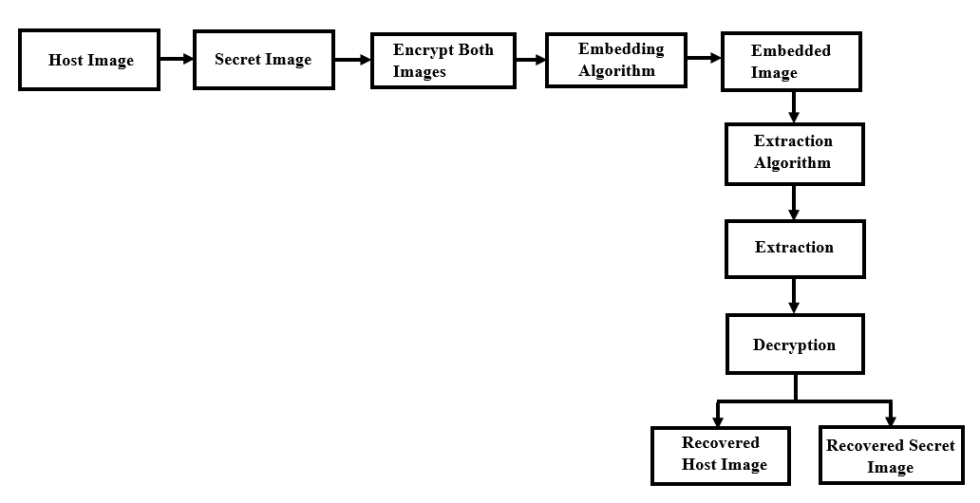
Introduction (cont.)
Figure 1. General architecture of the proposed method
5

Slide 6
Objectives
Develop a secure reversible data hiding system for secret image data transmission.
Apply adaptive techniques to improve embedding capacity for large payloads.
Use secure encryption methods to protect both host and secret images.
Ensure accurate extraction of hidden data.
Evaluates system performance in terms of quality, security, and efficiency.
Recover the original images without any loss after data extraction.
6

Slide 7
Literature Review
References, year | Used Methods | Experimental result | Limitation
Malik et al., 2020 [1] | Multi-Layer Embedding, Four-set Frame Splitting | • BPP=2 • PSNR=∞ • BER=0 SSIM=1 | Texture-sensitivity, High-overhead
Li et al., 2021 [2] | (7, 4) Hamming Code, Histogram-Based Undistorted RDHEI | • BPP:2.556 • BER=0 | Noise-vulnerability, Low embedding capacity
Jose and Subramaniam, 2020 [3] | RRBE, VRAE, Hybrid AES-ECC | PSNR=∞ BER=0 | Low embedding capacity
7

Slide 8
Literature Review (Cont.)
References, year | Used Methods | Experimental result | Limitation
Rehman et al., 2021 [5] | AES Encryption, ECC | • BPP=1.5 • PSNR=∞ • SSIM=1.0 •BER=0 | Algorithmic vulnerability, Texture-dependency
Venkatesh et al., 2025 [6] | VRAE, Additive Homomorphic Encryption, Encrypted Pixel Difference (EPD) | • BPP=1.2 • PSNR=∞ • SSIM=1.0 •BER=0 | High computational complexity, Noise-sensitivity
Ren et al., 2023 [7] | Multi-Prediction, Adaptive Huffman Encoding, | • BPP = 2.7718 • PSNR= ∞ • SSIM: 1.0 | Texture-sensitivity
8

Slide 9
Literature Review (Cont.)
Reference, year | Used Methods | Experimental result | Limitation
Chen and Chang, 2021 [8] | Separable RDH, Block-level Encryption, Huffman Compression Coding | • BPP=2.378 • BER=0 NC=1.0 | Strict block-size structural dependencies.
Gao et al., 2020 [9] | Pixel-Order Optimization (POB), Prediction Matrix, Image Encoding | • BPP=1.5 BER=0 | Highly reliant on spatial correlation of plaintext image.
Yang et al., 2025 [10] | Multi-level Pixel Shifting, Histogram Optimization | BPP=1.2 BER=0 | Low Security, Low embedding rate
9

Slide 10
Existing Research Gaps
Low embedding capacity
Limited to gray scale images
High computational complexity
Limited adaptability
Hard to scale for big size images
Limited formal security and robustness analysis
10

Slide 11
Research Motivations
• Hide secret and sensitive image data without affecting image quality.
• Achieve perfect extraction of the hidden secret data.
• Ensure lossless recovery of the original host image and secret image.
• Maintain high image quality after data embedding.
• Improve embedding capacity for larger secret payloads.
• Provide a secure, efficient, and reversible data hiding framework.
11

Slide 12
Proposed Method
In our proposed method, there are mainly three parts :
Preprocessing & Key Generation
Apply adaptive scaling of the secret image based on embedding capacity.
Generate encryption keys using Elliptic Curve Diffie-Hellman (ECDH).
Derive cryptographic keys and seeds using HMAC-based Extract-and-Expand Key Derivation Function (HKDF).
12

Slide 13
Proposed Method
II. Encryption & Embedding
Encrypt the host image using block permutation and AES-128 CTR mode.
Encrypt the secret image using ChaCha20 encryption.
Embed the encrypted secret data using an adaptive multi-layer embedding method.
III. Extraction & Decryption
Extract the hidden secret data from the embedded image.
Decrypt the secret image using the correct keys.
Recover both host and secret images without any loss.
13

Slide 14
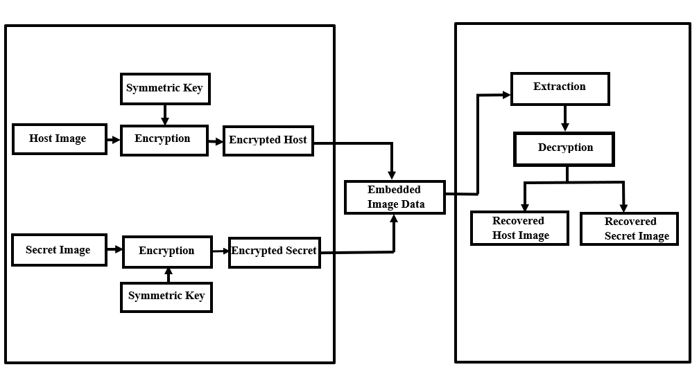
System Architecture
Figure 2. Overview of Proposed System
14

Slide 15
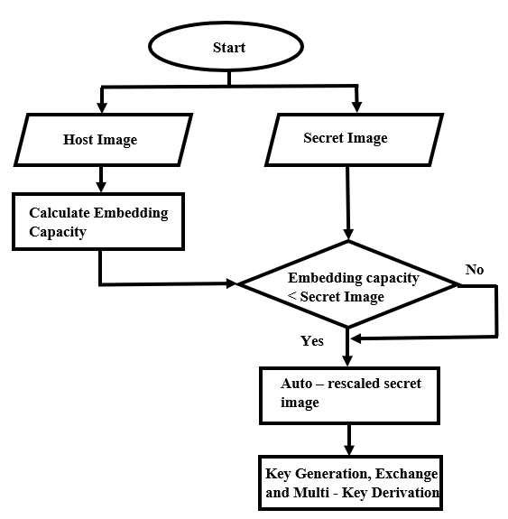
Preprocessing and Key Generation Process
Figure 3. Preprocessing and Key Generation
15

Slide 16
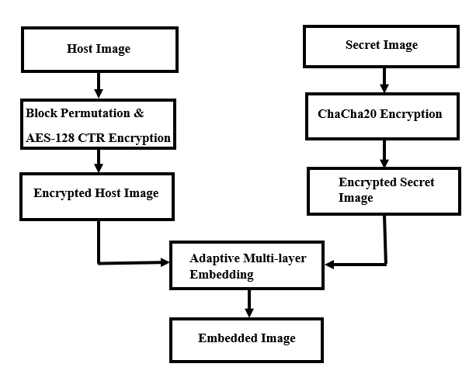
Encryption and Embedding Process
Figure 4. Encryption and Embedding
16

Slide 17
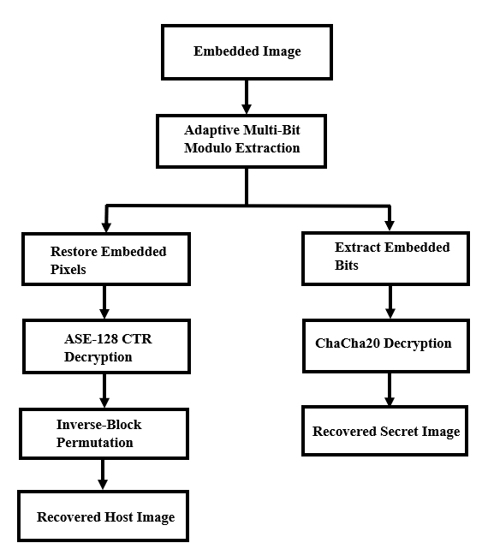
Extraction and Decryption Process
Figure 5. Extraction and Decryption
17

Slide 18
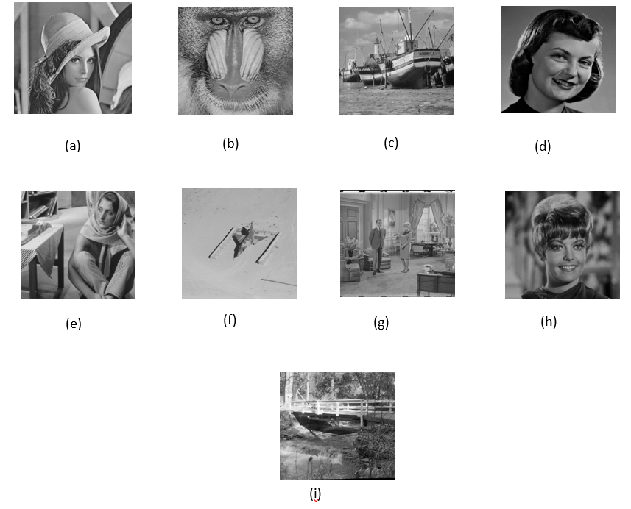
Result Analysis: Sample Input Images (Host)
Figure 6. Different Host Images: (a) Lena (b) Baboon (c) Boat (d) Girlface (e) Barbara (f) Airplane (g) Couple (h) Zelda (i) Bridge [12] [13]
18

Slide 19
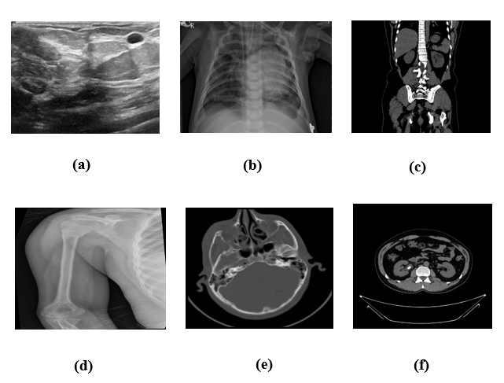
Result Analysis(Cont.):Sample Input Images(Secret)
Figure 7. Different Secret Images: (a) Breast Cancer (b) Chest X-ray (c) Kidney Cyst
(d) Bone Fracture (e) Brain Tumor (f) Brain CT_ Scan
19

Slide 20
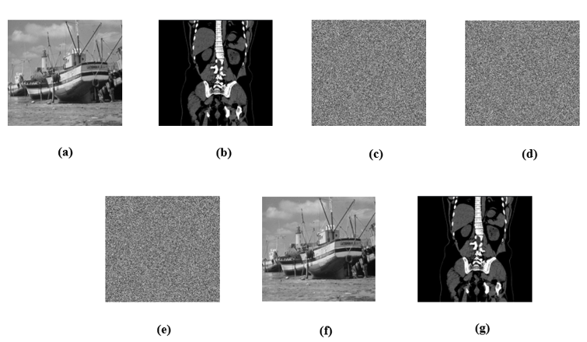
Result Analysis(Cont.):Visual Performance of Proposed System
Figure 8. Visual quality of images:(a) Original host image(b) Secret image (c) Encrypted host image (d) Encrypted secret image (e) Embedded image (f) Recovered host image (i) Recovered secret image
20

Slide 21
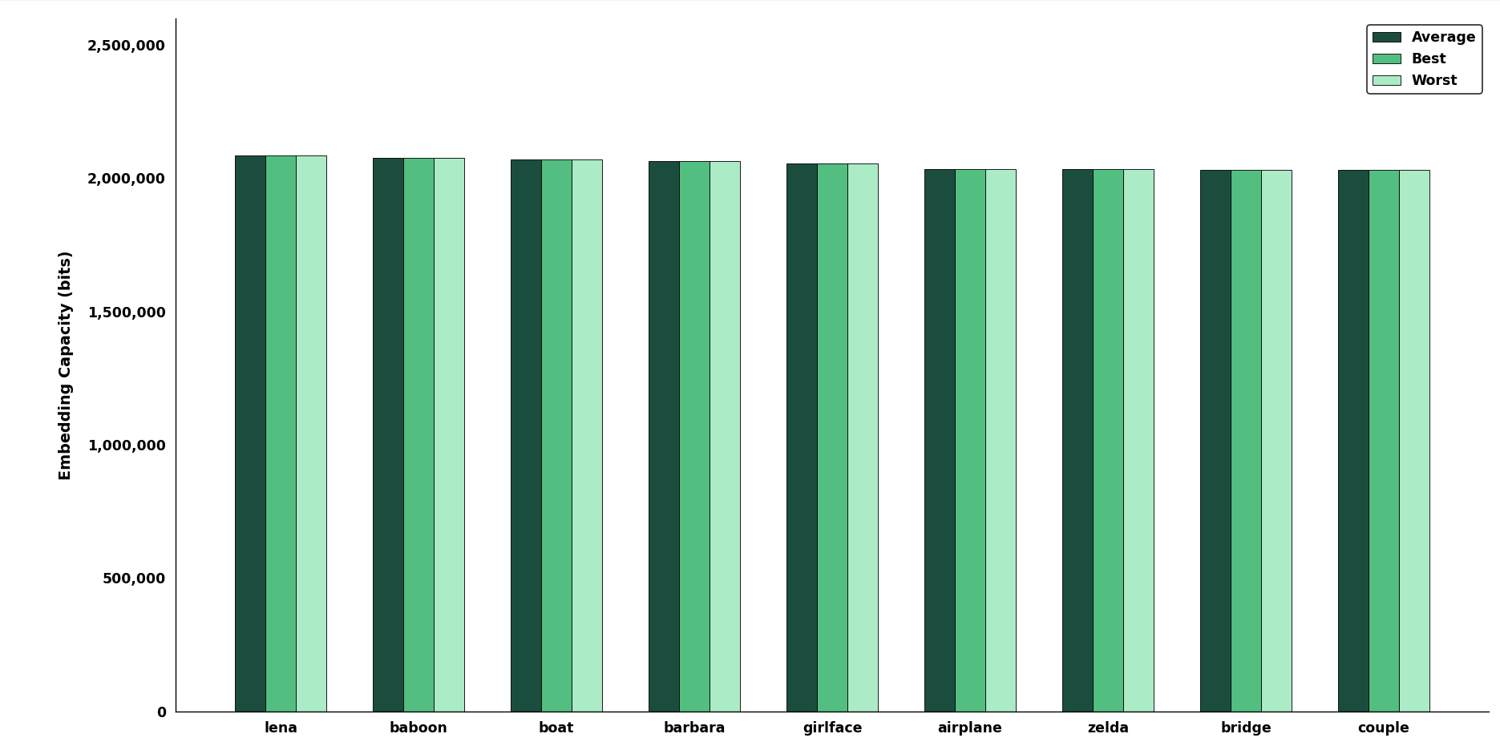
Result Analysis(Cont.): Embedding Capacity
Figure 9. Embedding Capacity Analysis of Host Images
21

Slide 22
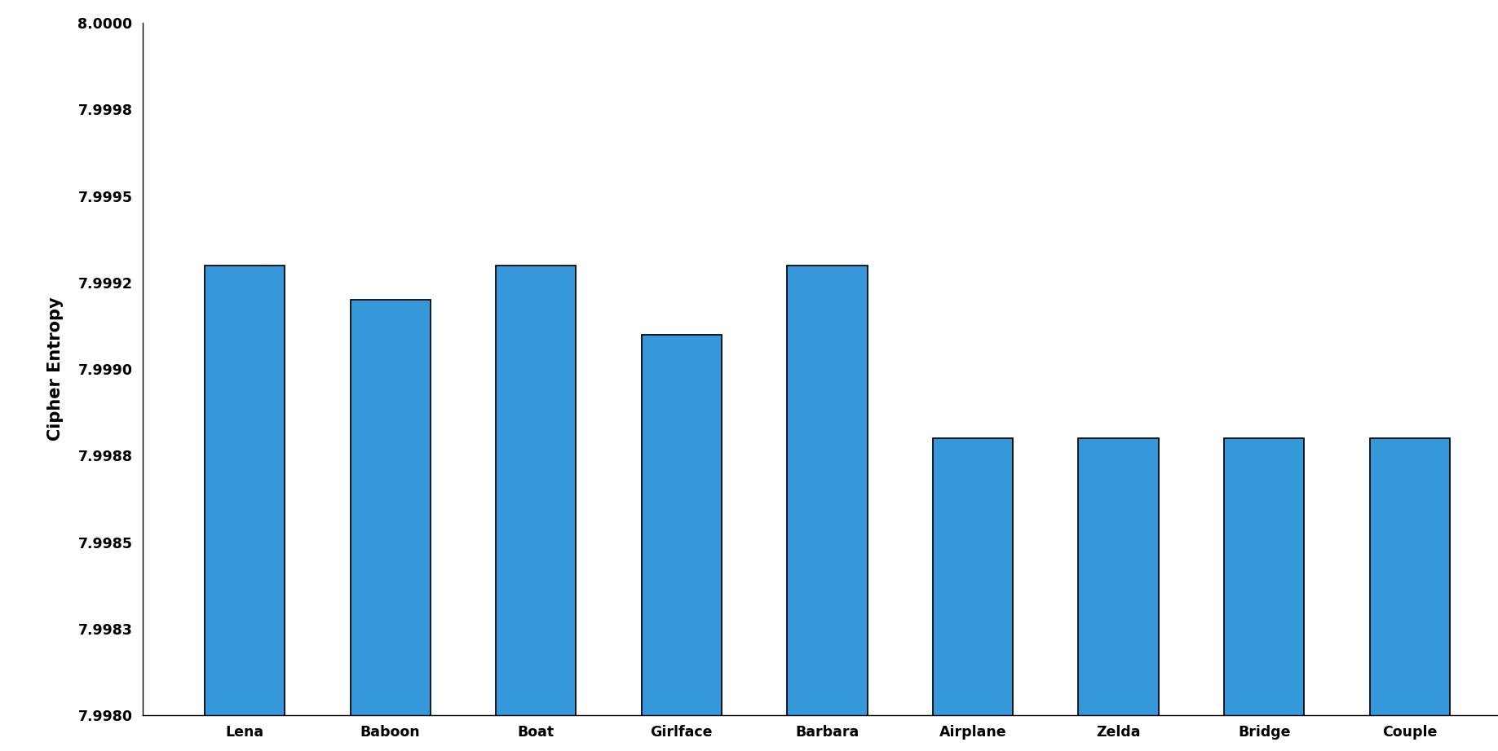
Result Analysis(Cont.):Pixel Correlation of Host
Figure 10. Entropy Analysis of Cipher Images
22

Slide 23
Result Analysis(Cont.): Host Images
Table 1: Lossless Host Recovery Metrics of the Proposed Method
Images (512×512) | PSNR (dB) | MSE | SSIM | NC
Lena | ∞ | 0 | 1 | 1
Baboon | ∞ | 0 | 1 | 1
Boat | ∞ | 0 | 1 | 1
Girlface | ∞ | 0 | 1 | 1
Barbara | ∞ | 0 | 1 | 1
Airplane | ∞ | 0 | 1 | 1
Zelda | ∞ | 0 | 1 | 1
Bridge | ∞ | 0 | 1 | 1
Couple | ∞ | 0 | 1 | 1
23

Slide 24
Result Analysis(Cont.): Host Images
Table 2: Embedding Rate Comparison with Existing Works
Images | Gao et al. 2020 [9] | Li et al. 2021 [12] | Chen & Chang 2021 [10] | Ren et al. 2023 [2] | Ankur et al. 2025 [1] | Saeidi & Mirzakuchaki 2025 [13] | Anushiadevi et al. 2026 [23] | Proposed Method
Baboon | 1.93 | 2.538 | 0.4690 | 1.1562 | 1.5122 | 0.1293 | 0.42 | 7.9231
Lena | 3.75 | 2.389 | 1.4005 | — | 3.1621 | — | — | 7.9504
Airplane | 4.54 | — | — | 3.7245 | 4.0237 | 0.1741 | — | 7.7532
Boat | 3.21 | — | — | — | — | 0.0430 | 1.00 | 7.9005
Barbara | 3.13 | — | 0.9526 | — | — | 0.1369 | — | 7.8762
Zelda | — | 2.475 | 1.5679 | — | — | — | — | 7.7532
24

Slide 25
Result Analysis(Cont.): Secret Images
Table 3: Performance Analysis of Secret Images Recovery
Secret Images | Image Size | PSNR (dB) | BER
Breast Cancer | 777 × 578 | ∞ | 0
Chest X-ray | 1024 × 680 | ∞ | 0
Kidney Cyst | 865 × 700 | ∞ | 0
Ultrasonogram of Fetus | 800 × 540 | ∞ | 0
Thyroid Cancer | 982 × 762 | ∞ | 0
Bone Fracture | 640 × 640 | ∞ | 0
Brain CT Scan | 650 × 650 | ∞ | 0
Brain Tumor | 512 × 512 | ∞ | 0
Kidney Stone | 512 × 512 | ∞ | 0
25

Slide 26
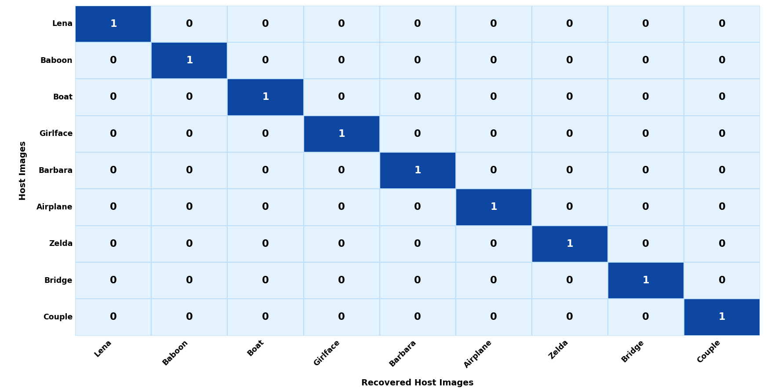
Result Analysis(Cont.): Host Images
Figure 11: Recovery result of host images
26

Slide 27
Conclusion
Safely hides secret data in encrypted images.
Provides high-capacity data embedding of 7.9504 bpp.
Ensures perfect recovery with PSNR = ∞, MSE = 0, SSIM = 1.0, NC = 1.0.
Maintains lossless transmission with BER = 0.
Preserves high image quality.
Ensures strong security through encryption.
27

Slide 28
Future Work
Extend the method for color images.
Reduce computational complexity and processing time.
Maintain high image quality without using backup pixels.
Increase the data hiding capacity.
Improve the security of the system.
Apply the method to real-world image sharing and storage applications.
28

Slide 29
Reference List
[1] A. Malik, P. He, H. Wang, A. N. Khan, S. Pirasteh, and S. M. Abdullahi, "High-capacity reversible data hiding in encrypted images using multi-layer embedding," IEEE Access, vol. 8, pp. 148998–149010, 2020. https://doi.org/10.1109/ACCESS.2020.3016539
[2] L. Li, C.-C. Chang, and C.-C. Lin, “Reversible data hiding in encrypted image based on (7,4) Hamming code and UnitSmooth detection," Entropy, vol. 23, no. 6, p. 790, 2021.
[3] A. Jose and K. Subramaniam, "Comparative analysis of reversible data hiding schemes," IET Image Processing, vol. 14, no. 10, pp. 2011–2023, 2020.
[4] S. Kumar, A. Gupta, and G. S. Walia, "Reversible data hiding: A contemporary survey of state-of-the-art, opportunities and challenges," Applied Intelligence, vol. 52, no. 7,7406, 2022. DOI: https://doi.org/10.1007/s10489-021-02840-7
[5] S. Rehman, N. T. Bajwa, M. A. Shah, A. O. Aseeri, and A. Anjum, "Hybrid AES-ECC model for the security of data over cloud storage," Electronics, vol. 10, no. 21, p. 2673, 2021. DOI: https://doi.org/10.3390/electronics10212673
29

Slide 30
Reference List
[6] V. Venkatesh, R. Anushiadevi, P. V. Meikandan, H. Mahalingam, and R. Amirtharajan, "Separable reversible data hiding by vacating room after encryption using encrypted pixel difference," Scientific Reports, vol. 15, p. 11916, 2025. DOI: https://doi.org/10.1038/s41598-025-11916-6
[7] H. Ren, G.-R. Bai, T.-T. Chen, Z. Yue, and R.-Y. Ren, "Reversible data hiding in encrypted images with multi-prediction and adaptive Huffman encoding," Scientific Reports, vol. 13, p. 23104, 2023. DOI: https://doi.org/10.1038/s41598-023-50364-7
[8] K.-M. Chen and C.-C. Chang, "High-capacity separable reversible data-hiding method in encrypted images based on block-level encryption and Huffman compression coding," Connection Science, vol. 33, no. 4, pp. 975–994, 2021. DOI: https://doi.org/10.1080/09540091.2021.1892630
[9] H. Gao, T. Gao, Z. You, and R. Cheng, "High capacity reversible data hiding in encrypted image based on image encoding and POB," Journal of the Franklin Institute, vol. 357, no. 13, pp. 9107–9126, 2020. DOI: https://doi.org/10.1016/j.jfranklin.2020.06.019
30

Slide 31
Reference List
[10] C.-N. Yang, Y.-Q. Lu, S.-Y. Liu, and L. Xiong, "Enhanced reversible data hiding in encrypted images by pixel shifting," Journal of Visual Communication and Image Representation, vol. 99, 2025. DOI: https://doi.org/10.1016/j.jvcir.2024.104156
[11] Prasun Roy, Natural Images Dataset, Kaggle. Available: https://www.kaggle.com/datasets/prasunroy/natural-images ↗. Accessed: June 15, 2026.
[12] Hlevkin, Test Images Collection. Available:
https://www.hlevkin.com/hlevkin/06testimages.htm ↗. Accessed: June 15, 2026.
[13] USC SIPI Image Database ↗. Available: https://sipi.usc.edu/database/ . Accessed: June 15, 2026.
31

Slide 32
Thank you
32

