Slide 1

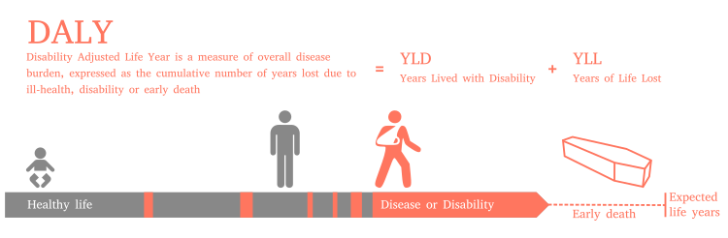
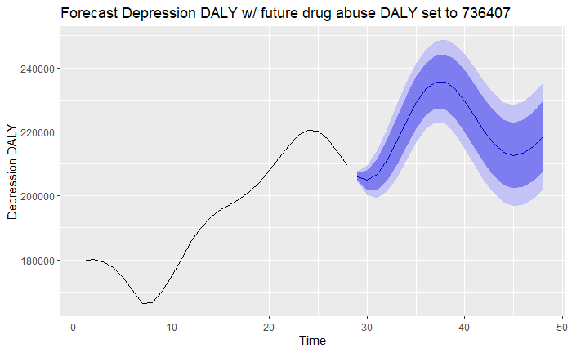
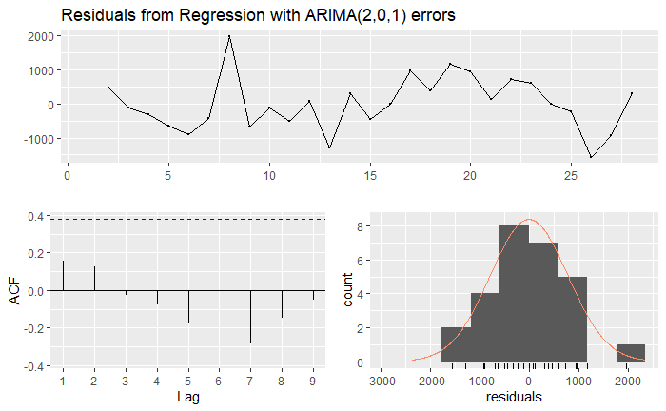
Forecasting Disability-affected Life Years for Depression using dynamic regression Joseph Addy Concordia College, Moorhead, Minnesota
Introduction
Disability-adjusted life years is a measure of overall disease burden expressed as the number of years lost due to ill health disability or early death. It was introduced in the 1990s as a way of comparing a country's overall health. DALY is calculated by summing the number of years lived with a disability and years of life lost (amount of years below expected). I was interested in researching the apparent rise in depression in American youth, and the DALY measure is a good tool to use. The United States has seen drastic increase in DALY for drug abuse disorder and major depression disorders for college students since 1996. I believe the increase in mental illness in our young people is an issue that must be addressed and explored.
Results and Discussion
The model using once lagged predictors did a better job of capturing the upward trend than the pure play arima, and also had significantly lower AICc and AIC. The ACF plot of the residuals resembles white noise and the residuals follow a normal distribution, therefore this model is more accurate than the pure play model, and was used in the final forecast.
The forecasts suggest that drug abuse disorder DALY has an affect on the DALY of depression disorders in the United States of America. The problem with the increase in DALY related to mental illness is not easily solved, however I believe these forecasts offer some insight.
Links
1. Chapter 9 Dynamic regression models | Forecasting: Principles and Practice. (2019) from https://otexts.com/fpp2/dynamic.html
2. Disability-adjusted life year. (2019) from https://en.wikipedia.org/wiki/Disability-adjusted_life_year
3. GBD Results Tool | GHDx. (2019) from http://ghdx.healthdata.org/gbd-results-tool
Methods and Materials
The dataset I used in this research is from the Global Health Data Exchange, and includes the years 1990-2017 with the DALY measure for depression, anxiety, drug abuse, and bipolar disorders in the United States for persons aged 20-24. My method was to use drug abuse DALY as a single regressor to forecast depression DALY. I began by fitting a linear model to the data but found that Arima model would fit better. I fit an arima model using drug abuse DALY as a single regressor and found it to be more accurate than the linear model. After fitting the Arima model I checked models that use 0 lag, 1 lag, 2 lag and 3 lag to see if any lag on the predictor variable would improve the model. The final forecast will be using the lag 0 and lag 1 models as regressors with the next 20 years of drug abuse DALY set to the last recorded measure (736407).
Figure 1: 20 year forecast using Drug Abuse DALY lag 0 and lag 1 as regressors
Table 1: AICc of the Arima models with lagged predictors
Figure 2: Residual plot of Lagged Predictor model
Measure | Pure play Arima | Predictor Lag 1 | Predictor Lag 2 | Predictor Lag 3
AICc | 482.8 | 437.2 | 488.1 | 491.7

