Slide 1
Predicting Stroke Risk from Clinical Symptoms and Analysing Patient Reported Experiences with Cardiovascular Risk Factor Management
A Comparative Machine Learning Study
Data Mining and Machine Learning

Slide 2
Overview
• Two datasets connected by a shared cardiovascular health theme
• Structured clinical symptom data used to predict binary stroke risk
• Patient authored drug reviews used to predict sentiment from free text
• Cardiovascular risk factor subset covers hypertension high cholesterol arrhythmia diabetes vascular disease smoking cessation obesity and weight management
• Four algorithms compared on structured data and two algorithms compared on text data
• Interpretability addressed through SHAP analysis feature importance and coefficient inspection

Slide 3
Datasets
• Stroke risk dataset: 70000 records reduced to a stratified sample of 11000 then 10981 after cleaning
• 18 columns including 14 binary symptom indicators age and stroke risk percentage
• Drug review corpus: 215063 records combining training and test files
• Cleaned to 127764 usable records after removing missing values and duplicates
• Cardiovascular risk factor subset: 13097 reviews with an average length of 82.75 words
Both datasets exceed the minimum size and word count thresholds

Slide 4
Data Mining Methodology
• CRISP-DM framework applied in parallel to both datasets
• Stroke task framed as binary classification of at risk status
• Drug review task framed as three class sentiment classification
• Stroke models trained on an 80 20 stratified split with feature scaling where required
• Drug review text vectorised using TF-IDF with unigrams and bigrams
• Five fold stratified cross validation used to assess stability

Slide 5
Stroke Risk Classification Results
• Four algorithms compared K-Nearest Neighbours Decision Tree Random Forest and Support Vector Machine
• Support Vector Machine achieved the strongest performance
• Accuracy 97.6 percent
• Macro F1 score 0.973
• Cohen's Kappa 0.947
• Sensitivity exceeded specificity across all four models

Slide 6
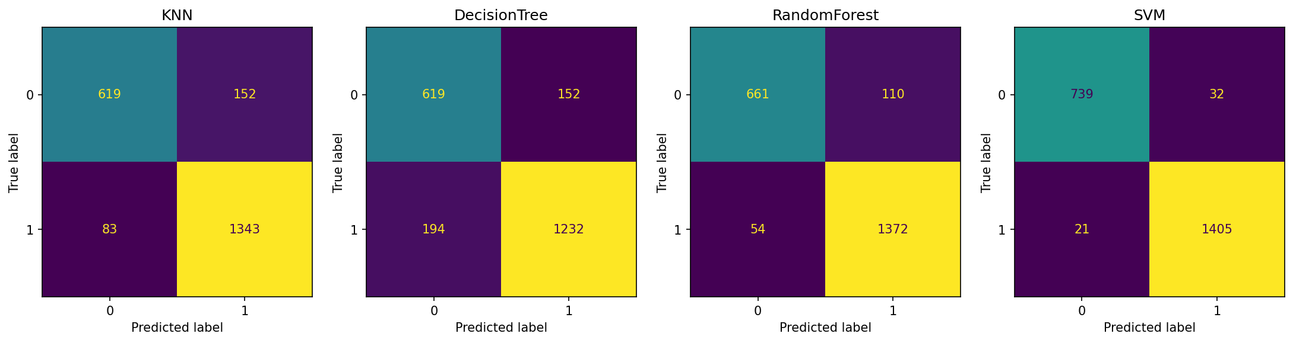
Stroke Model Confusion Matrices

Slide 7
Stroke Risk Interpretability
• Random Forest feature importance identifies age as the dominant predictor
• Age accounts for approximately 49.8 percent of total importance
• Remaining symptom indicators contribute between 3.3 and 3.4 percent each
• SHAP analysis independently confirms age as the leading predictor
• Two independent interpretability methods converge on the same conclusion

Slide 8
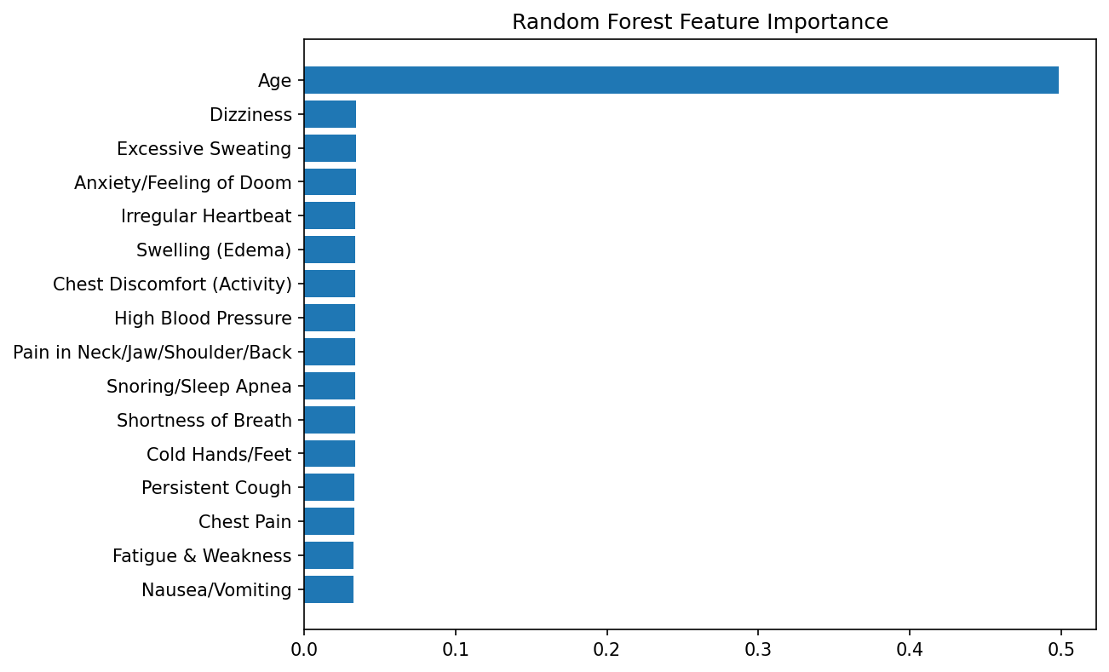
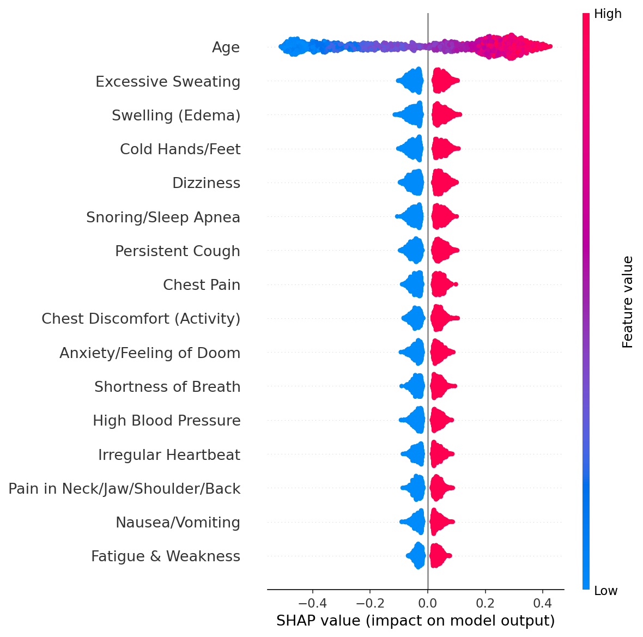
Random Forest Importance and SHAP Summary

Slide 9
Drug Review Sentiment Results
• Two classifiers compared Multinomial Naive Bayes and Logistic Regression
• Logistic Regression outperformed Naive Bayes on every metric
• Accuracy 78.9 percent
• Macro F1 score 0.528
• Cohen's Kappa 0.442
• Accuracy alone overstates performance given class imbalance

Slide 10
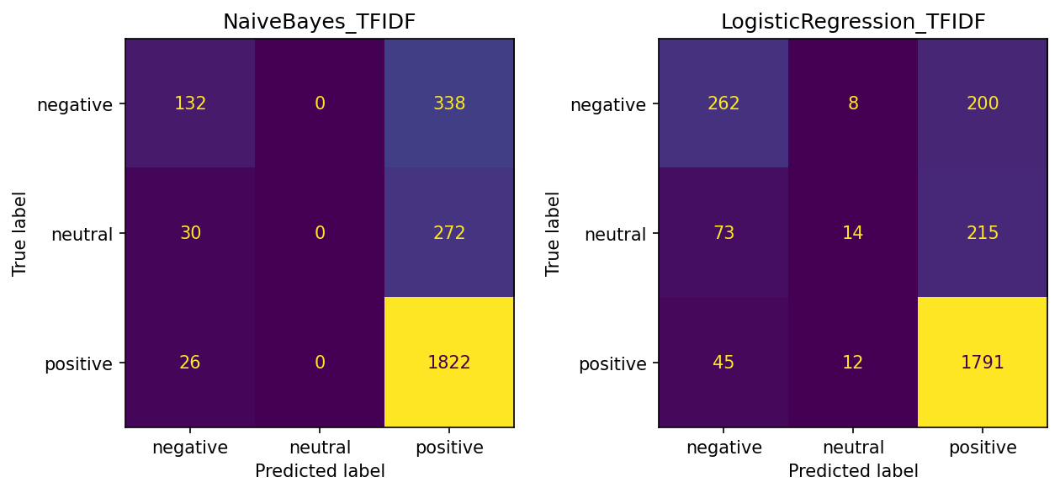
Sentiment Model Confusion Matrices

Slide 11
Sentiment Interpretability
• Logistic Regression coefficients highlight weight related terms as strongest positive drivers
• Top terms include lbs pounds great love and have lost
• Smoking cessation terms also appear among strong positive drivers
• SHAP linear explainer independently confirms the same leading terms
• Weight management and smoking cessation success dominate positive sentiment

Slide 12
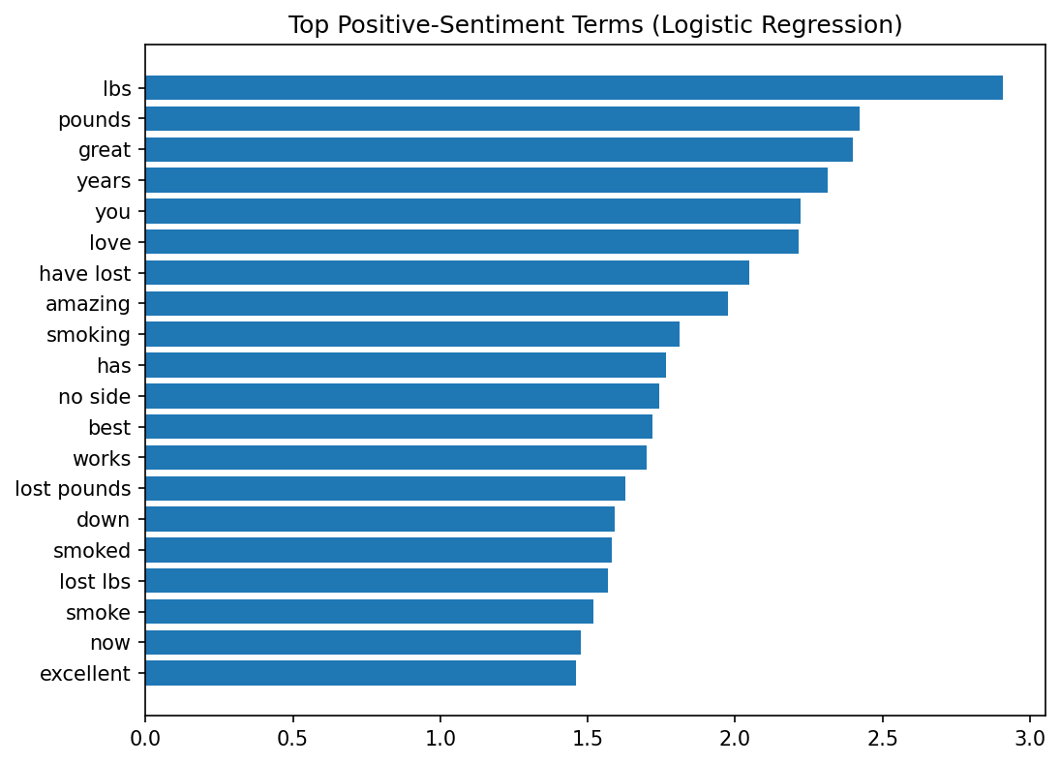
Top Positive Sentiment Terms

Slide 13
Sample Level Prediction Demonstration
• Best model in each task applied to a random sample of held out test records
• Support Vector Machine used for stroke risk demonstration
• Logistic Regression used for sentiment demonstration
• Predicted labels compared directly against actual labels for individual cases
• Provides a transparent case by case illustration beyond aggregate metrics

Slide 14
Conclusion
• Structured symptom data supports highly accurate and stable stroke risk classification
• Free text medication reviews present a harder but still tractable sentiment task
• Age is the dominant driver of stroke risk prediction
• Weight and smoking related language dominates positive sentiment in cardiovascular reviews
• Interpretability methods consistently converge across both data types

