Slide 1

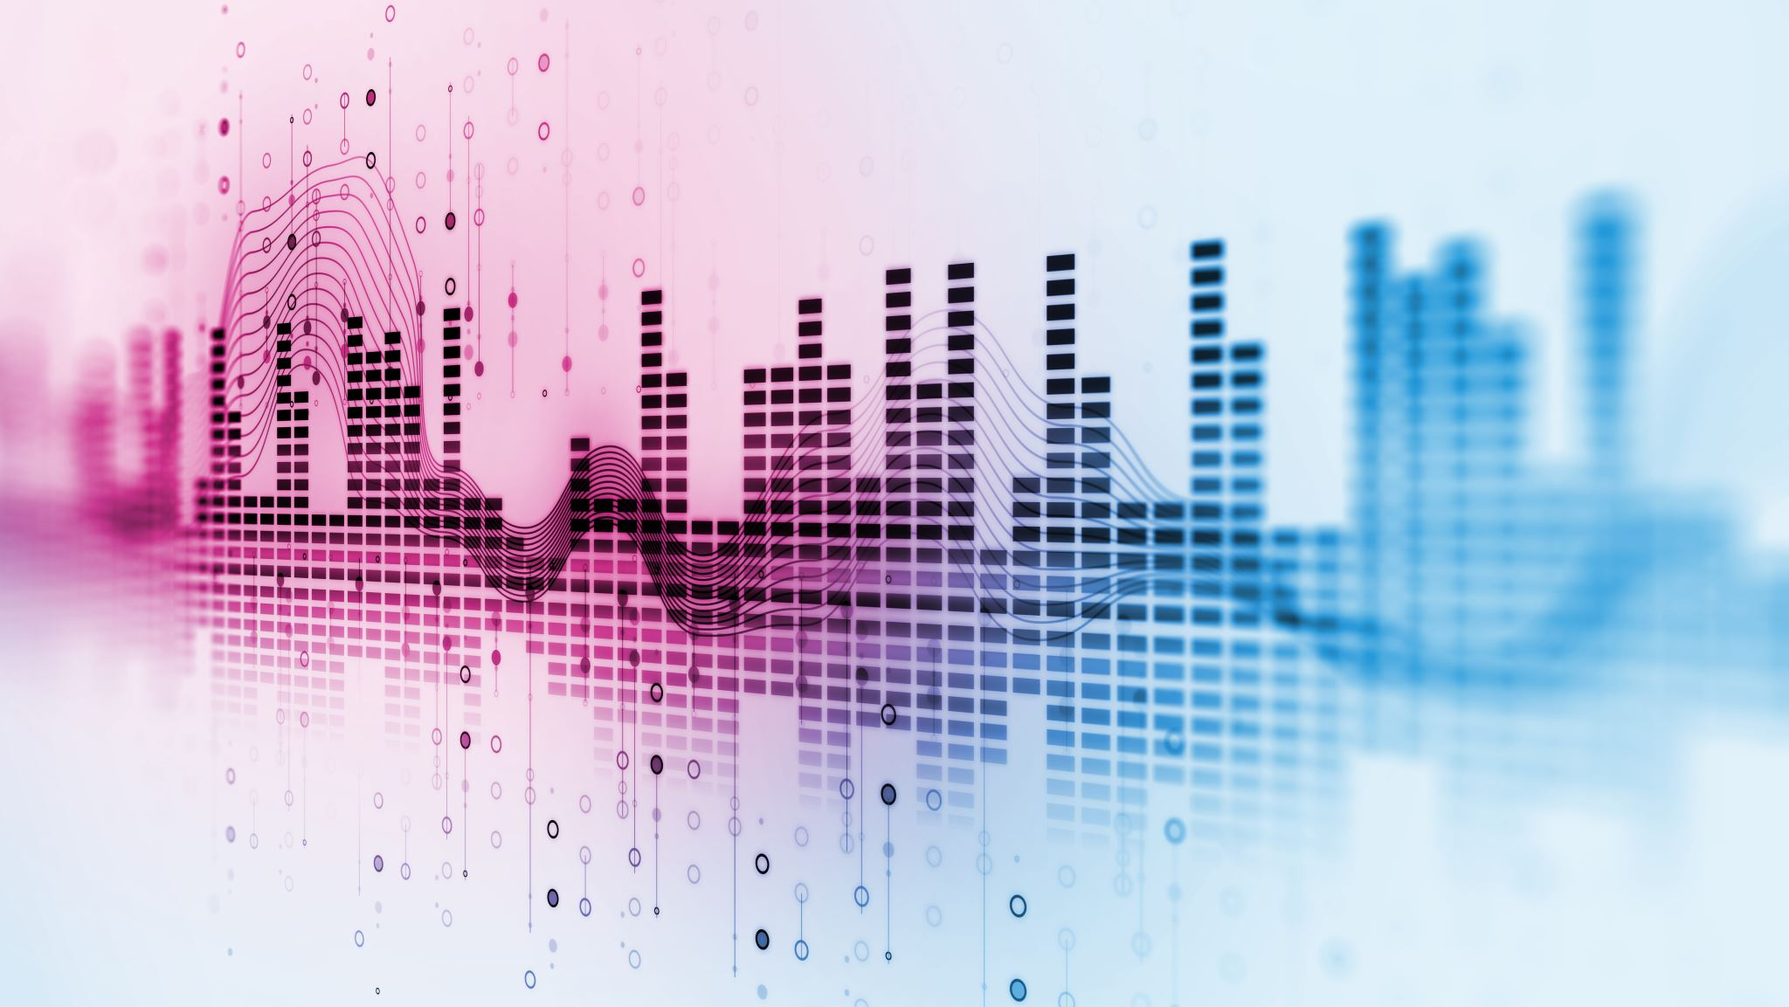
Audio Classification using Deep Learning
Rakesh Kantharaju
Siva Ram
Sahel Patel

Slide 2
Problem Overview
Automatic speech recognition systems play a crucial role in enhancing accessibility, benefiting individuals with visual impairments or those who prefer voice-based interactions.
This project aims to improve human-computer interaction by enabling machines to understand and respond to spoken commands or inputs.
The objective of our deep learning project is to develop a robust system for automatic speech recognition (ASR) that accurately identifies spoken numbers from 0 to 9. The system takes audio input, processes it into a Mel spectrogram, converts it into a NumPy array, and employs a deep learning model to predict the spoken digit.

Slide 3
Dataset Collection & Preprocessing
Audio Collection
Audio conversion to wave form using librosa
Wave form to Spectrogram conversion
Spectrogram to Mel Spectrogram generation
Mel Spectrogram to NumPy array conversion

Slide 4
Audio collection
Engaged students in the data collection process by inviting them to speak numbers from 0 to 9.
Ensured diversity in the dataset by encouraging participants with varying accents, speaking styles, and backgrounds.

Slide 5
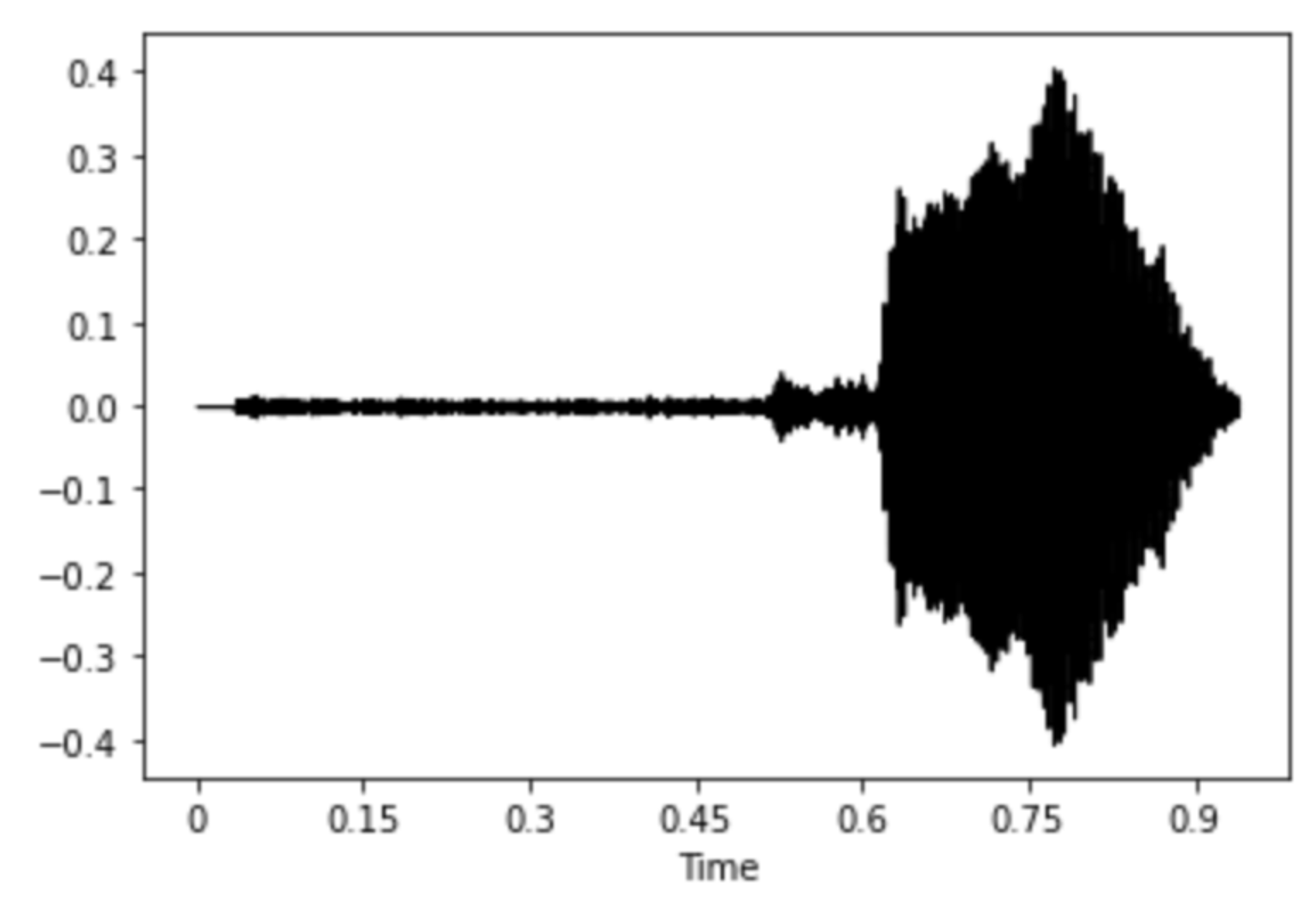
Audio Conversion to waveform using librosa
Librosa is a Python library for analyzing and processing audio signals. It provides various functions for audio processing, including loading audio files, extracting features, and transforming audio data.
The raw audio data in an audio file is represented as a waveform. A waveform is essentially a time-series signal where amplitude values are sampled at regular intervals.

Slide 6
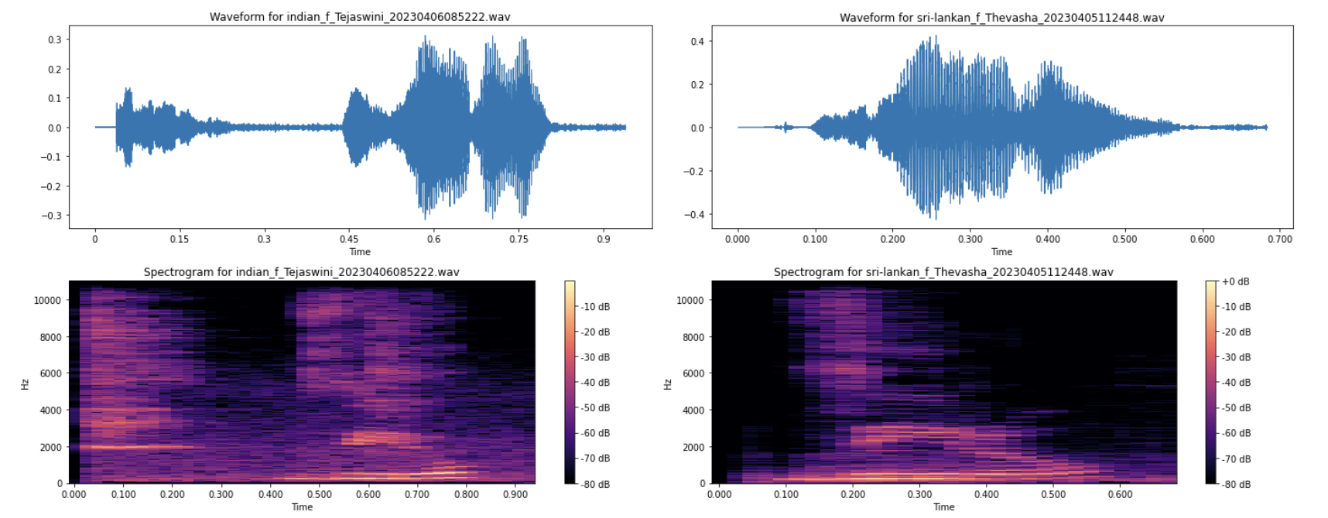
Spectrogram generation
The spectrogram is a visual representation of the frequency content of an audio signal over time.
Librosa's librosa.stft computes the Short-Time Fourier Transform (STFT), breaking the audio signal into small overlapping frames and applying the Fourier Transform to each frame.

Slide 7
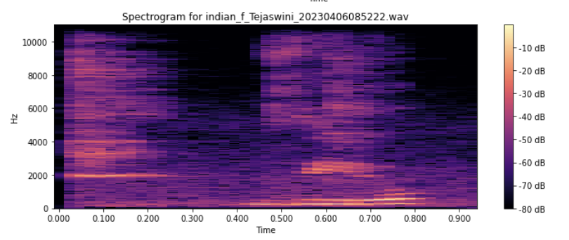
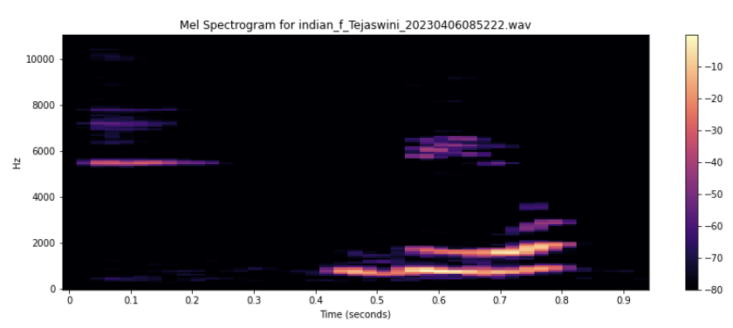
Mel Spectrogram generation
Derived mel spectrograms from the spectrograms, emphasizing perceptually relevant frequency bands which is a transformation of the spectrogram that is more aligned with human perception of sound.
The mel spectrogram is obtained by applying a mel filter bank to the spectrogram. The mel scale is a perceptual scale of pitches that approximates the human ear's sensitivity to different frequencies.

Slide 8
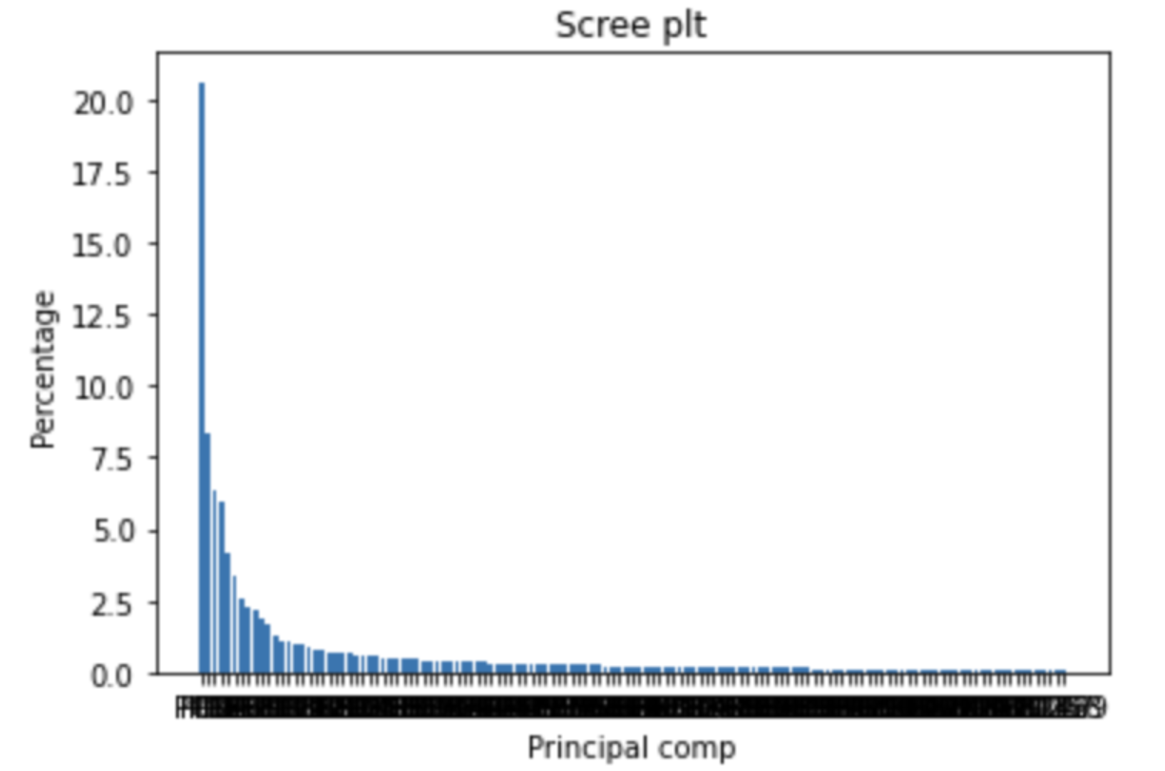
NumPy array conversion
Converted mel spectrograms into NumPy arrays, which is a 2D matrix, to a NumPy array for further processing or analysis. This NumPy array (mel_spectrogram_array) can then be used for our modelling which represents the audio signal

Slide 9
Data Labelling

Slide 10
Methadology

Slide 11
Training & Testing data

Slide 12
Results Interpretability

Slide 13
Conclusion

