Slide 1
COL864 paper presentation: Lunar Terrain Relative Navigation Using a Convolutional Neural
Network for Visual Crater Detection
Shreyans Nagori- 2018CS10390
Aayush Agarwal - 2018CS10322

Slide 2
Problem Statement
Previous lunar missions have relied mostly on inertial navigation methods that time-integrate measurements from an inertial measurement unit (IMU) to estimate spacecraft position and velocity. Past lunar landing errors have been as high because inertial navigation systems drift and accumulate error over time. However, many of the locations of interest for future lunar landing missions are surrounded by or are close to hazardous terrain, motivating the requirement for increased estimation precision throughout the mission. One method to reduce estimation error is terrain relative navigation (TRN). Image based crater detectors are highly sensitive to lighting conditions, noise, camera parameters, etc. Explores the inclusion of LunaNet’s (neural network) measurements in a navigation system

Slide 3
Baseline used by paper:
The baseline used by this paper is that of L Singh and S Kim’s Feature tracking driven EKF.
Due to its usage of trinary thresholding and edge detection it is called trinary edge detector by the author. Basically this paper uses standard image processing techniques to detect craters.
The paper explores how Lunanet, a CNN based crater detector leads to an improved position and velocity estimate for EKF.

Slide 4
Technical Approach
The task done by the robot can be split into 3 main parts:
Crater Detection: Done with the help of a UNet based architecture.
Crater Identification: Matching done on basis of position and size along with RANSAC to avoid outliers.
Extended Kalman Filter: Used to incorporate the measurements of distance with current belief in according states.

Slide 5
Crater Detection
Done with a UNet like structure called LunaNet which does semantic segmentation on elevation imagery. Unet architectures have been used for semantic segmentation (detection/localisation of objects in an image).
Lunanet’s CNN is initially warmed up with the weights of Deepmoon, and trained for 10 iterations on 800 Lunar Reconnaissance Orbiter Camera (LROC) images. Deepmoon’s weights was already trained on many lunar elevation images so is a good warm start.
Lunanet’s CNN outputs bright pixels around predicted crater’s rims. Thresholding and eroding is done along with fitting to ellipse. This makes it robust to noise.

Slide 6
B) Crater Identification
We use 2 datasets, craters of diameter 5-20 km and craters of diameter > 20 km. Estimated latitude and longitude of the image are used to discard all craters not within expected field of view.
Remaining database craters are transformed into image coordinates as per expected positions. Then craters identified are paired up using a least mean squares fit taking into account position and diameter.
RANSAC is used to safeguard against false matches, in order to ensure that false outlier pairs are rejected.

Slide 7
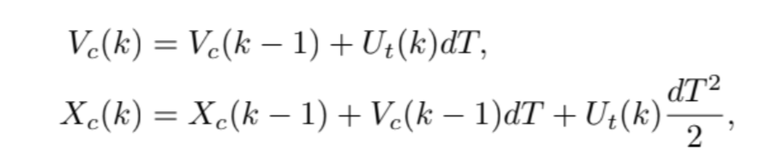
C) Extended Kalman Filter
We denote a state vector as:
X = [ V_{c} X_{c} X_{f1} …… X_{fn} ]
Where V_{c} is velocity of camera in lunar coordinates, X_{c} is coordinates of camera in lunar coordinates and X_{fi} is the position of ith feature in lunar coordinates.
Following are the equations of motion for camera. Note that dT is time step.

Slide 8


C) Extended Kalman Filter (Continued)
After the craters have been successfully matched to the database, we use their latitudes and longitudes as features in the state space. When the same craters are detected in subsequent frames, we use following normalisation to track them:
The residual for feature i is calculated as below, is the expected vs actual feature.

Slide 9
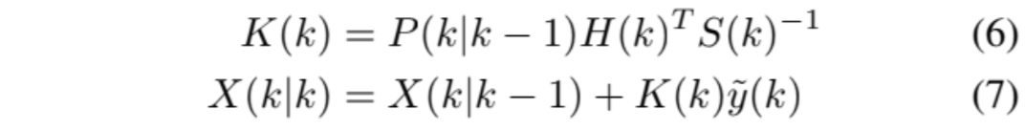
C) Extended Kalman Filter (Continued)
Actual residual is collection of camera residual and feature residual.
Above equations are used to update Kalman Filter belief after every observation is made. K is Kalman gain, H is observation matrix, S is residual covariance. We use featurer residual to update in state for already observed features.

Slide 10
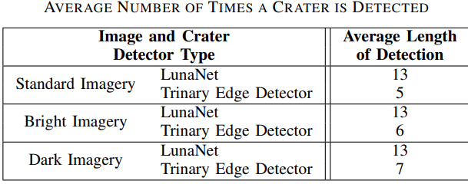
Results
length of crater detection tracks in a trajectory better
subsequent detection increase confidence in feature state estimate, which increases accuracy in vehicle state estimate
Lesser false match in crater matching

Slide 11
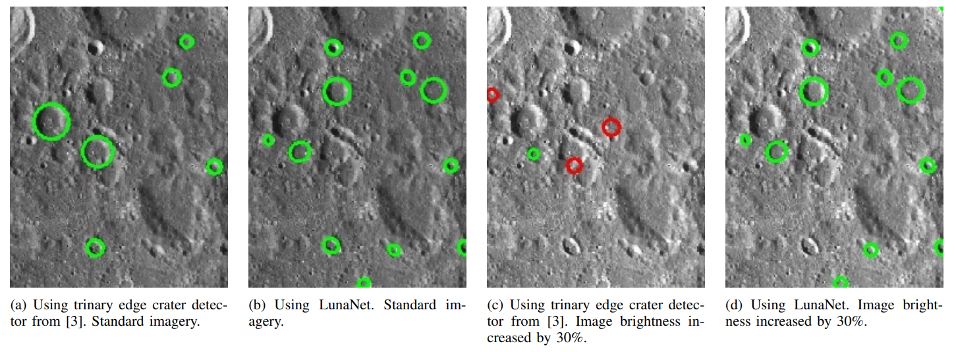
Results (cont.)
4) Better performance in brightness changes than trinary edge detector - immune to differences in time of day, exposure of the camera, or albedo properties of the local lunar surface.

Slide 12
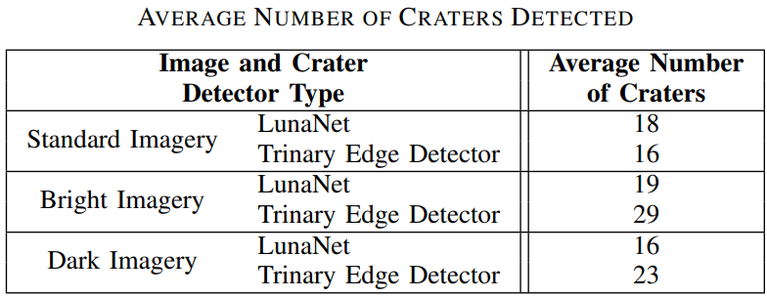
Results (cont.)
5) LunaNet outperforms the trinary edge detector in average number of craters detected.

Slide 13
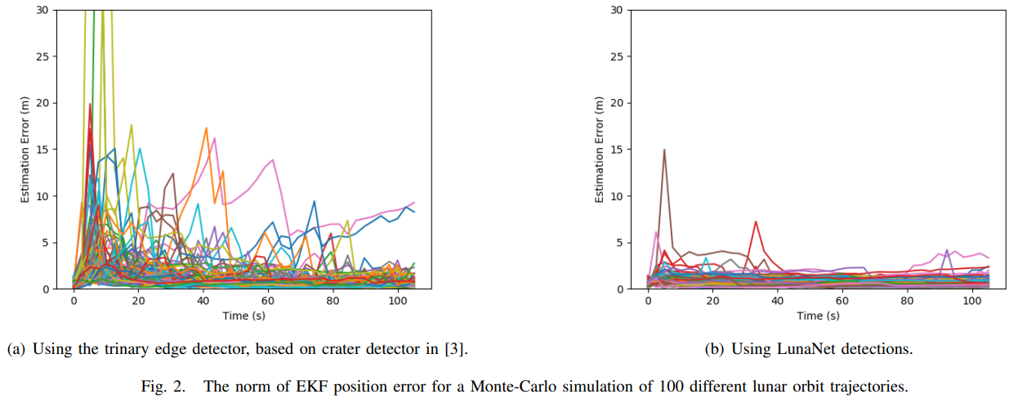
Results (cont.)
6) LunaNet results in fewer estimation error in EKF, faster convergence and fewer error spikes (Monte Carlo simulation method)

Slide 14
Others
This work is similarly being applied to underwater exploration, a particle filter is used instead of a kalman filter for doing the same.
As for how to improve upon this work, some ways are being looked into as to how to incorporate pose estimation using Spatial Transformer Networks for feature extraction.

