Slide 1
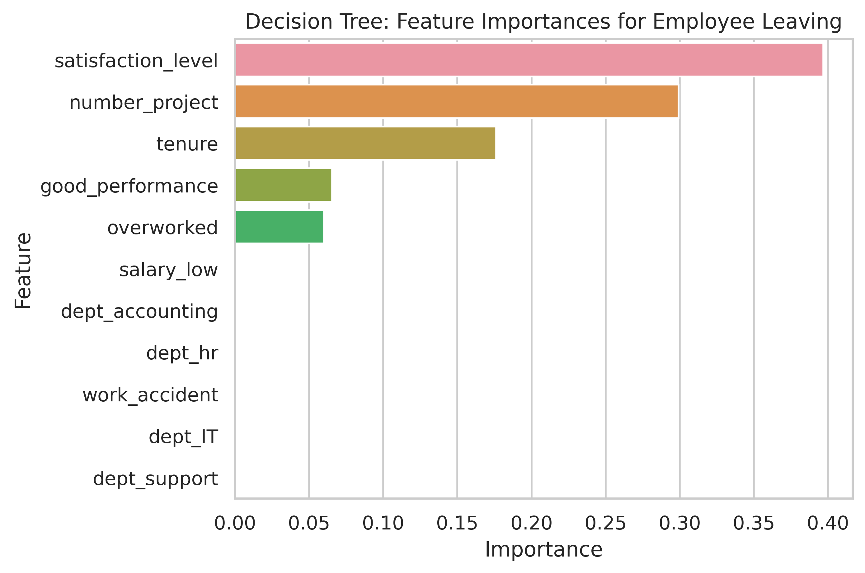
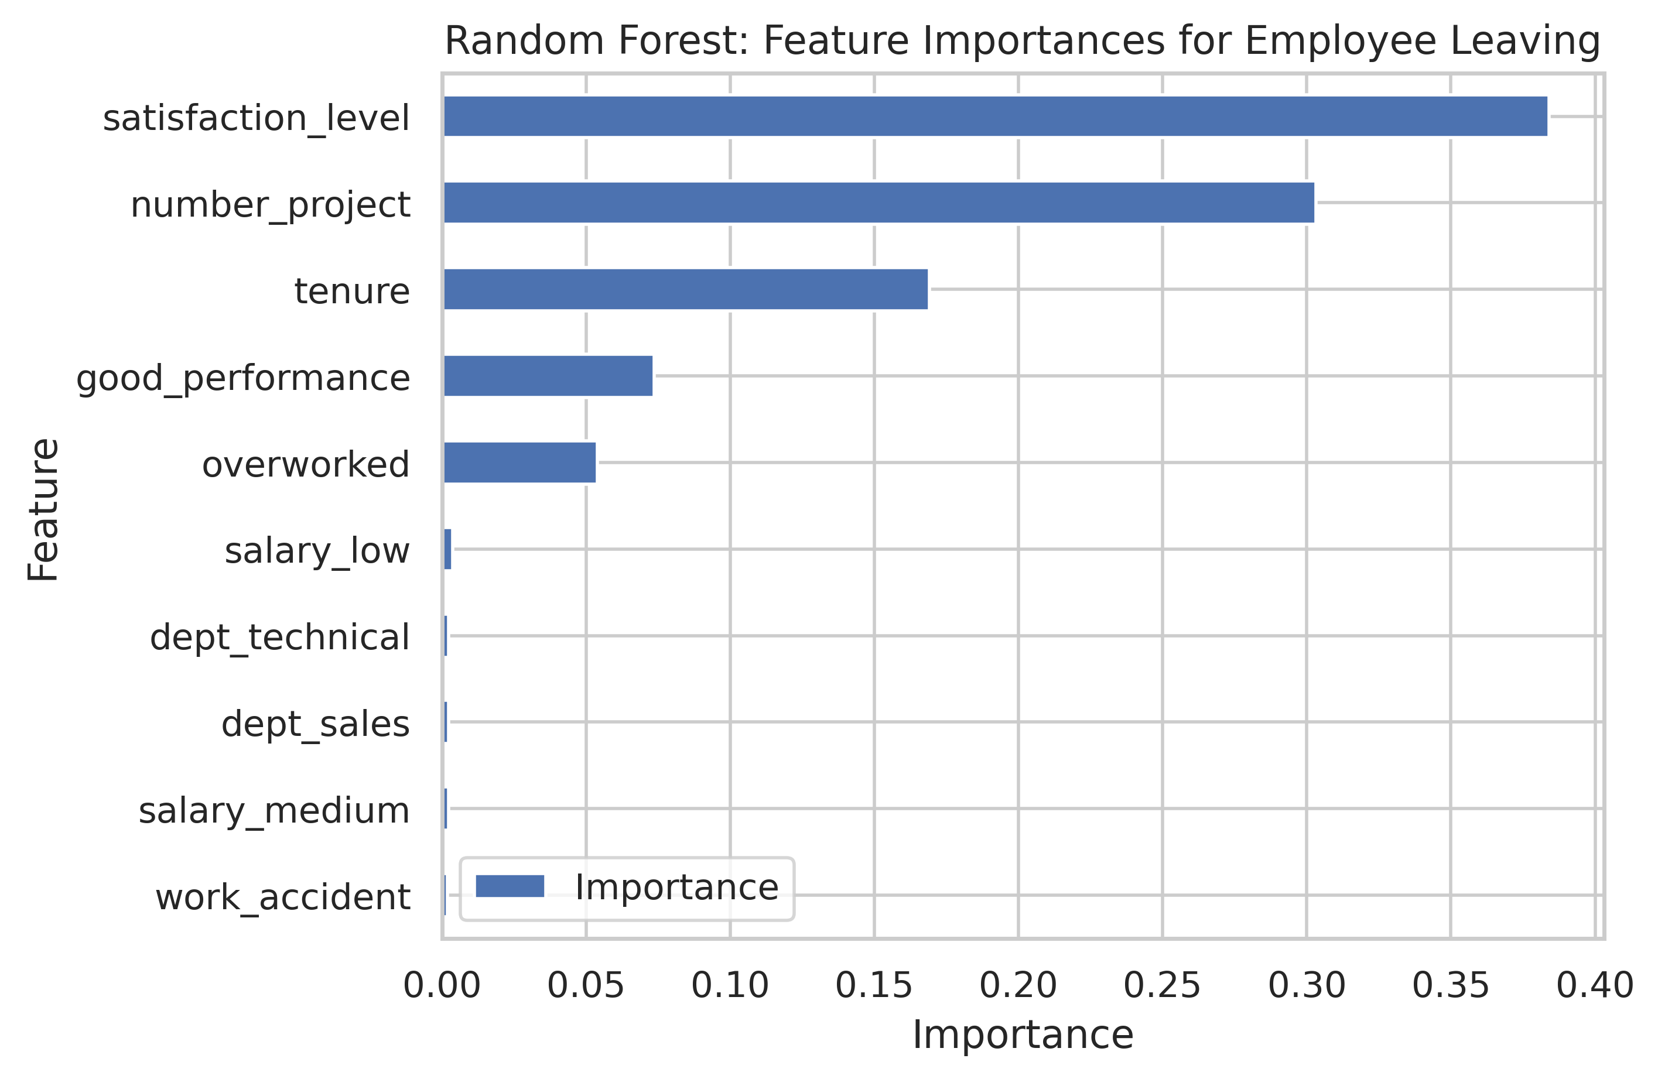
Salifort Motors
Employee Retention Project
Salifort Motors seeks to improve employee retention and answer the following question:
What’s likely to make the employee leave the company?
Since the variable we are seeking to predict is categorical, the team could build either a logistic regression or a tree-based machine learning model or a xgboost.
The model slightly outperforms the decision tree and random forestmodel.
Barplot above shows the most relevant variables: ‘satisfaction_level’, ‘number_project’, ‘tenure’, ‘good_performance’ and ‘overworked’.
This model helps predict whether an employee will leave and identify which factors are most influential. These insights can help HR make decisions to improve employee retention.
In the random forest model above, ‘satisfaction_level’, ‘number_project’, ‘tenure’, ‘good_performance’, ‘overworked’, and `salary_low` have the highest importance. These variables are most helpful in predicting the outcome variable, `left`.
Limit the number of projects that employees can work on.
Promote employees who have great evaluation results and have been for atleast four years, or conduct further investigation about why four-year tenured employees are so dissatisfied.
Give reward to employees for working longer hours who have brought significant improvements, working collaboratively executing in a project(s) or consider that employee can exchange their overtime with more paid leave of holiday or vacation.
Ensure that employee has understood the overtime policy, check and if the employee has been given information accordingly.
Consider proprtionate score on employee's evaluation towards employee who have great impact and team enabler as not due to the amount of works as aligned to point 2.
Important to have team or department as well in company-wide discussion regarding the work culture. Open consultation from HR to address together with department head or related parties for the objective of employee retention specially for the top and medium talent employees
Set a features that can elaborate satisfaction level similar to filter medium and top talent employees (good performance).

