Slide 1
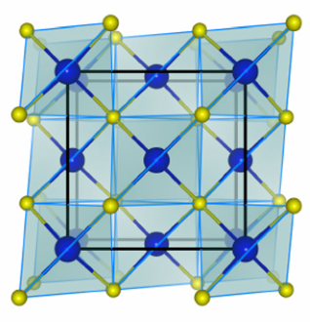
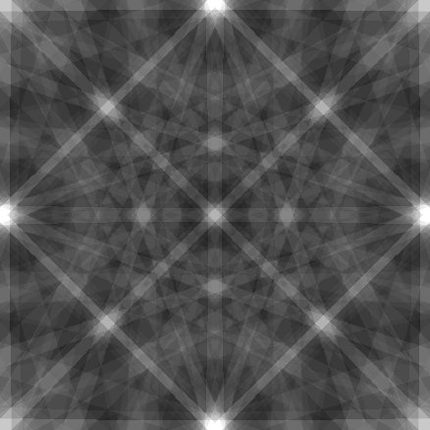
GaP: Kinematic Theory
90°
90°
2
2

Slide 2
GaP: Kinematic Theory
90°
2

Slide 3
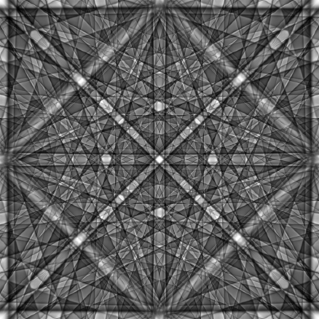
GaP: Dynamical Theory
90°
2

Slide 4
GaP: Dynamical Theory
90°
2

