Slide 1
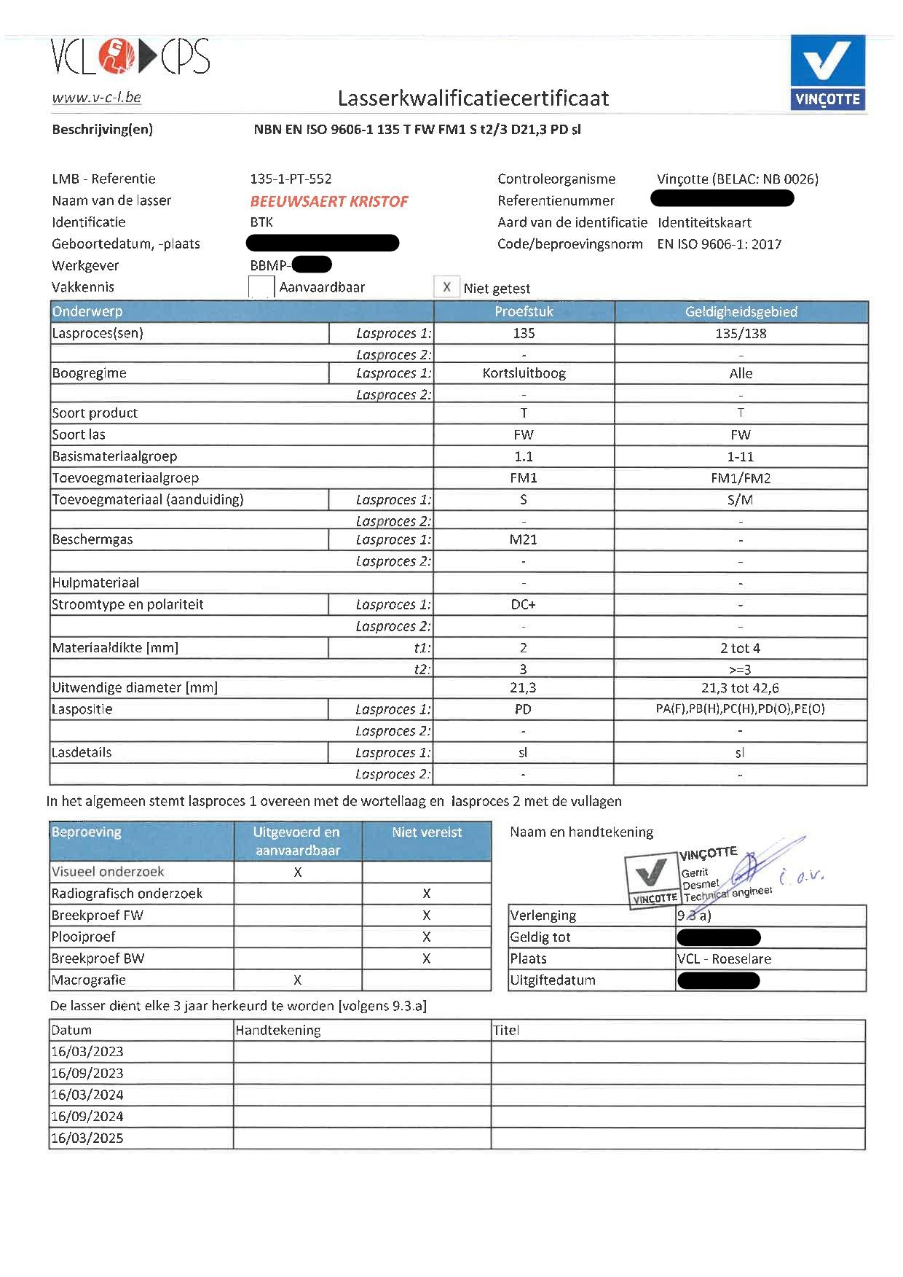
BBMP watermark
BBMP watermark

