Slide 1
A/B test
New shopping cart

Slide 2
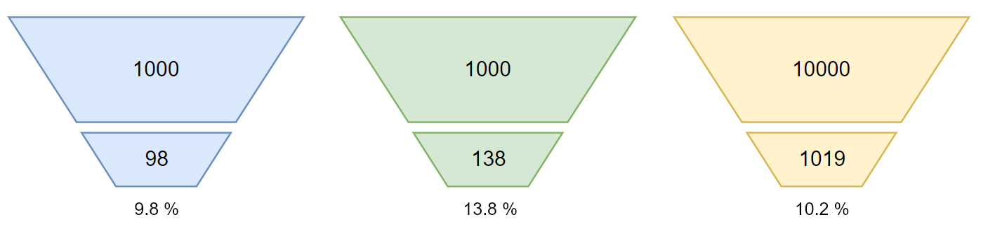
Conversion funnel
Event A
Event B
Event Before
Opened shopping cart
Purchased shopping cart
*Outliers was detected and all Order Values below or equal to zero was removed

Slide 3
Conversion difference
Event A
Event B
Event Before
Conversion Difference between Event B and Event A
+ 41.0 %
Conversion Difference between Event B and Event Before (average)
+ 35.4 %

Slide 4
Sample size
The sample size need per A/B group is 384
Number of samples for Event a: 1000 with 98 conversions
Number of samples for Event b: 1000 with 138 conversions
*Significant level = 1.96, Margin of Error = 0.05, p-value = 0.5

Slide 5
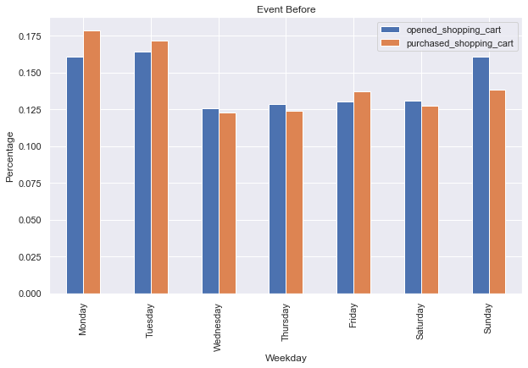
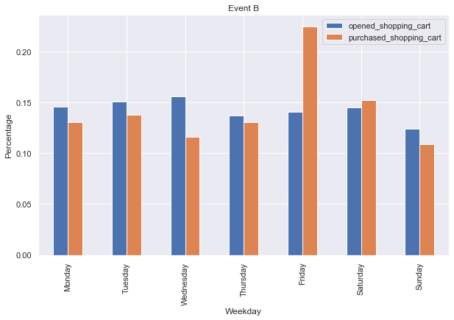
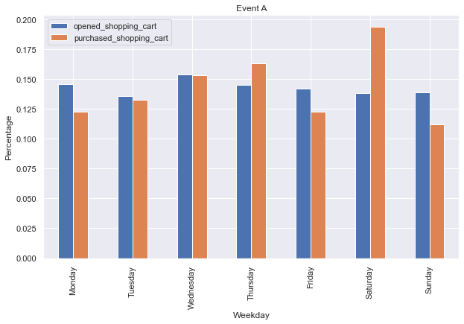
Weekday

Slide 6
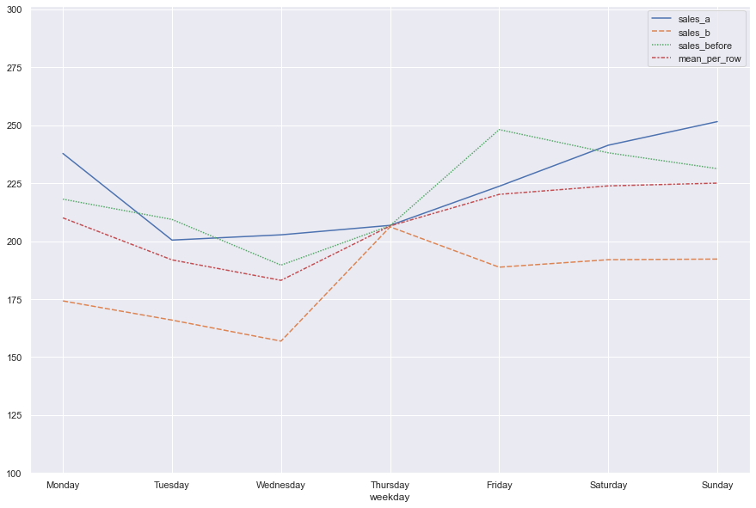
Difference in order value
Average Order value
Weekday | Event A | Event B | Event Before (AVG)
Monday | 238 | 174 | 218
Tuesday | 200 | 166 | 209
Wednesday | 203 | 157 | 190
Thursday | 207 | 206 | 207
Friday | 224 | 189 | 248
Saturday | 241 | 192 | 238
Sunday | 252 | 192 | 231
+2 %
-17 %

Slide 7
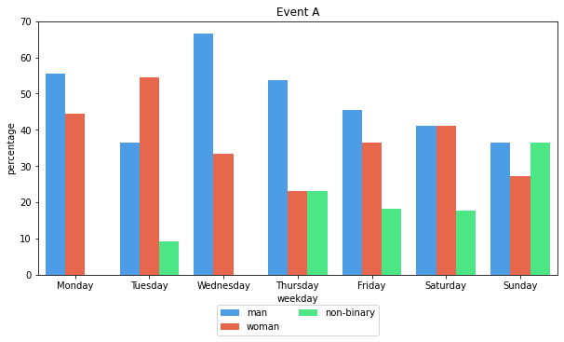
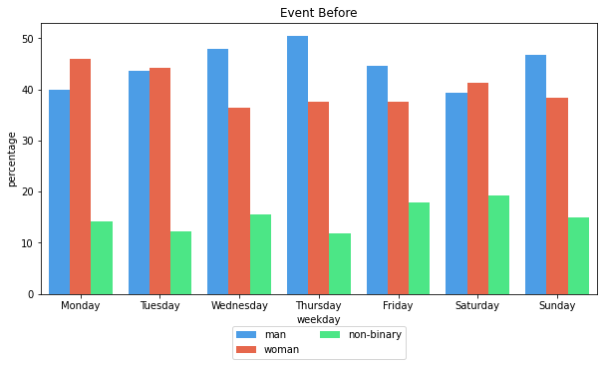
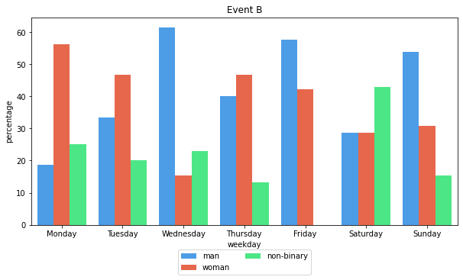
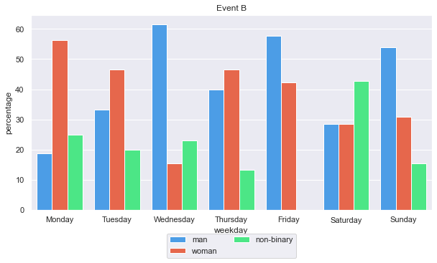
Gender purchase

Slide 8
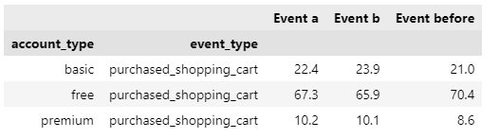
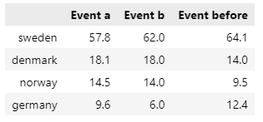
Account type and Country

